Slide 1


Micro:bit
Beyond
Basics
Beyond Basics Challenge Introduction

Slide 2
Beyond Basics Challenge
We are learning to adapt or create games for our micro:bit.
I can choose a game to create or adapt for my micro:bit.
I can create a name and logo for my game.
I can create instructions on how to use my game.
I can create a poster (or video) to advertise my game.

Slide 3
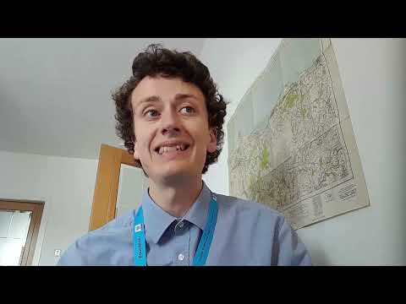
Challenge Video

Slide 4
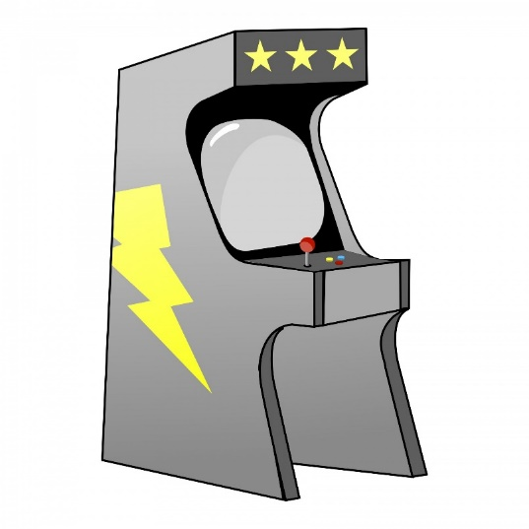
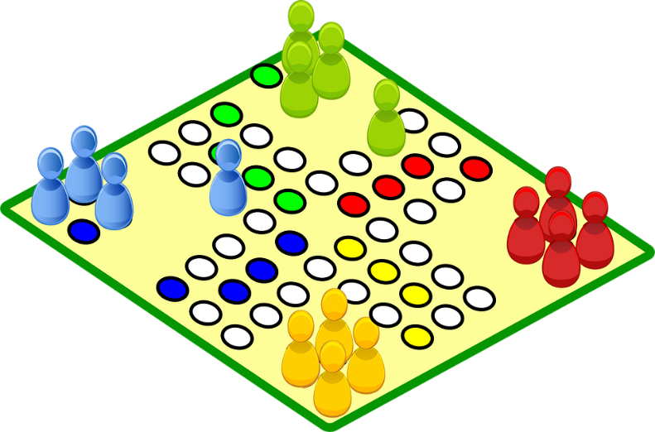
Beyond Basics
Challenge
Create or adapt a game for the micro:bit.
DEADLINE...

Slide 5

Challenge Instructions
Adapt or create a game for the micro:bit.
Create a name and logo/icon for your game.
Create instructions for how to use the game.
Create a Poster (or video) to advertise your game (think about who it is for).
Complete the worksheet to help you.
UPLOAD FORM HERE

Slide 6
Game Suggestions (to use/adapt)
Arcade Games
Snap the Dot
Flappy Bird
Space Invaders
Driving Game
Obstacles Game
Maze Runner
Simple Physical Games
Reaction Game
Rock Paper Scissors
Coin Flipper
Salute!
Micro:bit Radio Games
Multi-Dice
Mood Radio
Tele-Potato
Hot or Cold
Red Light Green Light
Voting Machine
Rock Paper Scissors Team Version
UPLOAD FORM HERE

Slide 7
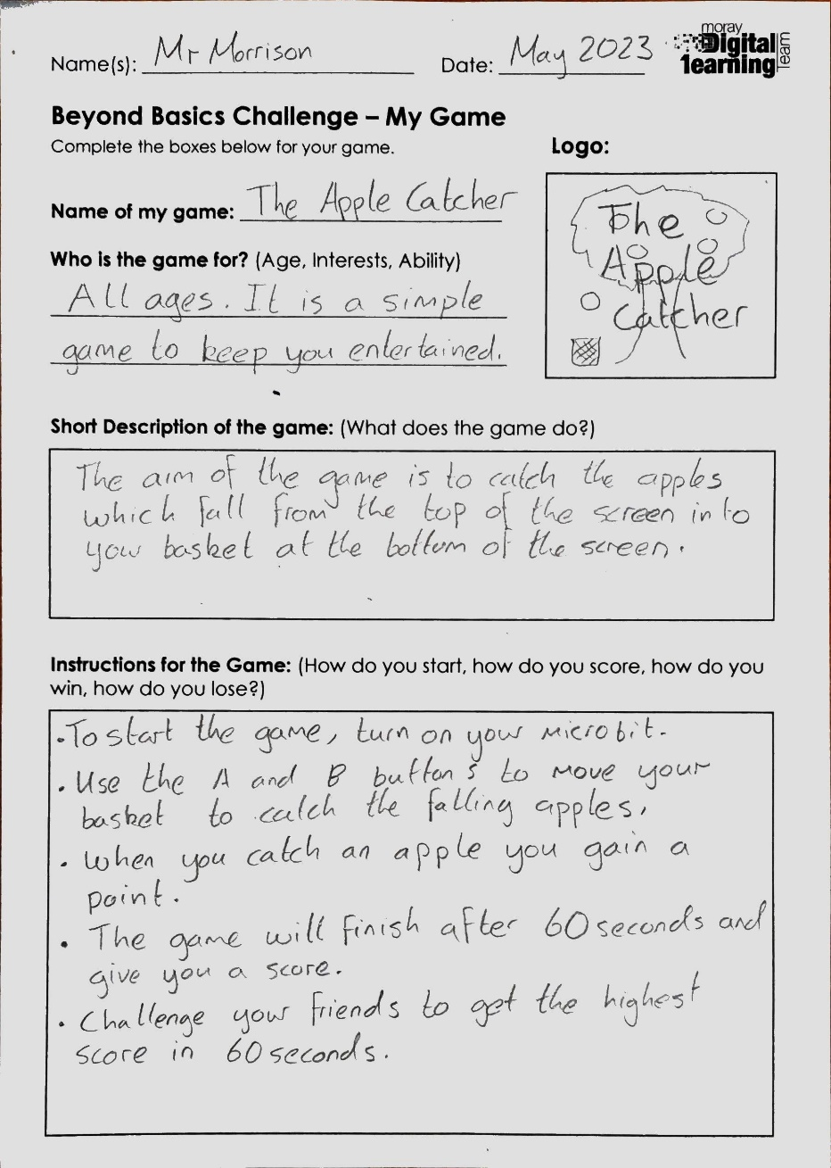
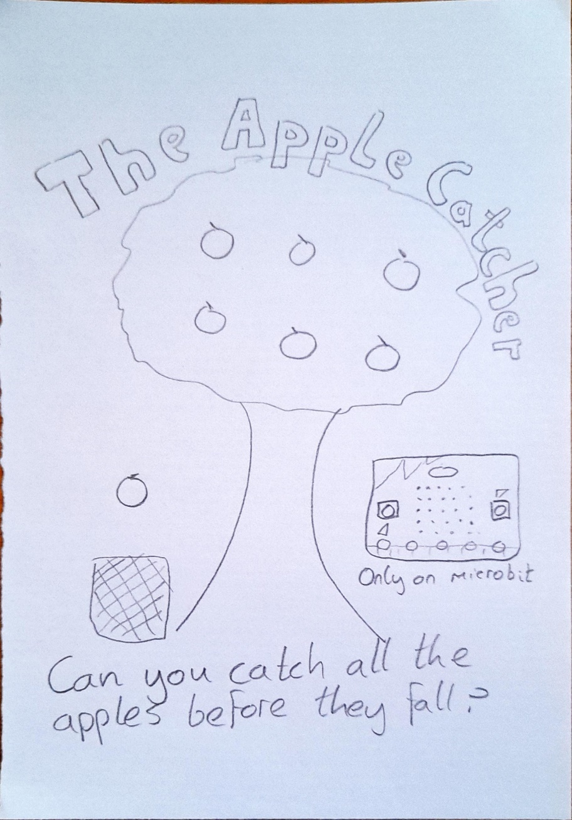
Example Worksheet and Poster
Your poster should be far more colourful and neat than mine! This is just a draft.

Slide 8
Questions?
How big a group can it be?
Any size you like groups of 2-4 work well.
2. Can I create my poster on the computer?
Yes absolutely, a single PowerPoint Slide works well for this.
3. How long should my video be?
Less than 2mins long.

