Slide 1
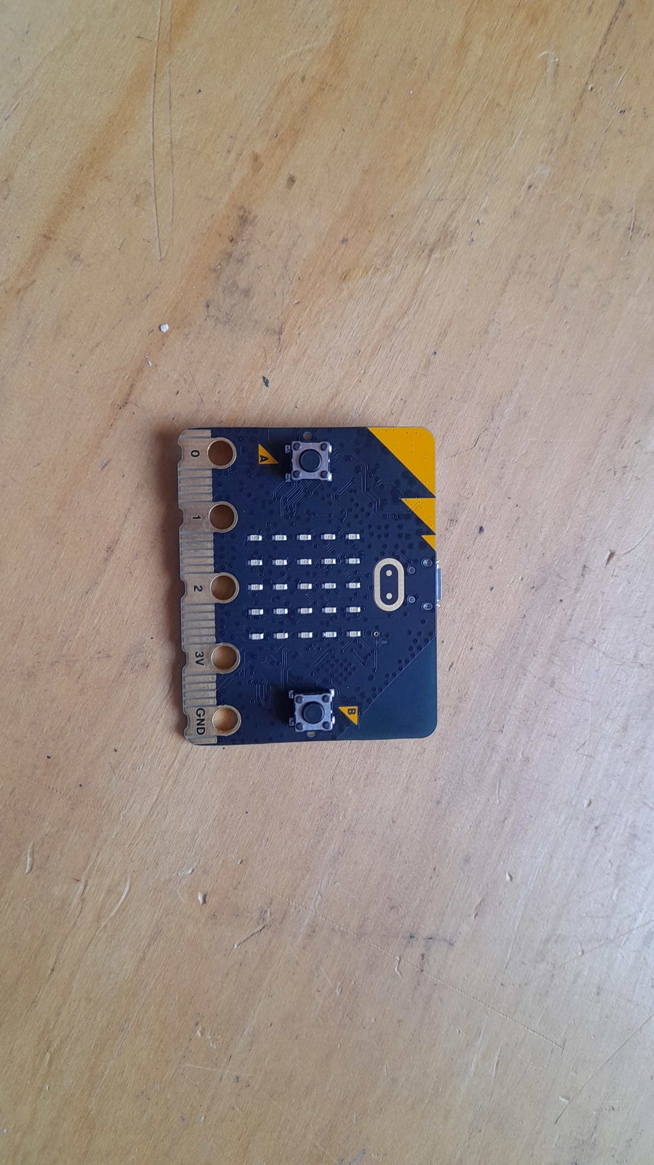

Micro:bit
Beyond
Basics
Lesson 1 – Magnetism and Logic

Slide 2
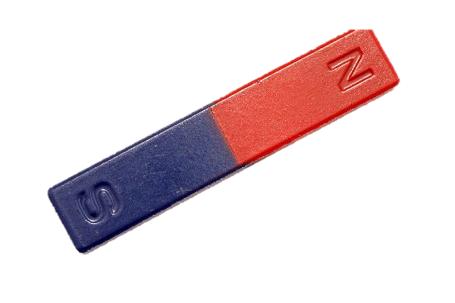
Lesson 1: Magnetism and Logic
We are learning to use the magnetometer on the micro:bit
I can explain what magnetism is.
I can measure the magnetic strength of a magnet at different distances
I can create a simple alarm using logic.

Slide 3
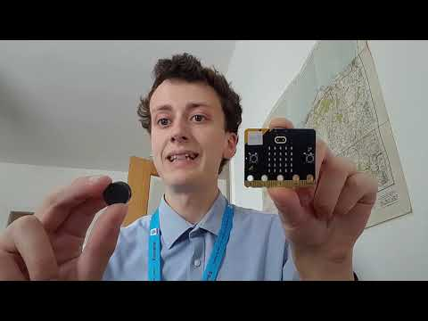
Introduction Video

Slide 4
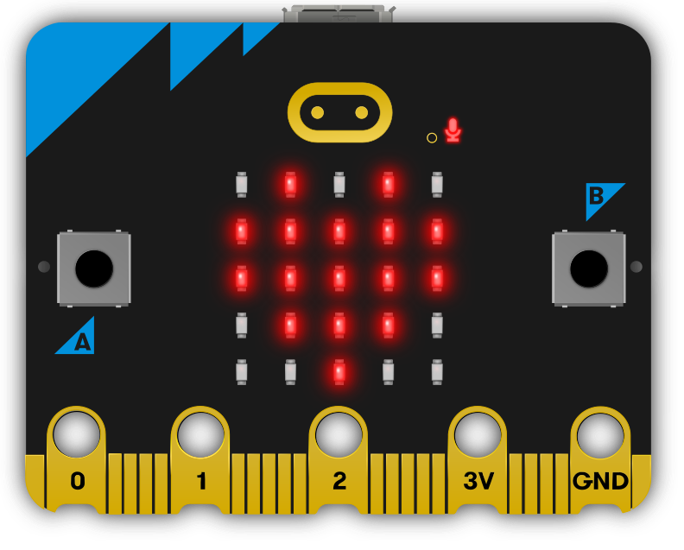
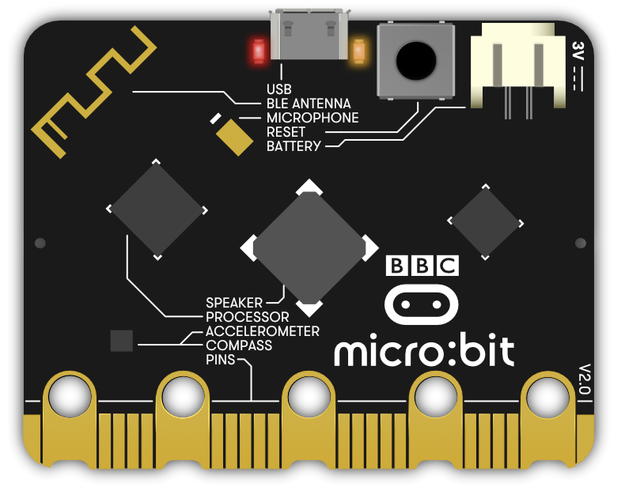
Where is the magnetometer?

Slide 5
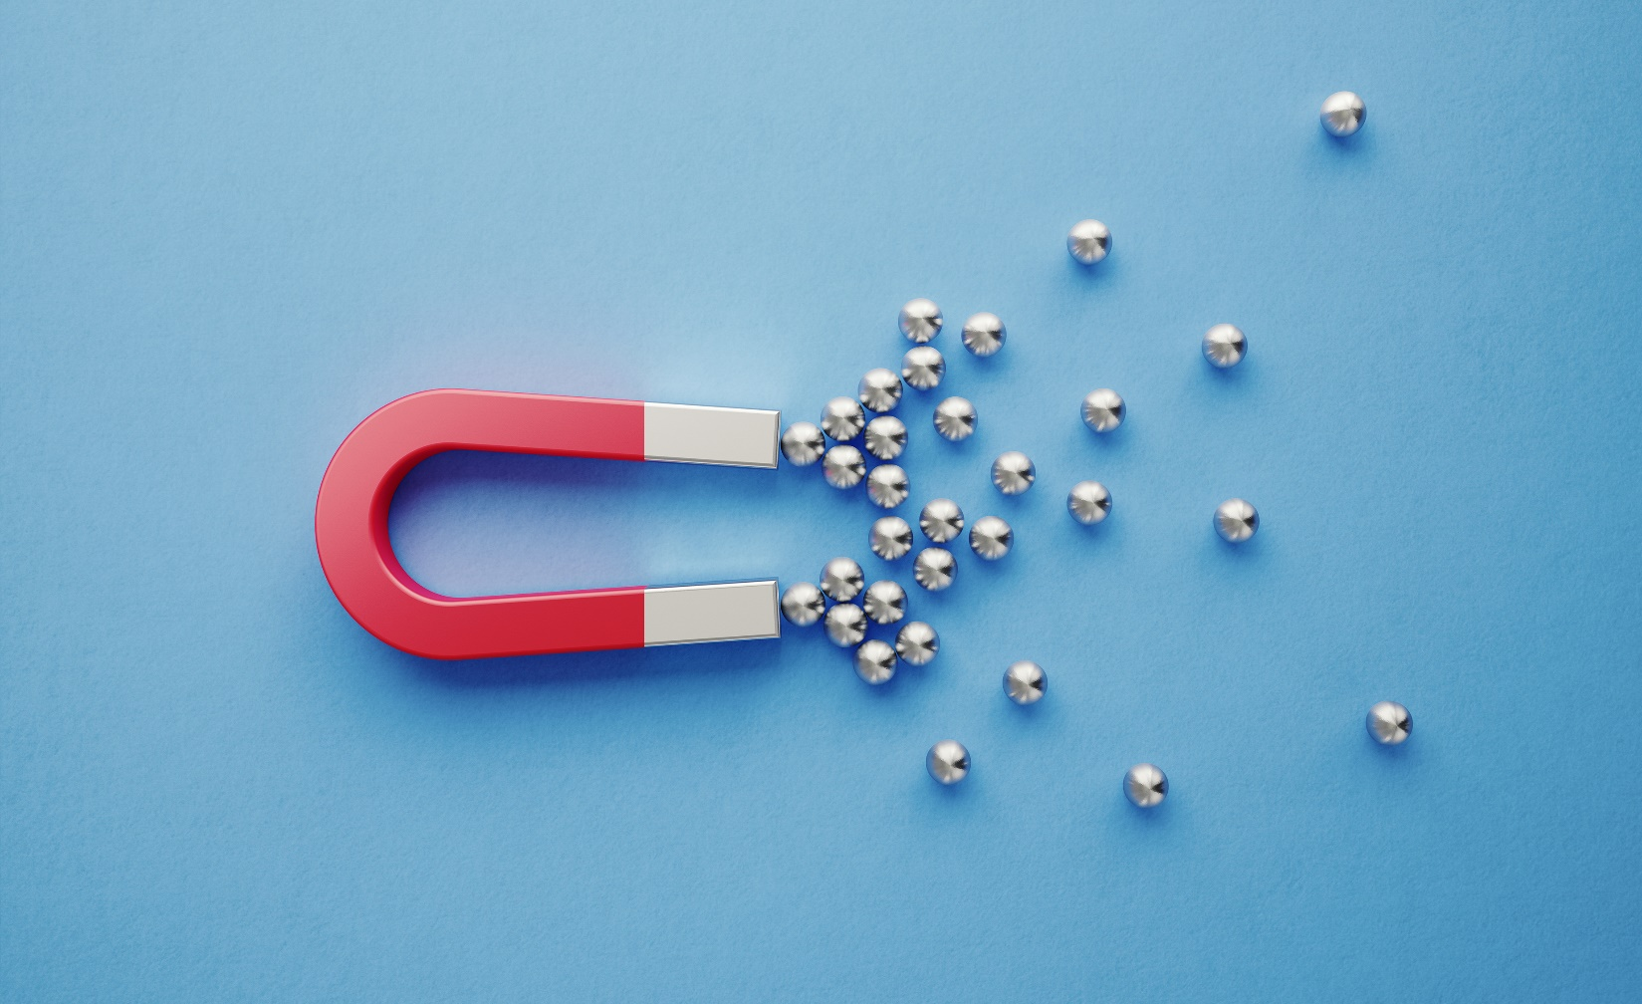
What is a magnet?
Magnets are pieces of metal, usually iron or steel, that are able to attract certain kinds of other metals.
They have a north and south pole, opposites poles attract.
Attraction S + N or N + S
Repulsion N + N or S + S

Slide 6


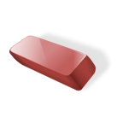

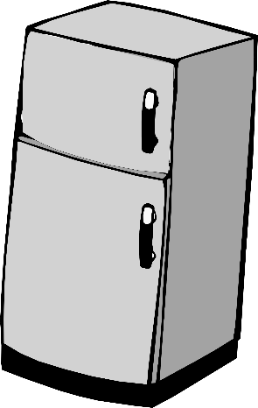


Magnetic or Not?
Magnetic
Non-magnetic

Slide 7
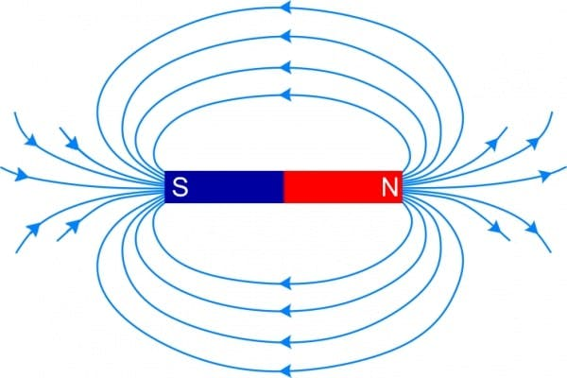
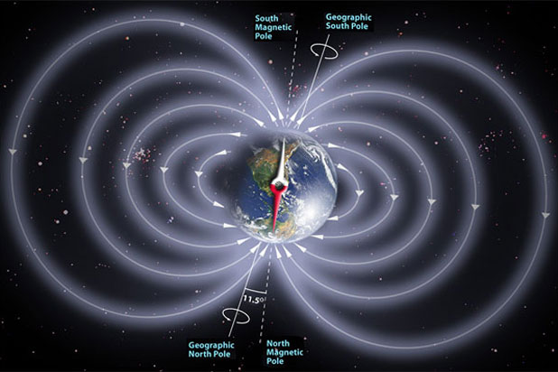
Magnetism
The force drawing objects to a magnet is called magnetism.
A magnetic field is created around a magnet, it gets weaker the further from the magnet you are.
Earth also has a magnetic field.

Slide 8
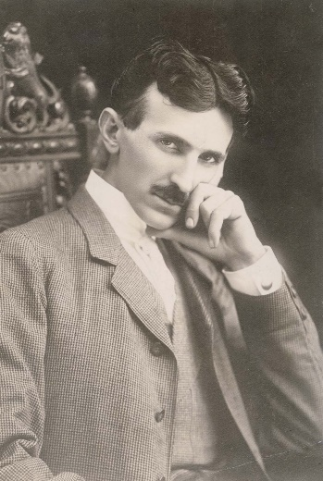
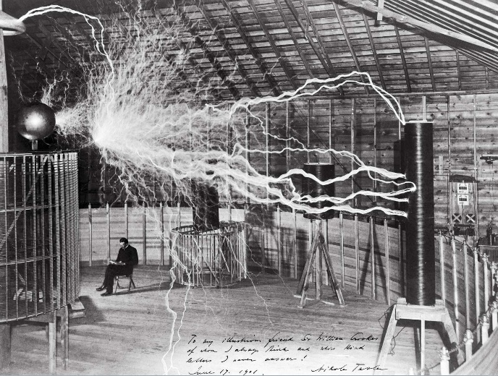

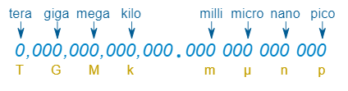
Magnetism
How strong a magnet is, (magnetic strength) is measured in Tesla (T) or (µT) in our case.
1µT = 0.000001T

Slide 9
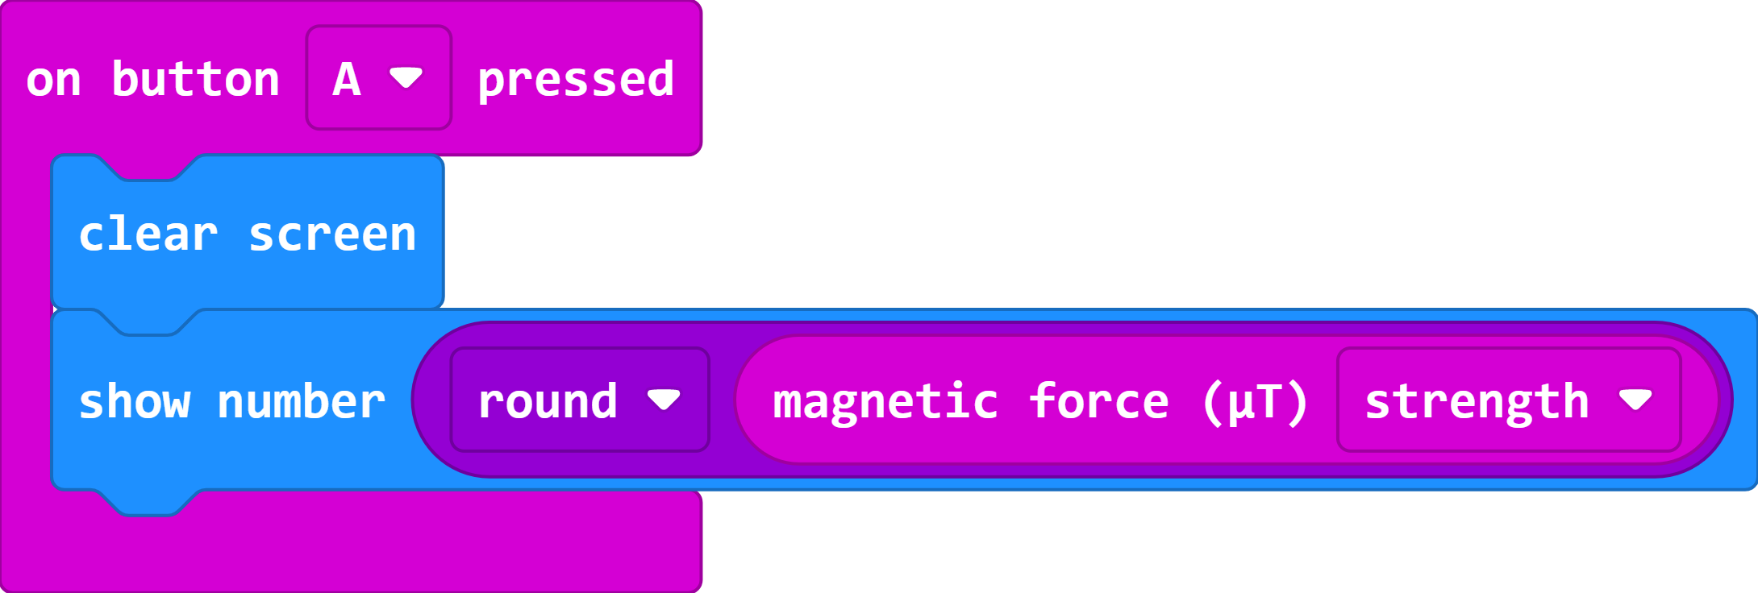


makecode.microbit.org

Slide 10
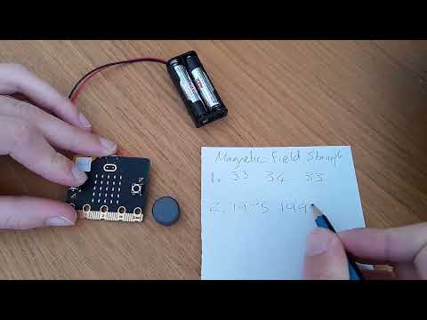
Video 2

Slide 11
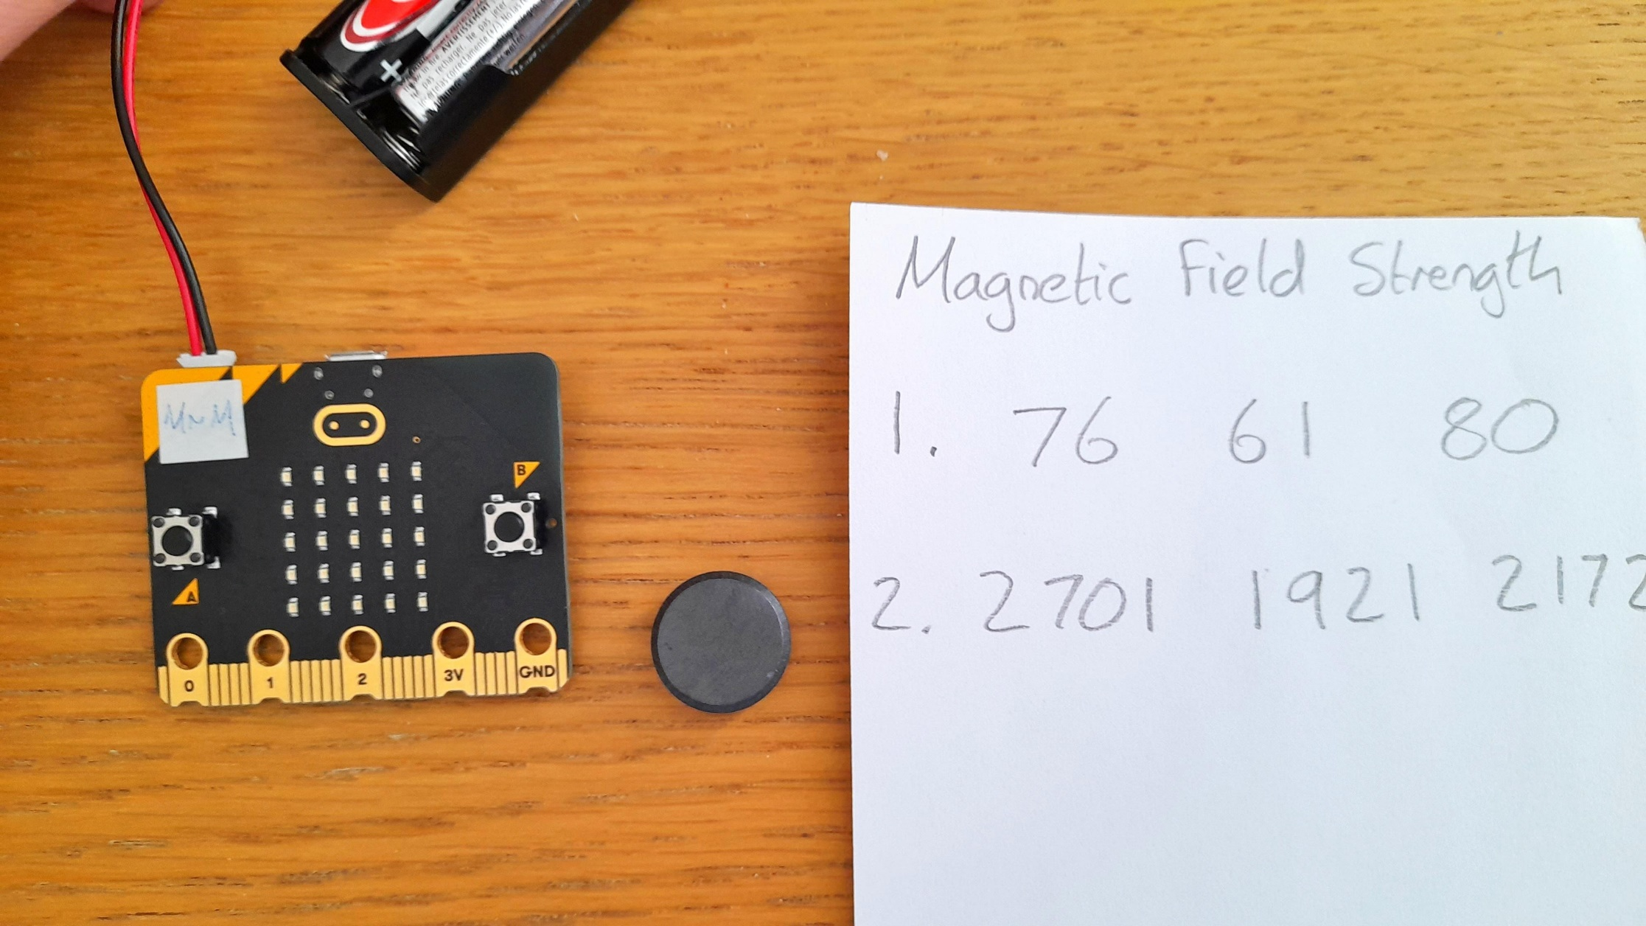
Magnetic Strength Test
Measure the Magnetic Field Strength.
When there is no magnet.
When the magnet is close.
Record three times for each.
(Extension) Investigate the magnetic field of your laptop. Is there a part that is magnetic?

Slide 12
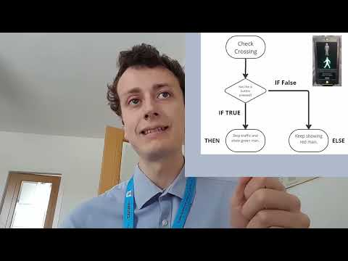
Video 3

Slide 13
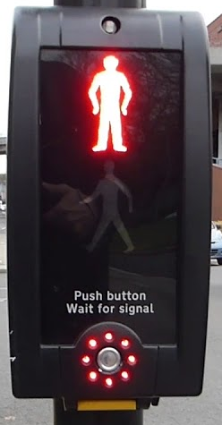
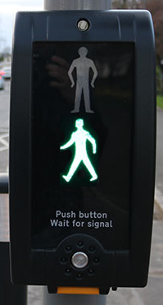
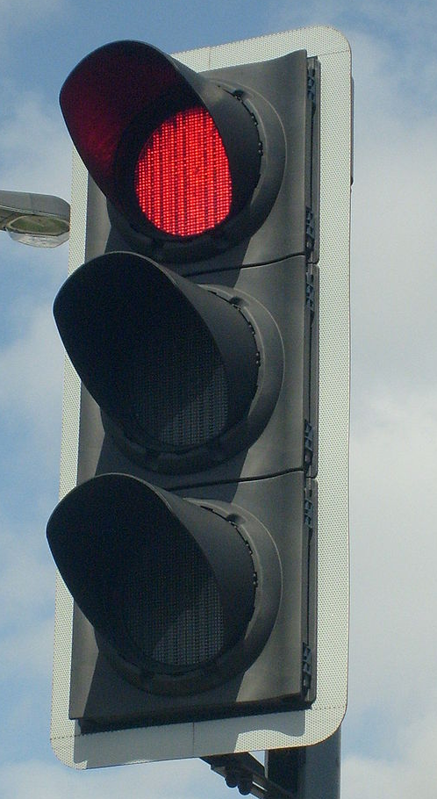
What is Logic (Selection)?
What instruction is this pedestrian crossing waiting for?
What happens when you press the button?
What happens if you don’t press the button?

Slide 14
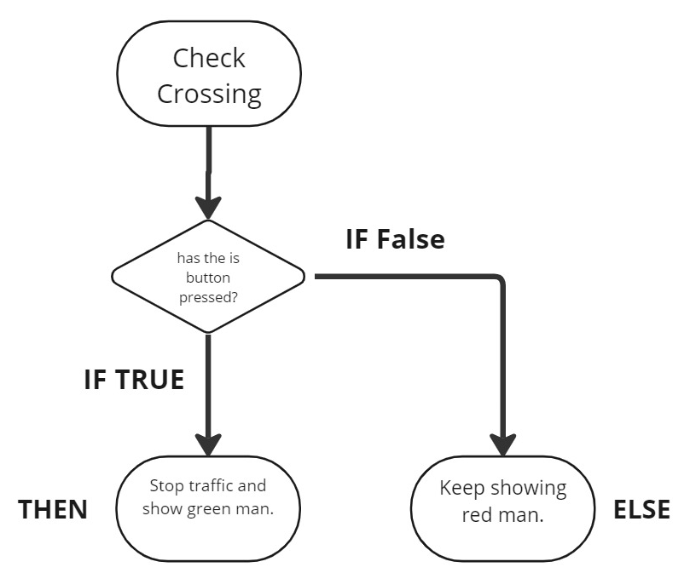
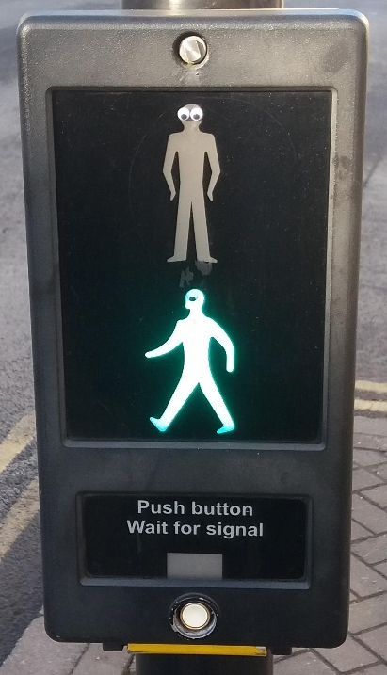
What is Logic (Selection)?
Making different things happen based on different conditions.
IF button is pressed THEN stop traffic and show green man
ELSE keep showing red man.

Slide 15
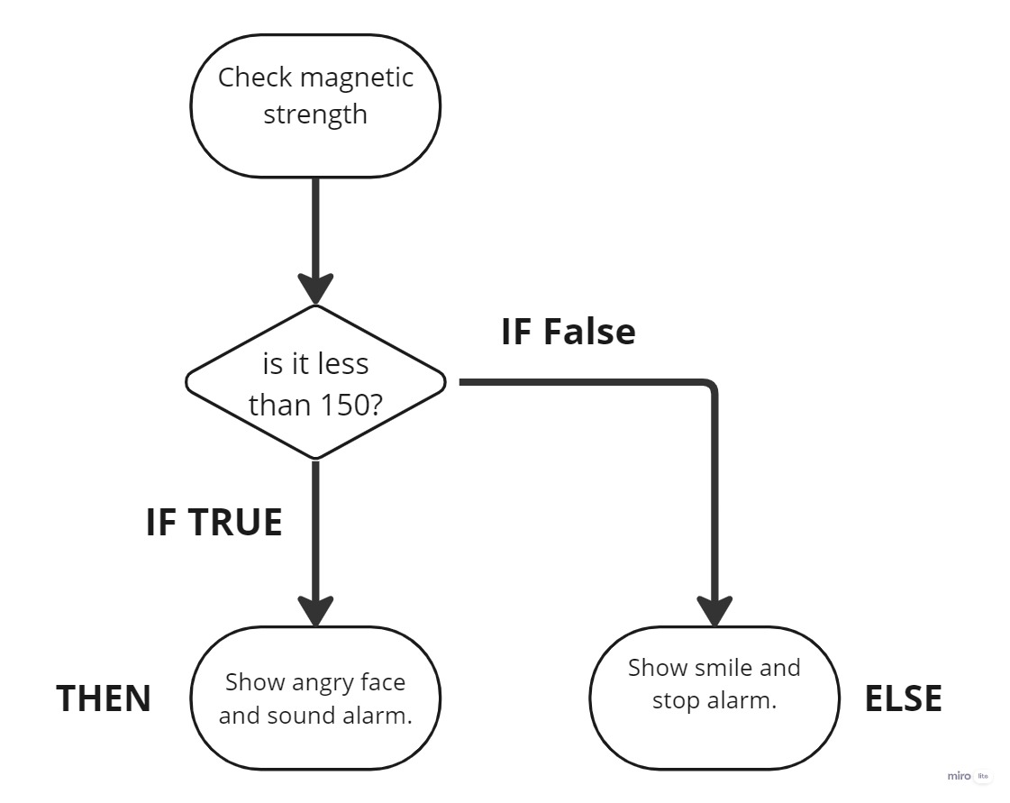
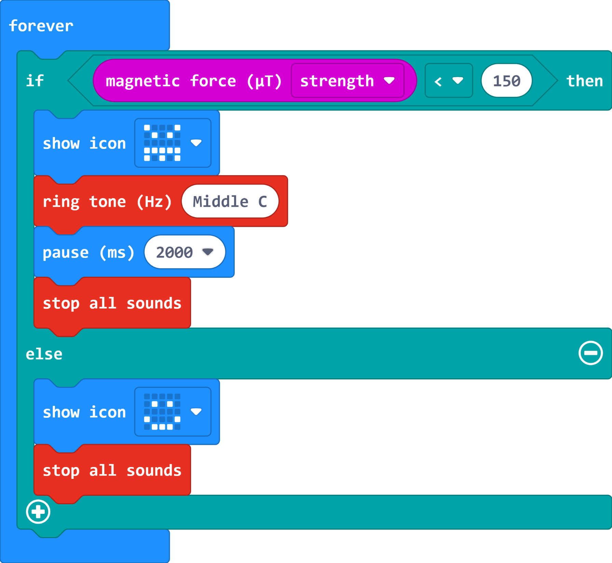
Magnet Alarm Code

Slide 16
Magnet Alarm Code
1000

Slide 17
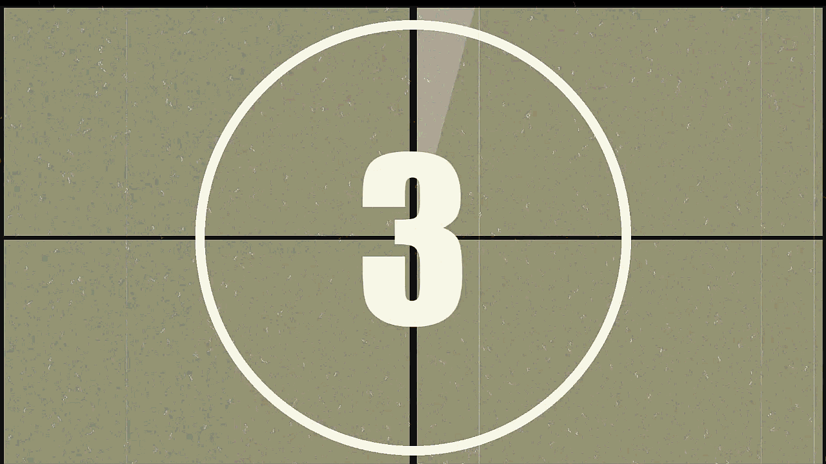
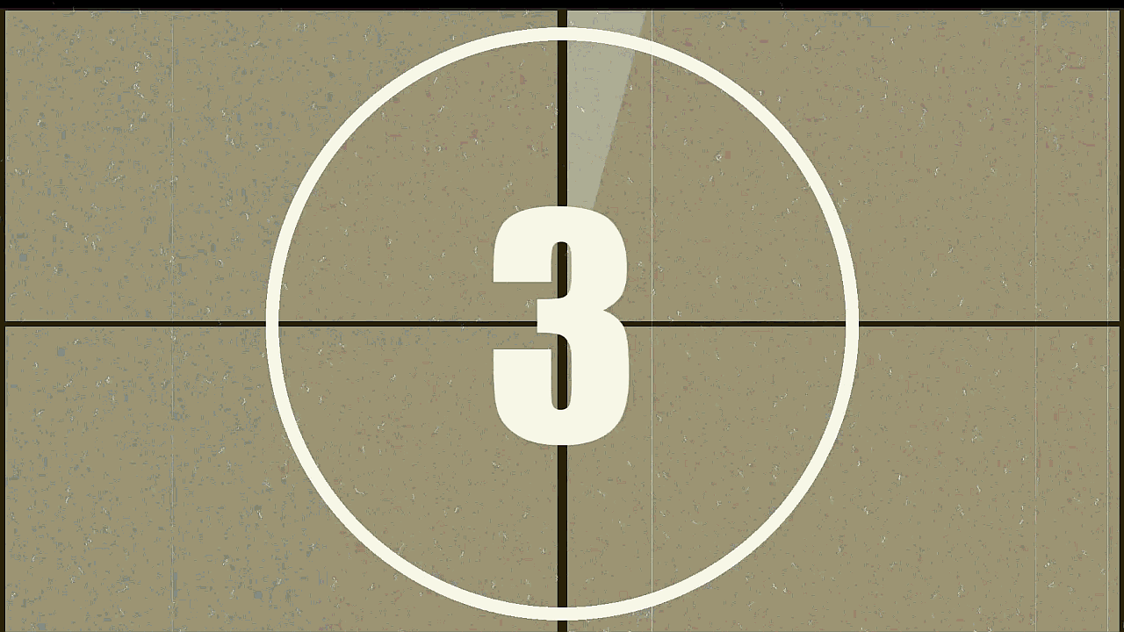
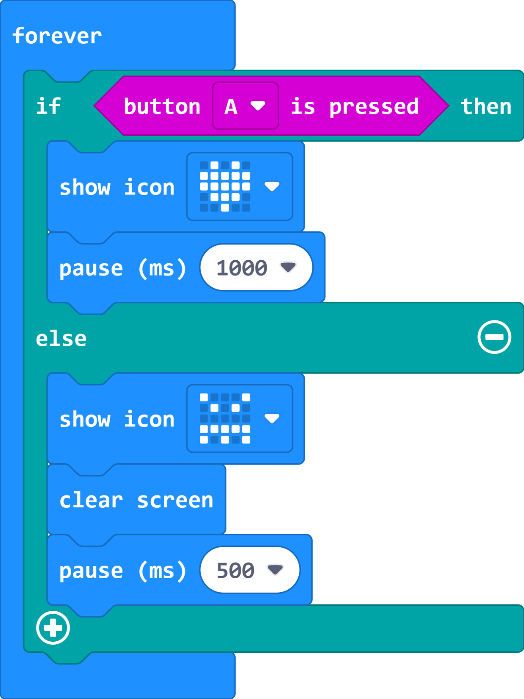
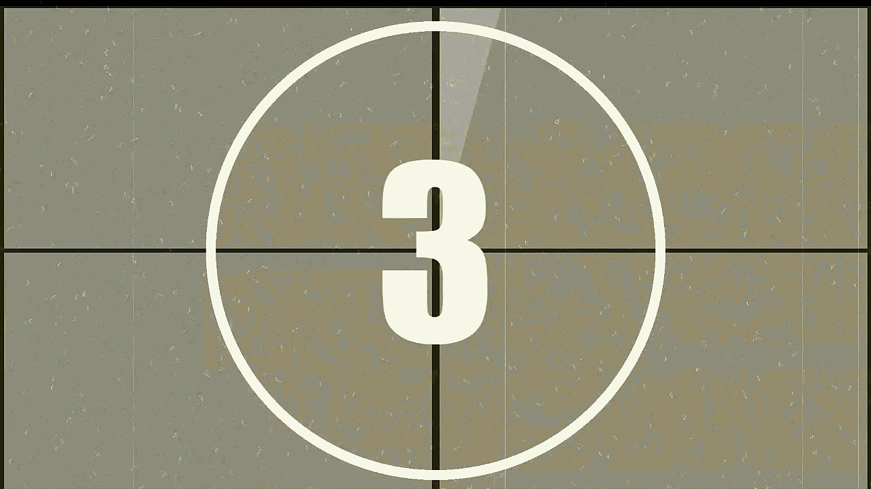
Which one matches the code?
A:
B:
C:

Slide 18
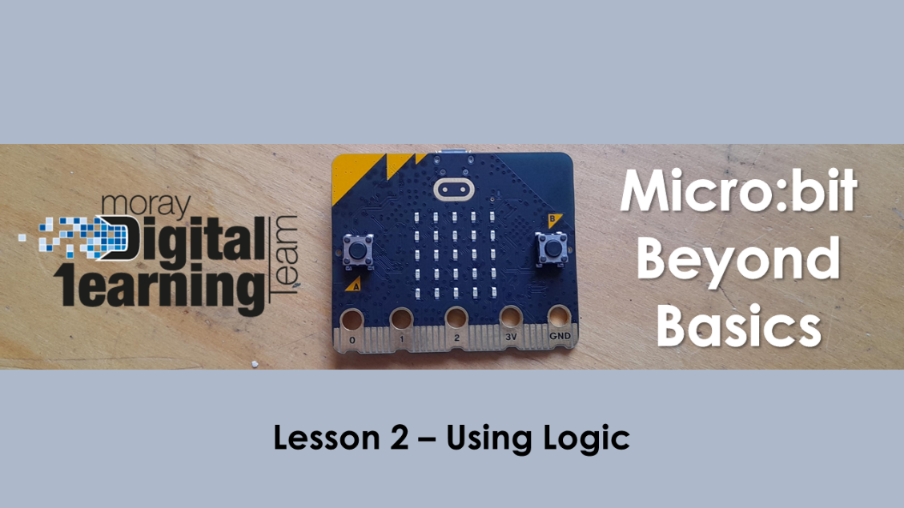
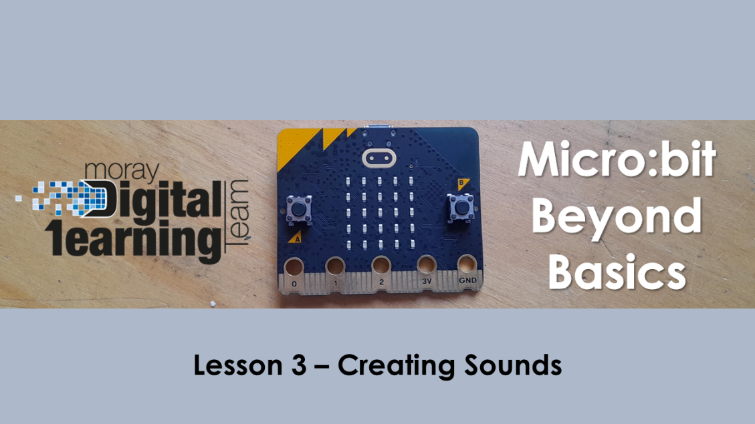
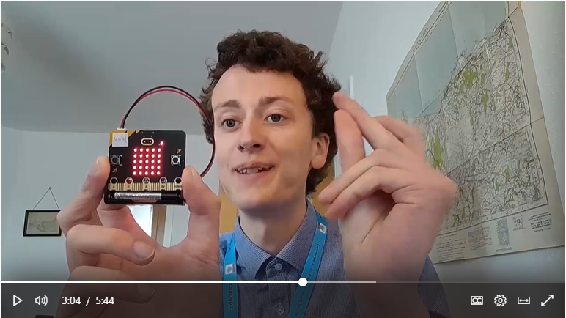
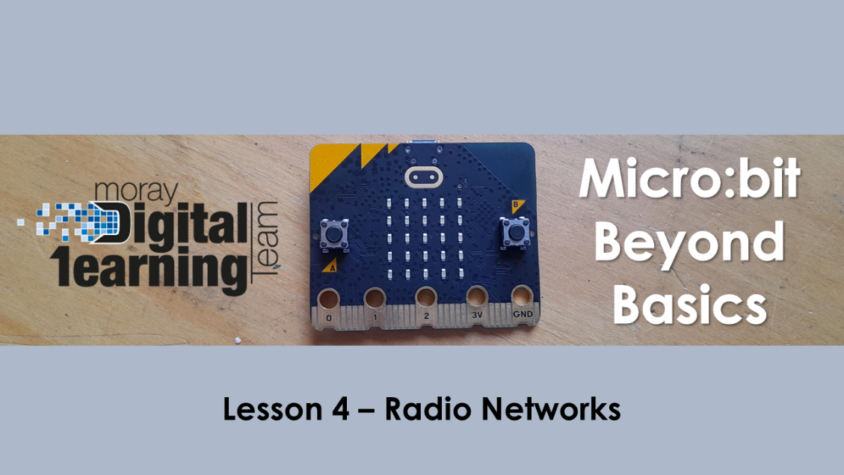
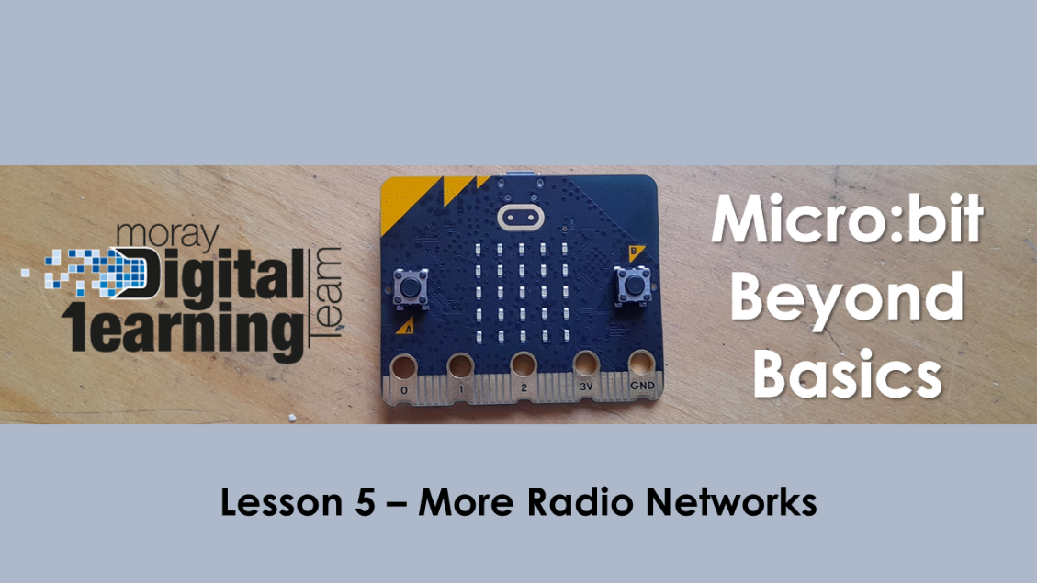
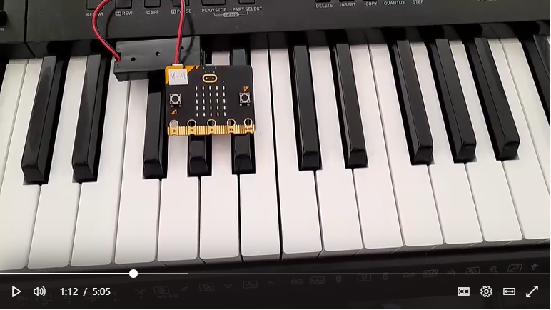
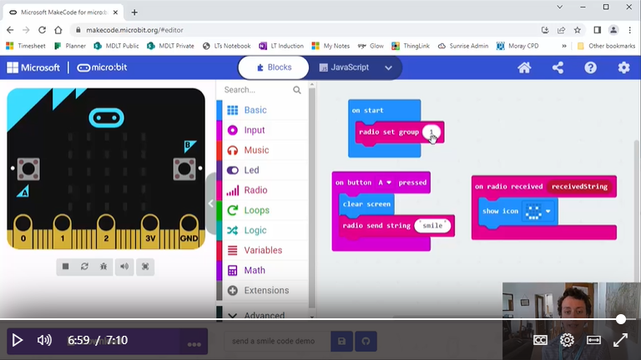
Next Lessons…
Lesson 6 – Creating Games

Slide 19
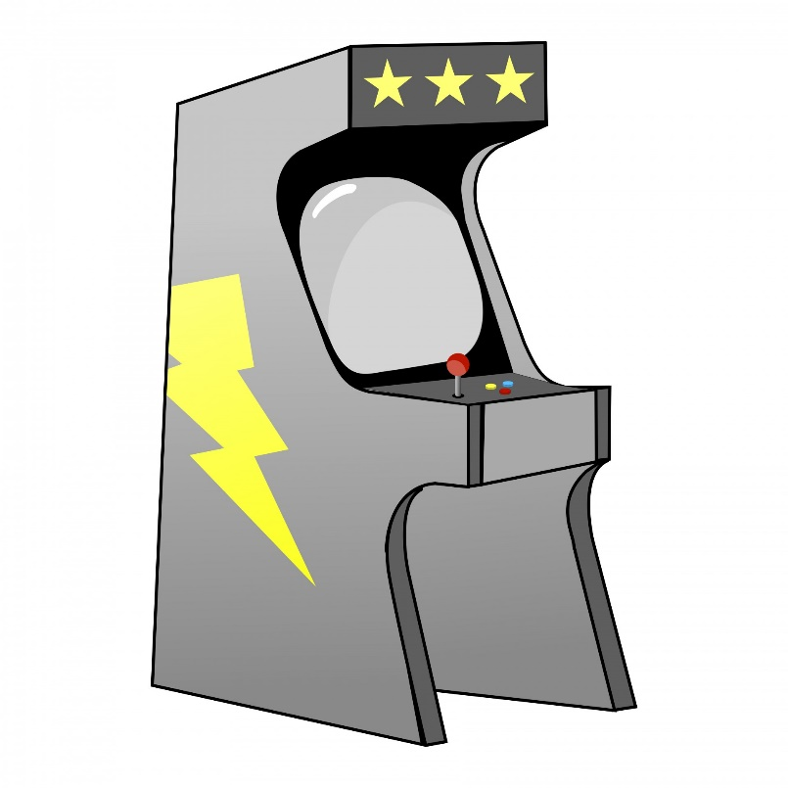
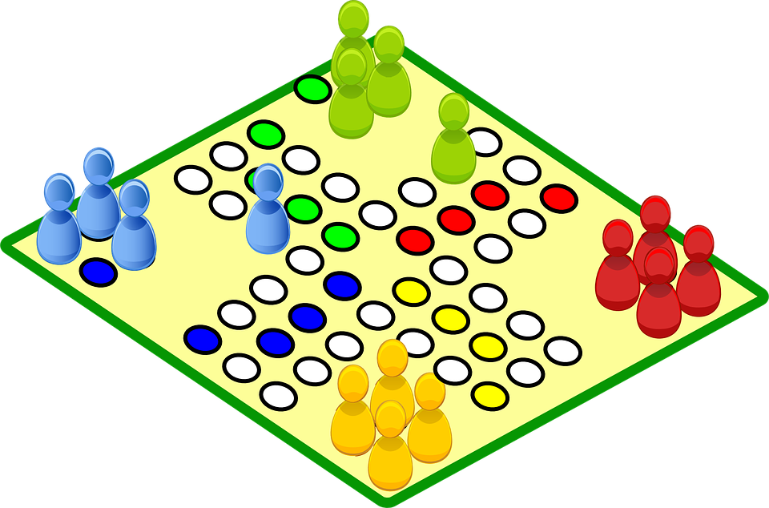
Beyond Basics
Challenge
Create or adapt a game for the micro:bit.
DEADLINE TBC

Slide 20
Micro:bit
Beyond
Basics
Thank you for listening and taking part!

