Slide 1


Micro:bit
Beyond
Basics
Lesson 2 – Using Logic

Slide 2
Lesson 2: Using Logic
We are learning to use logic with the micro:bit.
I can define what logic is.
I can use the logic blocks in MakeCode.
I can create code with logic which reacts to an input.

Slide 3

Video Introduction

Slide 4
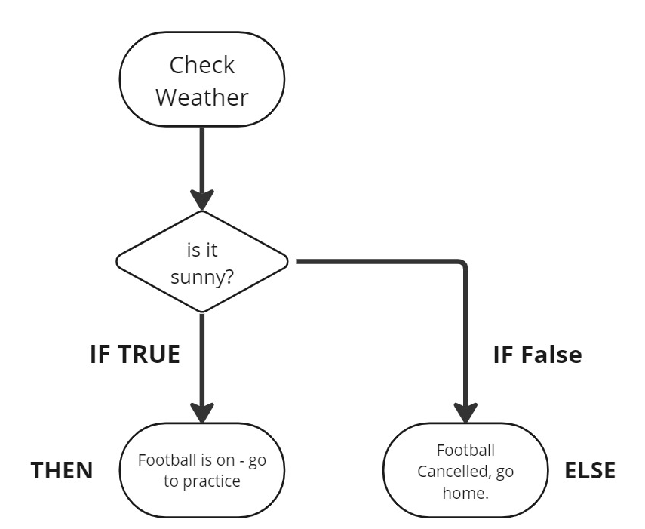
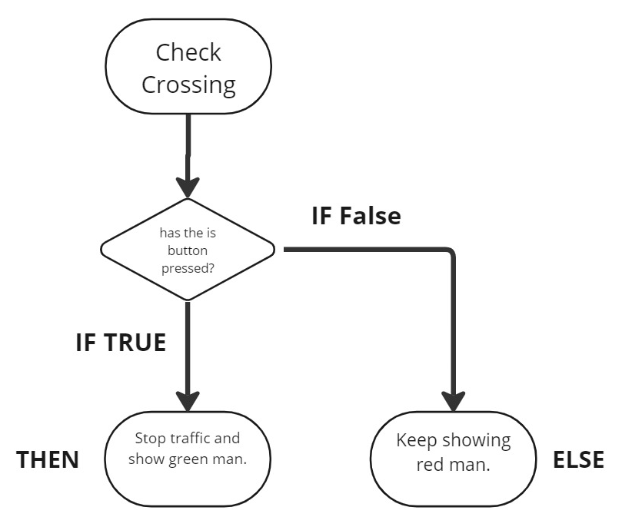

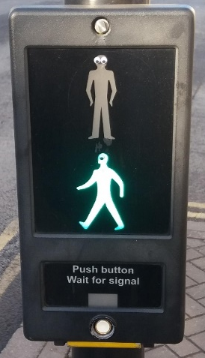

Flow Chart Activity (Worksheet)
Complete your own flow chart with a logic selection from daily life.

Slide 5
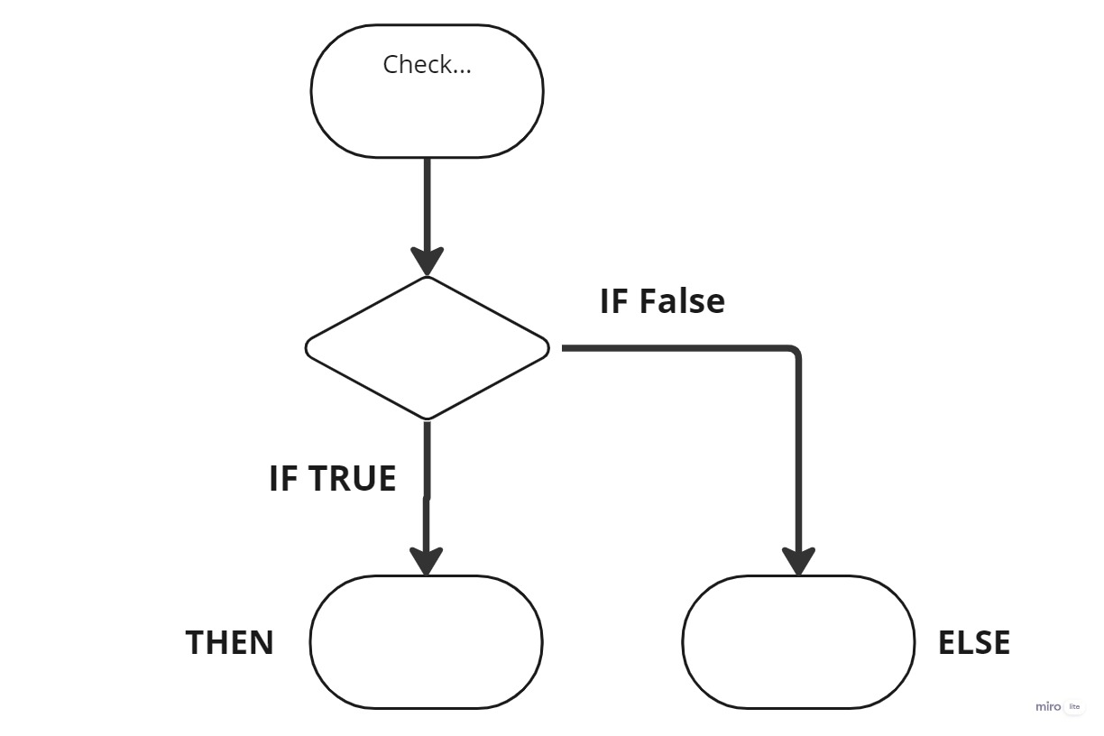
Teacher Board Copy

Slide 6
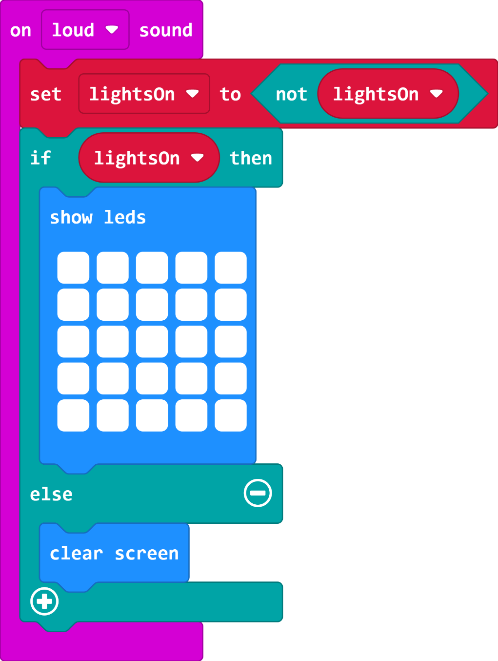
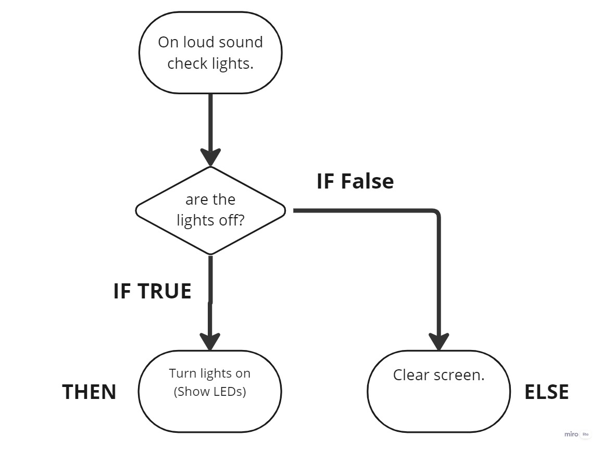

Clap Lights Code

Slide 7
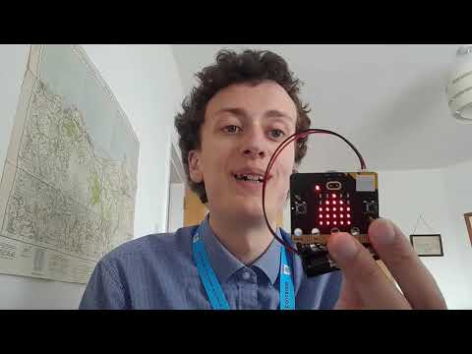
Video Part 2

Slide 8
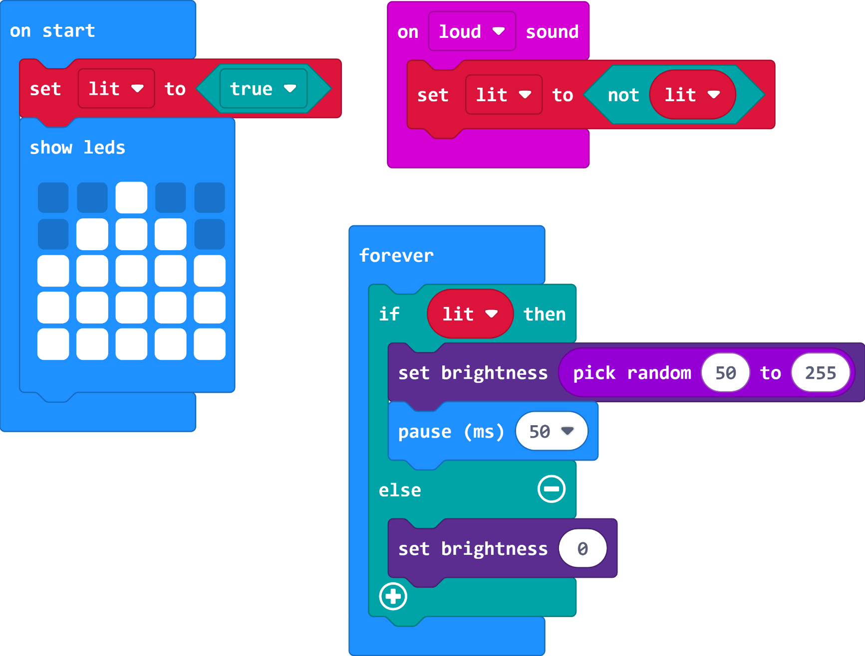
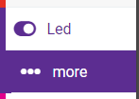

Candle Code

Slide 9
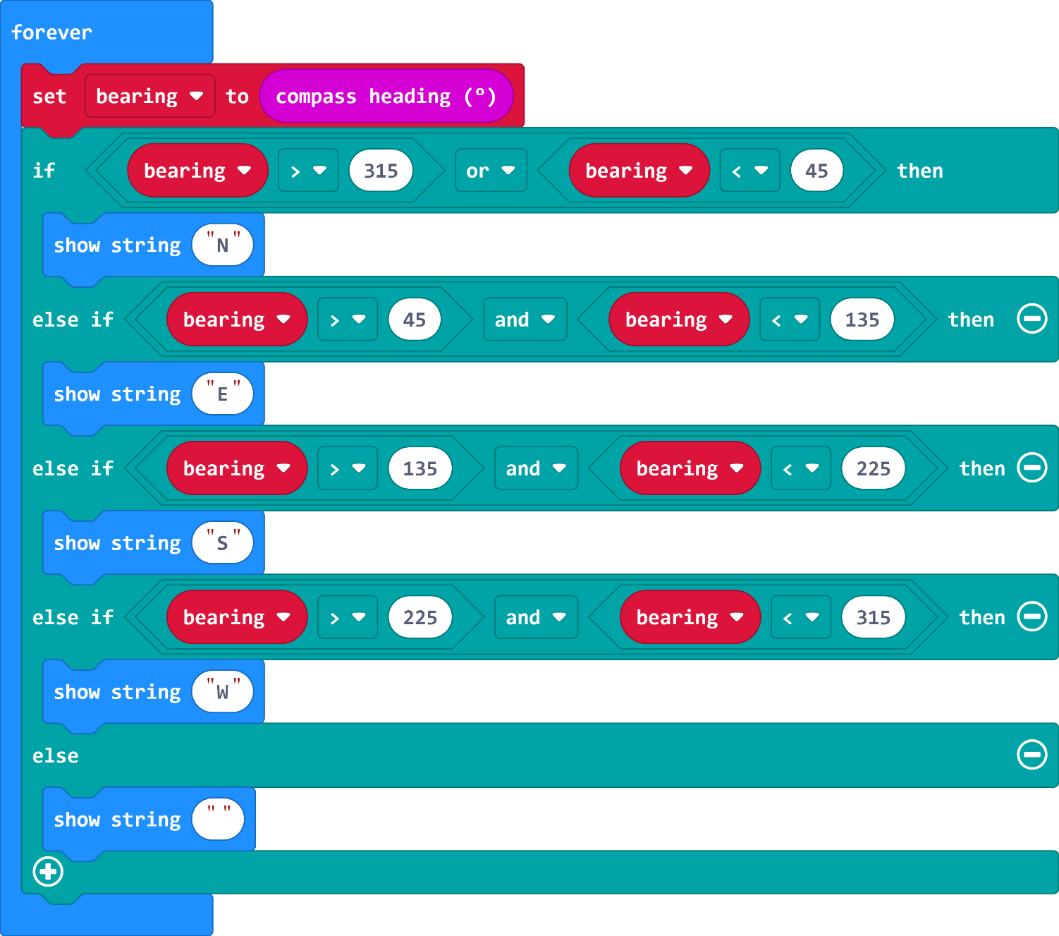
Extension
Investigate this code, what does it do? (Load it onto your micro:bit and see!
What is the IF statement checking?
Do you know what the ‘<‘ and ‘>’ signs mean?
Why have I not used exact numbers like 0, 90, 180 and 270?

Slide 10
Plenary Discussion Questions
What were some of the examples of real life logic?
What was the difference between the light and the candle?
Why did the candle keep coming back on?
Which of the programs was more useful in real life?

