Slide 1


Micro:bit
Beyond
Basics
Lesson 3 – Creating Sounds

Slide 2
Lesson 3: Creating Sounds
We are learning to create sounds using the micro:bit
I can recognise the different ways to create sound using the micro:bit
I can use loops to create longer sounds.
I can code the micro:bit to play a range of different sounds.

Slide 3
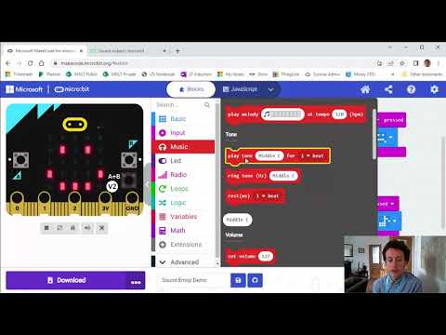
Video Introduction

Slide 4
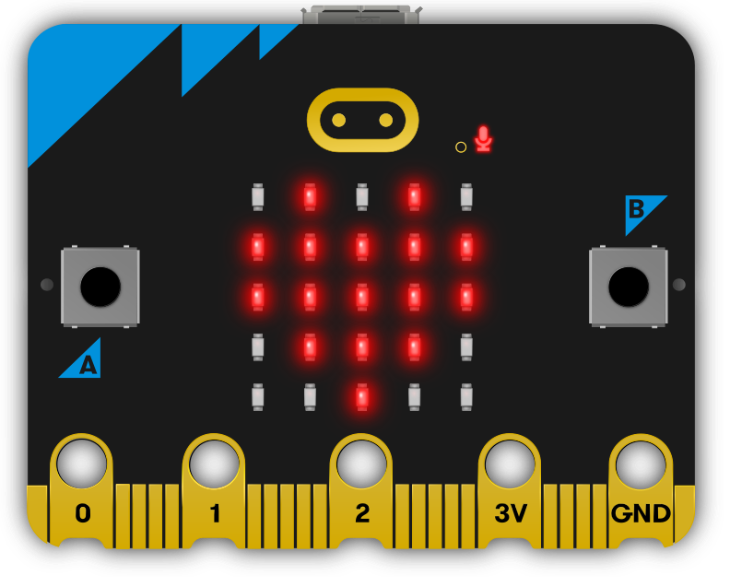
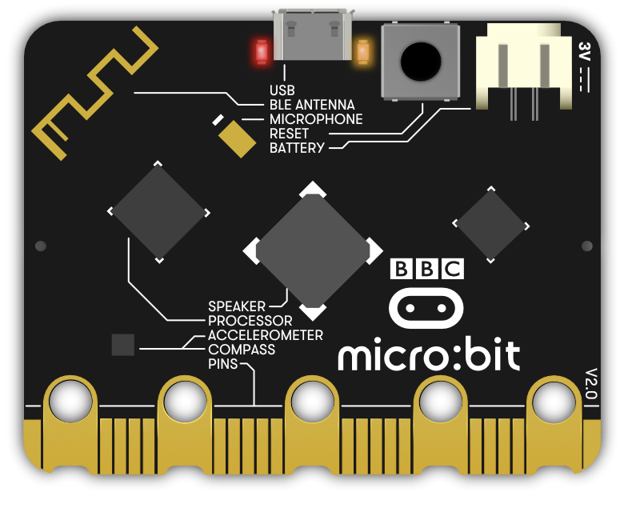
Where is the speaker?

Slide 5
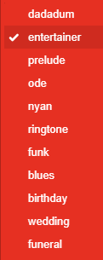
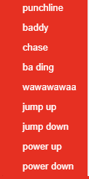
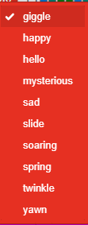
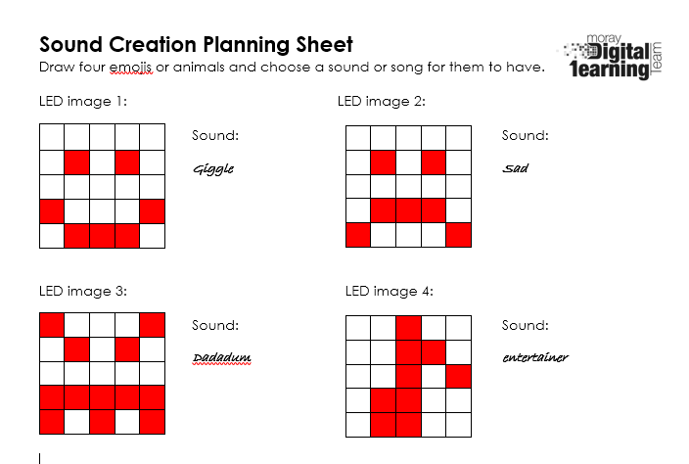
Sound Planning Sheet
Choose one of these melodies or sounds

Slide 6
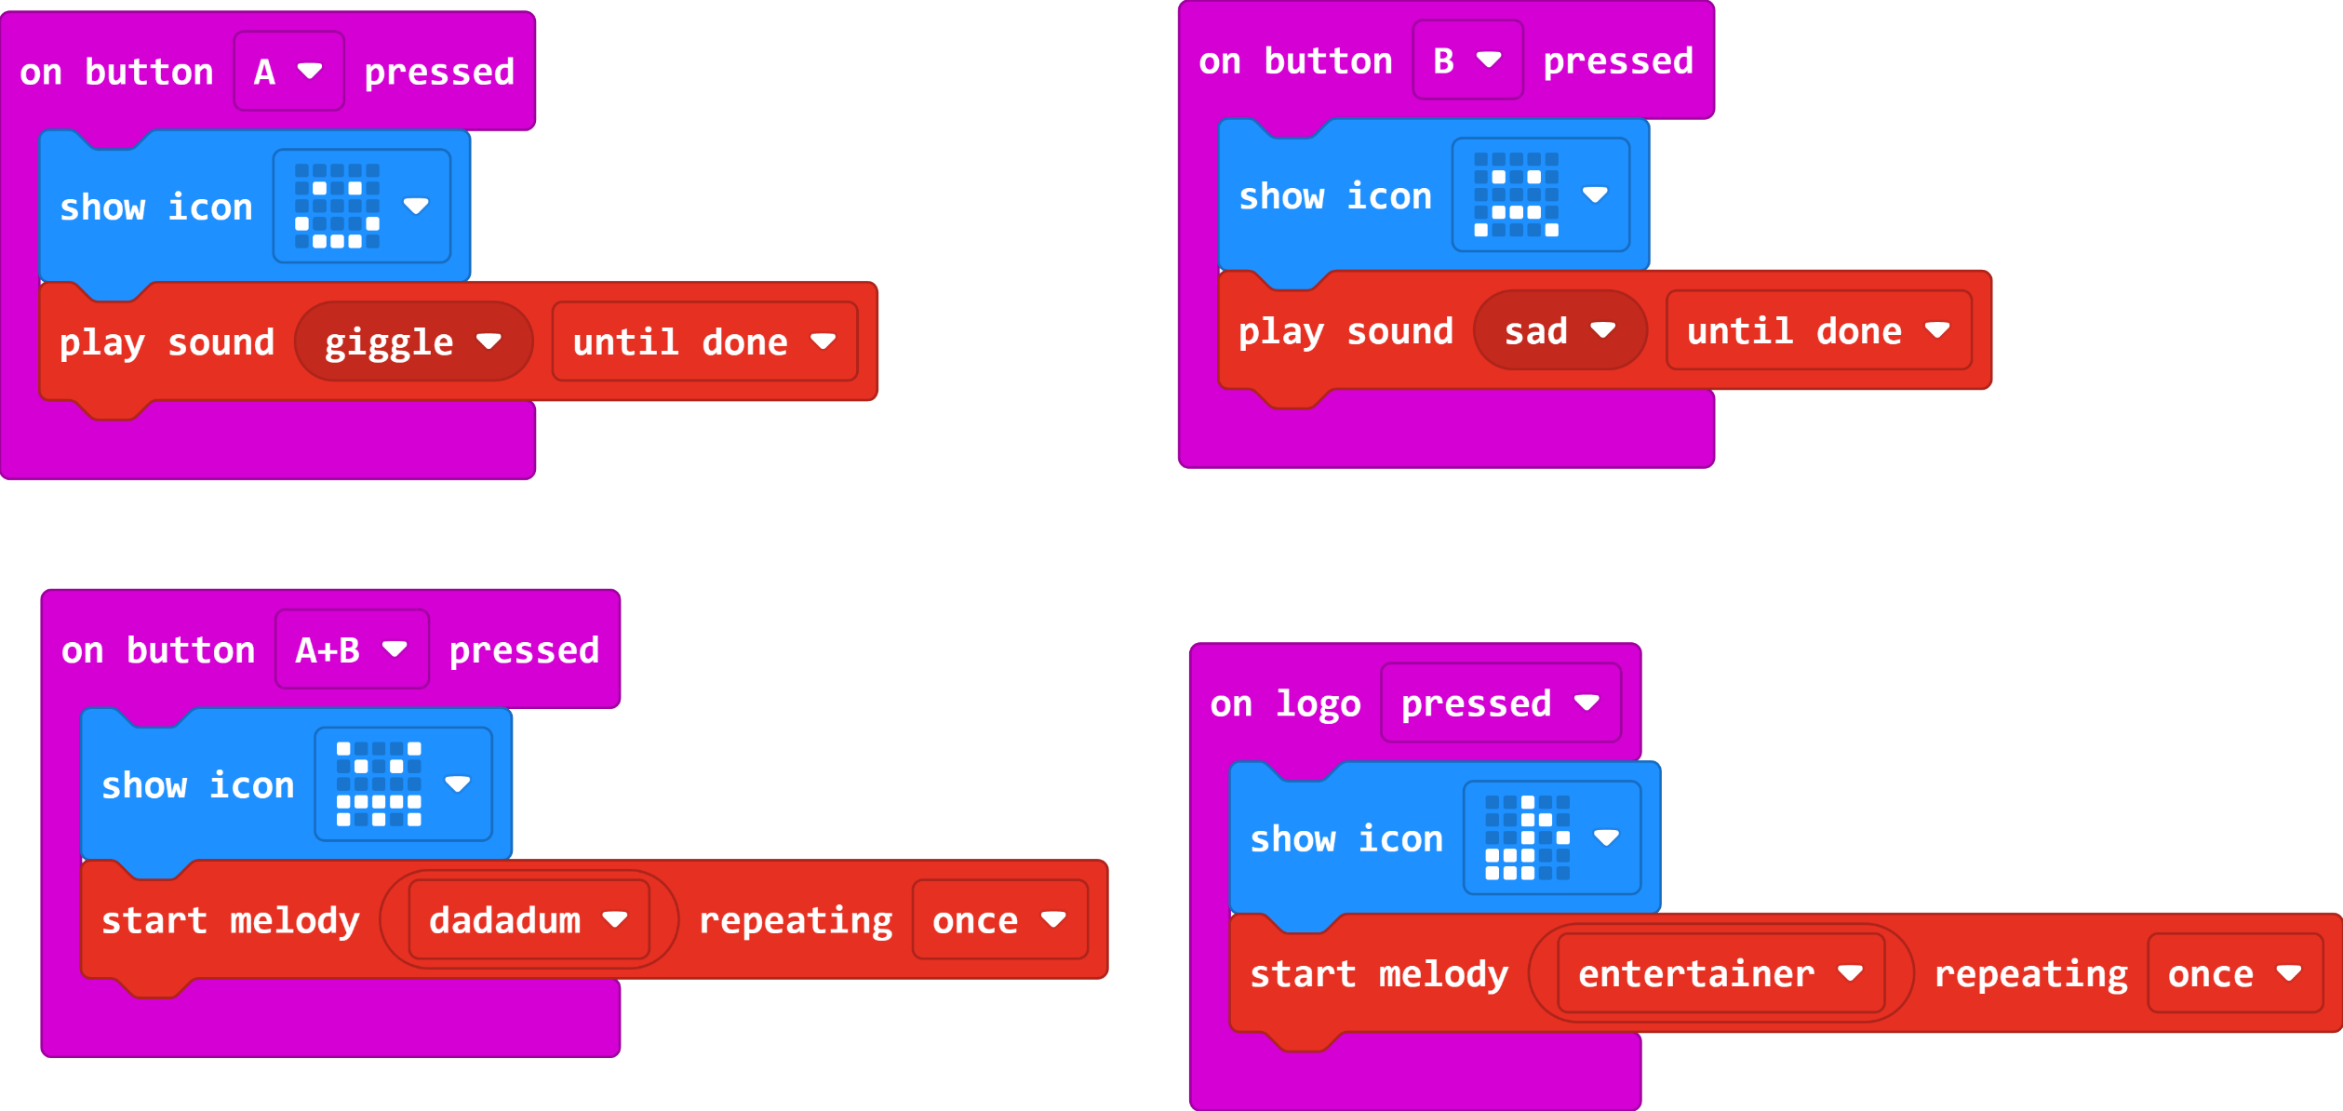
Sound Emoji Code

Slide 7
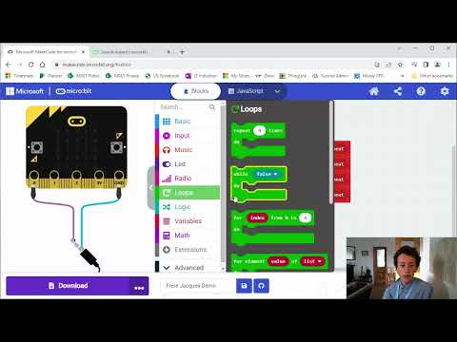
Video Part 2

Slide 8
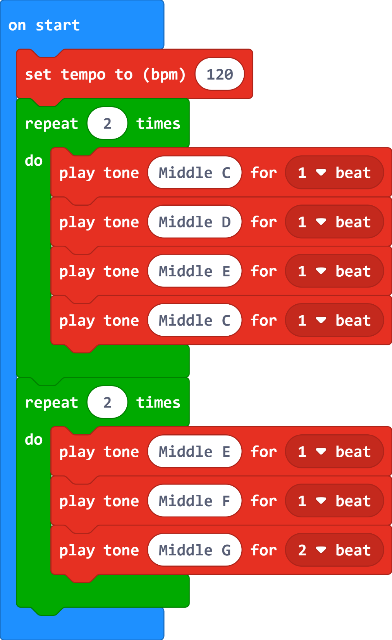
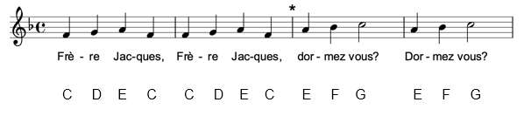
Frère Jacques Code

Slide 9
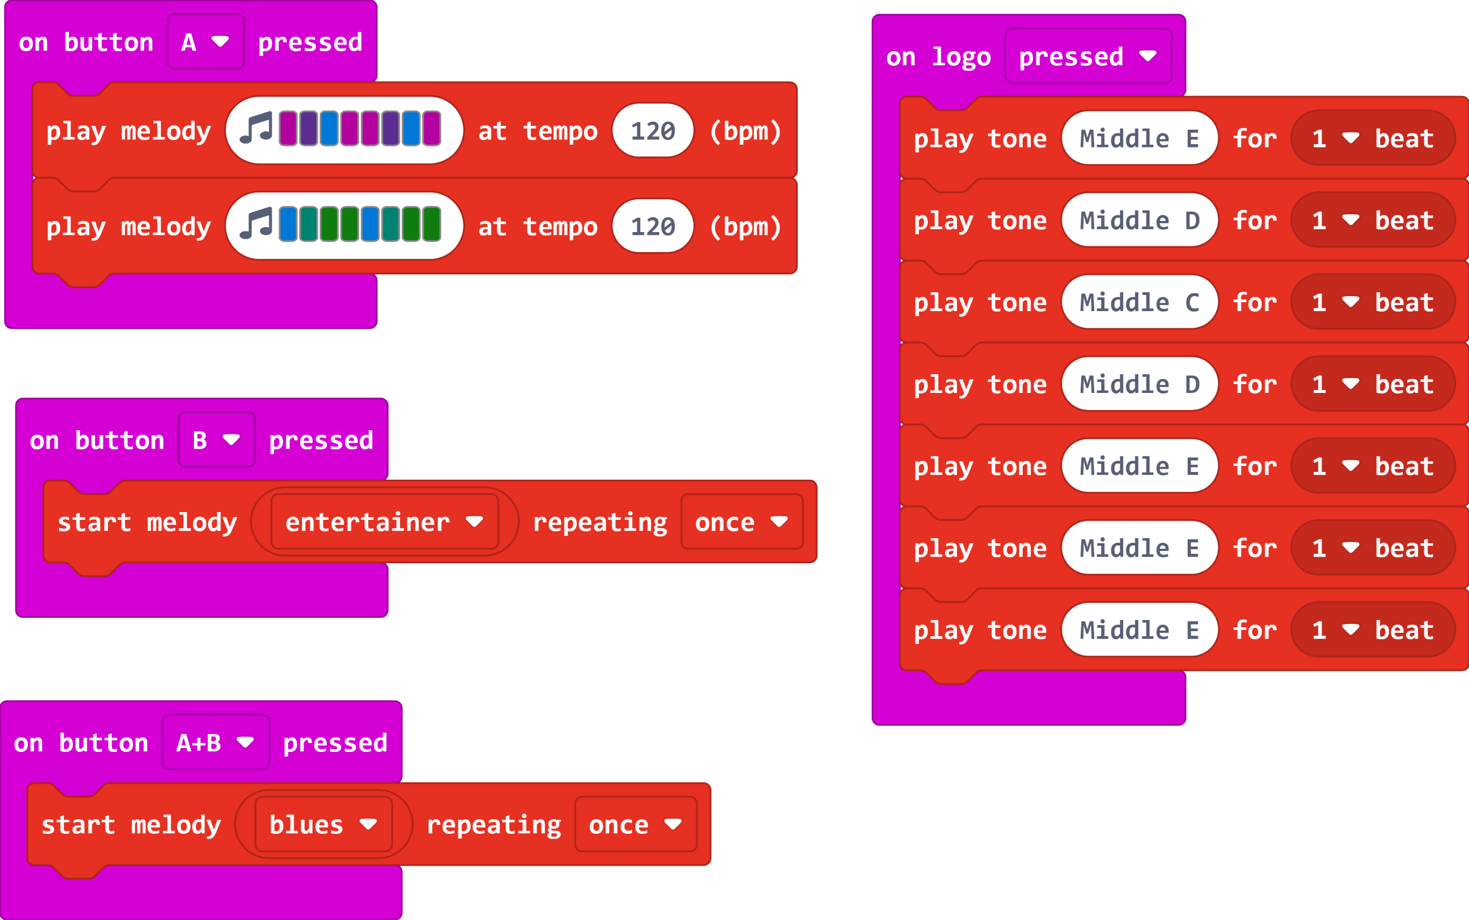
Jukebox Code (Extension)
Create different sounds or tunes for each of the inputs. Experiment with the different ways to create these.

Slide 10
Plenary Discussion Questions
What were your favourite sounds that you used or created?
Did loops make it easy to create longer bits of music?
What real life uses could you see for sounds that are programmed by a computer?

