Slide 1


Micro:bit
Beyond
Basics
Lesson 4 – Radio Networks

Slide 2
Lesson 3: Creating Sounds
We are learning to use radio networks with the micro:bit
I can recognise what devices use wireless communication.
I understand how micro:bits can communicate with each other.
I can create simple wireless communications.

Slide 3
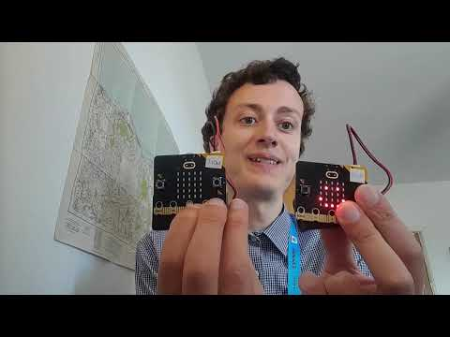
Video Introduction

Slide 4
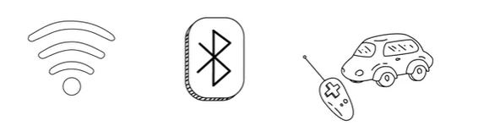
Discussion
Where have you seen wireless communications in the real world? (Not just internet devices)

Slide 5
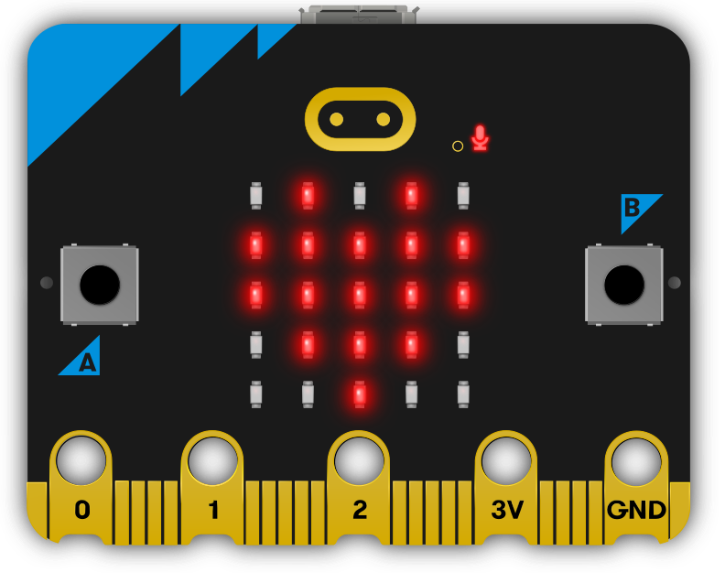
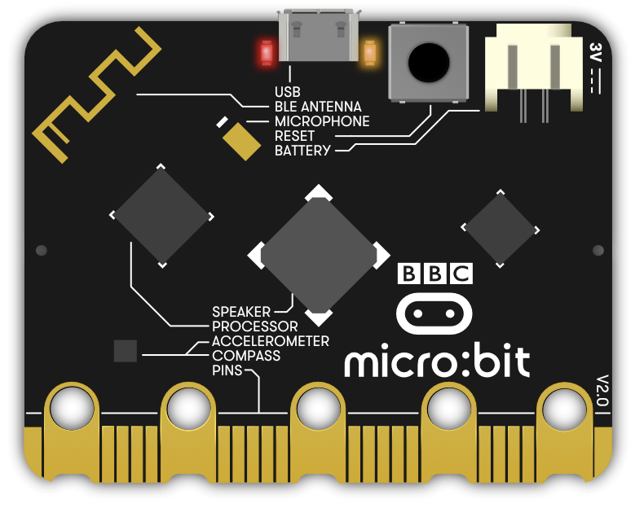
Where is the Radio Antenna?

Slide 6
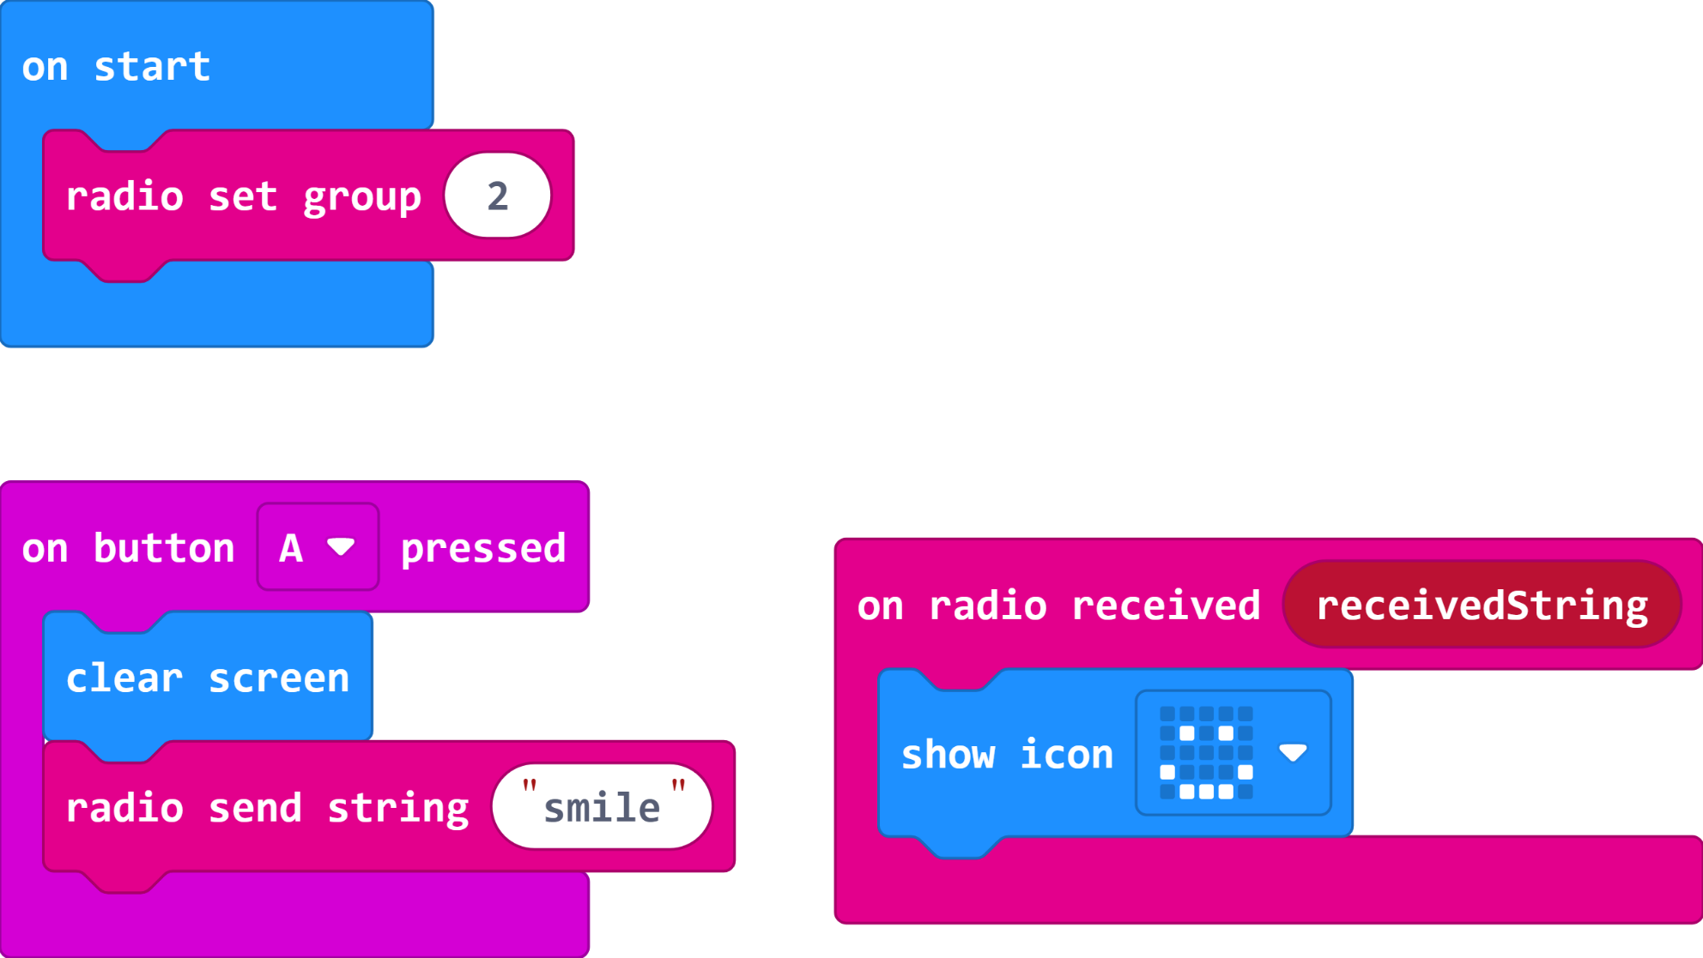
Send a Smile Code
Remember to use a different number for each group. Your teacher can choose this for you.

Slide 7
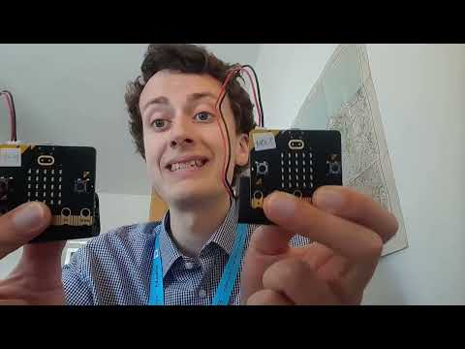
Video Part 2

Slide 8
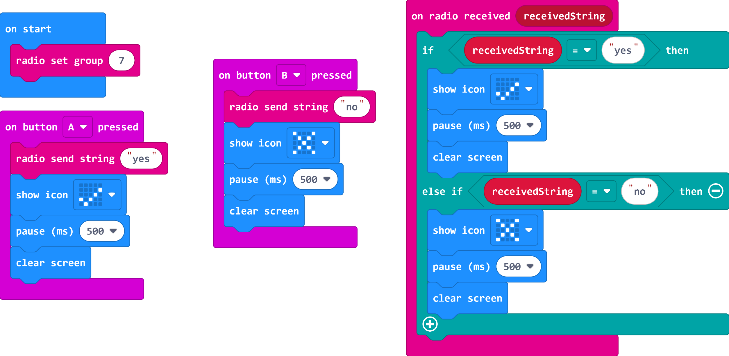
Asking Questions Code

Slide 9
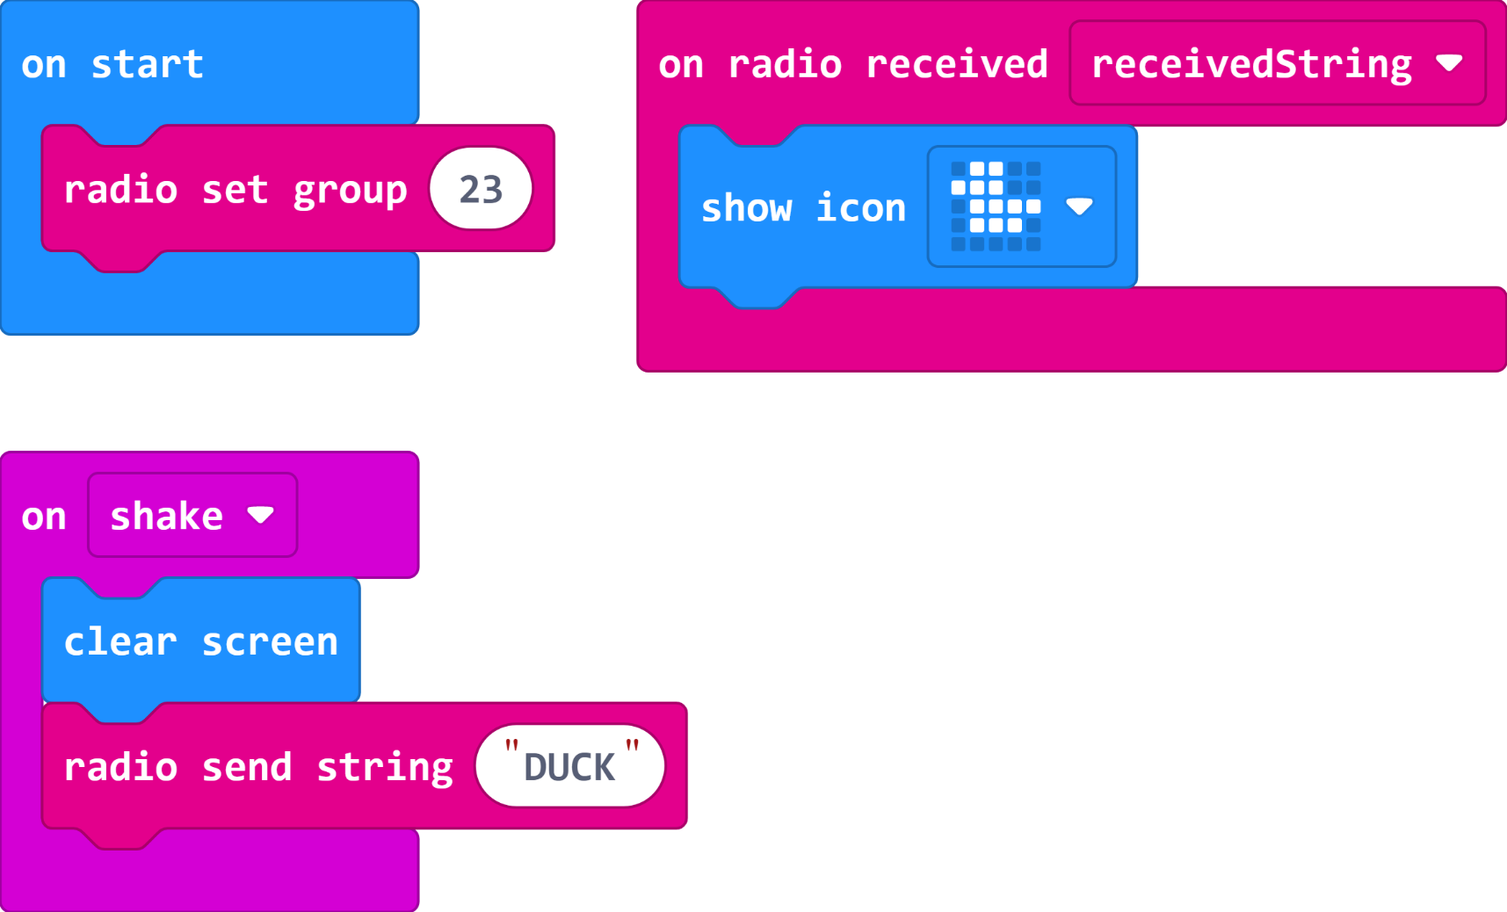
Extension – Teleporting Duck Game
Flash this program onto two micro:bits, shake one and a duck appears to travel magically through the air from one to the other. Shake the other to send it back.
Could be any animal or emoji…
Can you create a game out of this? With multiple players?

Slide 10
Plenary Discussion Questions
Why was it important to set a ‘radio group’ in our code today?
Why is it important that we know who we are sending ‘data’ our information to online?
What is a ‘string’ in programming?

