Slide 1


Micro:bit
Beyond
Basics
Lesson 5 – More Radio Networks

Slide 2
Lesson 3: Creating Sounds
We are learning to use radio networks with the micro:bit
I can recognise the challenges of radio networks.
I can describe the difference between transmitting and receiving.
I can code transmitter and receiver beacons with the micro:bit.

Slide 3
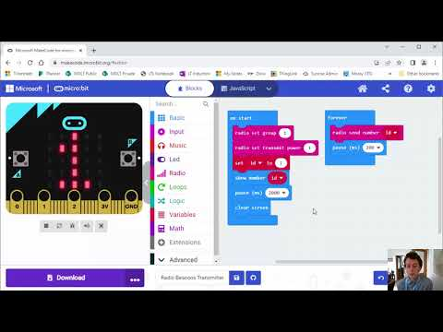
Video Introduction

Slide 4
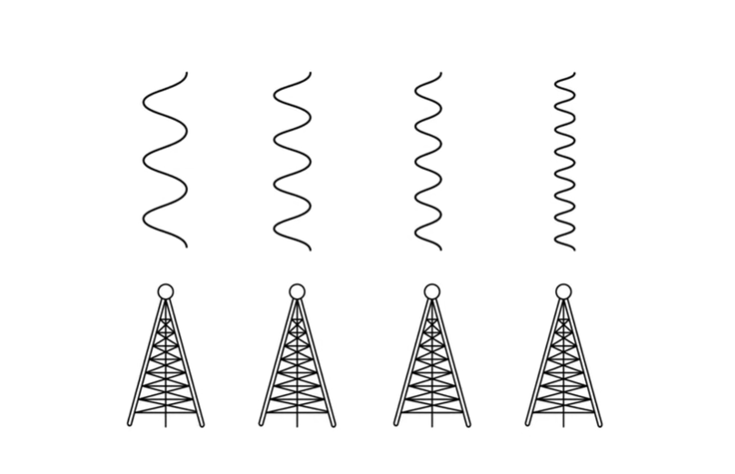
Discussion
Have you experienced radio signals that don’t work in certain places? Or certain distances from the transmitter?

Slide 5
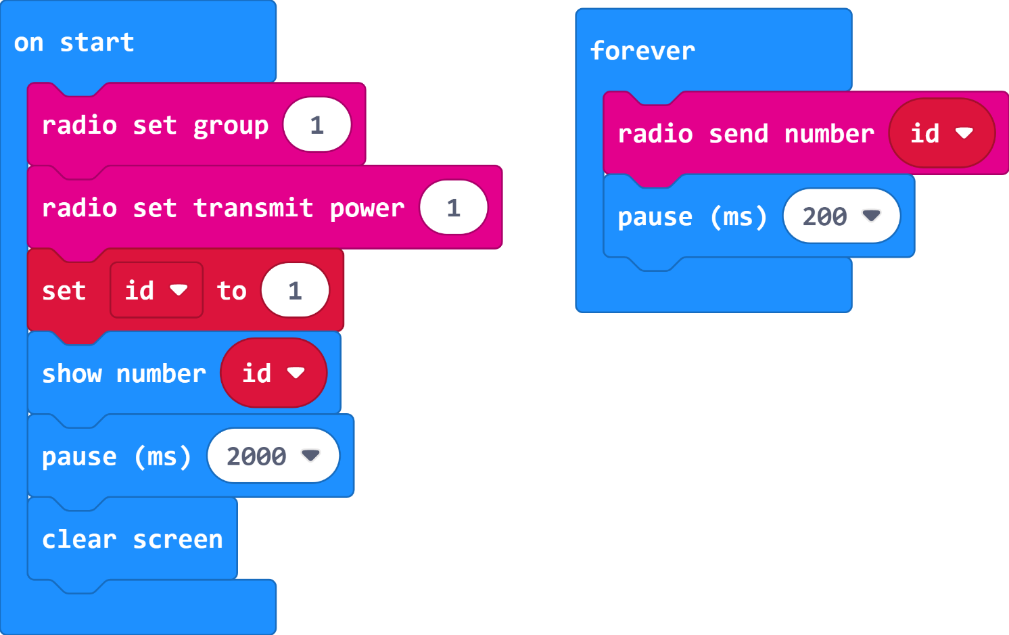
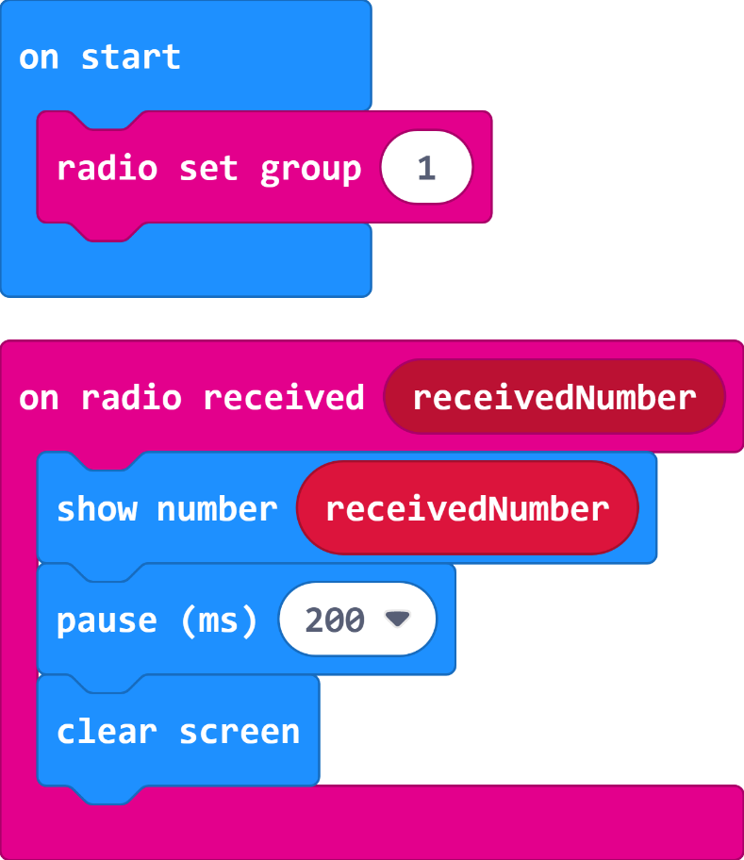
Radio Beacons Code
Transmitter
Receiver
Remember to use a different number for each group. Your teacher can choose this for you.

Slide 6
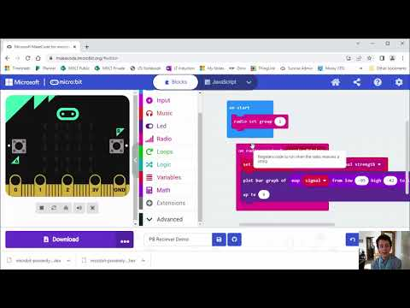
Video Part 2

Slide 7
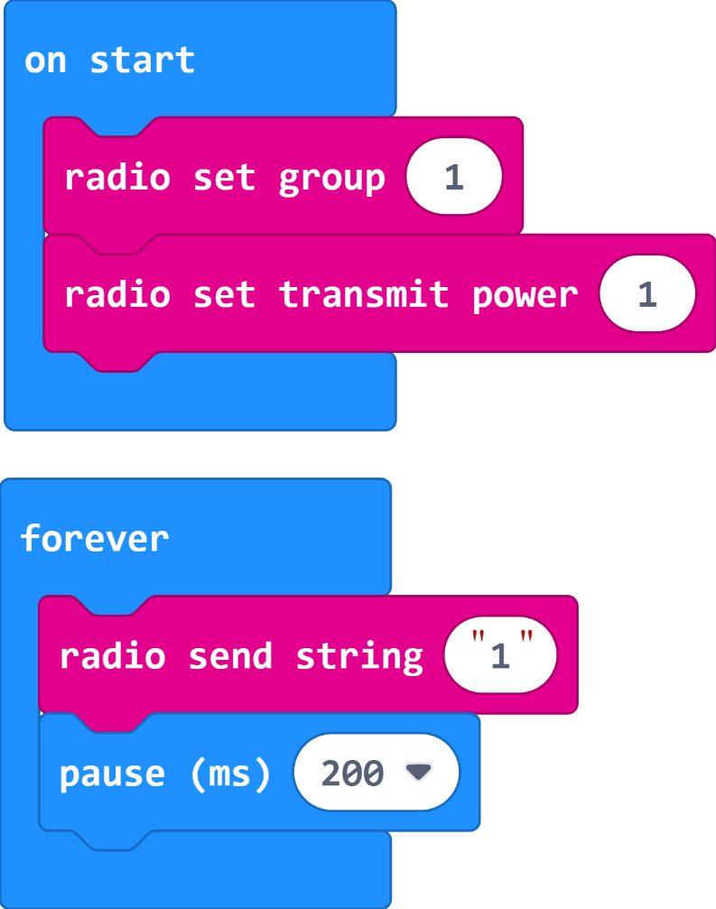
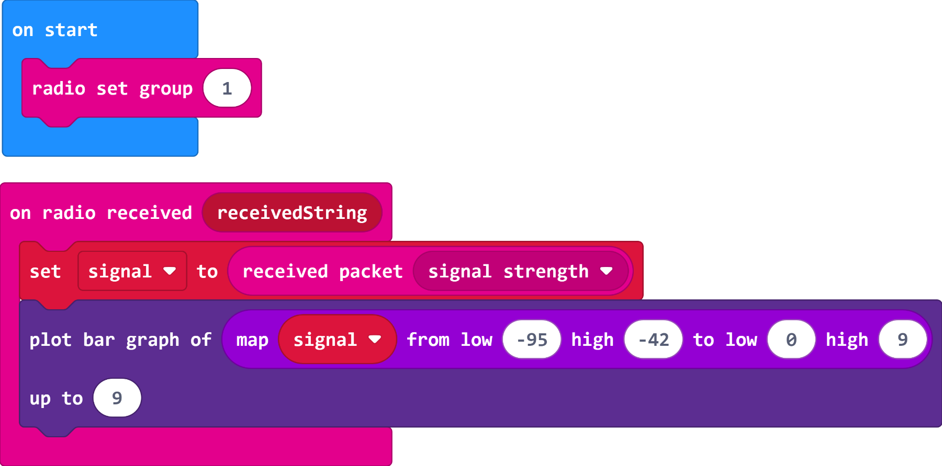
Proximity Beacon Code
Transmitter
Receiver
Remember to use a different number for each group. Your teacher can choose this for you.

Slide 8
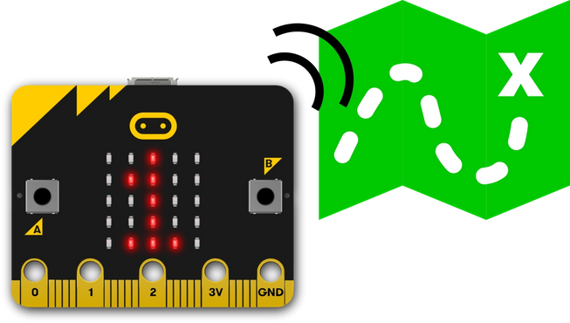
Extension – Treasure Hunt
Hide one micro:bit somewhere in the classroom (or outside if you put it inside a plastic bag/box). Everyone else in the game has a receiver. Who is going to find the micro:bit first?

Slide 9
Plenary Discussion Questions
What was the explanation for some radio stations not working in certain places?
How far away did your beacon code work?
Was it easier to find the beacon using the proximity sensor?

