Slide 1


Micro:bit
Beyond
Basics
Lesson 6 – Creating Games

Slide 2
Lesson 6: Creating Games
We are learning to create games on our micro:bit.
I can recognise some of the features of a simple arcade game.
I can code a simple arcade game onto the micro:bit.
I can investigate the features of a more complex game.

Slide 3
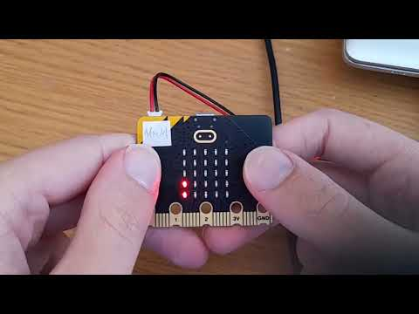
Video Introduction

Slide 4

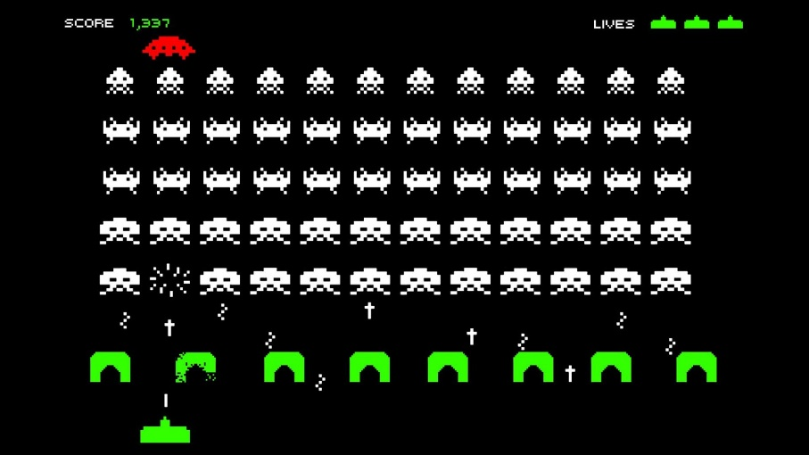

Discussion
What features do most simple video/online/arcade games have?

Slide 5
Discussion
What features do most simple video/online/arcade games have? Suggested answers: A character that moves, easy controls, short levels, a game over screen, high scores and Lives.

Slide 6
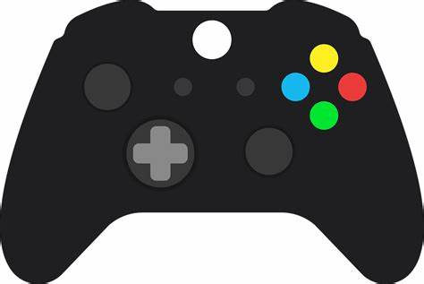
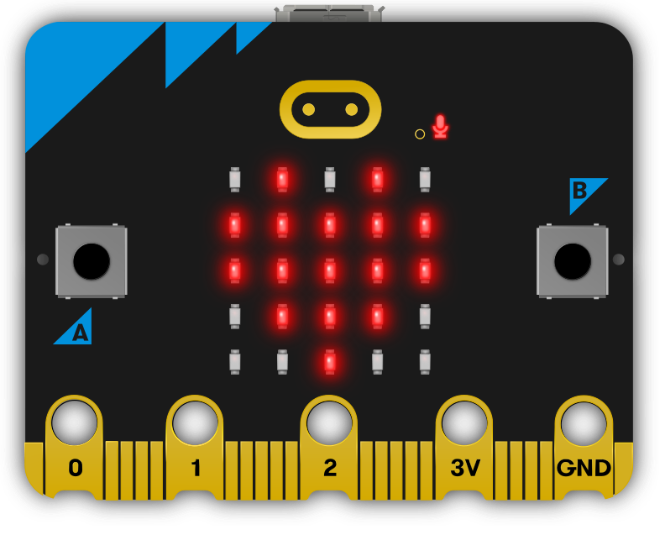
Do you see similarities?

Slide 7
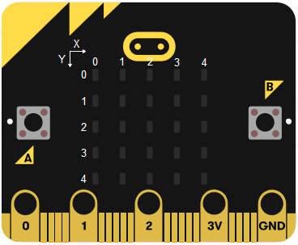
Screen x and y Coordinates
x = 3
y = 1
x = 4
y = 3

Slide 8
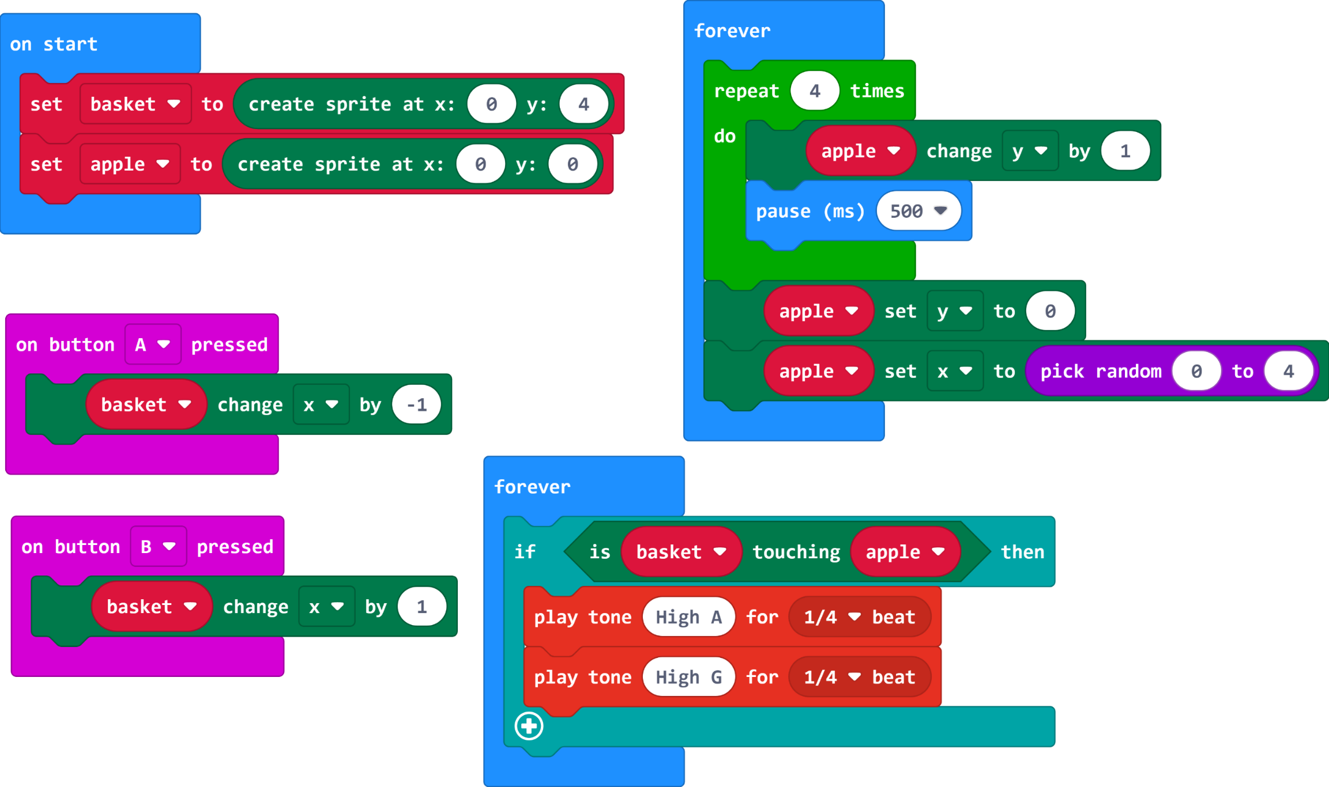

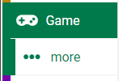
Apple Catching Game Code

Slide 9
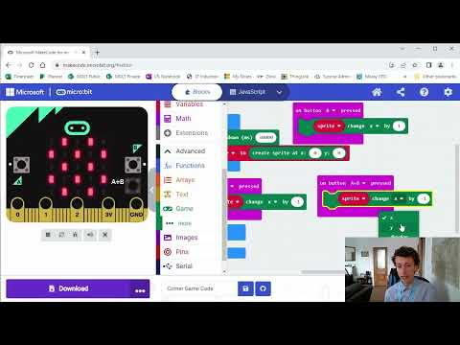
Video Part 2

Slide 10
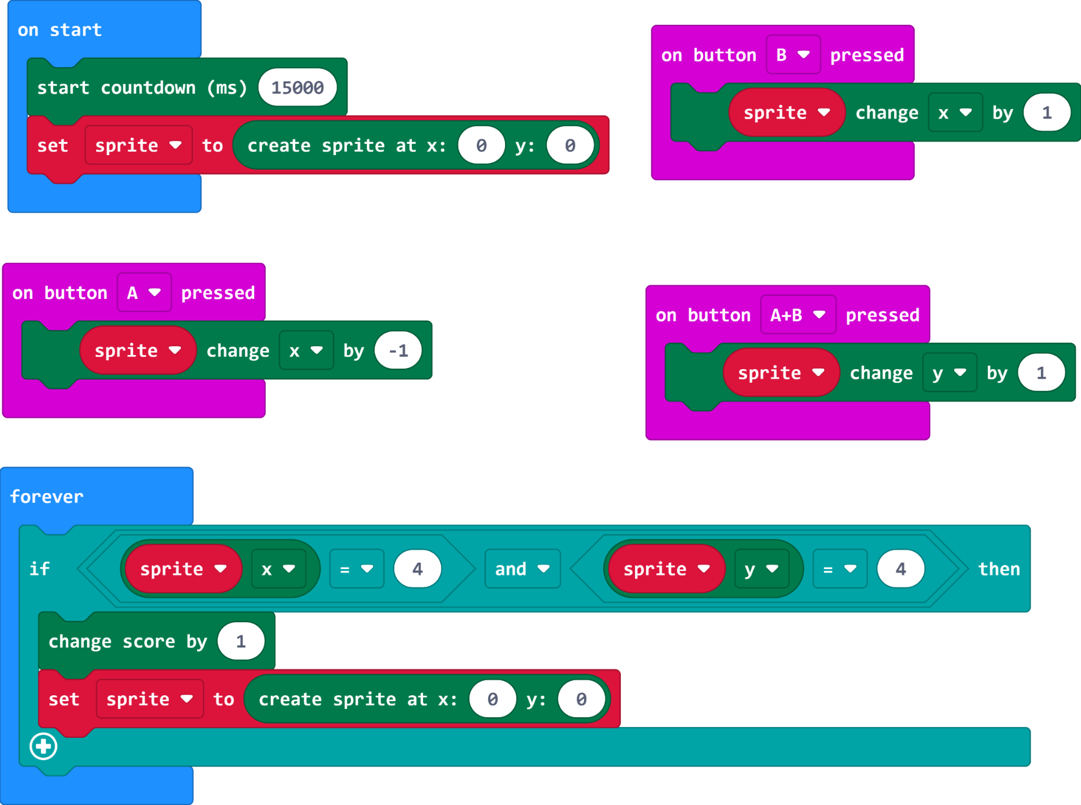
Corner Game Code

Slide 11
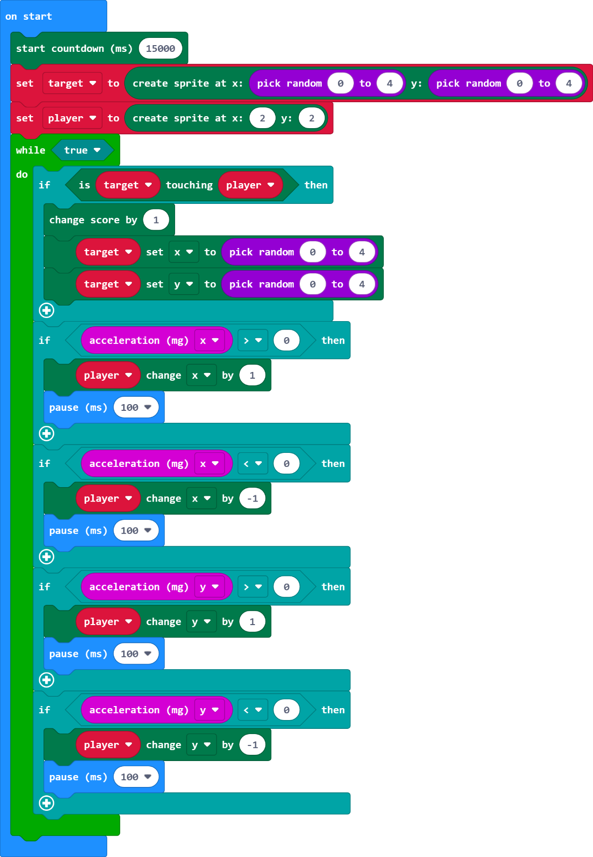
Tilt Game Code (Extension
Load it onto your micro:bit and test it. See if you can understand what the code is doing.

Slide 12
Plenary Discussion Questions
Why was a sprite in today’s lesson?
What was important about x and y for our games?
What is a ‘string’ in programming?

