Slide 1

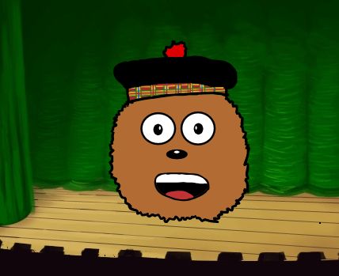
Coding a Scots Poem on Scratch

Slide 2
Lesson: Coding a Scots Poem
We are learning code a Scots poem using Scratch.
I can create a Scottish character and background in Scratch.
I can create a program to display speech bubble blocks and recorded voice.
I can input a Scots Poem into my program by typing and speaking.

Slide 3
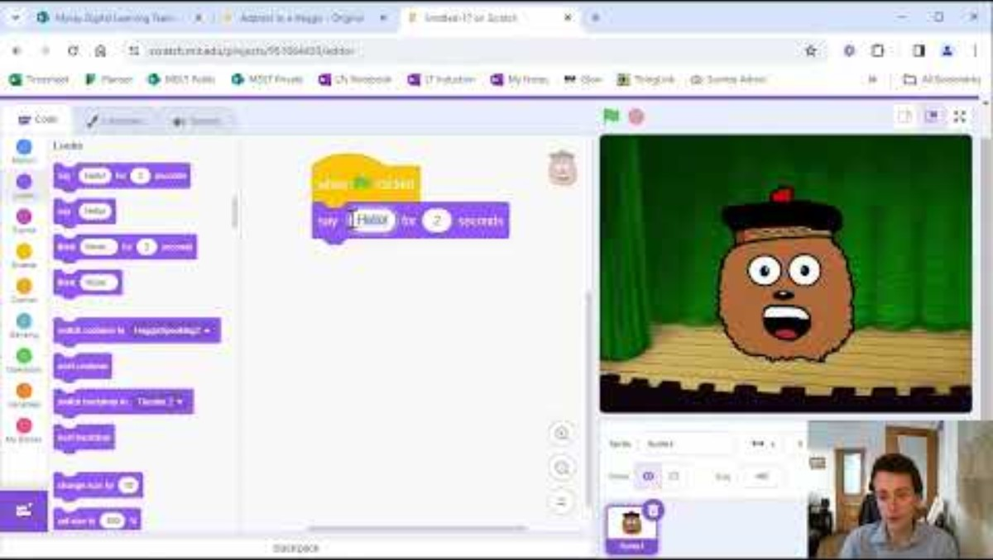
Video Tutorial

Slide 4
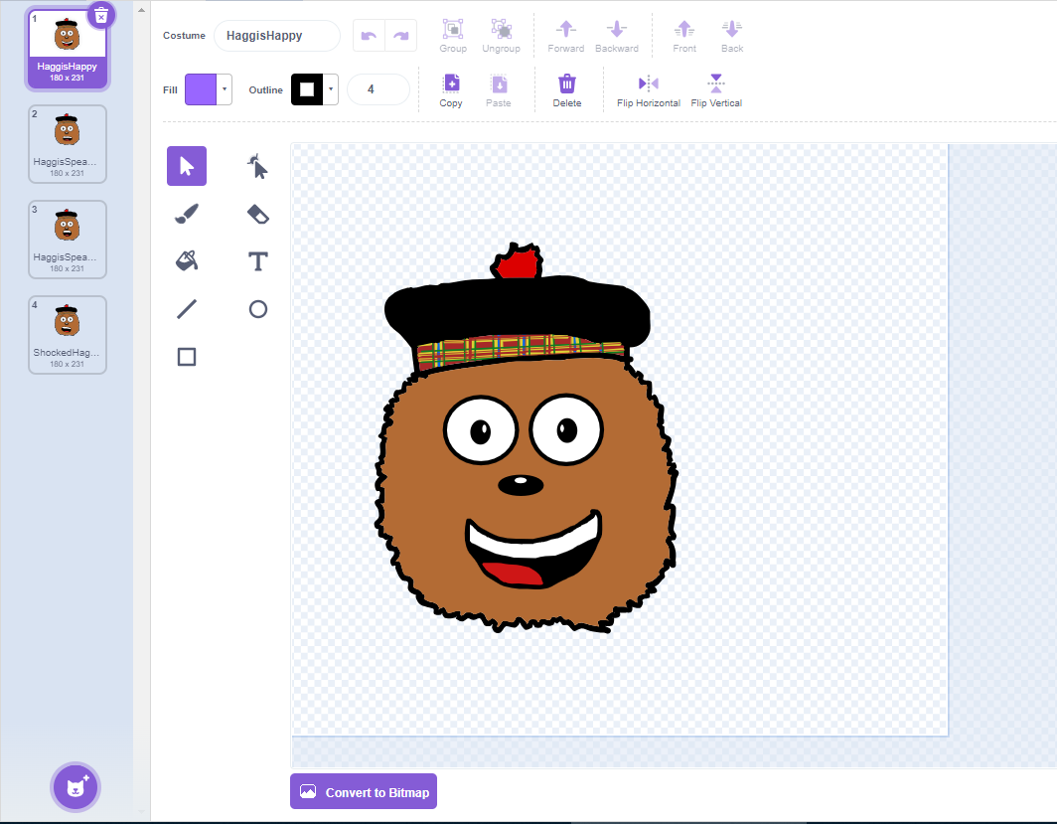
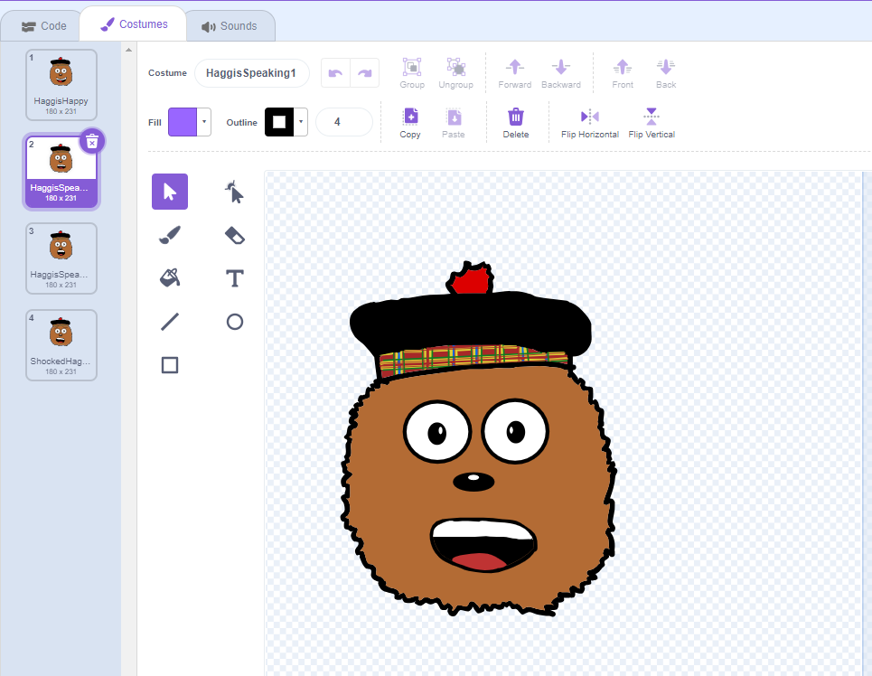
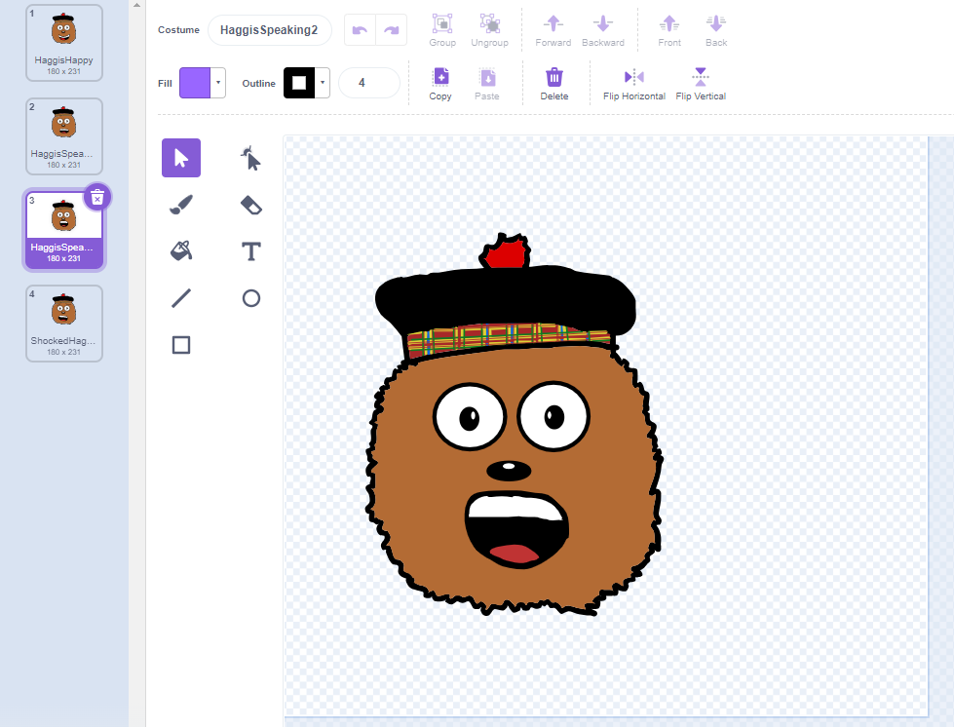
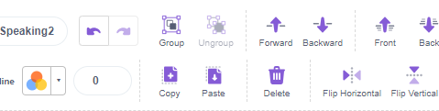
Creating your Character
Create one character.
Then Copy and Paste them 3 times.
Change the mouths to smiling, fully open and half open (speaking).
Name these clearly.

Slide 5
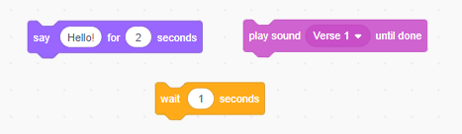
What do these blocks do?

Slide 6
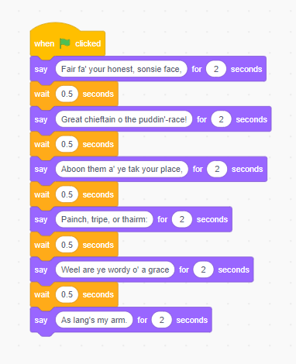
Creating the Poem Program
Type out the words, remember to not make each line too long to fit in the speech bubble.
Choose the length as 2 seconds and add a wait 0.5 between the blocks.

Slide 7

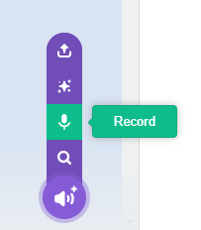
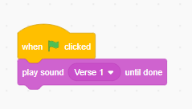
Creating the Poem Program
Go to the sound tab.
Record your Poem.
Try to say it in one go!
Name your code.
Insert these blocks to put it in your program.

Slide 8
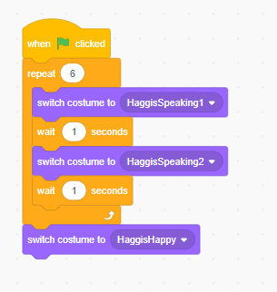
Making the mouth move…
Create code like this.
Change the repeat depending on how many seconds are in your poem code. My code has 12 seconds so I have chosen 6 times.
This will stop with the mouth smiling at the end.

Slide 9
(Extension)
Can you add different characters in your scene who say different poems? Can you add in some Scottish music? Can your characters move?

Slide 10
Plenary Discussion Questions
Why might it be useful to use both the speech bubbles and spoken word?
What did the ‘say’ block do?
What was the most difficult part of creating this project?
What was your favourite part of creating this project?

