Slide 1






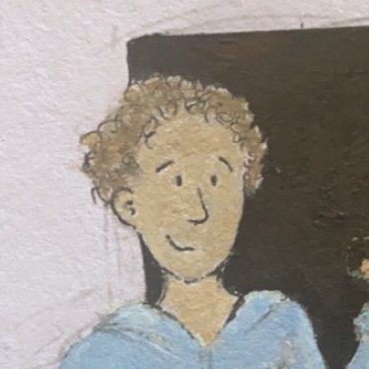
Christmas
micro:bit
Lessons
Coding a Snow Globe
Notes:
This resource can be found on www.mrmorrison.co.uk

Slide 2
Coding a Snow Globe
We are learning to create a snow globe with the micro:bit.
I can identify the accelerometer on the micro:bit and explain its purpose.
I can use the shake and LED blocks in MakeCode to create a snow globe.
I can add extra blocks to my code to improve my snow globe.

Slide 3

Tutorial Video – Part 1

Slide 4
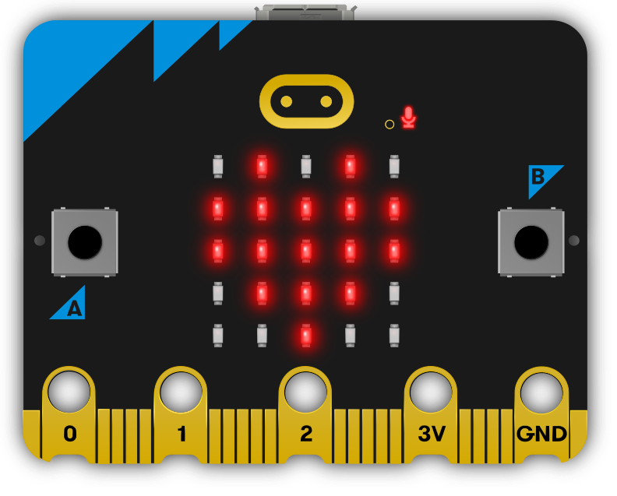
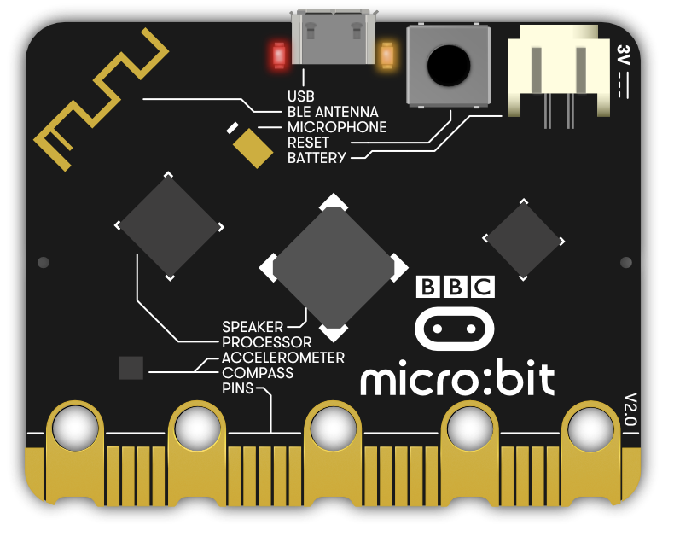
micro:bit inputs

Slide 5
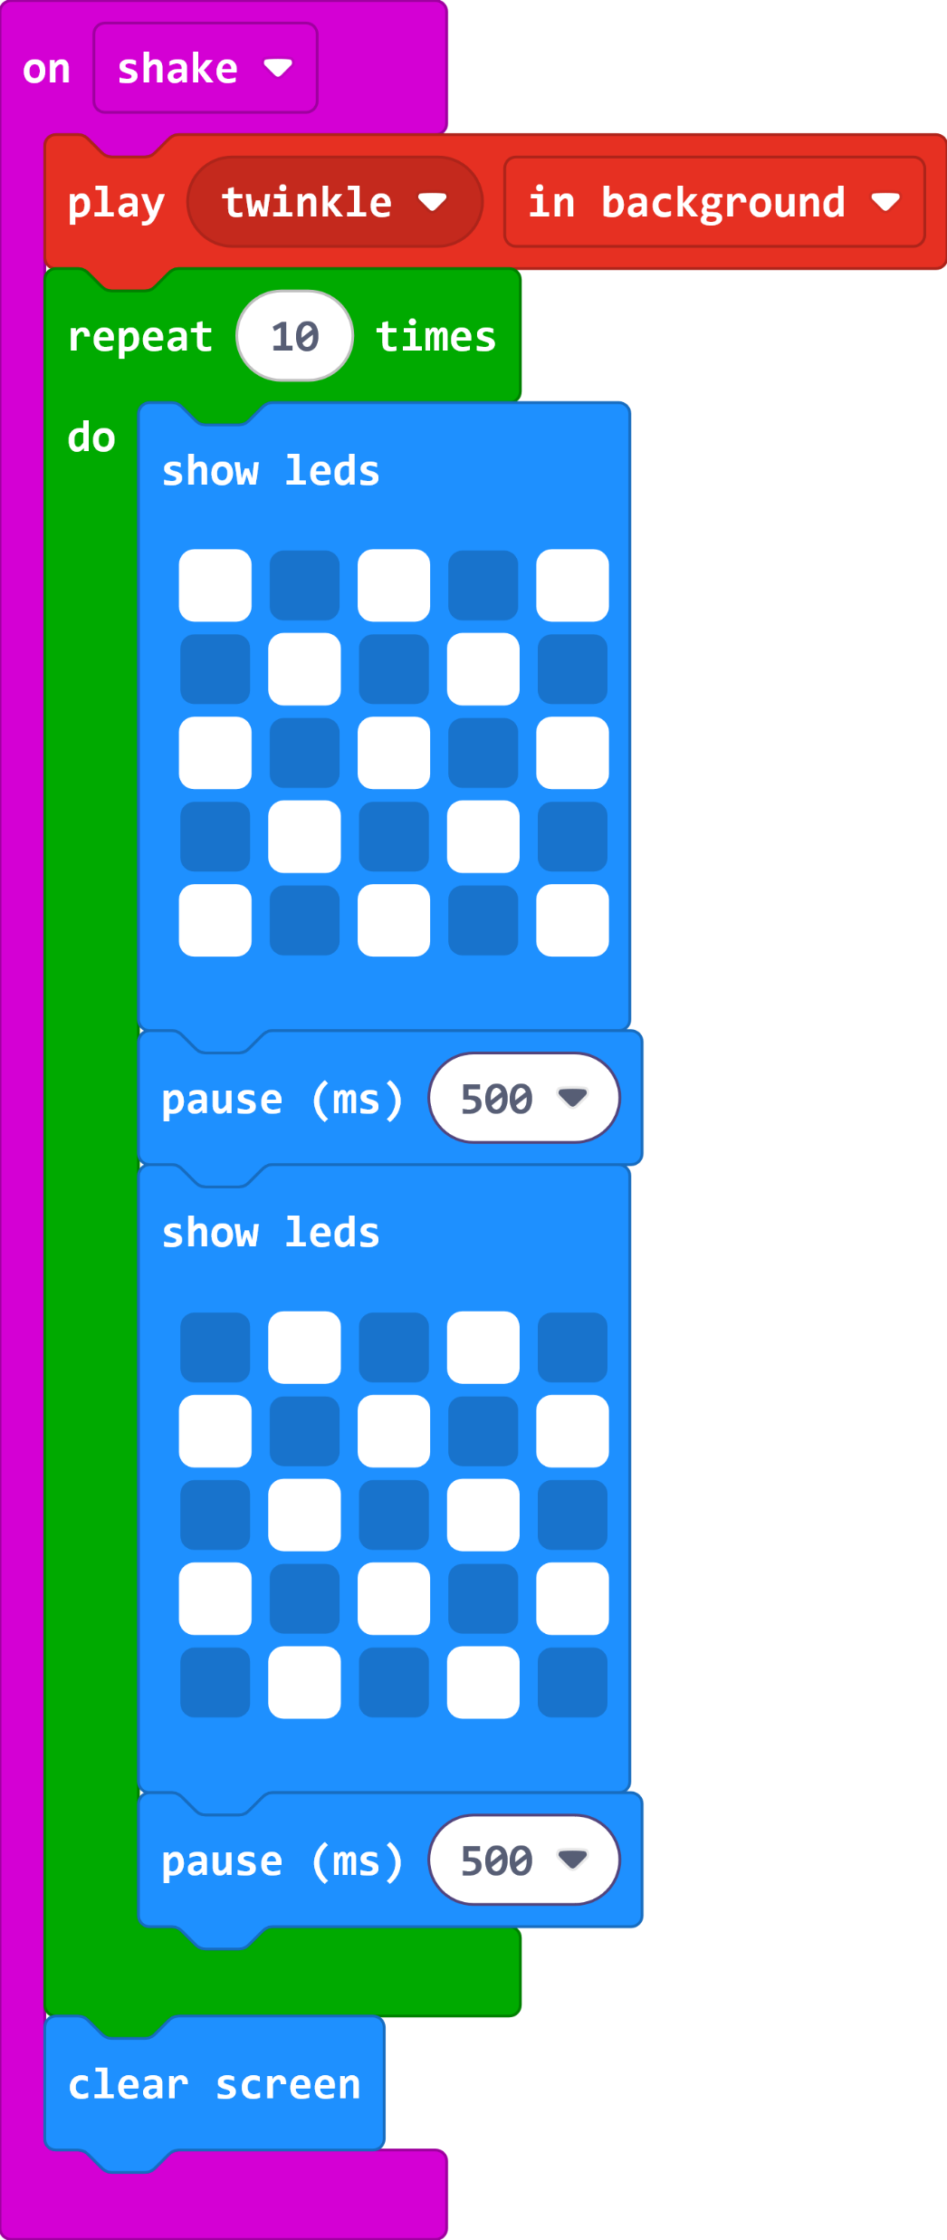
Snow Globe - Simple

Slide 6
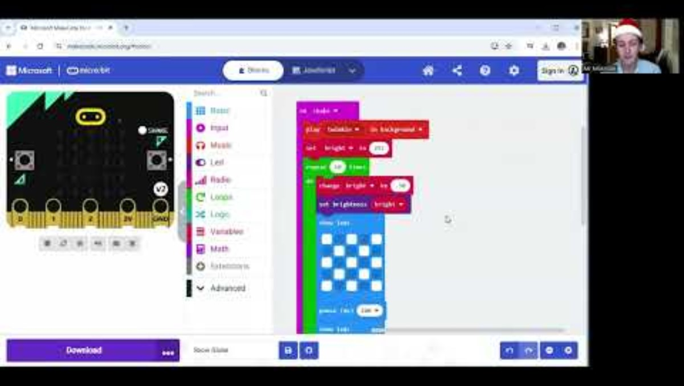
Tutorial Video – Part 2

Slide 7
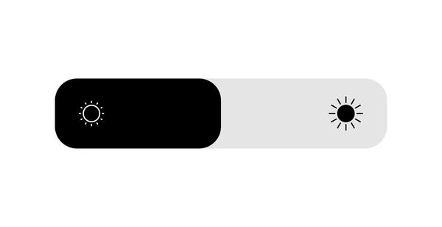
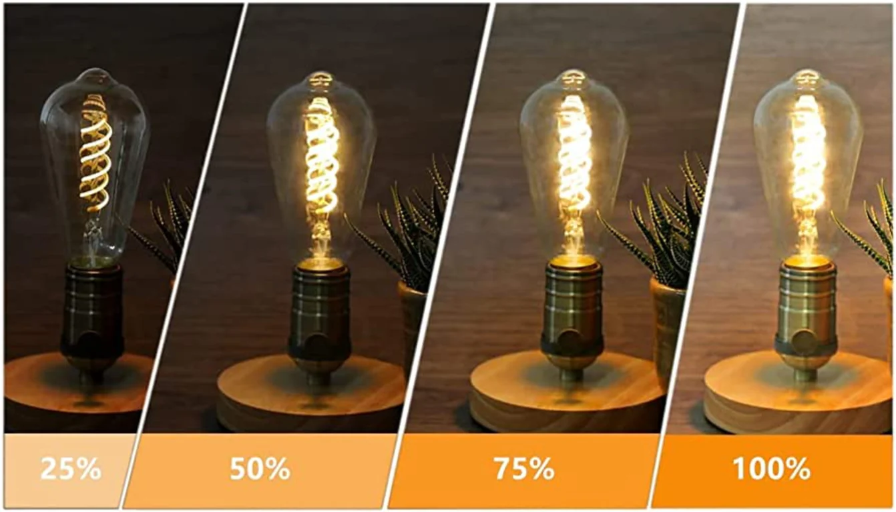
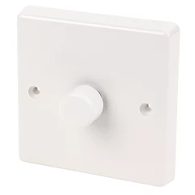
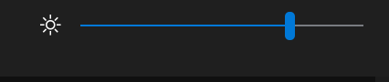
Discussion
What is brightness? Where do you change the brightness of something?

Slide 8
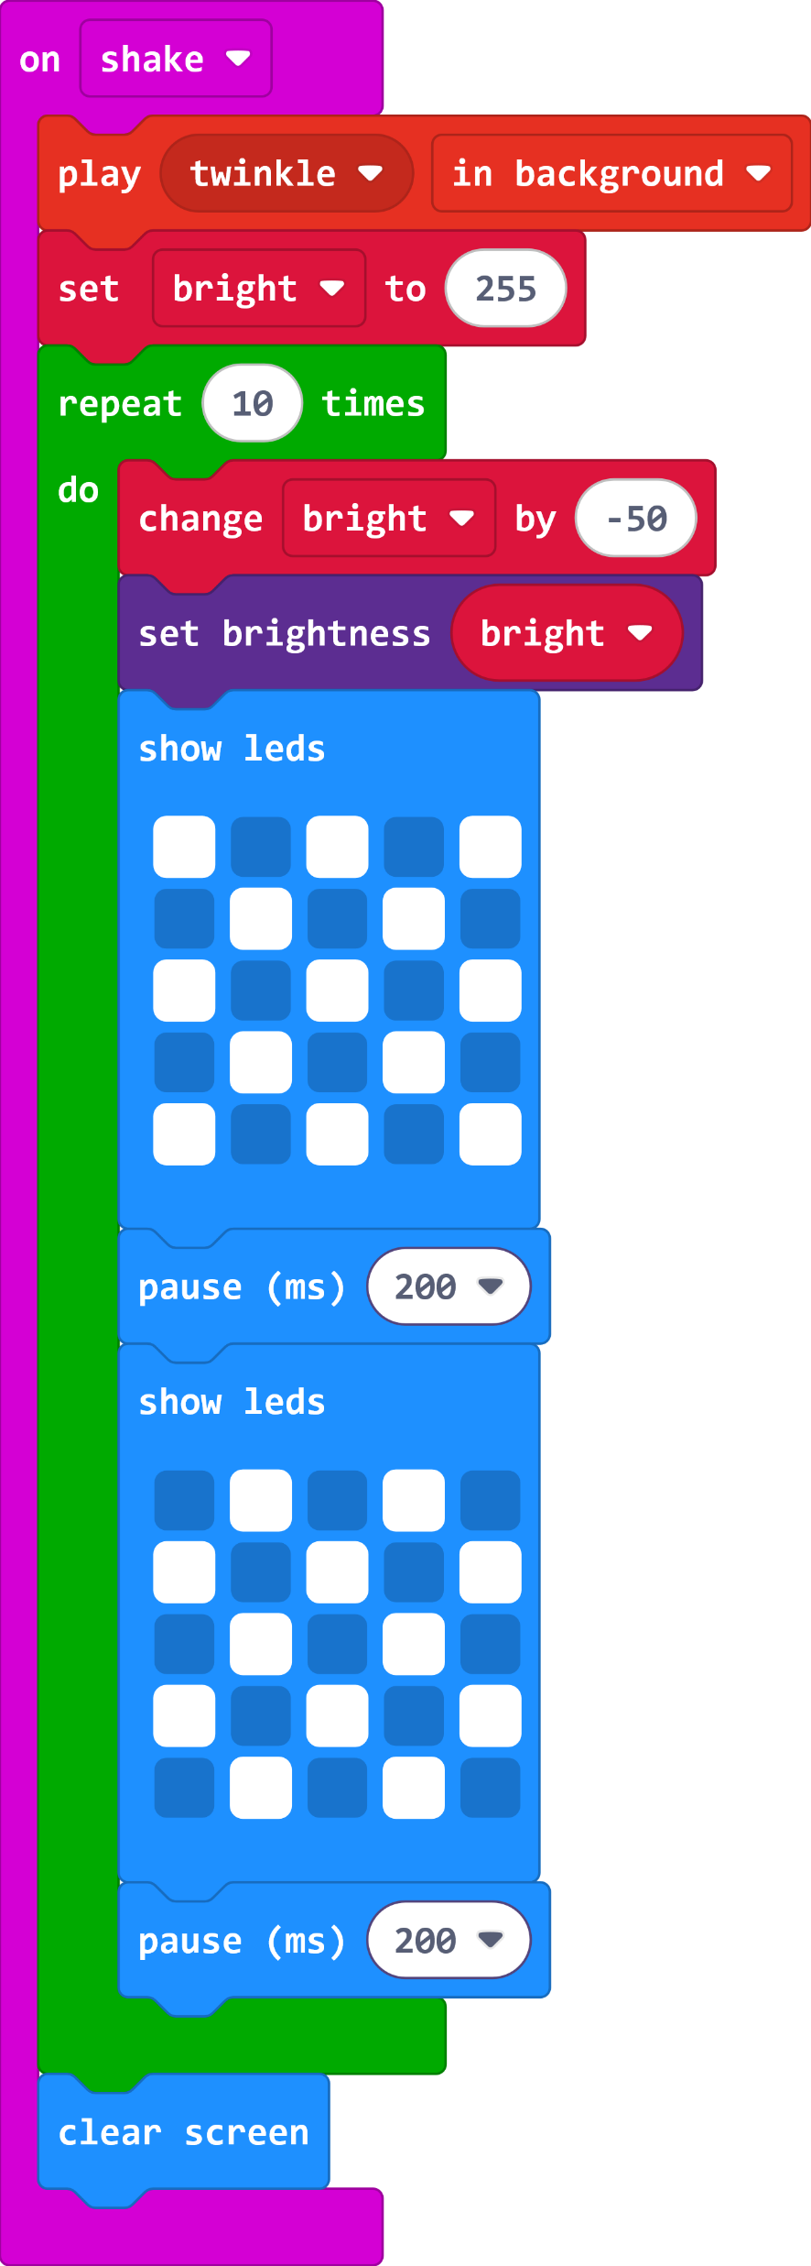
Snow Globe with Fade.
On micro:bit - 0 (darkest) to 255 (brightest)

Slide 9
(Extension)
Can you make changes to the snow to make it more realistic? Can you add a longer sound to your project?

Slide 10
Plenary Discussion Questions
What is the accelerometer used for?
What is the pause block for?
What things do you change brightness on?
How could you improve this project?

Slide 11
Christmas
micro:bit
Lessons
Have a great Christmas!!!

