Slide 1






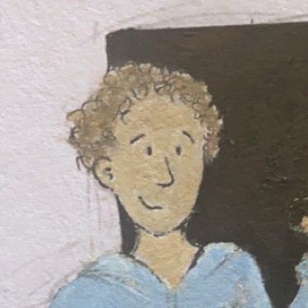
Christmas
micro:bit
Lessons
Coding Christmas Decorations
Notes:
This resource can be found on www.mrmorrison.co.uk

Slide 2
Coding Christmas Decorations
We are learning to create Christmas decorations with the Micro:bit.
I can recognise and use some of the inputs of the micro:bit.
I can understand how to use some of the logic blocks on MakeCode.
I can create a working and creative Christmas decoration using the micro:bit.

Slide 3
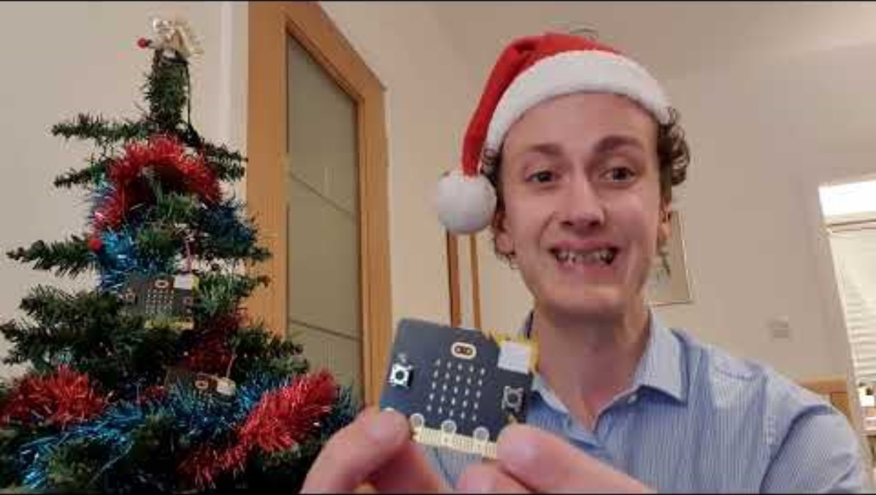
Tutorial Video – Part 1

Slide 4
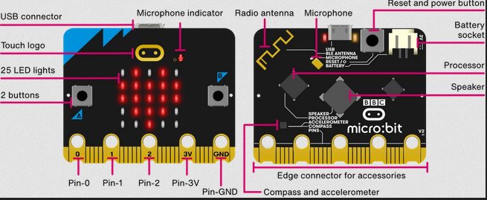
micro:bit inputs

Slide 5
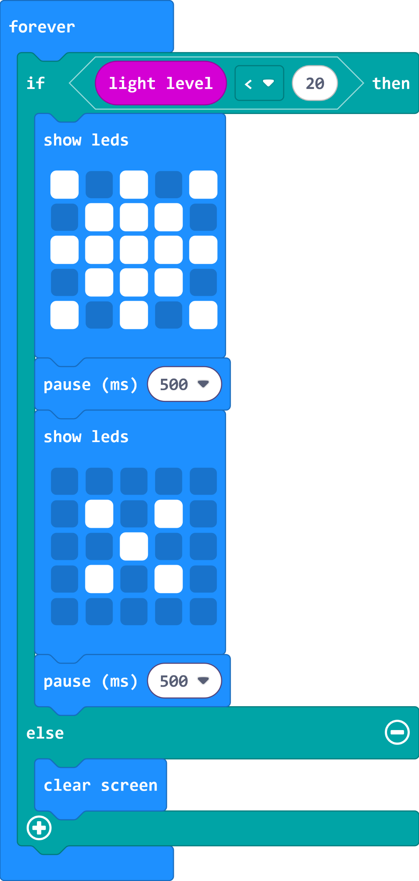


Decoration using light level

Slide 6


Decoration using sound level

Slide 7
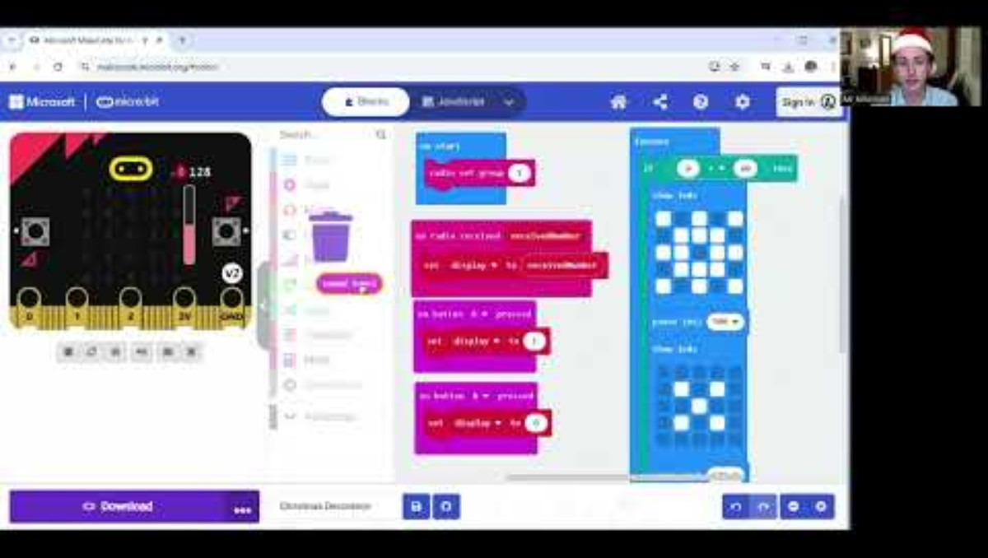
Tutorial Video – Part 2

Slide 8

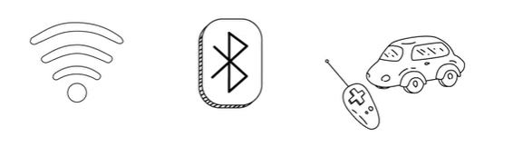
Discussion
Where have you seen remote control used? What devices?

Slide 9
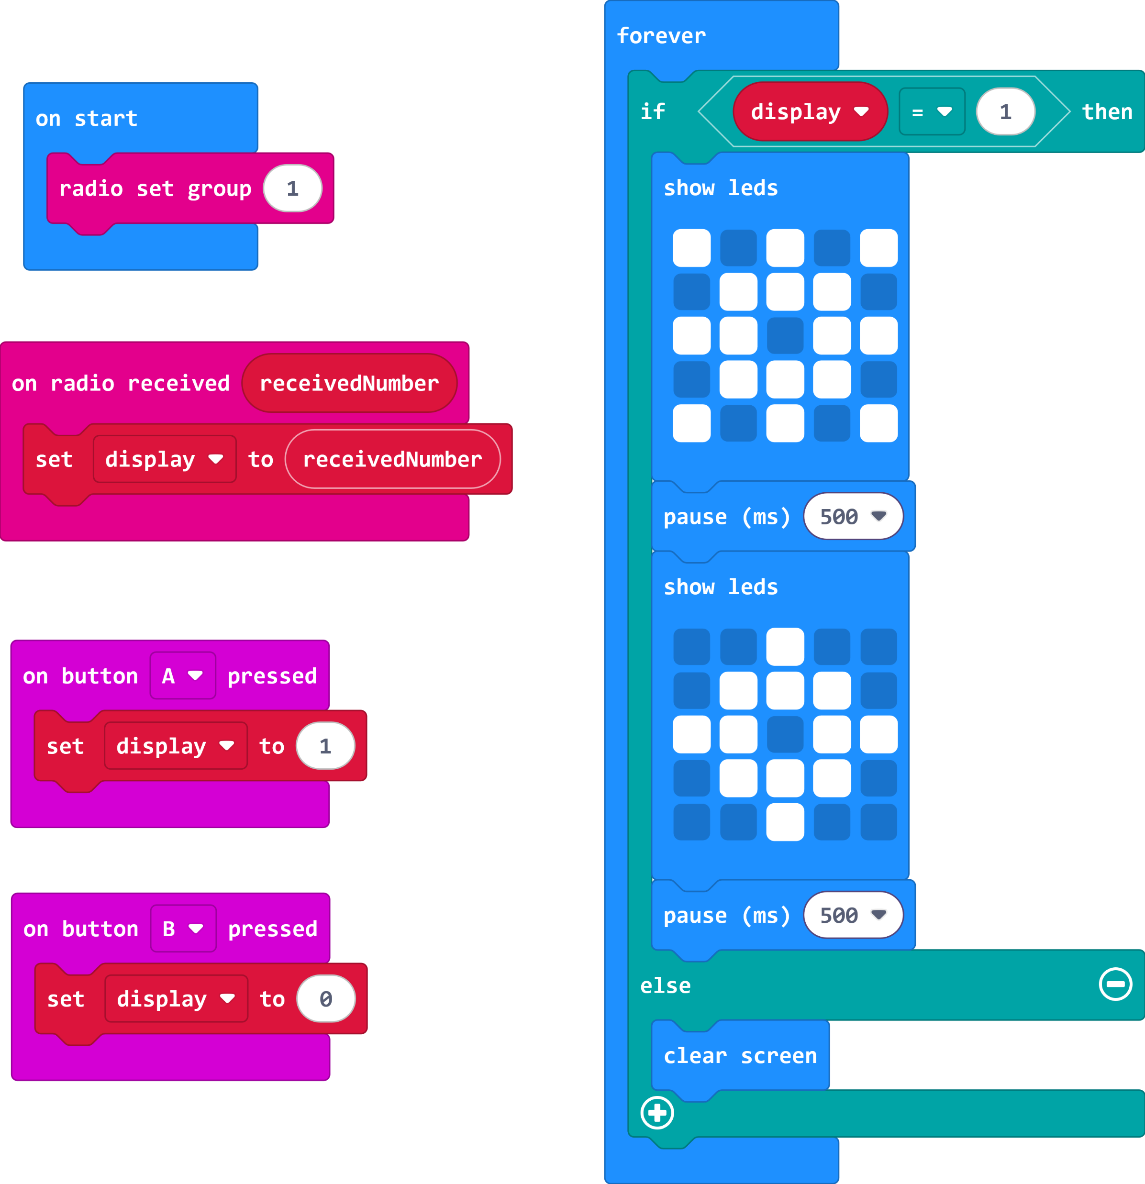
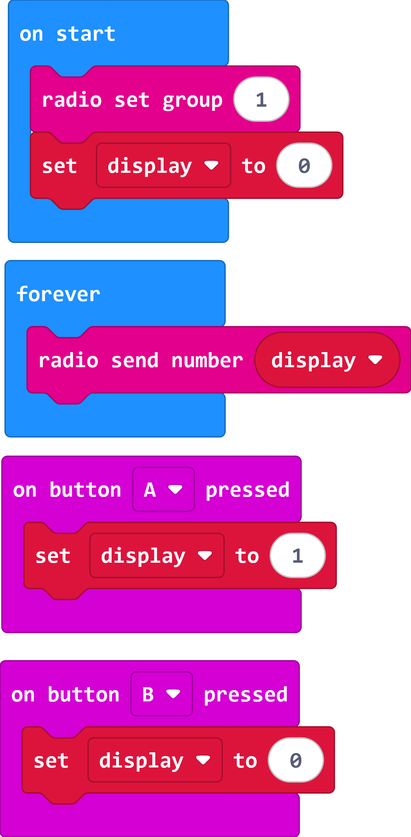
Decoration using radio
Receiver (Decoration)
Transmitter (Remote Control)

Slide 10
(Extension)
Can you create a more complex sequence of pictures for your decoration? Can you add music to your decoration?

Slide 11
Plenary Discussion Questions
What are some inputs of the micro:bit?
What other inputs on the micro:bit could we use turn on the decoration?
What was your favourite way to turn on the decoration?
For what other projects could this radio feature be useful?
How could you improve your decoration?

Slide 12
Christmas
micro:bit
Lessons
Have a great Christmas!!!

