Slide 1







Christmas
Micro:bit
Lessons
Coding Christmas Music

Slide 2

Coding Christmas Music
We are learning to code Christmas Music on the Micro:bit.
I can understand some simple music concepts such as notes names, note lengths and rests.
I can understand how to use the different music blocks on MakeCode.
I can create a well known Christmas Song on the micro:bit using the notes.

Slide 3
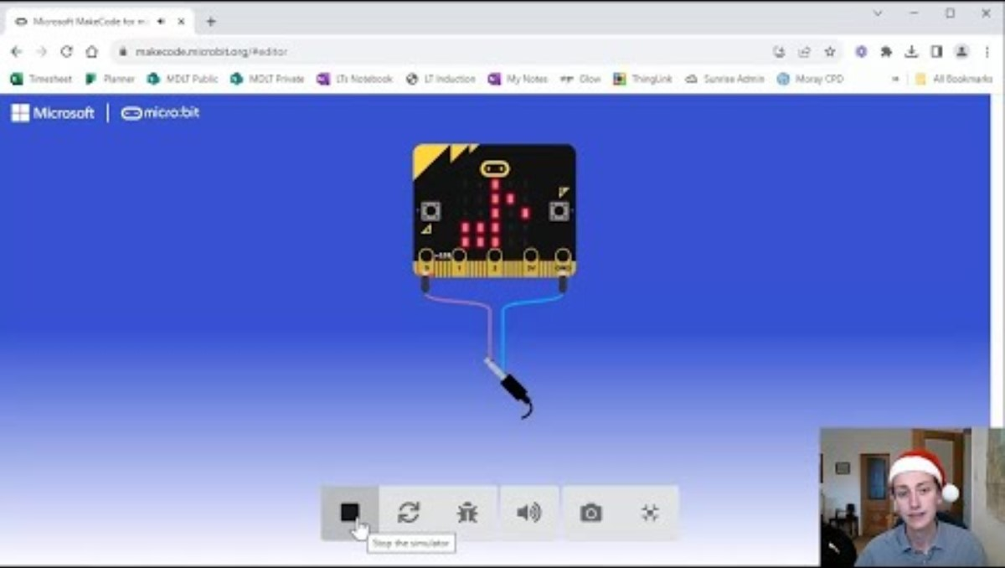
Tutorial Video

Slide 4
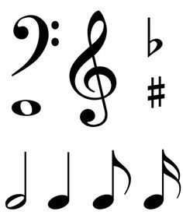
What do these symbols mean?

Slide 5
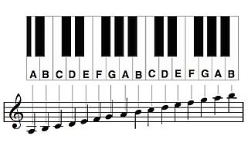
What is music made of?
Low Octave
Middle Octave
High Octave
Notes:
The notes. Letters A-G repeat. All of the same letters sound similar but each is higher than the one before. There are some notes which are ‘sharp’ or ‘flat’ these are the black notes on the piano. They change the key.

Slide 6
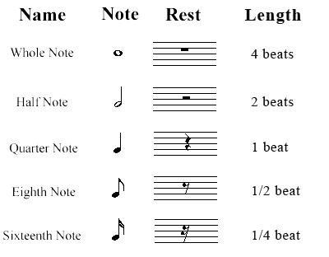
Note Lengths and Rests

Slide 7
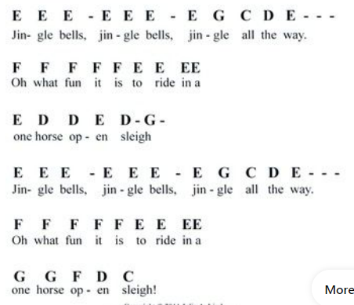
Jingle Bells Music

Slide 8
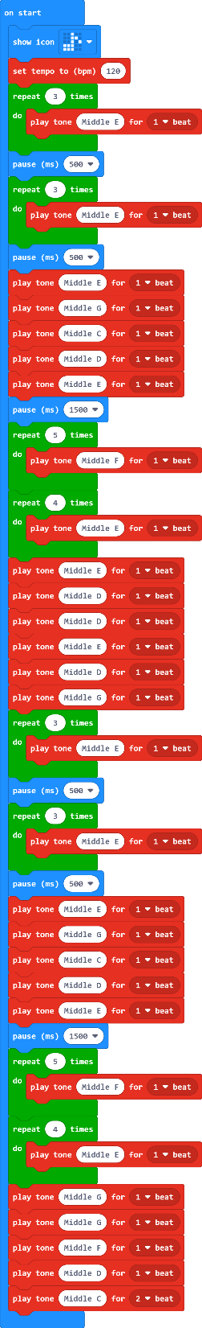
Jingle Bells Code

Slide 9
EASIER
Christmas Songs to Try

Slide 10
We Wish You A Merry Christmas
D G G A G-F# E - E
We wish you a Merry Christmas,
E A A B A-G F# - D
We wish you a Merry Christmas,
D B B ^C B-A G - E D D E - A F# G
We wish you a Merry Christmas and a Happy New Year!
D G - G G F# F# G F# E D
Good tidings we bring to you and your kin;
A B - A G ^D - ^D E E E - A F# G
Good tidings for Christmas and a Happy New Year!
This means it is a high D on the keyboard input.

Slide 11
All I Want for Christmas is You
.G .B D F# G F# E - D
I don't want a lot for Christmas
A G G F# G F# E-D
There is just one thing I need
C E G A-Bb A G-E
I don't care about the presents
C - D# - G A Bb - A F-D#
Underneath the Christmas tree
G A F# G E F# E-D#
I just want you for my own
B A G F# E-F# E-D#
More than you could ever know
D E G ^D ^C
Make my wish come true
B A G E D# - A B A-G
All I want for Christmas is you!

Slide 12
Silent Night
G - AG E G-AG E
Silent night, Holy night
^D ^D B ^C ^C G
All is calm, all is bright...
A A ^C-BA G - A G E
Round yon virgin, mother and child
A - A ^C-B A G -A G E
Holy infant so tender and mild
^D ^D ^F-^D- B ^C-^E
Sleep in heavenly peace,
^C-G E G-F-D C
Sleep in heavenly peace....

Slide 13
HARDER
Christmas Songs to Try

Slide 14
Twelve Days of Christmas
C C C - C F F F - E
On the first day of Christmas
F G A Bb G A
My true love gave to me
Bb ^C-^D-Bb A F G F
A partridge in a pear tree!
C C C - C F F F - E
On the second day of Christmas
F G A Bb G A
My true love gave to me
^C G - A Bb
Two turtle doves
A Bb ^C-^D-Bb A F G F
And a partridge in a pear tree!
C C C F F F - E
On the third day of Christmas
F G A Bb G A
My true love gave to me
^C G - A Bb
Three French hens
^C G - A Bb
Two turtle doves
A Bb ^C-^D-Bb A F G F
And a partridge in a pear tree!
A new line with these notes is added for each day.

Slide 15
Twelve Days of Christmas
D G G A G-F# E - E
We wish you a Merry Christmas,
E A A B A-G F# - D
We wish you a Merry Christmas,
D B B ^C B-A G - E D D E - A F# G
We wish you a Merry Christmas and a Happy New Year!
D G - G G F# F# G F# E D
Good tidings we bring to you and your kin;
A B - A G ^D - ^D E E E - A F# G
Good tidings for Christmas and a Happy New Year!
This means it is a high D on the keyboard input.

Slide 16
Rudolph the Red Nose Reindeer
G - A G E - ^C A - G
Rudolph, the red-nosed reindeer
G A G-A G-^C B
Had a very shiny nose
F G F D-B A G
And if you ever saw him,
G A G-A G A E
You would even say it glows!
G A G E-^C A - G
All of the other reindeer
G A G A G ^C B
Used to laugh and call him names
F G - F D B A - G
They never let poor Rudolph
G A G-A G -^D ^C
Play in any reindeer games.
A A ^C-A G - E G
Then one foggy Christmas Eve
F - A G F E
Santa came to say
D - D G A B B B
"Rudolph with your nose so bright
^C ^C B A G F - D
Won't you guide my sleigh tonight?"
G A G E - ^C A G
Then all the reindeer loved him
G A G - A G ^C B
As they shouted out with glee,
F - G F D - B A - G
"Rudolph the red-nosed reindeer
G A G A G - ^D-^C
You'll go down in history!"

Slide 17
Frosty the Snowman
G - E F G - ^C B ^C ^D-^C B-A G
Frosty the snowman was a jolly happy soul
B ^C ^D-^C B A A G-^C E
With a corncob pipe and a button nose
E A G F E D G
And two eyes made out of coal!
G - E F G -^C B ^C ^D-^C-B A G
Frosty the snowman is a fairytale they say
B ^C ^D ^C B A A G - ^C E
He was made of snow but the children know
E A G F E D C
How he came to life one day
E G G ^C ^C B-G G E
There must have been some magic in that
E A G F E
Old silk hat they found
E D D G G B B ^D
For when they placed it on his head
B ^C-^D ^C B A - G
He began to dance around!
G - E F G - ^C
Frosty the snowman
B ^C-^D ^C B A G
Was alive as he could be
B ^C ^D ^C B A A G ^C E
And the kids all say he could laugh and play
E A G F E D C
Just the same as you and me!

Slide 18
(Extension)
Can you create your own piece of Christmas music? Think about the features and play about with using different notes and lengths.

Slide 19
Plenary Discussion Questions
What letters can a note be?
What is the pause block used to represent?
Why do we use the repeat block in our code?
What is the main block that we used in our code?
Why do you think our music sounds ‘robotic’, what could a human do differently when they play?

Slide 20
Christmas
Micro:bit
Lessons
Have a great Christmas!!!

