Slide 1
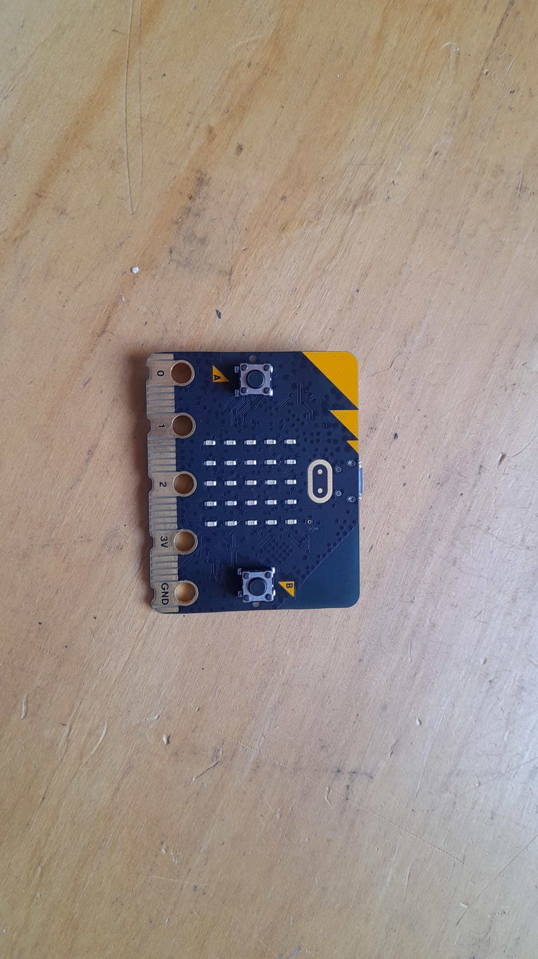
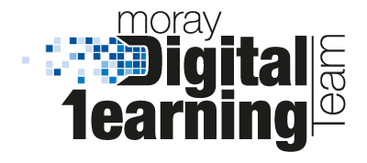
Micro:bit
Data and Sustainability
Lesson 1 – What is Data?

Slide 2
Lesson 1: What is Data?
We are learning to record and analyse data using the micro:bit
I can explain what data is and give examples.
I can measure light, temperature and sound using a micro:bit.
I can analyse the data a micro:bit outputs over time.

Slide 3
What is data?

Slide 4

Video 1

Slide 5

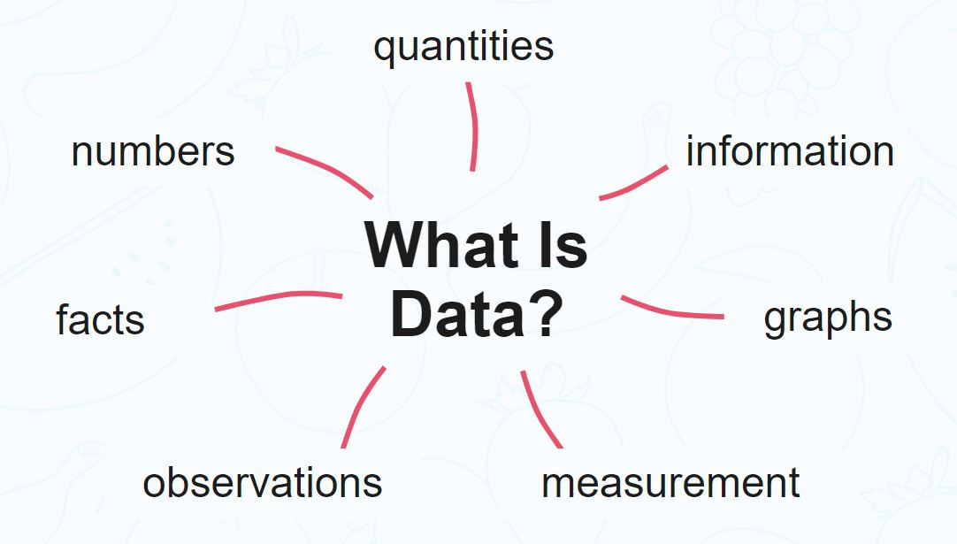
What is data?
Data is a collection of information gathered by observation, questioning or measurement.
Data is often organised in graphs or charts for analysis and may include facts, numbers or measurements.

Slide 6
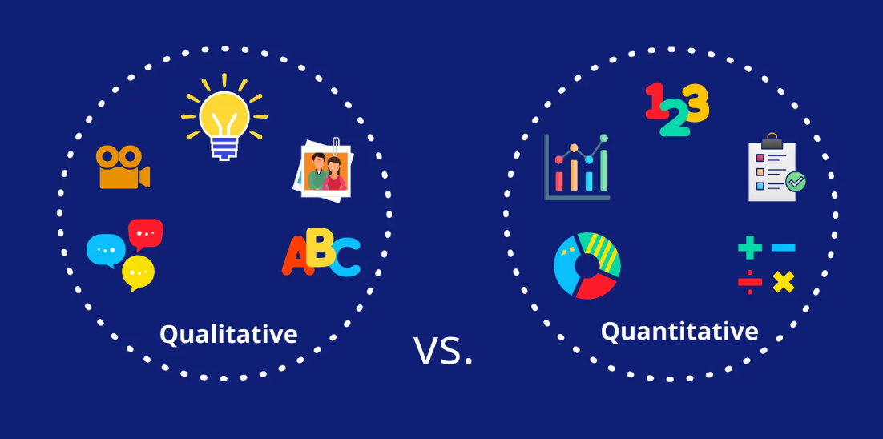
Qualitative vs. Quantitative?

Slide 7
Write down or draw as many different things that could be recorded as data …
(e.g. temperature, light level, number of children in a class…)

Slide 8
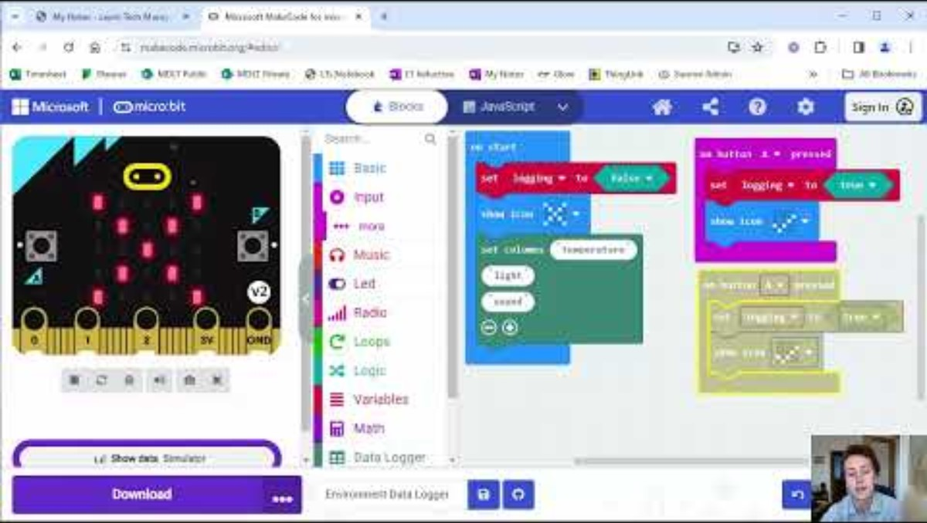
Video 2

Slide 9
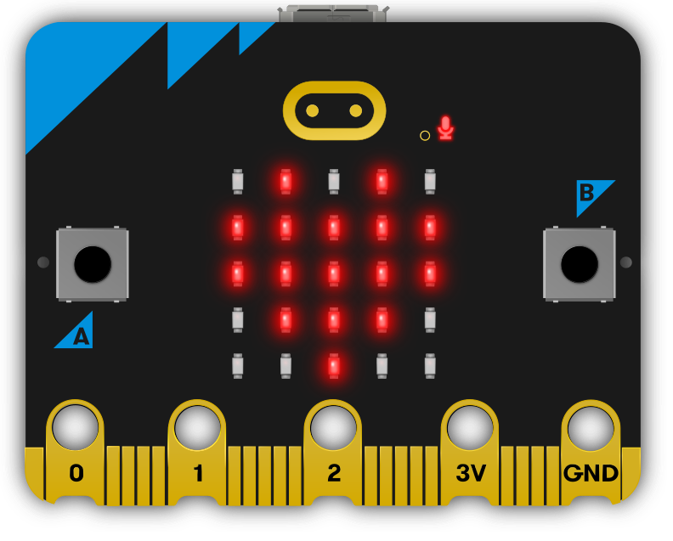
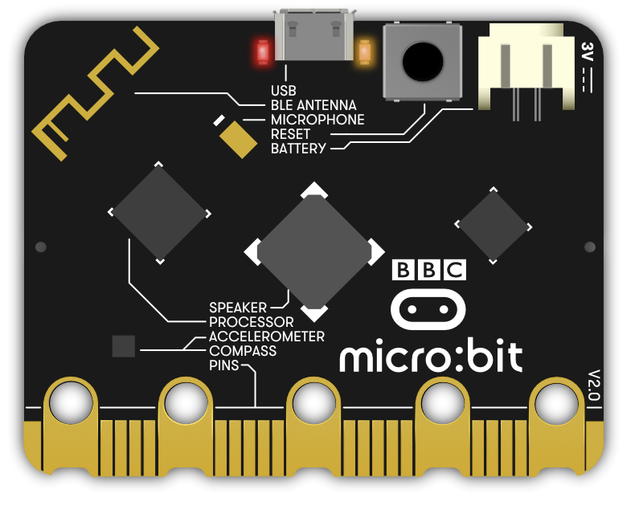
Where are the light, temperature and sound sensors?

Slide 10
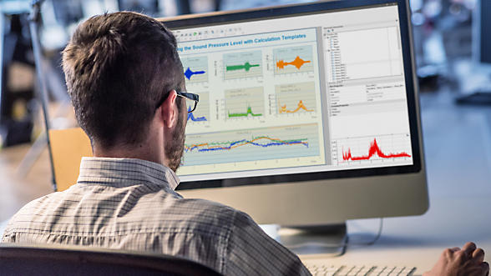
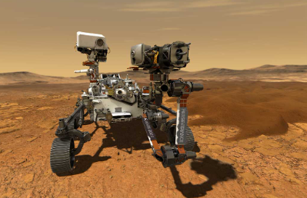
What is data logging?
Data logging is the process of capturing, storing and displaying one or more datasets to analyse activity, identify trends and help predict future events.
In our case we are recording the changes over time.

Slide 11
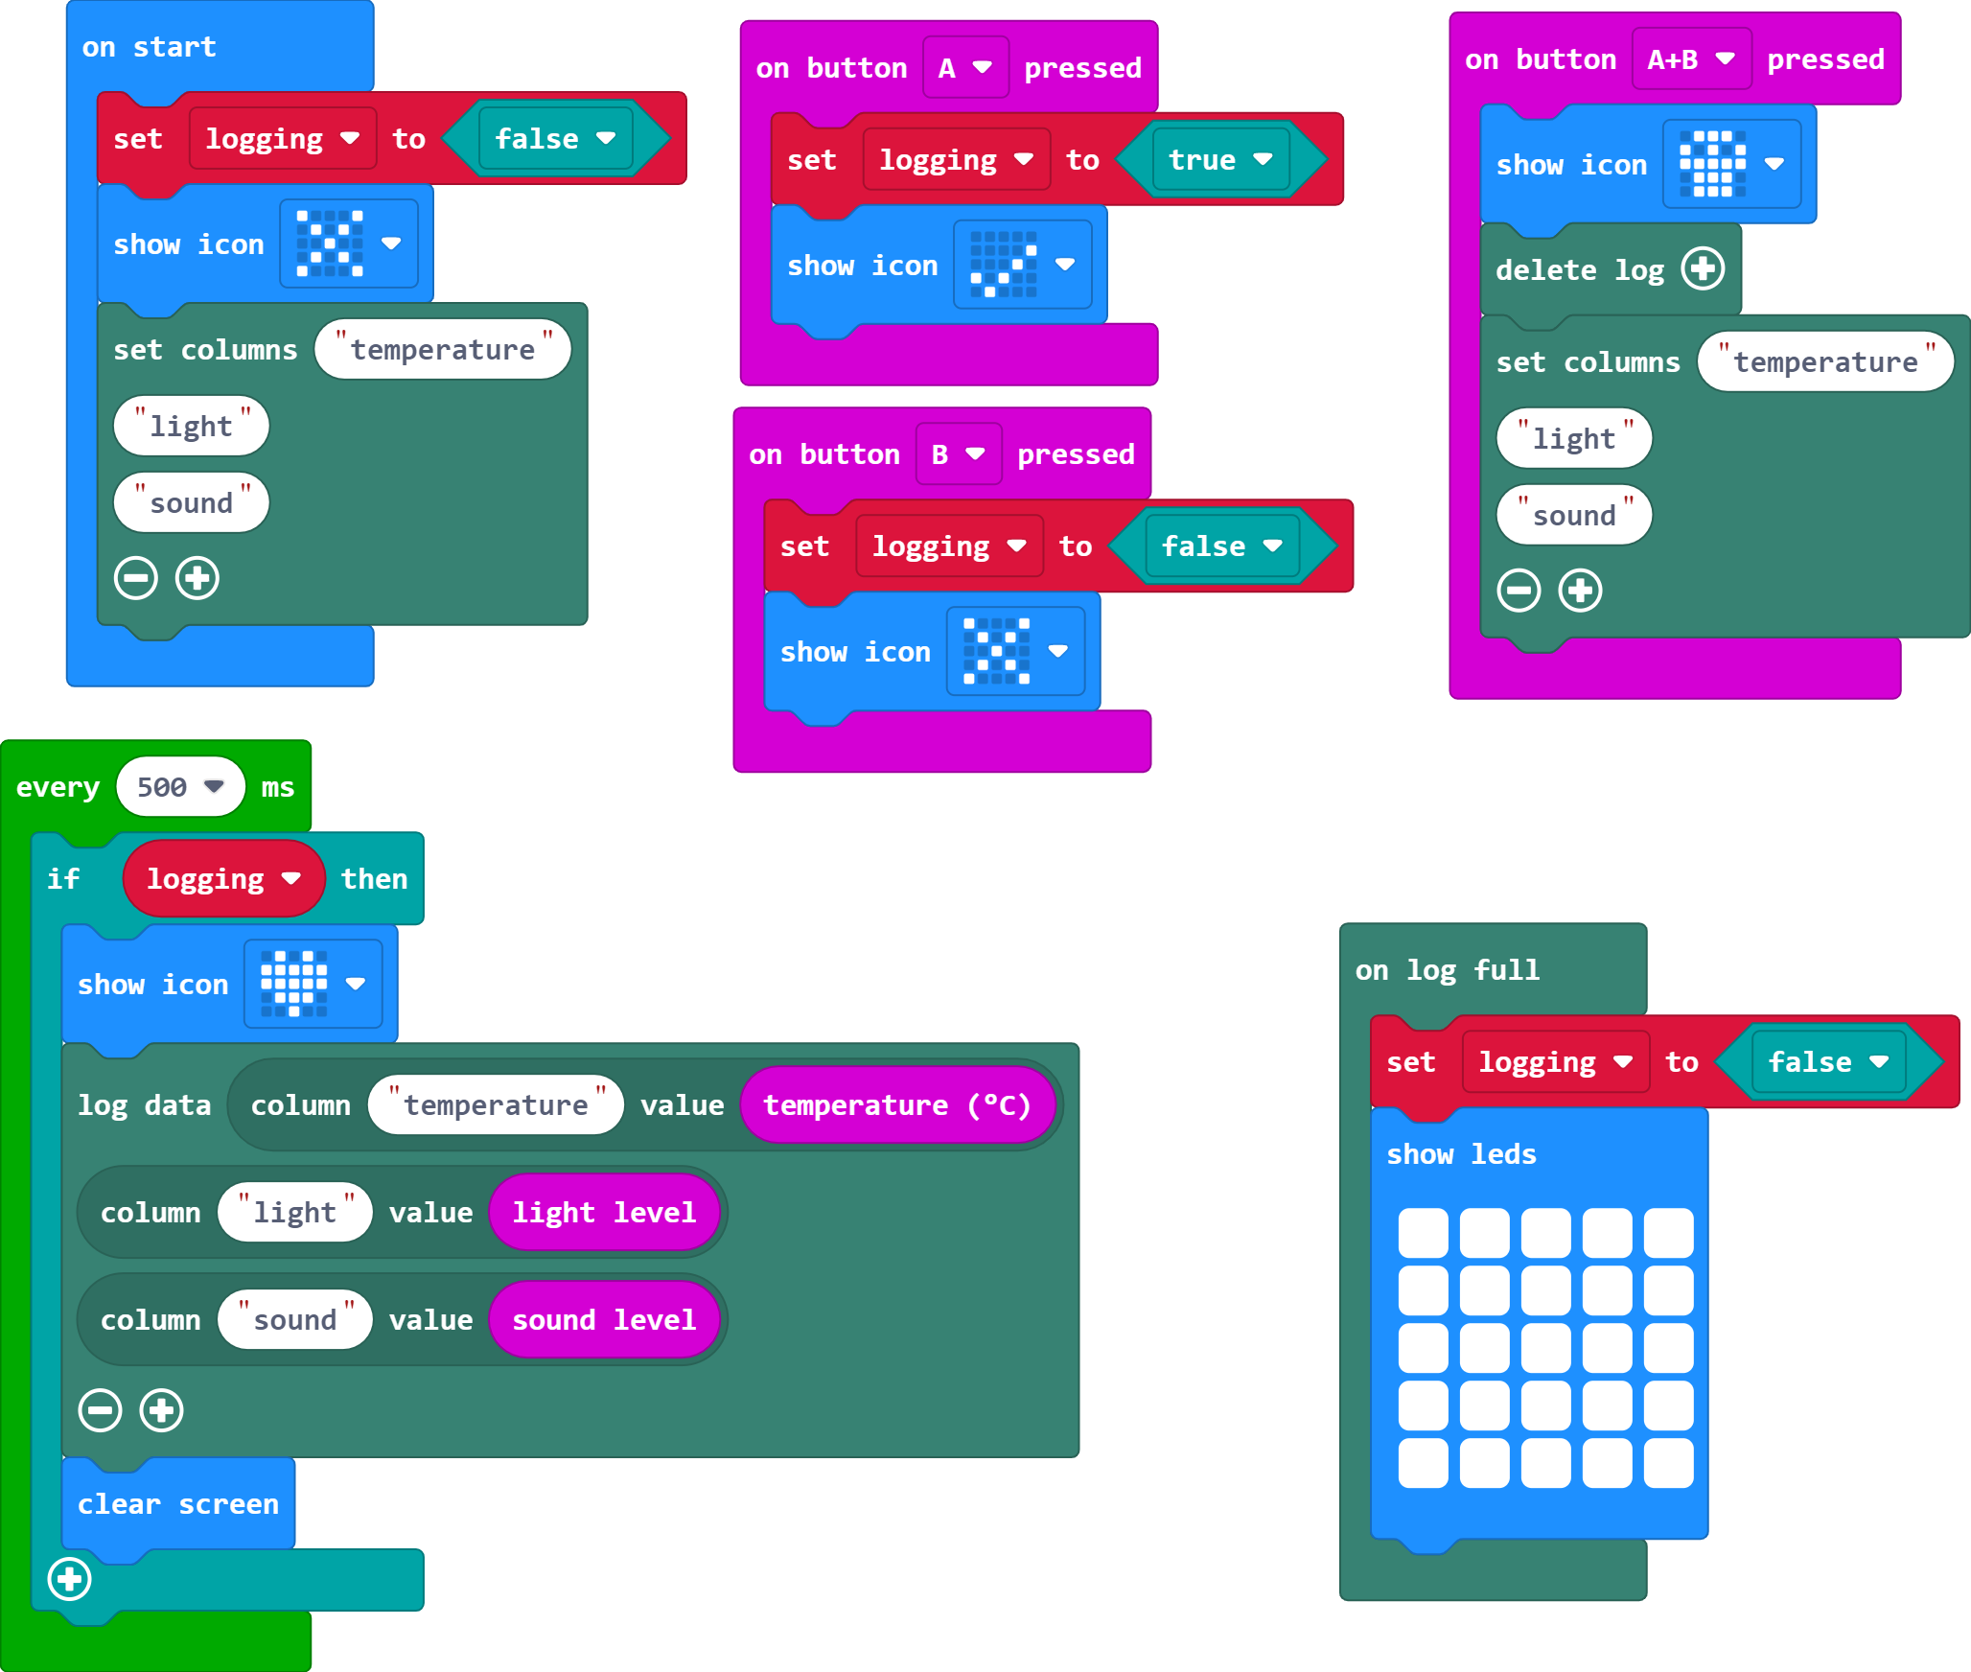
makecode.microbit.org

Slide 12
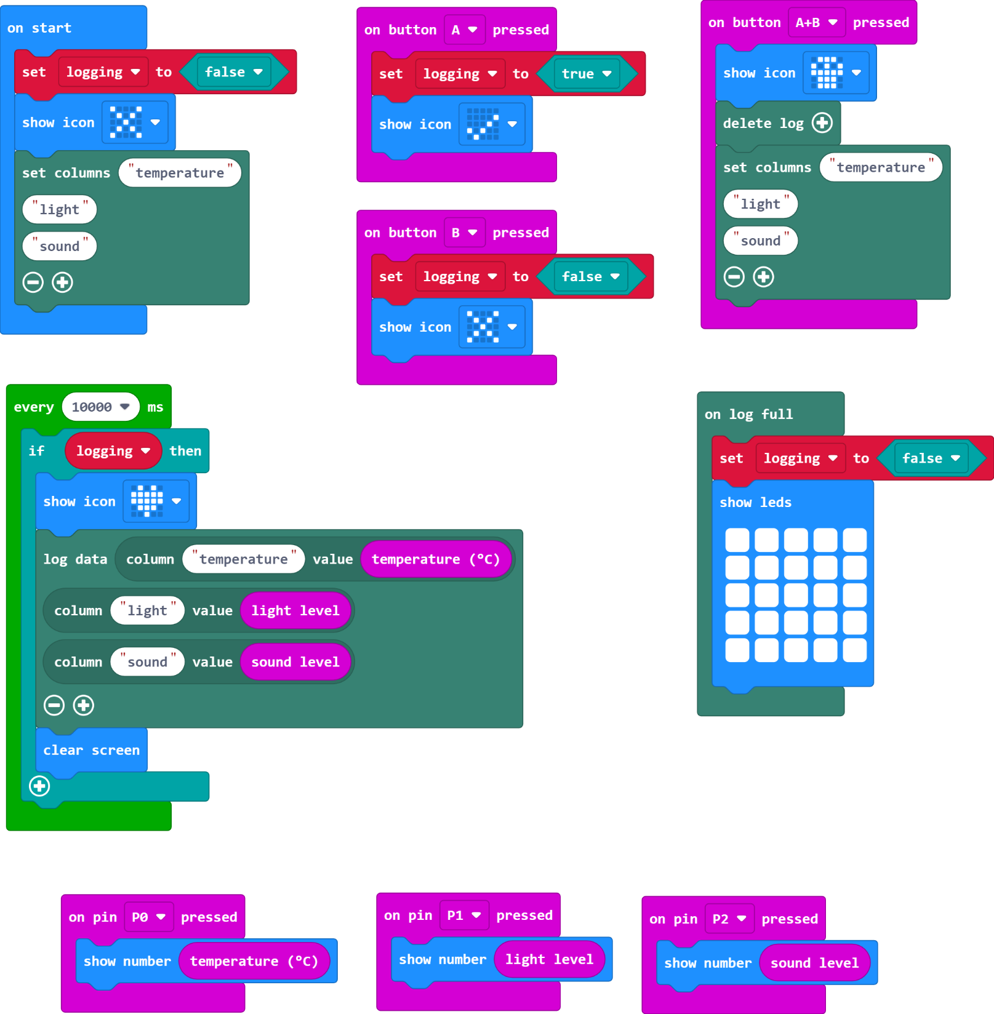
makecode.microbit.org

Slide 13
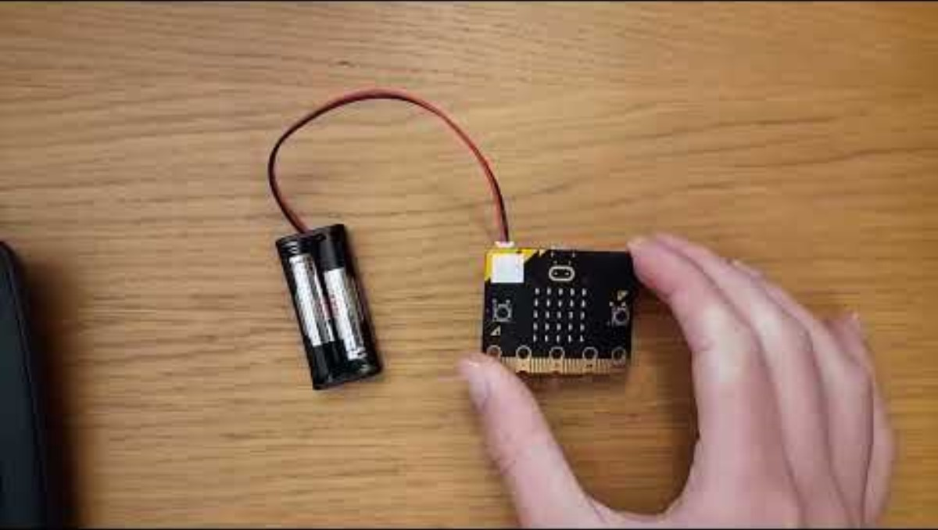
Video 3

Slide 14
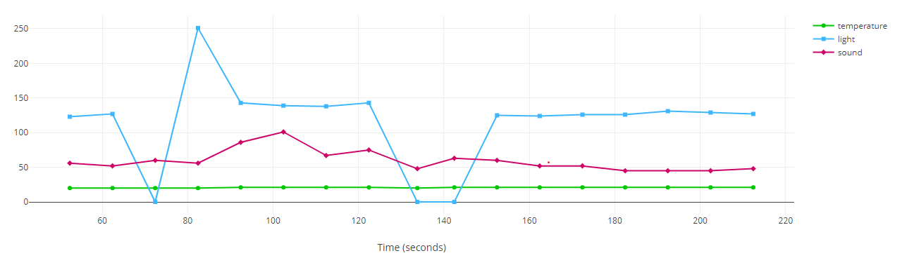
The Results

Slide 15
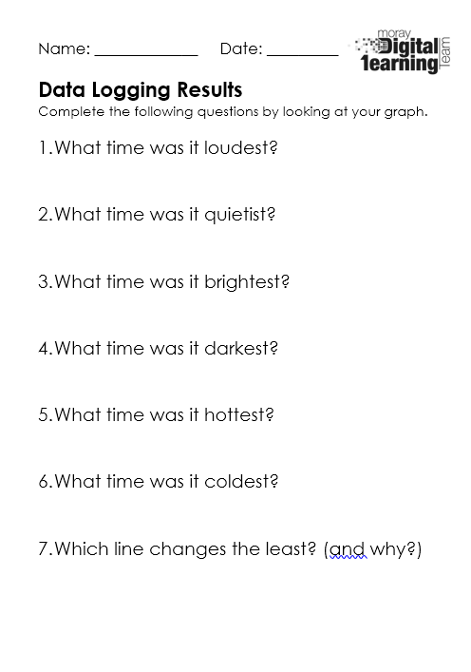
Complete the worksheet

Slide 16
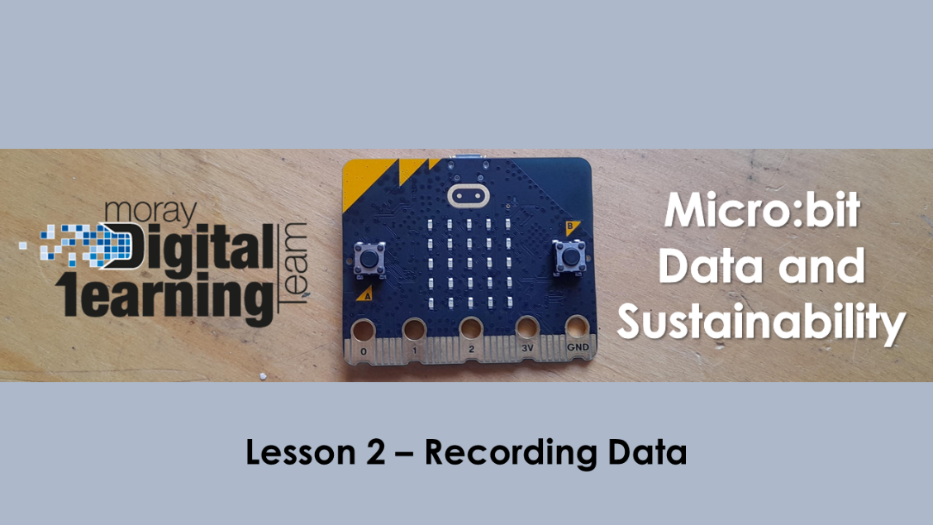
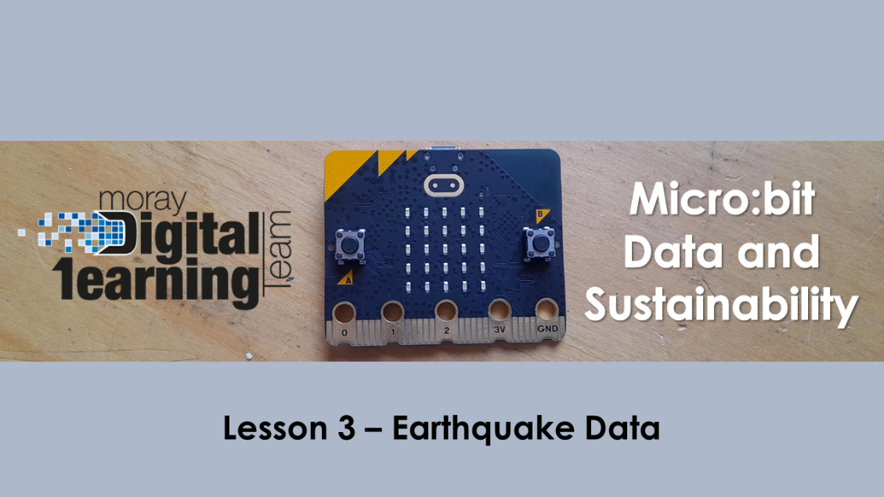

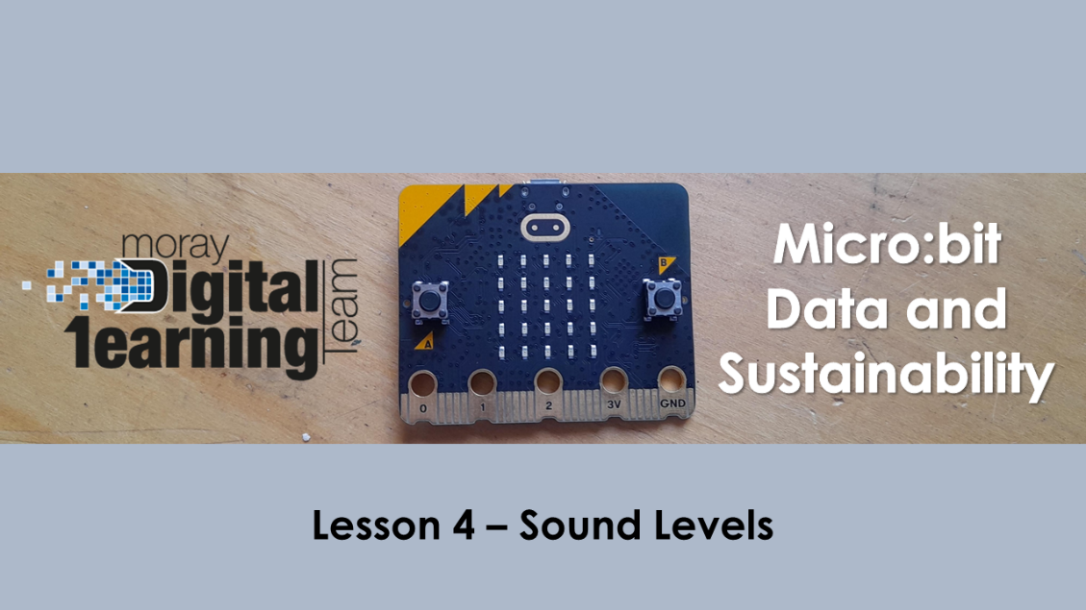
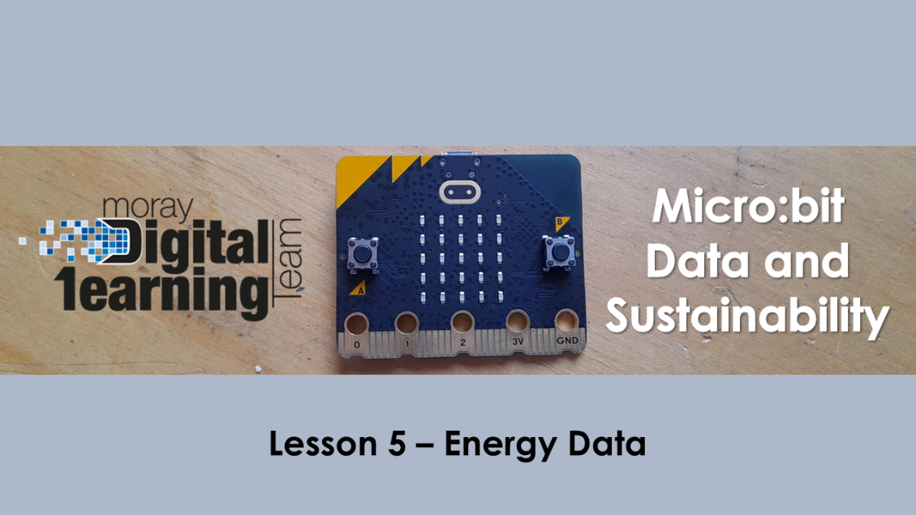
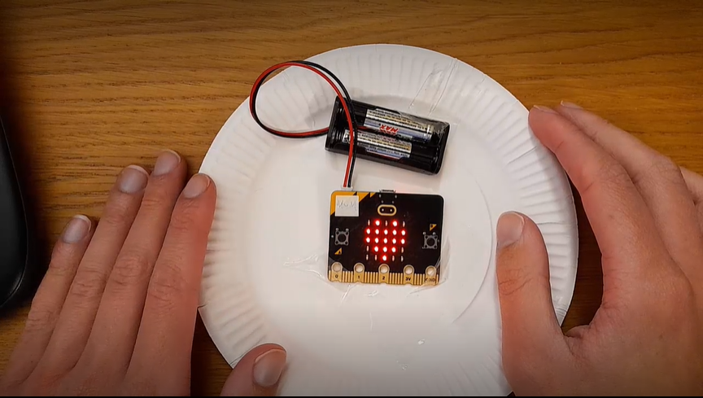
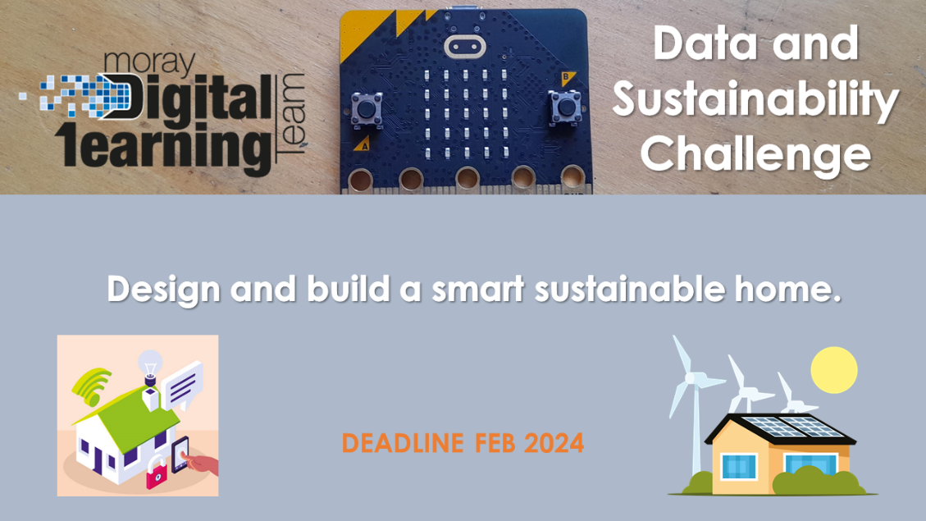
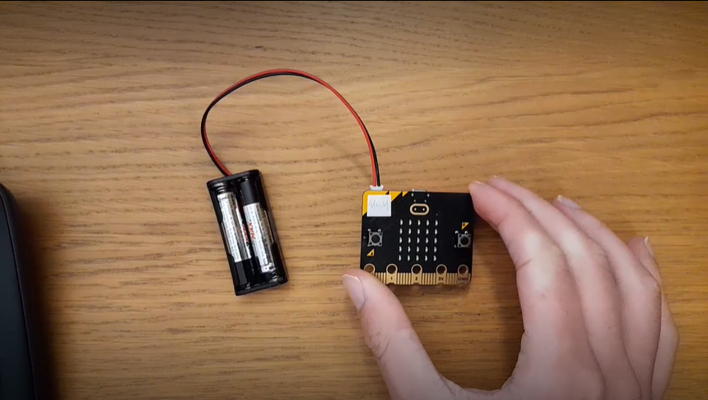
Next Lessons…

Slide 17
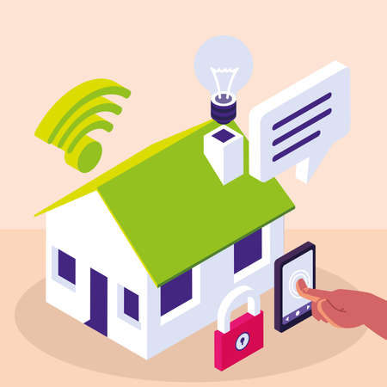
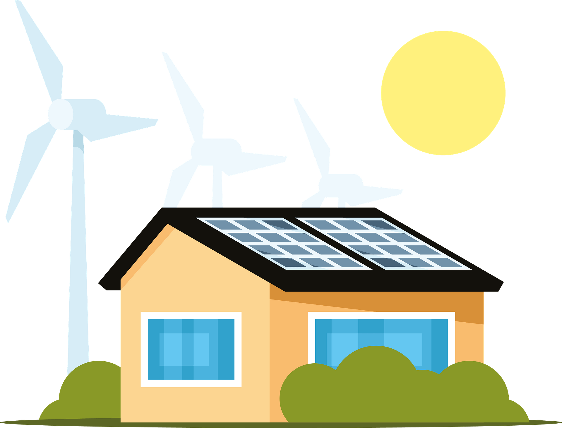
Data and Sustainability
Challenge
Design and build a smart sustainable home.
DEADLINE FEB 2024

Slide 18
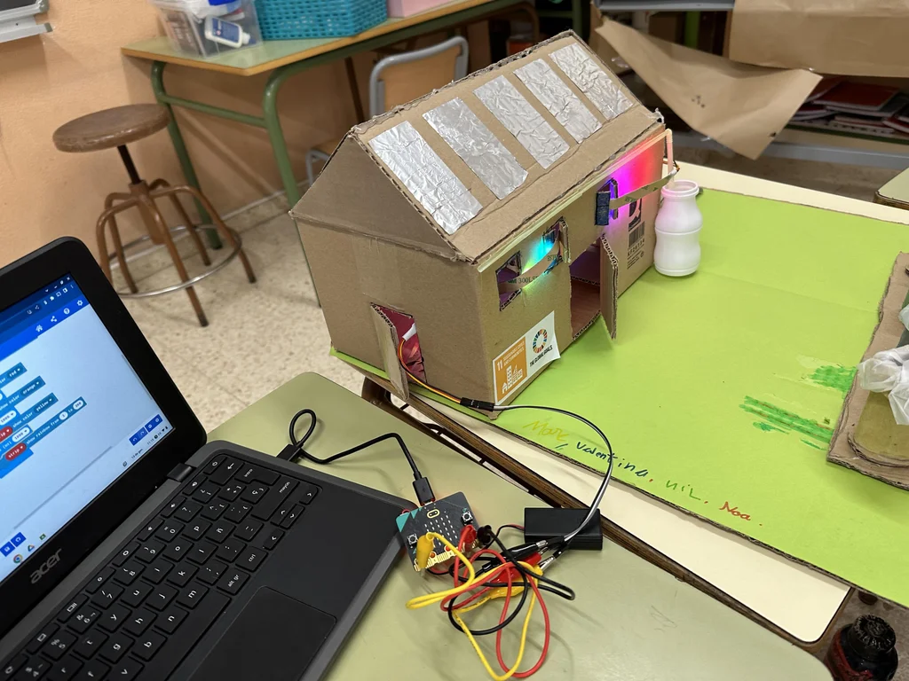
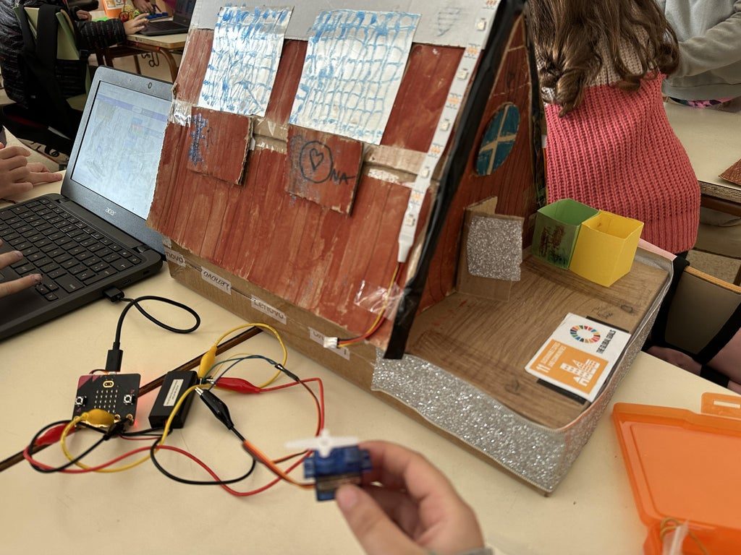
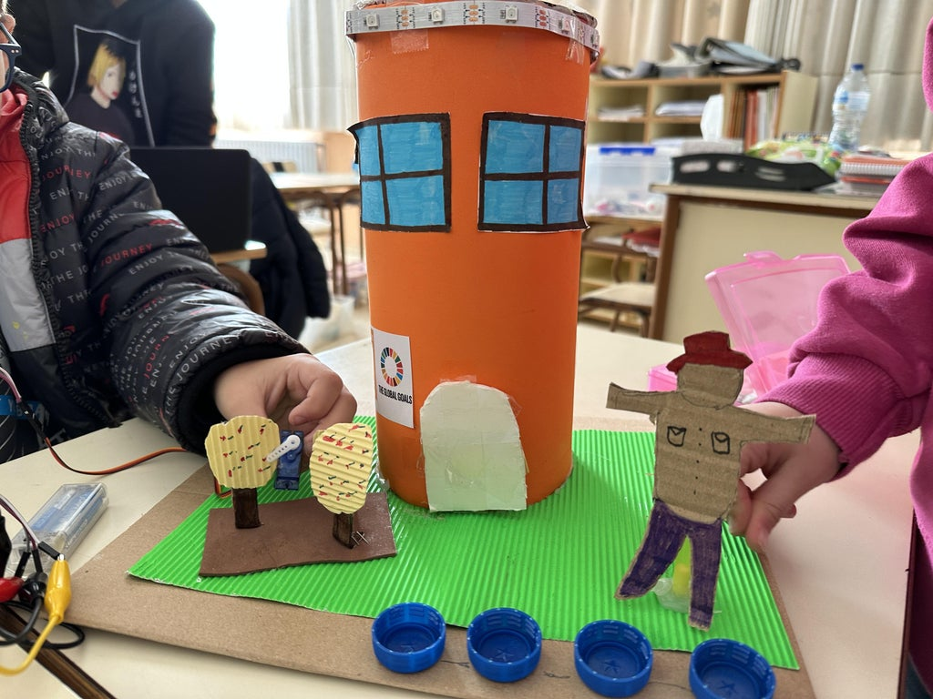
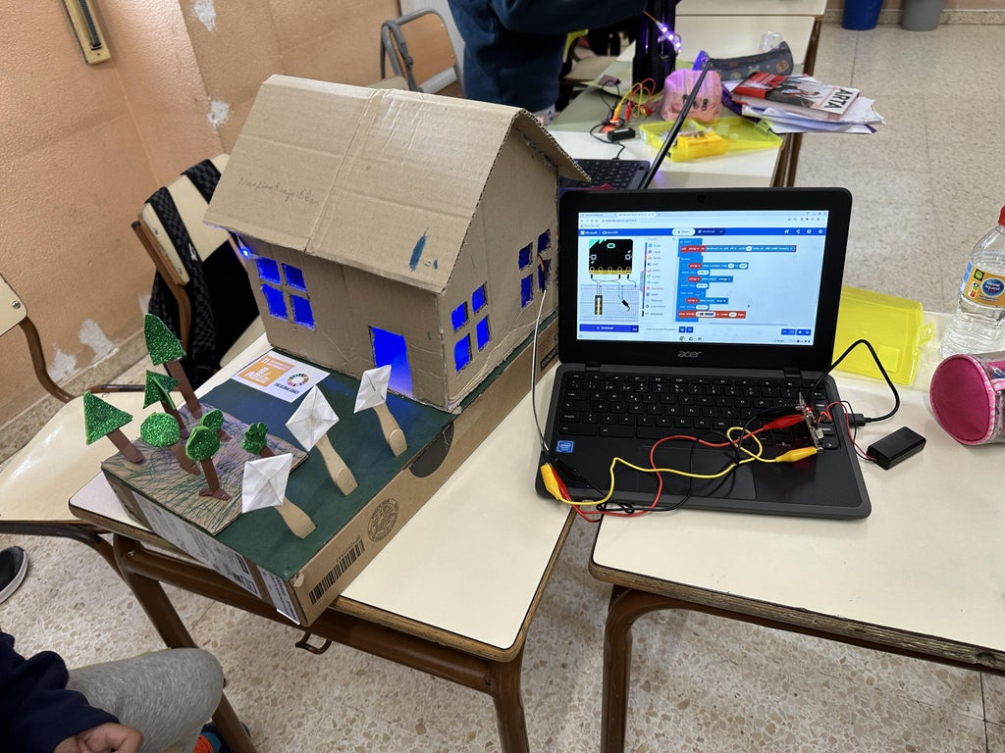
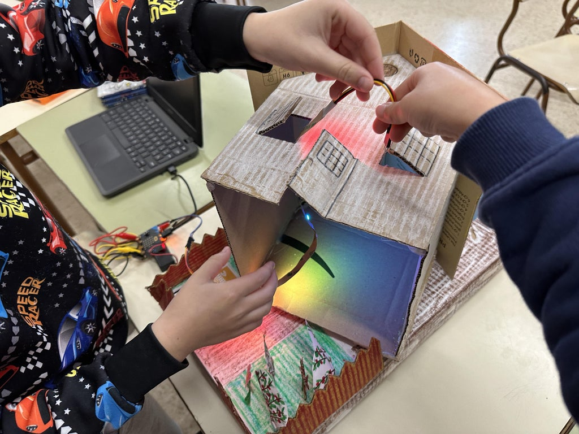
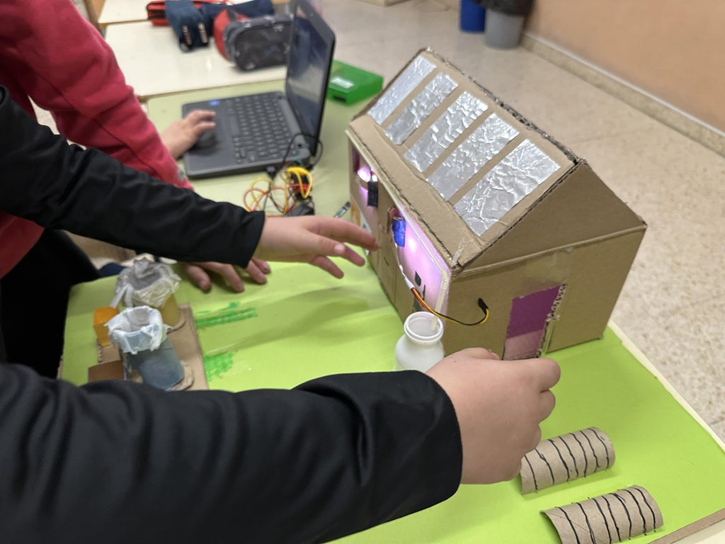
Examples:
Images from Elena Vercher – Instructables Sustainable Houses with TinkerCad and micro:bit

Slide 19
Micro:bit
Data and Sustainability
Thank you for listening and taking part!

