Slide 1


Micro:bit
Data and Sustainability
Lesson 2 – Recording Data

Slide 2
Lesson 2: Recording Data
We are learning to collect and analyse data using the micro:bit
I can create a program which records data when buttons are pressed.
I can use my program to carry out a survey
I can create and analyse a graph of my results

Slide 3
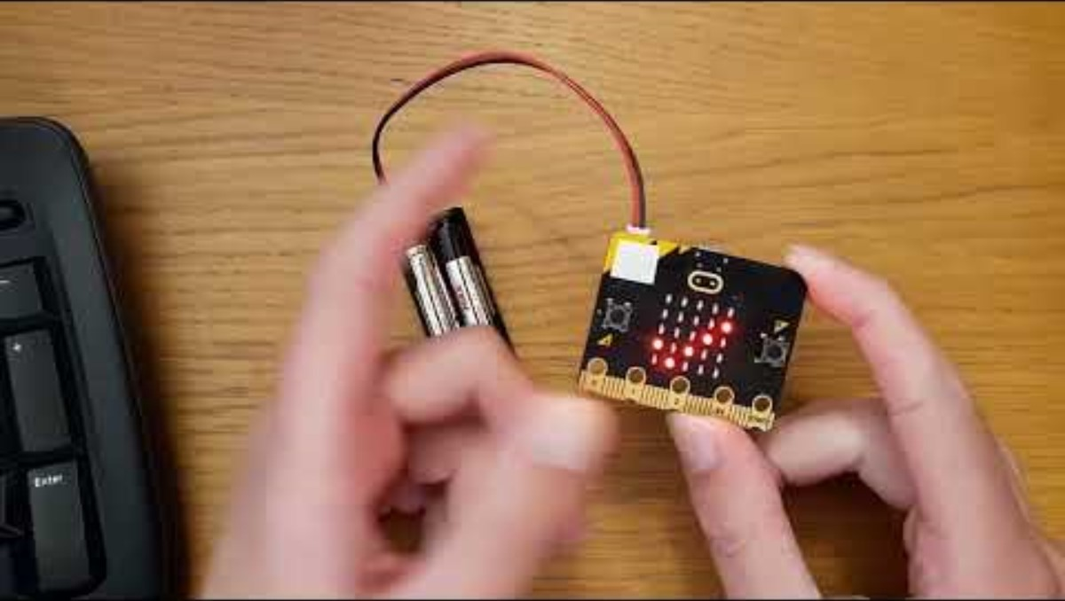
Introduction Video

Slide 4

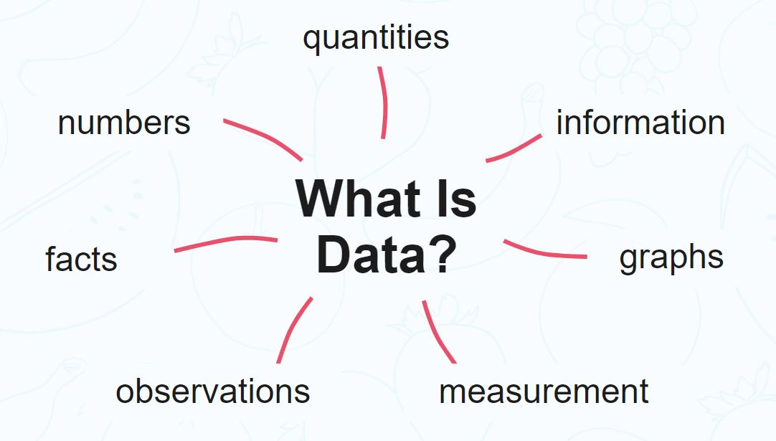
What is data?
Data is a collection of information gathered by observation, questioning or measurement.
Data is often organised in graphs or charts for analysis and may include facts, numbers or measurements.

Slide 5
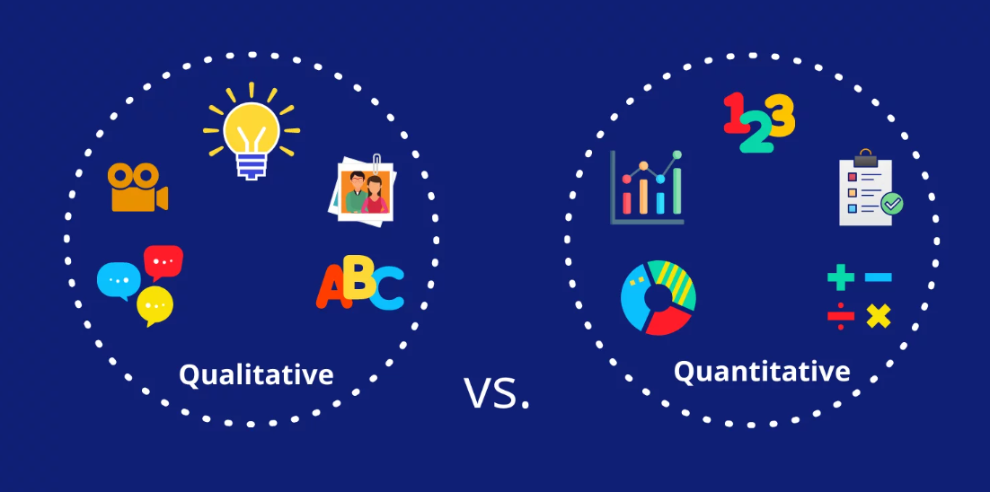
Qualitative vs. Quantitative?

Slide 6
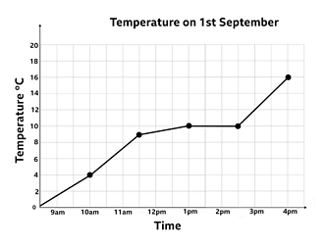
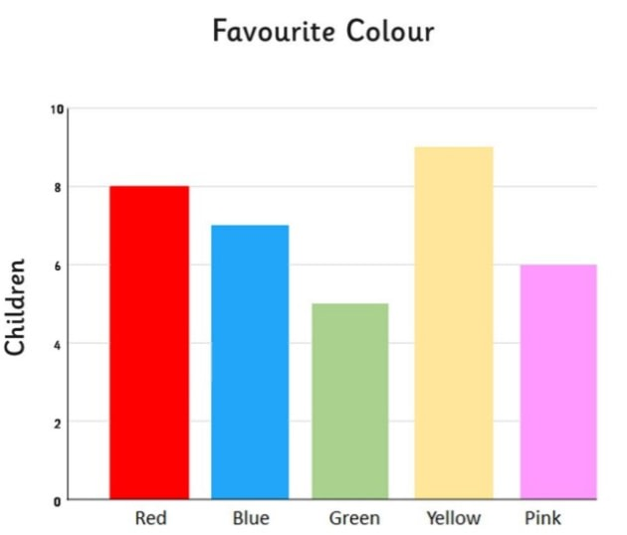
Line graph vs. Bar graph
Why can’t you use a line graph for favourite colours?

Slide 7
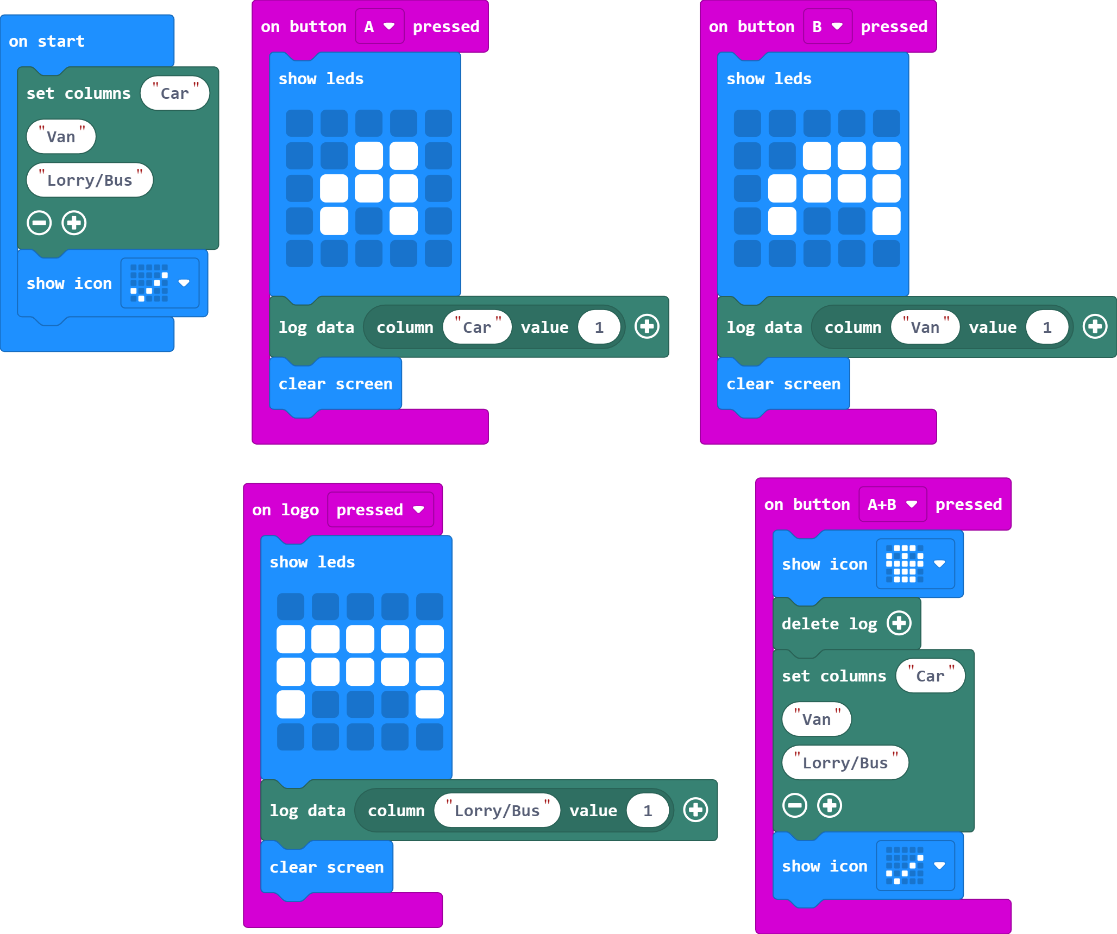
The Code

Slide 8
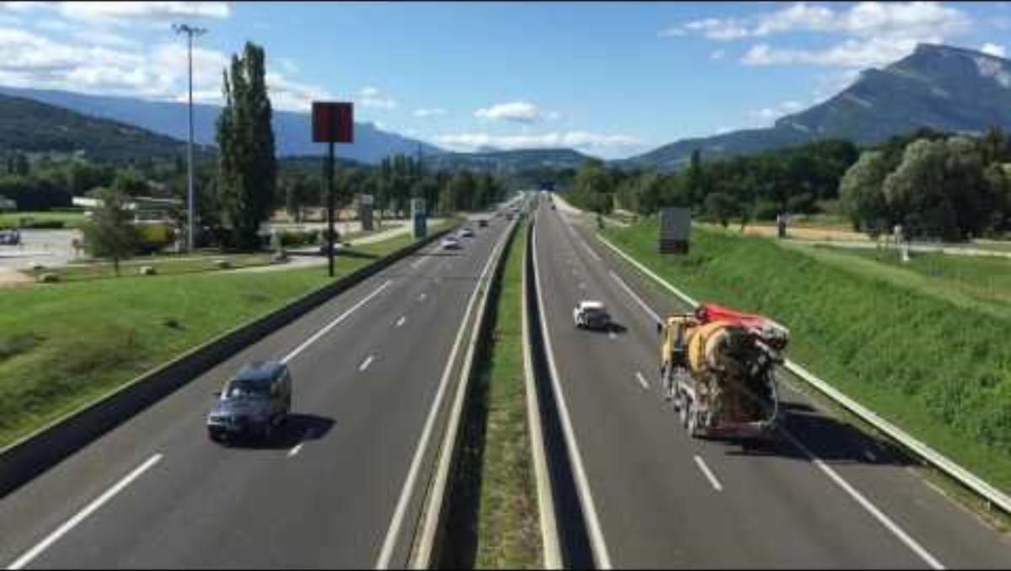
Traffic Survey Video

Slide 9
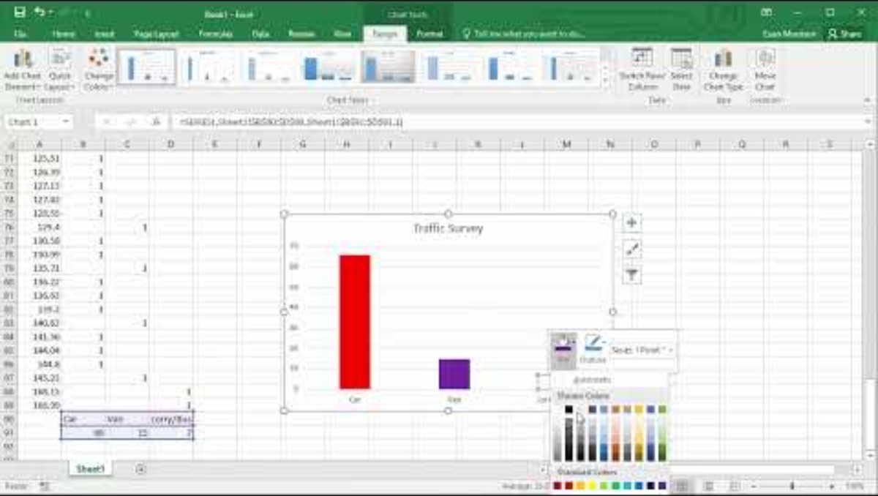
Video 2

Slide 10
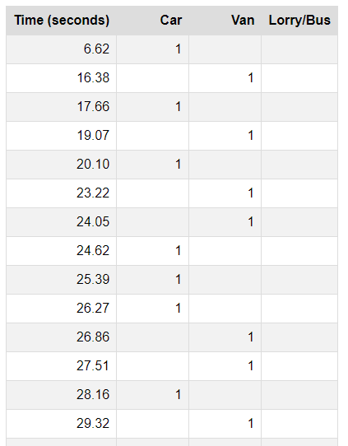
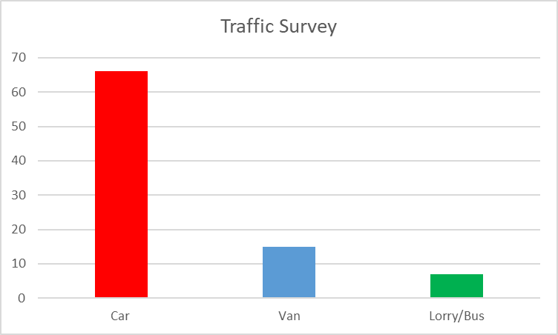

Analysing Results

Slide 11
Answer the questions below:
How many cars were there?
How many vans were there?
How many lorries and busses were there?
How many vehicles in total?
What was the most seen (frequent) vehicle?

Slide 12
Plenary Discussion Questions
How was the data recorded different from the light, temperature and sound in lesson 1?
Why was it useful to create a graph after collecting the data?
Would there be any way of recording more than 3 columns of data using the micro:bit?

