Slide 1


Micro:bit
Data and Sustainability
Lesson 3 – Earthquake Data

Slide 2
Lesson 3: Earthquake Data
We are learning to record earthquake data using the micro:bit
I can understand how acceleration is related to earthquakes.
I can create code to record the strength of acceleration.
I can carry out an experiment to simulate an earthquake and analyse the results

Slide 3
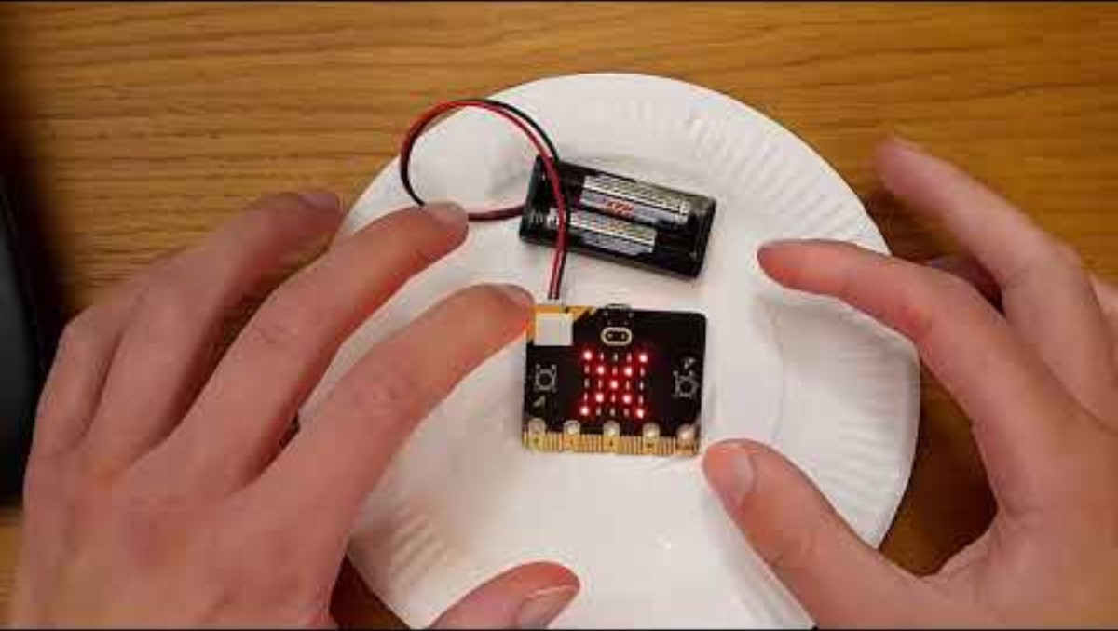
Introduction Video

Slide 4
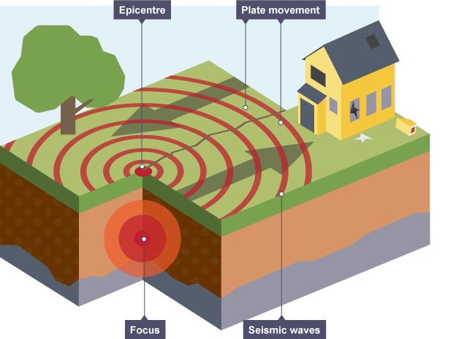
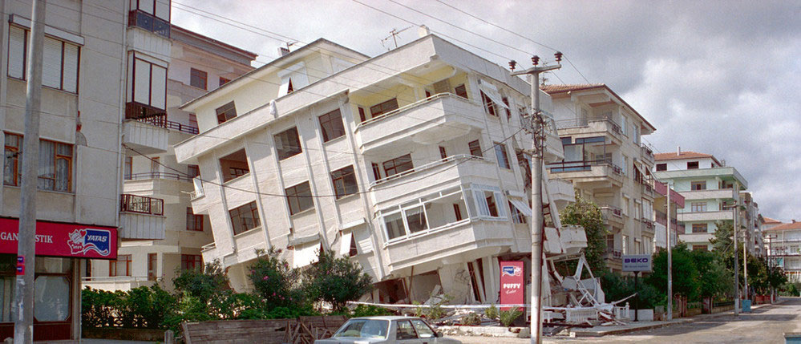
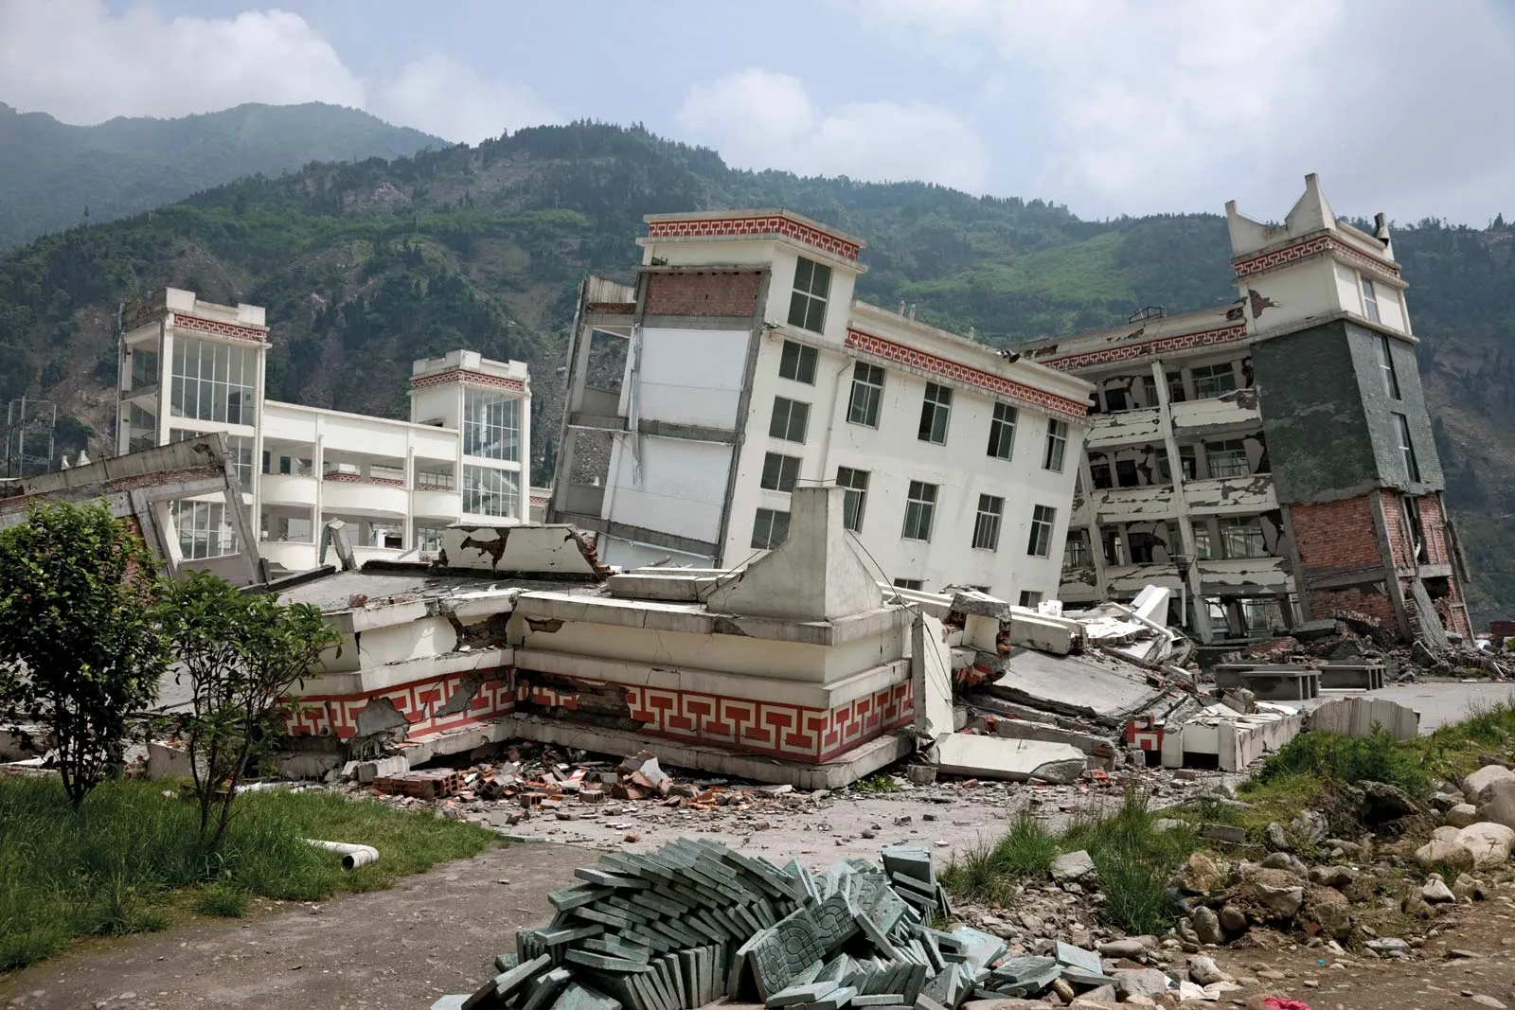
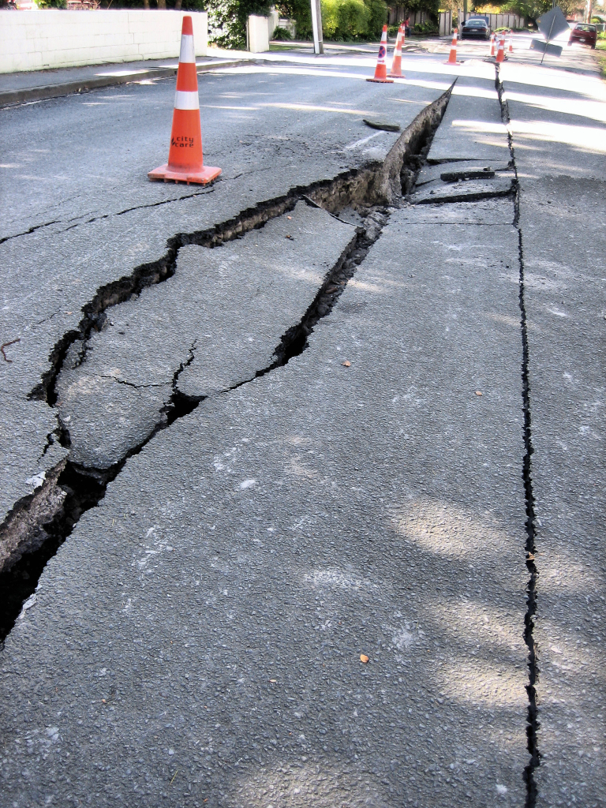
What is an Earthquake?
Earthquakes are events where the ground shakes. They are a natural part of our environment, but earthquakes can be terrifying and destructive events.

Slide 5
Why is it important to measure earthquakes?

Slide 6
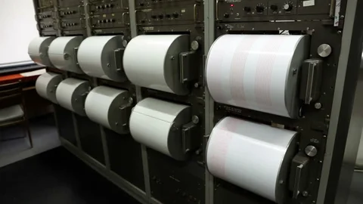
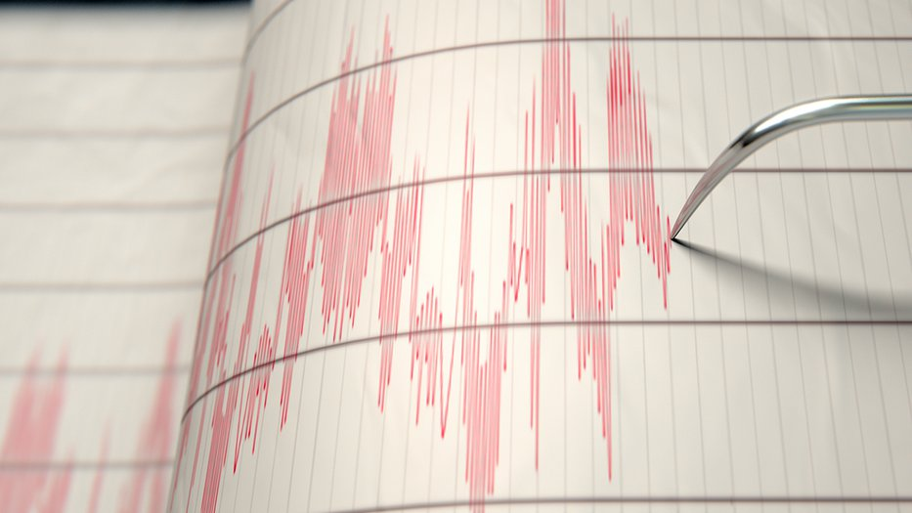
What is a seismograph?
Seismographs are instruments used to record the motion of the ground during an earthquake.
Originally manual now often digital.
Network across world.

Slide 7
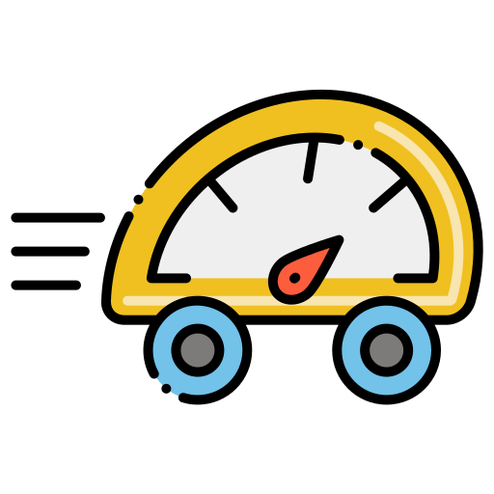

What is acceleration?
Acceleration is the measurement of how quickly the speed (velocity) of an object changes.
It depends on the speed and direction of the object.

Slide 8
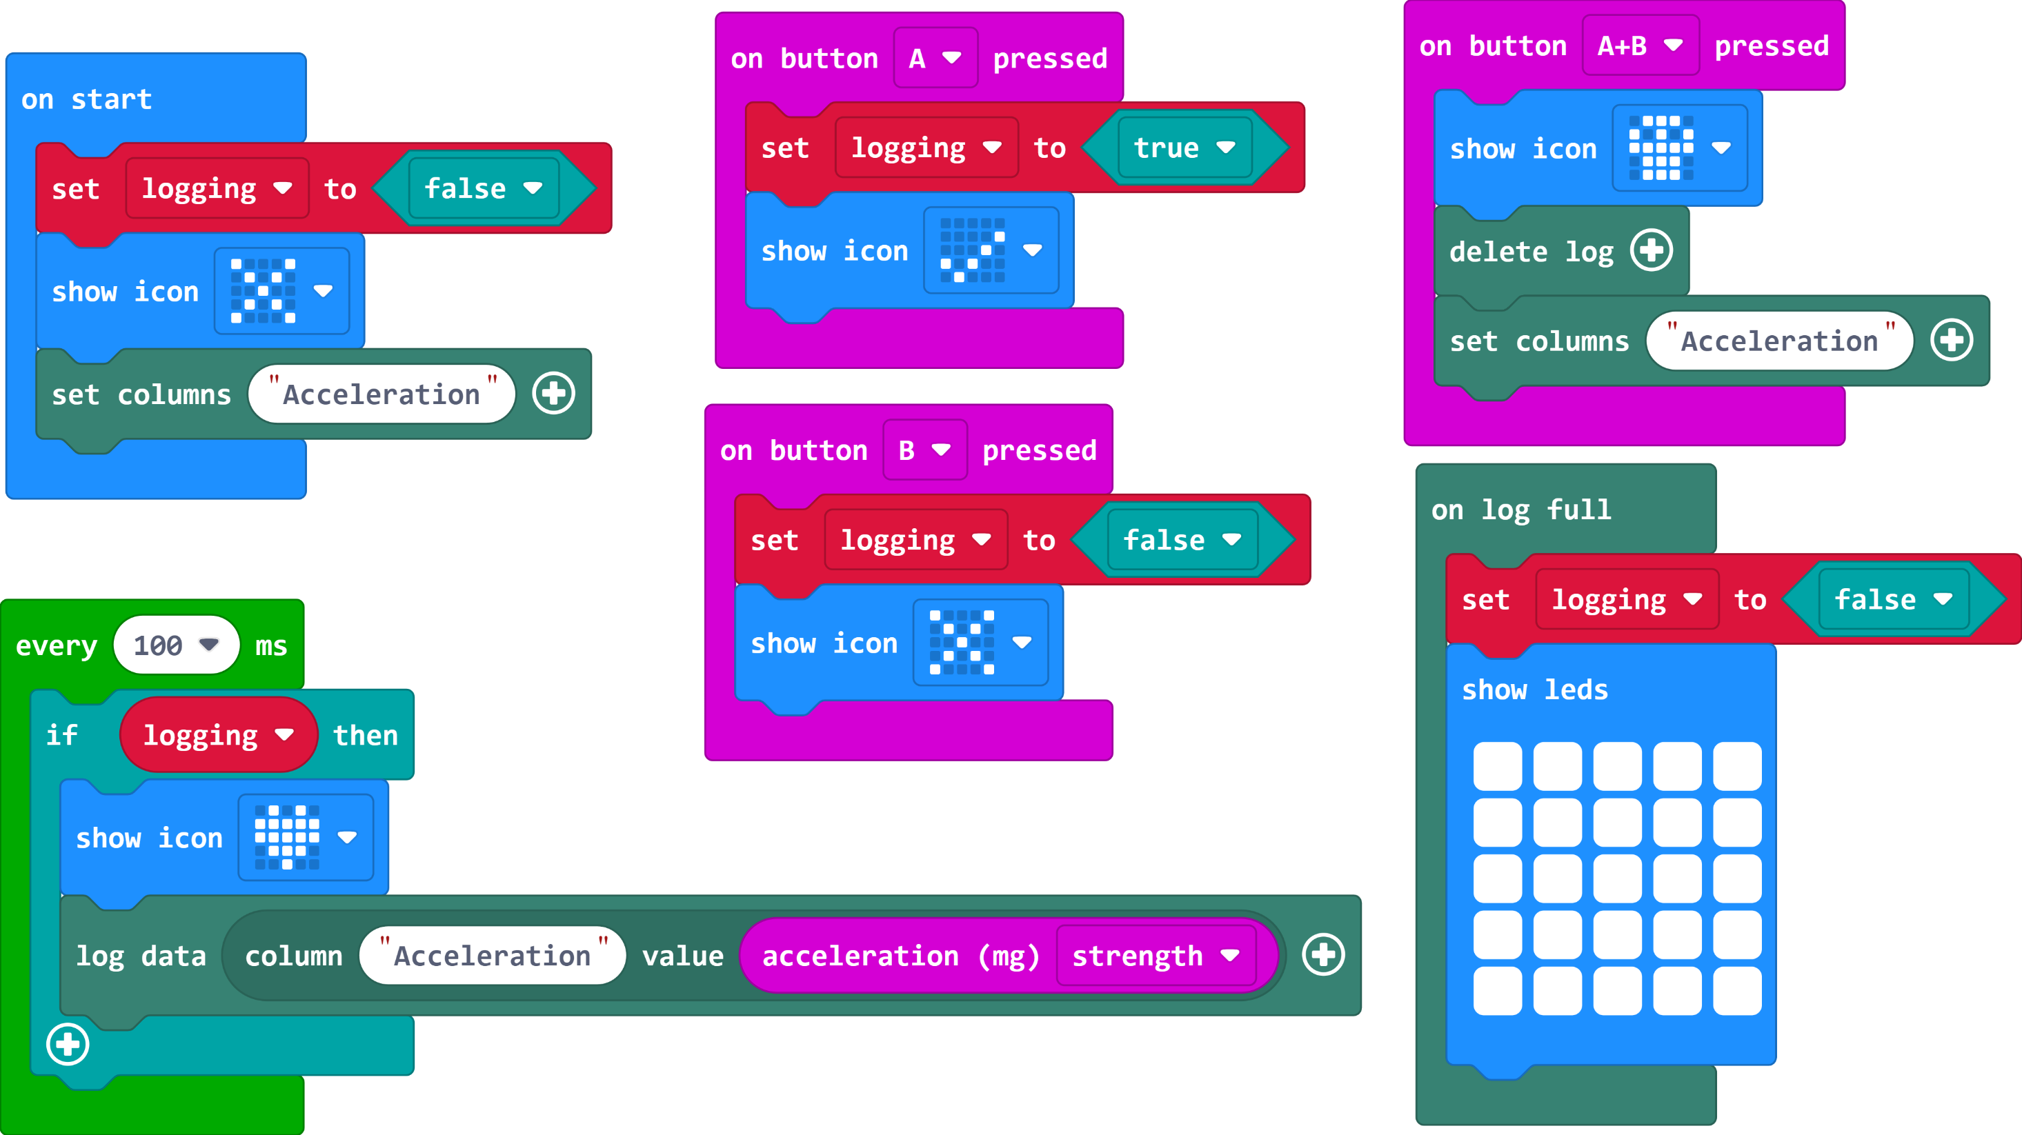
The Code

Slide 9
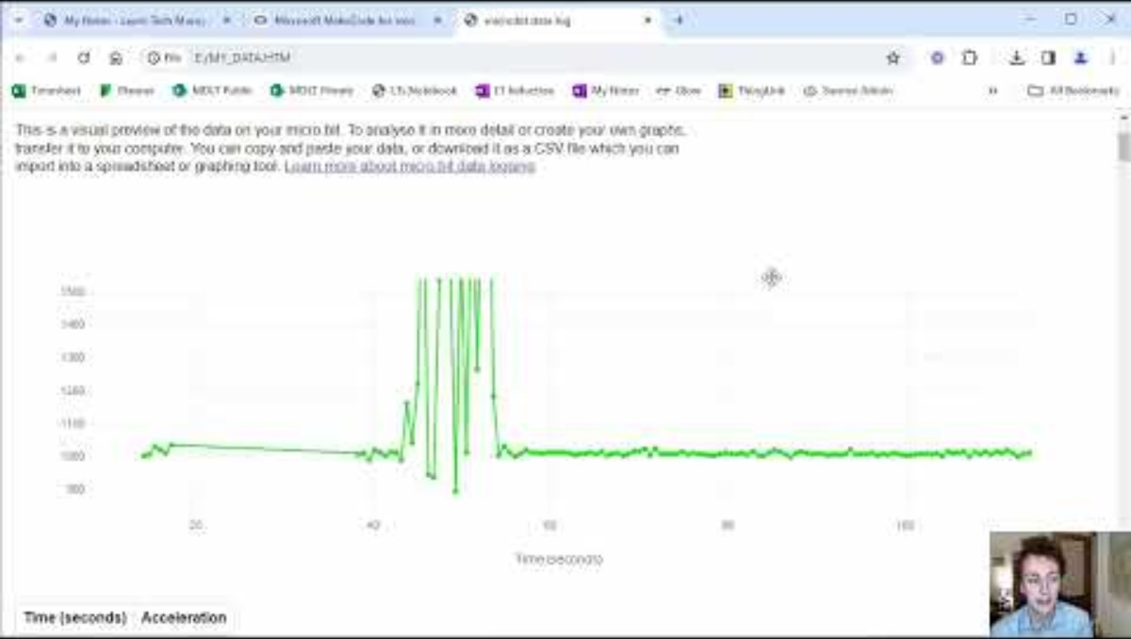
Video 2

Slide 10
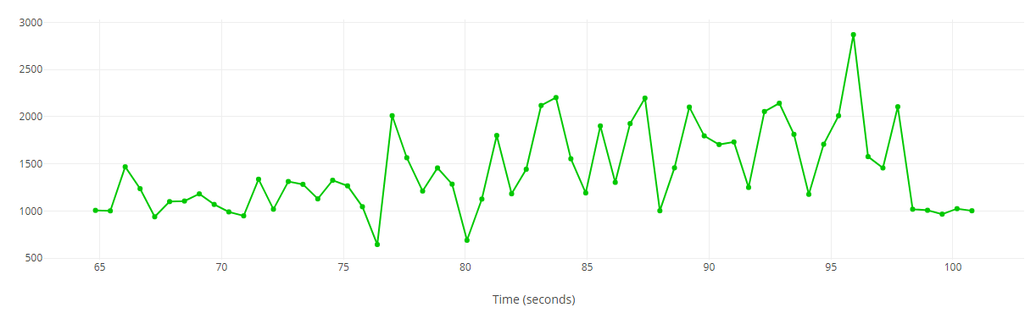
Analysing the Results

Slide 11
Answer the questions below:
At what time was your earthquake strongest.
How long did your earthquake(s) last? (start time take away end time).
Is there a strength that you reached more often?
What is the strength when there is no earthquake? Why is it not 0?

Slide 12
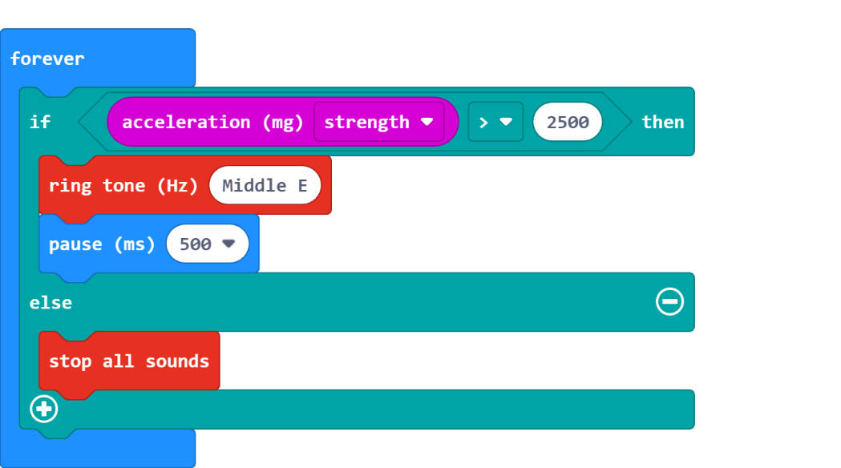
(Extension)
After you have analysed your data, you could decide to create an Earthquake warning alarm. This will sound when the acceleration reaches a certain number (you choose). Add code like this to your program:

Slide 13
Plenary Discussion Questions
Why was it important to measure Earthquakes?
What was the purpose of a seismograph?
Have you ever experienced an Earthquake? Or know someone who has?
Could you tell the ear

