Slide 1


Micro:bit
Data and Sustainability
Lesson 4 – Sound Levels

Slide 2
Lesson 4: Sound Levels
We are learning to investigate sound and materials.
I understand how sound travels.
I can create code to measure sound levels remotely using two micro:bits.
I can carry out an experiment to investigate the effect of materials on sound.
I can record and analyse my results.

Slide 3
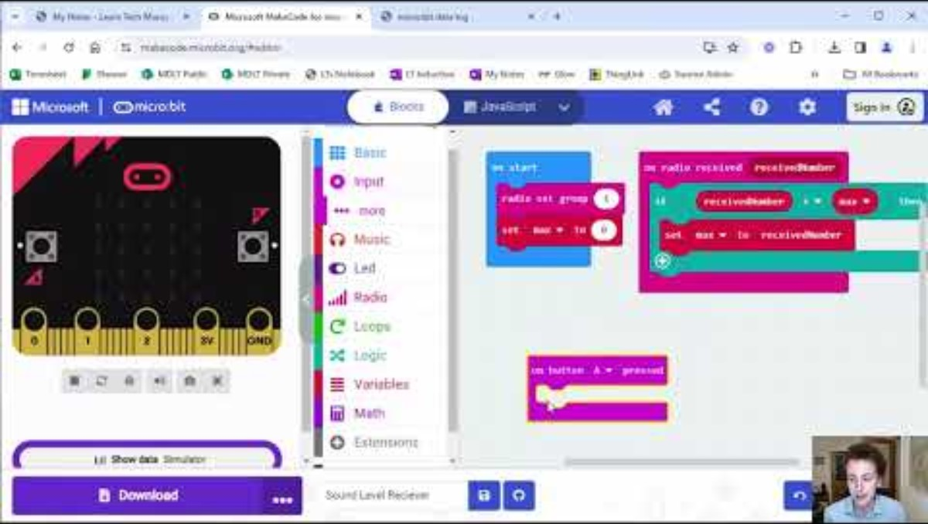
Introduction Video

Slide 4
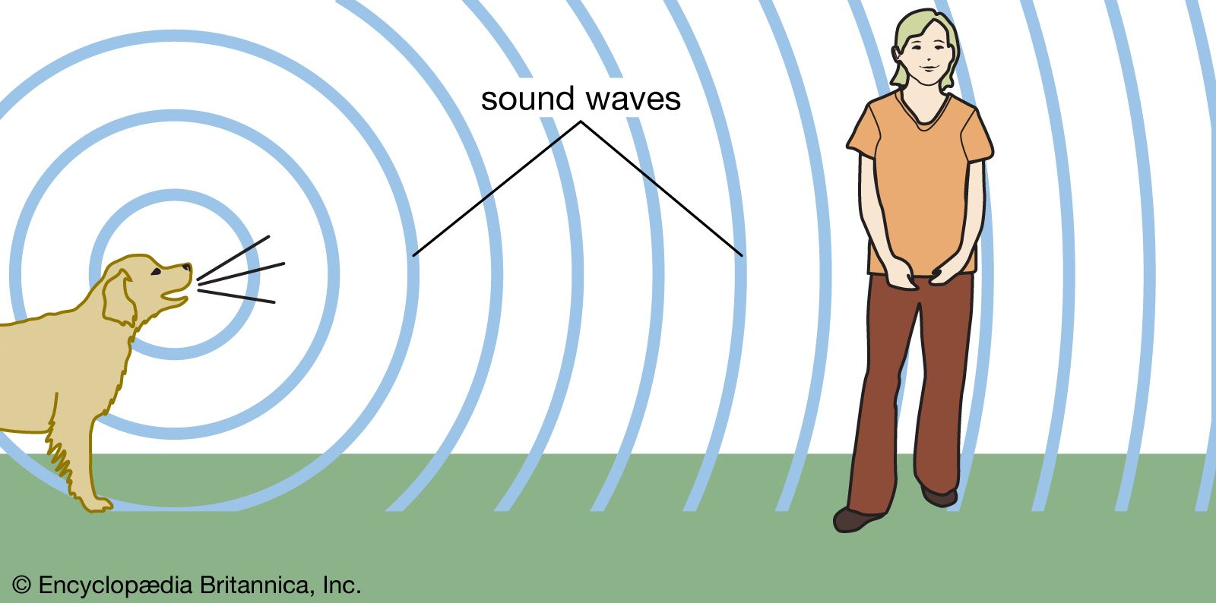
How does sound travel?
Sound travels as waves. These sound waves are formed by objects vibrating (shaking back and fourth).
Notes:
For a sound to be made and heard, three things need to happen. First, an object vibrates. A vibrating object makes tiny, very fast back-and-forth movements. For example, when a musician strums guitar strings, they vibrate. The vibration moves the surrounding air and produces waves of sound.
Second, the sound waves pass into a medium. A medium is any substance through which the waves can travel. Sound waves may travel through many mediums. These include air, water, and solid objects. Sound waves pass through mediums in all directions.
Third, some kind of receiver, such as the ear of a person, picks up the sound waves. The ear changes the sound waves into signals that travel to the brain. The brain understands these signals as sound.
The speed of sound varies depending on what medium it is traveling through. In air at a temperture of 70° F (21° C) sound travels at a speed of 1,129 feet (344 meters) per second. This means that it takes sound about five seconds to travel one mile.

Slide 5
Why is it useful to know what different materials do to sound?

Slide 6
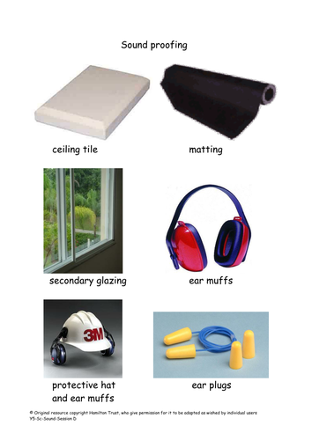
What is insulation?
An insulator is a material that reduces the loss of heat or sound.
Soundproofing is taking measures to reduce unwanted or loud sound in a room.
Noise protection such as earplugs and headphones use insulating materials too.

Slide 7
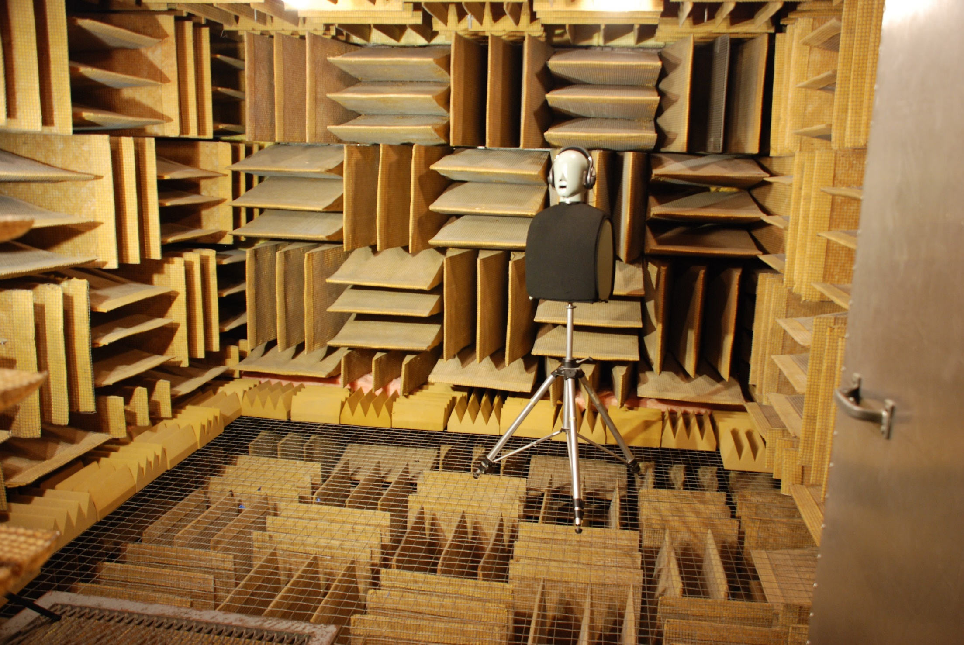
What could this room be used for?
Source: https://edition.cnn.com/style/article/anechoic-chamber-worlds-quietest-room/index.html
Notes:
World’s quietest room – anechoic chamber – No echo at all.
Anechoic chambers are generally used to test noises and sounds coming from a variety of products with a high degree of scientific reliability.
Microsoft uses it for audio equipment such as microphones, receivers, headphones and speakers, or to analyze clicks and hums from computing devices like keyboards, mice, fans and backlight modules on touch panels and displays. Among the products that have benefited from the chamber are the Surface line of tablets, the Xbox gaming console and the HoloLens VR goggles, but also software where the audio component is dominant, like Skype and the Cortana virtual assistant.
It’s very uncomfortable to sit in the room

Slide 8
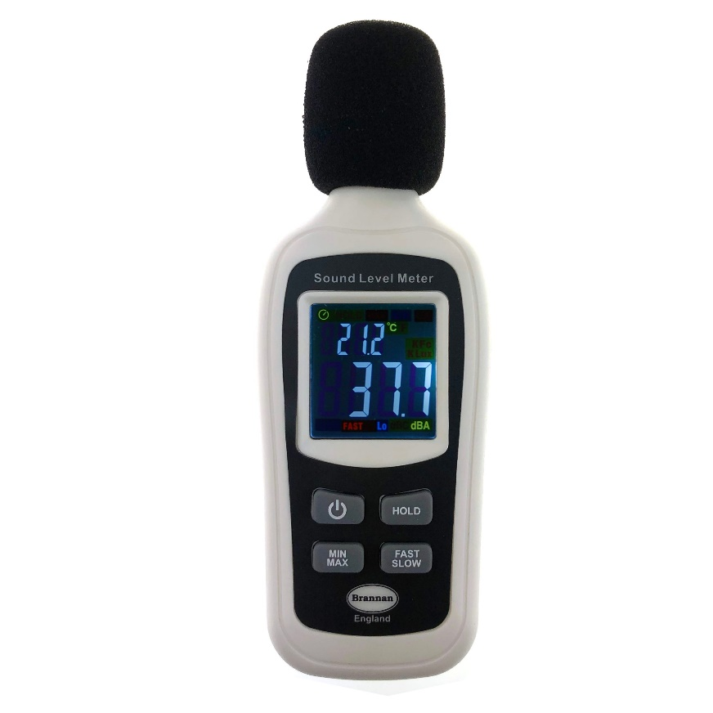
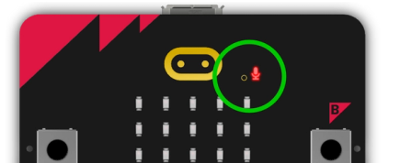
What is a sound meter?
Usually a handheld device with a microphone and display – sounds like the micro:bit has both!
Sound is measured in Decibels (dB)
Notes:
named in honour of Alexander Graham Bell, the inventor of both the telephone and the audiometer.

Slide 9
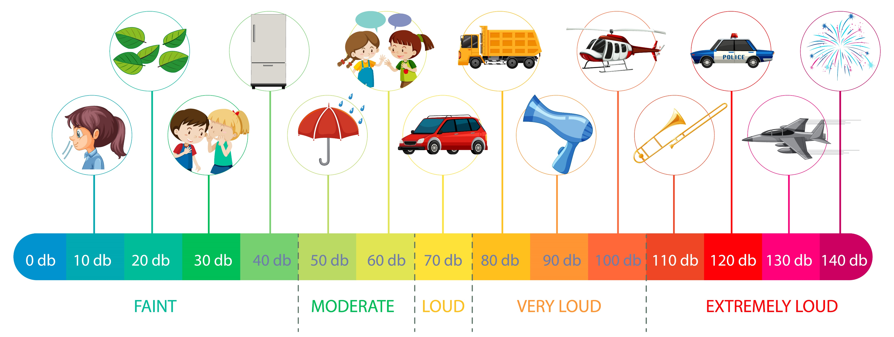
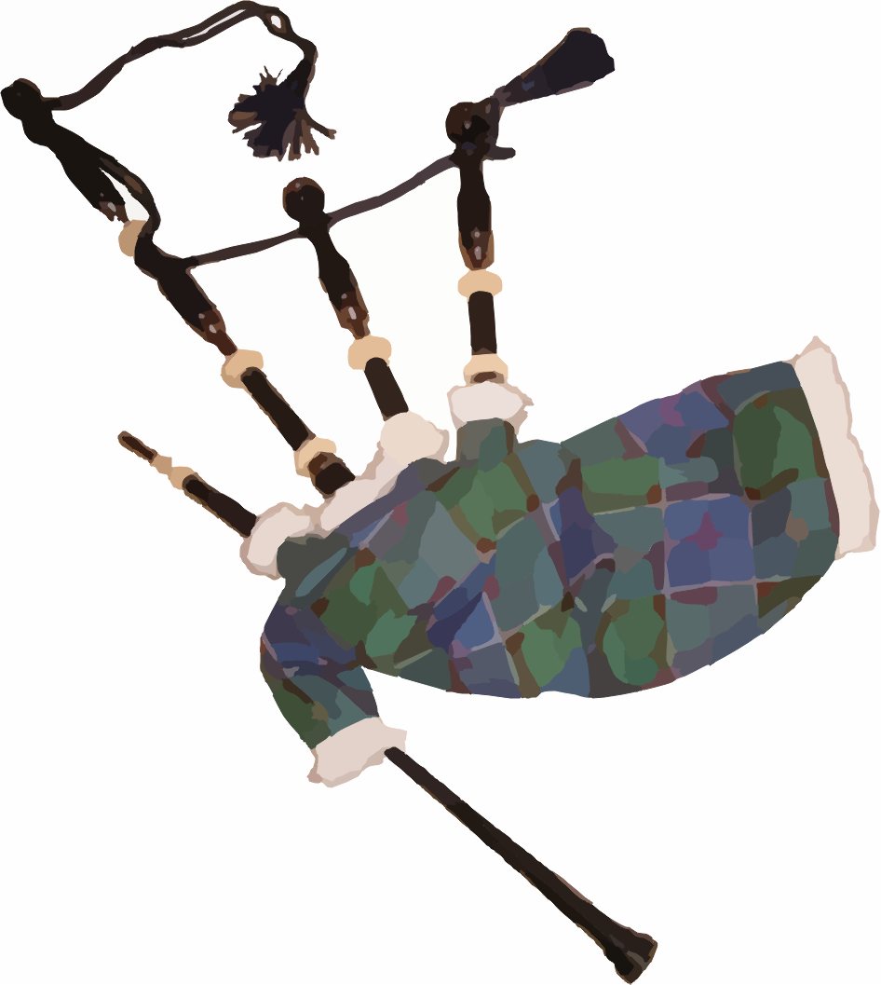
Notes:
.

Slide 10
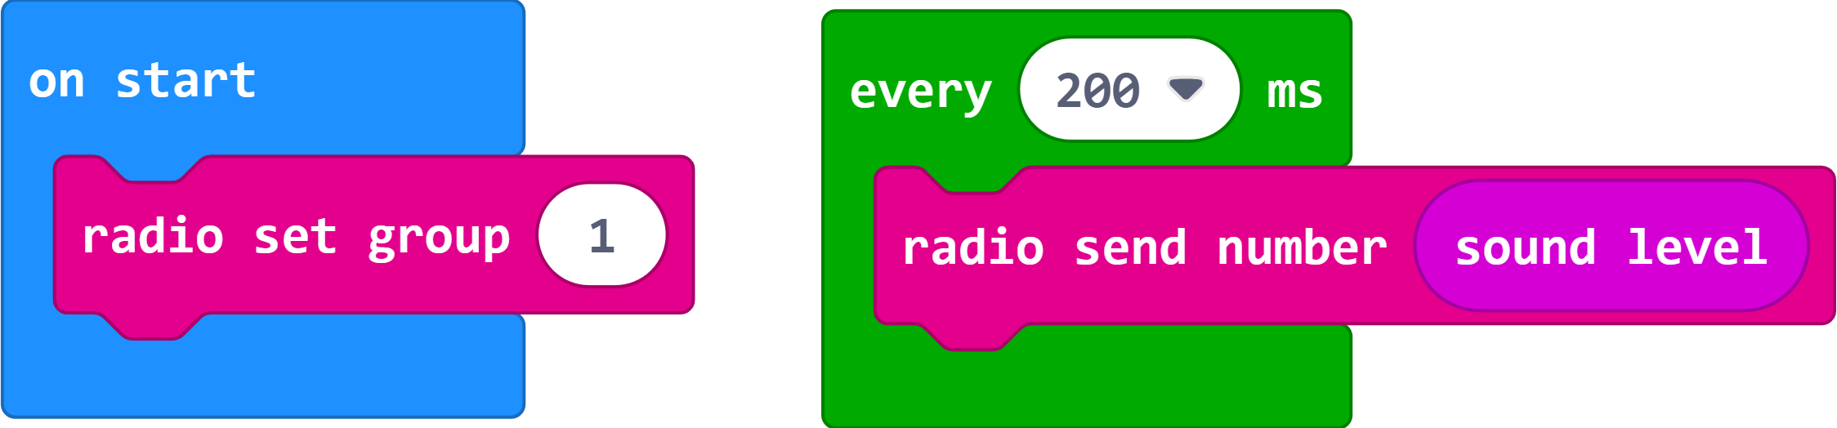
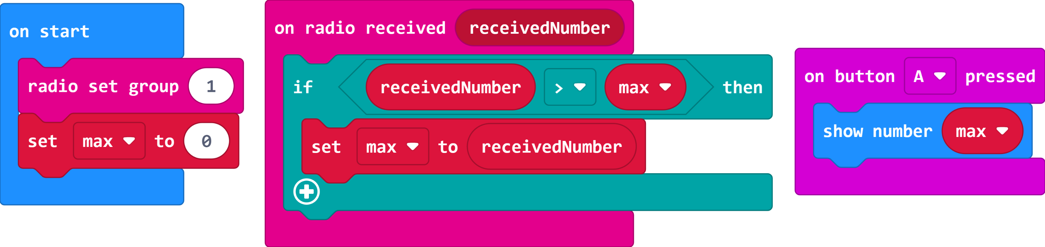
The Code
Transmitter
Receiver

Slide 11
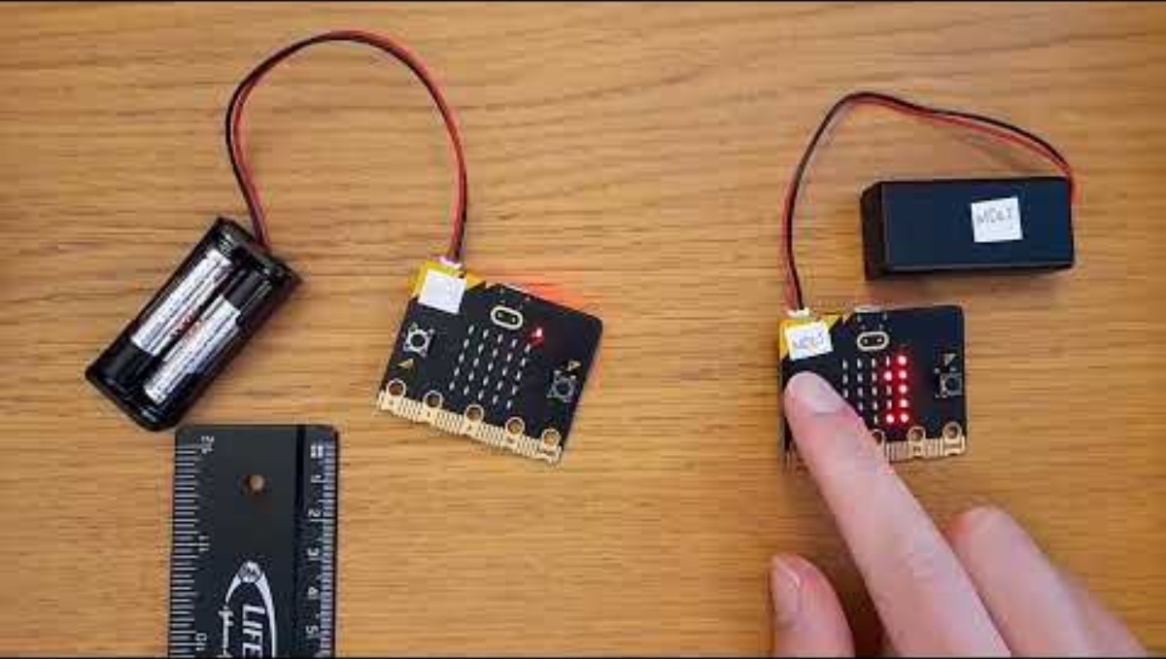
Video 2

Slide 12
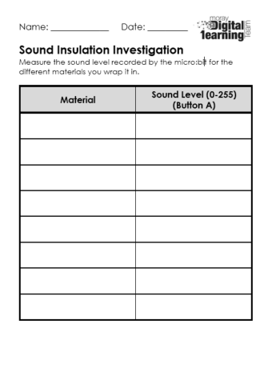
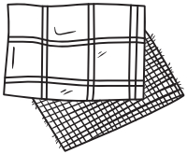
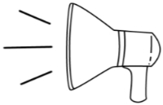
Complete the Worksheet

Slide 13
Answer the questions below:
How far away did you place your sound source?
Which material was the best insulator?
Which material was the worst insulator?
Were there any results you were surprised about?
What would you change if you completed the experiment again?

Slide 14
Discuss the Results

Slide 15
(Extension)
Complete the experiment again with different materials or the sound further away/quieter and see what the changes are.

Slide 16
Plenary Discussion Questions
How does sound travel?
Why was it important to discover the sound properties of materials?
Why were two micro:bits used in this experiment?
Why was the distance and volume kept the same in the experiment each time?

