Slide 1


Micro:bit
Data and Sustainability
Lesson 5 – Energy Data

Slide 2
Lesson 5: Energy Data
We are learning to record and analyse energy use.
I can create code for a light meter.
I can measure the light level of a room.
I can record the changes in light over time.
I can use my results to calculate the cost of energy.

Slide 3
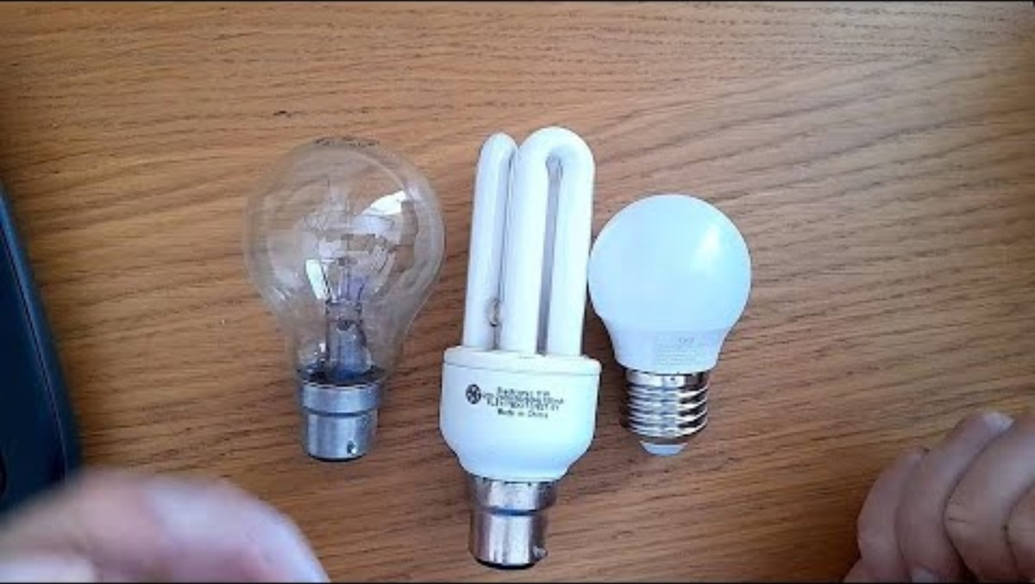
Introduction Video

Slide 4
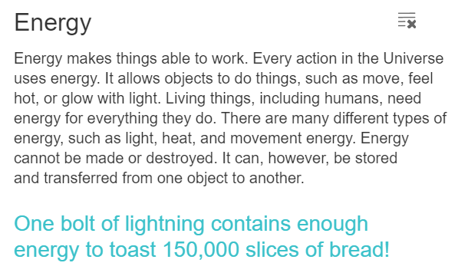
What is Energy?

Slide 5
List some things that use energy (at school and at home)…

Slide 6
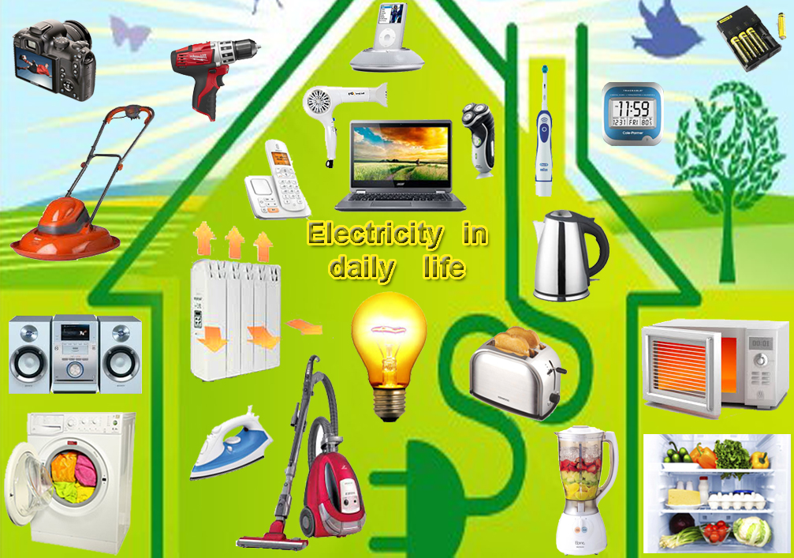
Things that use energy at home…
Source: https://www.operationjimmy.uk/bird-safety/bird-friendly-living/modern-day-life.html

Slide 7
What do you know about sustainability?

Slide 8

What do you know about sustainability?

Slide 9

What do you know about sustainability?

Slide 10

‘Learning is the first step to doing’
Climate change includes the global warming driven by human emissions of greenhouse gases and the resulting shifts in weather patterns.
Many sources of energy have an impact on climate change by putting CO2 into the atmosphere.

Slide 11
How can we make a contribution to combating climate change by becoming more aware about our energy use?
How might we be able to use data to drive changes in behaviour?

Slide 12
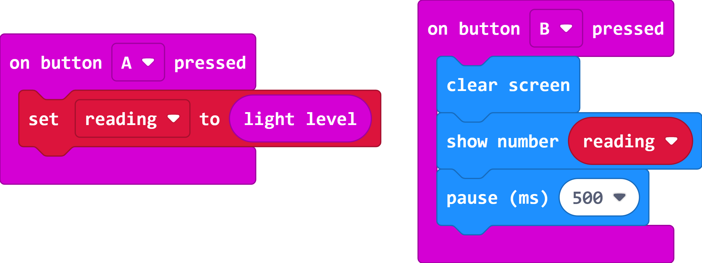
The Code – Energy Light Meter

Slide 13
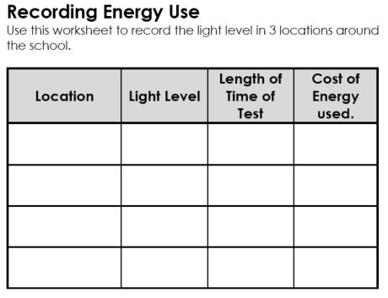
Recording the Light Level
Record the light level in two or three different rooms, this could include the classroom, the corridor, the cloakroom or a cupboard.
Record the location and light level in the first two columns of the worksheet.

Slide 14
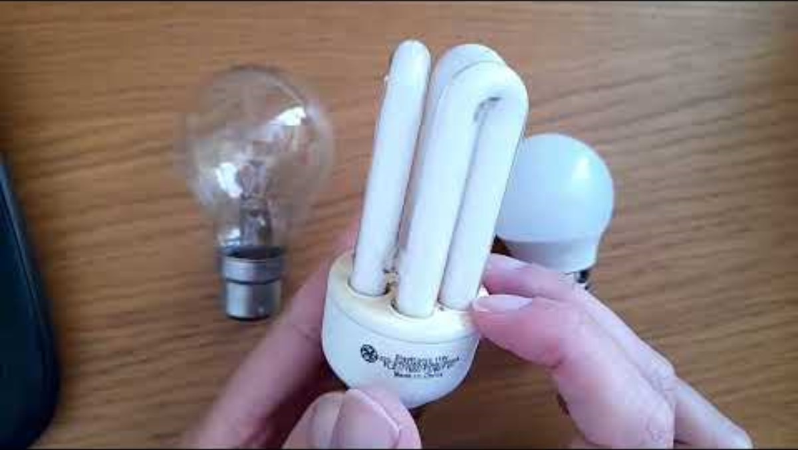
Video 2

Slide 15
Will the light level stay the same the whole time the light is on?

Slide 16
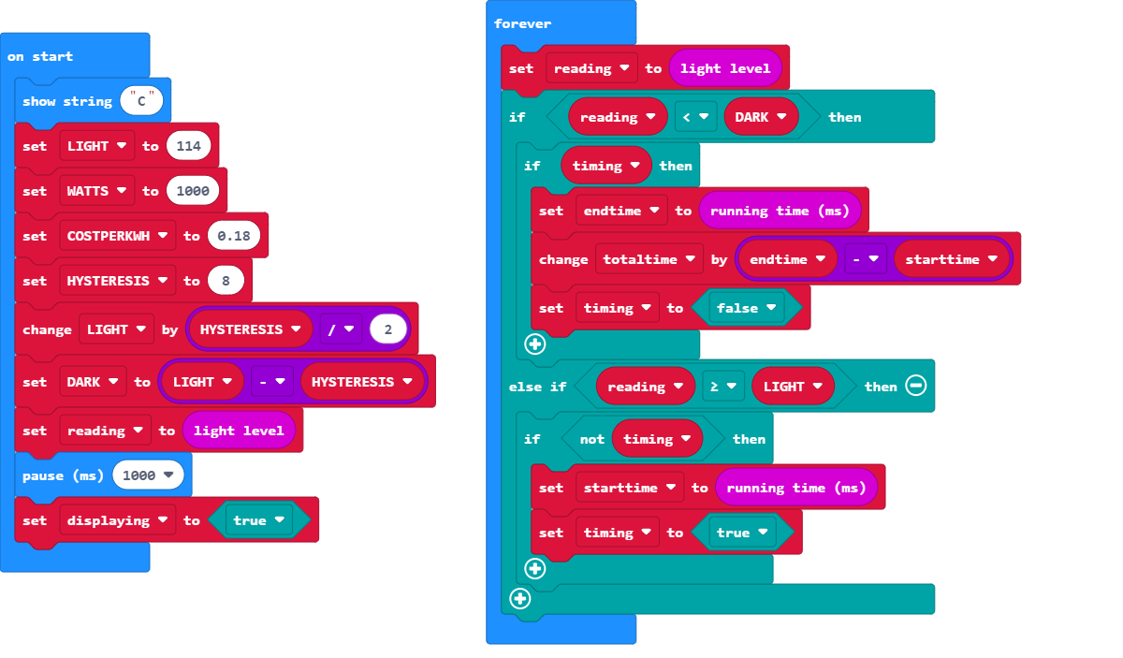
The Code – Energy Light Timer
Part 1

Slide 17
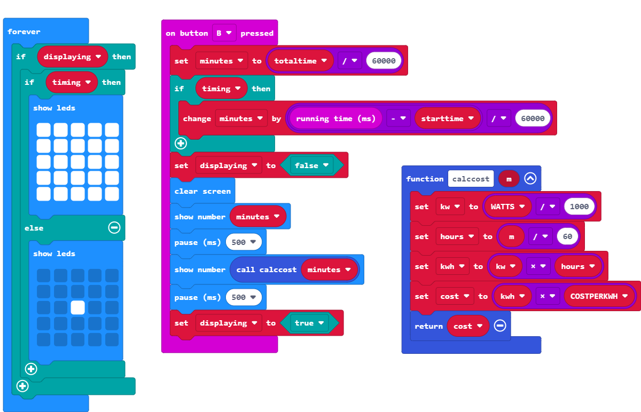
The Code – Energy Light Timer
Part 2

Slide 18
Complete the Worksheet
Be consistent with the length of time that you record the energy for e.g. all at 10mins.
You may find it helpful to also record the start time (e.g. 2pm)

Slide 19
Answer the questions below:
Which room had the highest light level?
Which room had the lowest light level?
Which room used the most energy?
Which room used the least energy?
What savings could be made?

Slide 20
Discuss the Results

Slide 21
(Extension)
If you haven’t already complete this experiment over 24hrs/48hrs/whole week and see what the results are.

Slide 22
Plenary Discussion Questions
Is there a sustainable development goal you would like to learn more about?
Which room will give the most accurate reading?
Were you surprised how much energy is used by the lights?
Is there any changes we can make to save energy?

