Slide 1

GarageBand
Lessons
Lesson 1 – Getting Started
Notes:
Notes for teachers:
Learners will need to use the same iPad to access the same piece of music if you split this lesson up.
I would recommend headphones if all learners are working on this at the same time.
The videos are designed to be paused at any points you find suitable. For this reason I have only summarised the steps on a slide as screenshots aren’t as useful as just watching the part of the video again.

Slide 2
Lesson 1: Getting Started
We are learning to create a simple song using GarageBand.
I can explore the GarageBand App.
I can create a simple drum beat.
I can create a simple song using single notes
I can experiment with the instrument sounds.

Slide 3
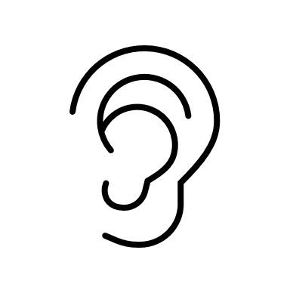
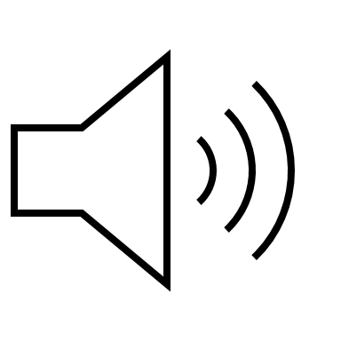

Listening Questions
What can you hear?
What instruments did you hear?
Is it fast or slow?
What is the style of music?
Where in the world is the music from?
When do you think the music was written?

Slide 4
Vocabulary/Topics to Explore
Beats
Parts of a Drum Kit
Bars
Keyboards
Notes
Melody
Accompaniment

Slide 5
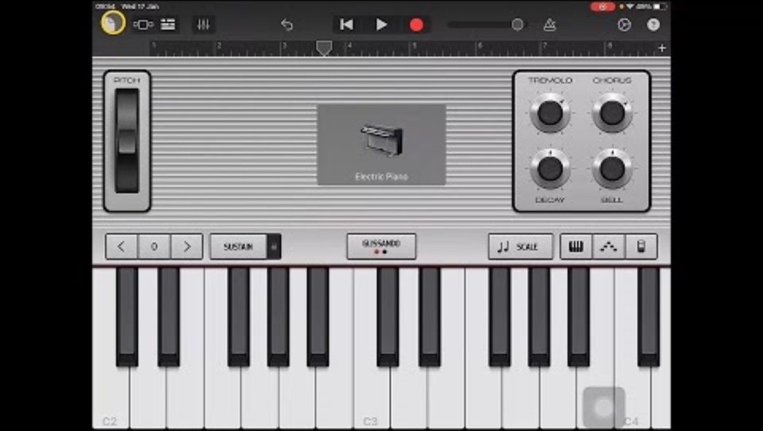
Lesson Video

Slide 6
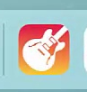
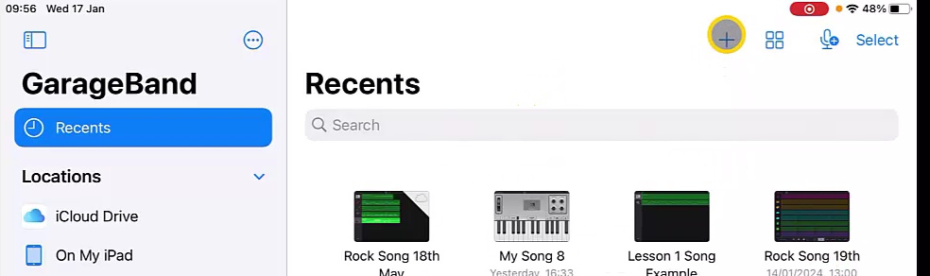
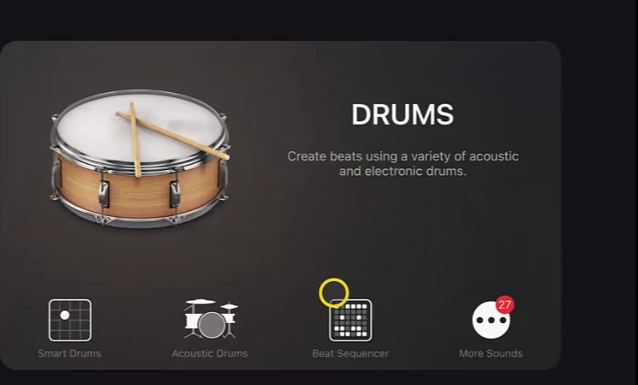
Steps to Create Song
  Open GarageBand App
  Create a new song using ‘+’ button
  Swipe to ‘Drums’ and choose ‘Beat Sequencer’

Slide 7
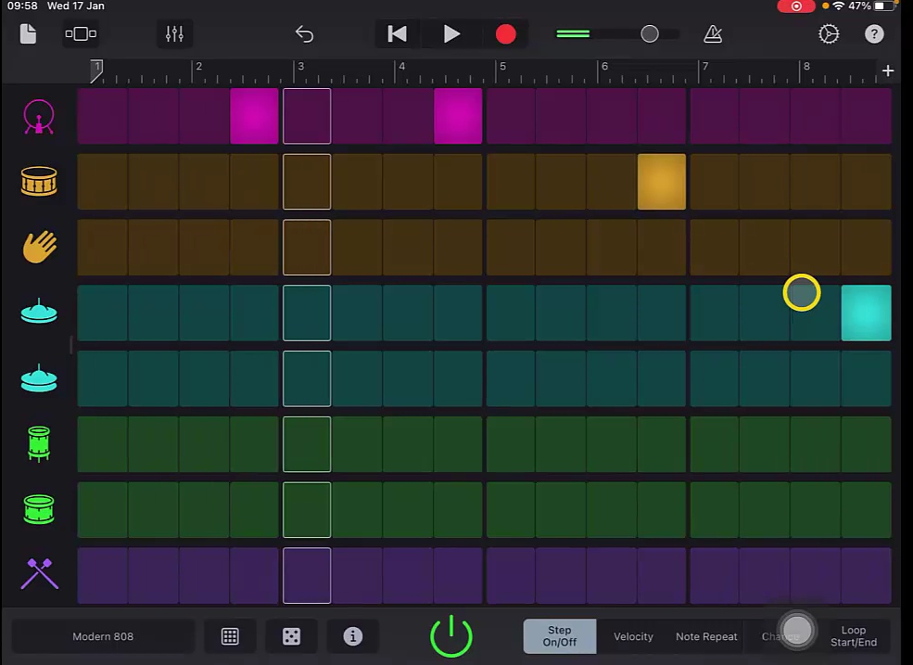
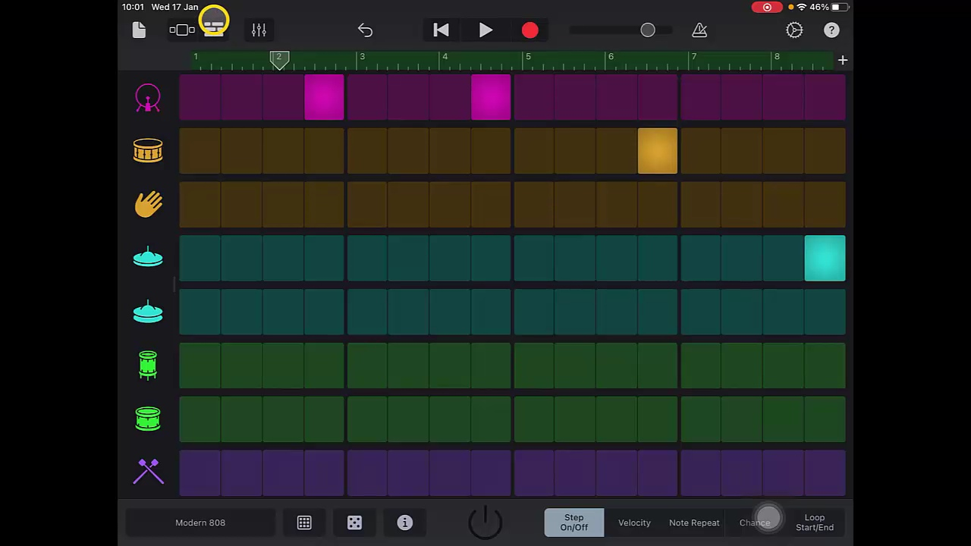
Steps to Create Song
  Create a beat pattern with Bass Drum, Snare and Hi-Hat.
  Record the beat track by pressing record button.
  You can press stop once red bar fills up and turns green.

Slide 8
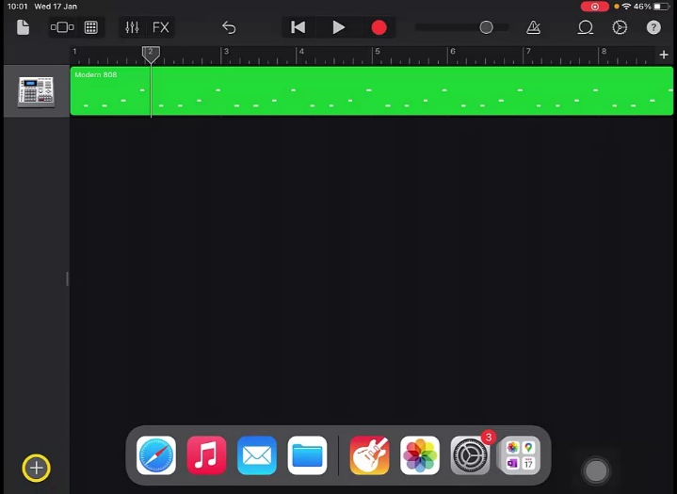
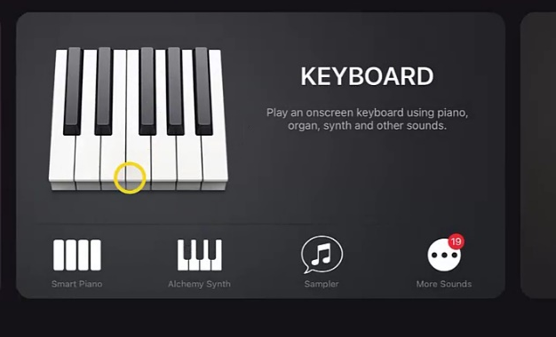
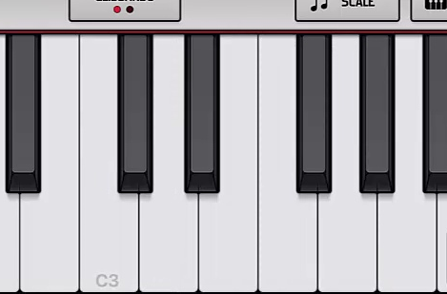
Steps to Create Song
  Tap on ‘track view’ icon and add a new track
  Swipe to and tap on keyboard
  Practice playing 5 notes (C,D,E,F,G) to create a melody.

Slide 9
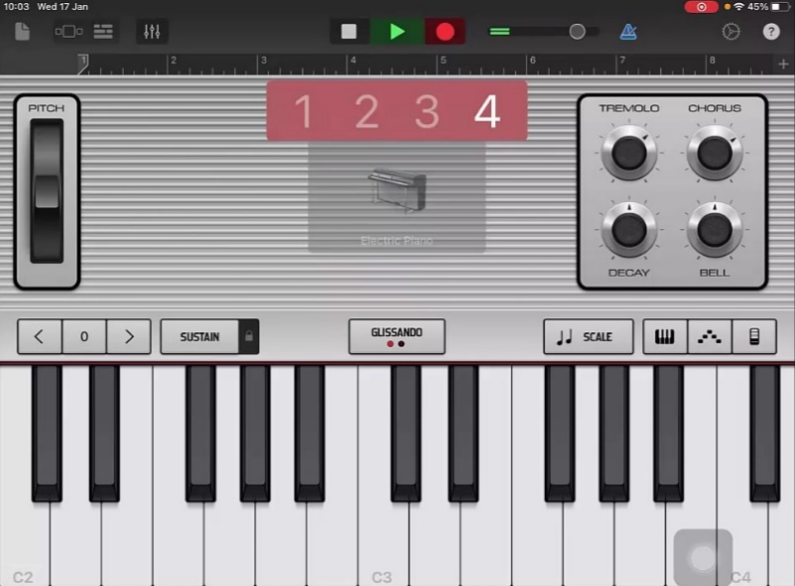
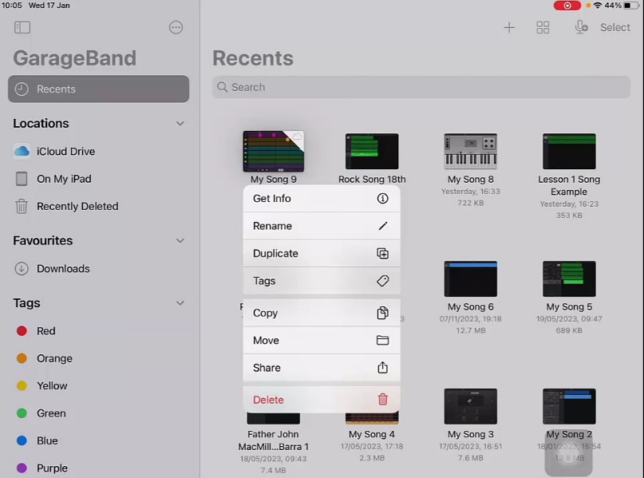
Steps to Create Song
  Record the melody (If you make a mistake tap the back arrow and record again).
  Return to the ‘track view’ screen and play back track.
  Return to home using paper icon and rename the track.

Slide 10
Plenary Discussion Questions
What did you enjoy the most about creating this track?
What did you find challenging about creating this track?
What would you do differently if you created another track like this?

