Slide 1

GarageBand
Lessons
Lesson 2 – Creating a Rock Song

Slide 2
Lesson 2: Creating a Rock Song
We are learning to create a rock song using chords.
I can explain what a chord is.
I can use the smart instruments in GarageBand.
I can follow a simple chord progression.
I can build a song with multiple instruments.

Slide 3



Listening Questions
What can you hear?
What instruments did you hear?
Is it fast or slow?
What is the style of music?
Where in the world is the music from?
When do you think the music was written?

Slide 4
Vocabulary/Topics to Explore
Musical Genre
Rock Genre
Rock Drum Kit
Electric Guitar
Bass Guitar
Keyboard Sythesiser

Slide 5
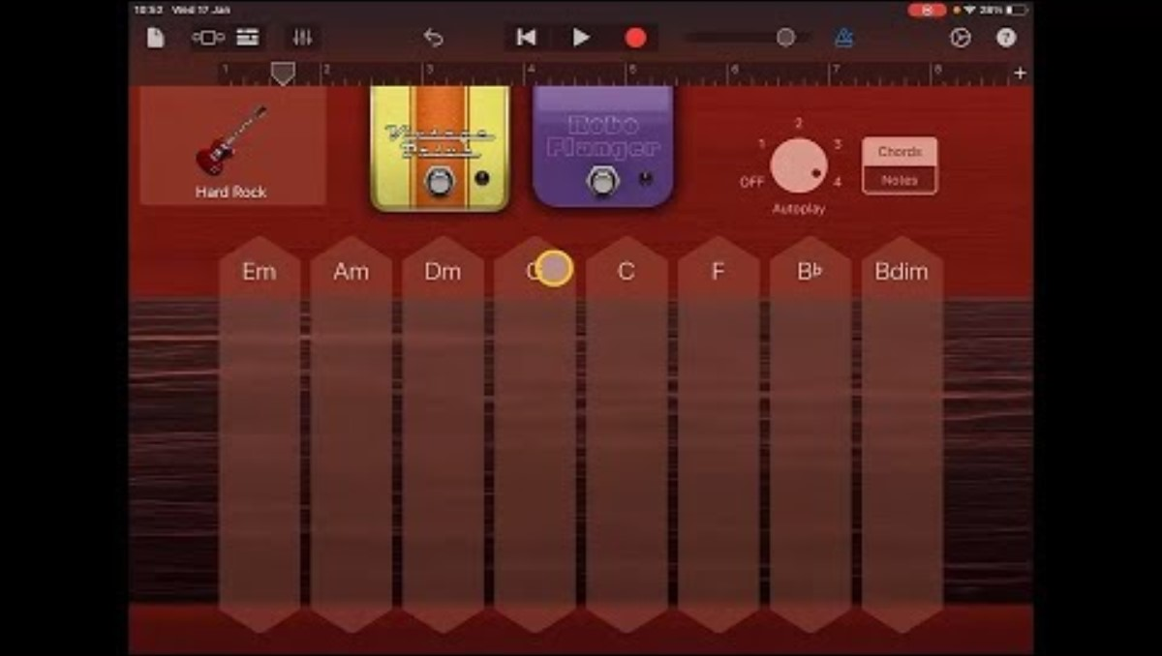
Lesson Video

Slide 6
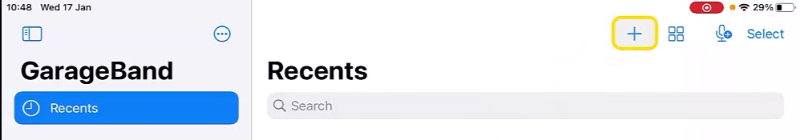
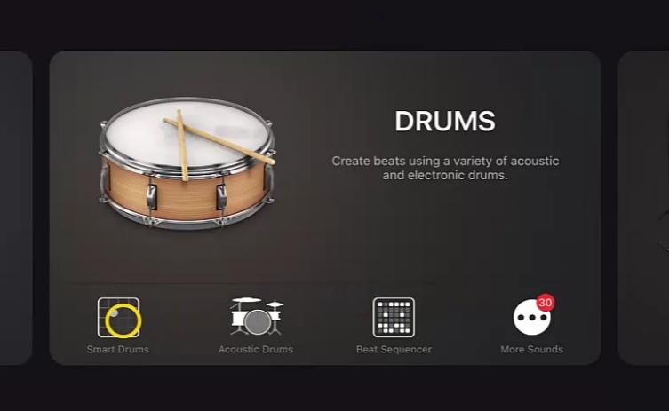
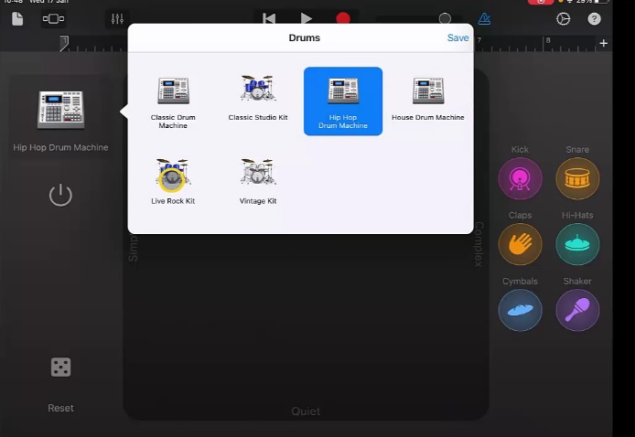
Steps to Create Song
  Create a new track using ‘+’ icon (You can return to home to find this option by selecting page icon).
  Swipe to find ‘Drums’ and select ‘Smart Drums’.
  Tap on the instrument icon and change it to ‘Live Rock Kit’.

Slide 7
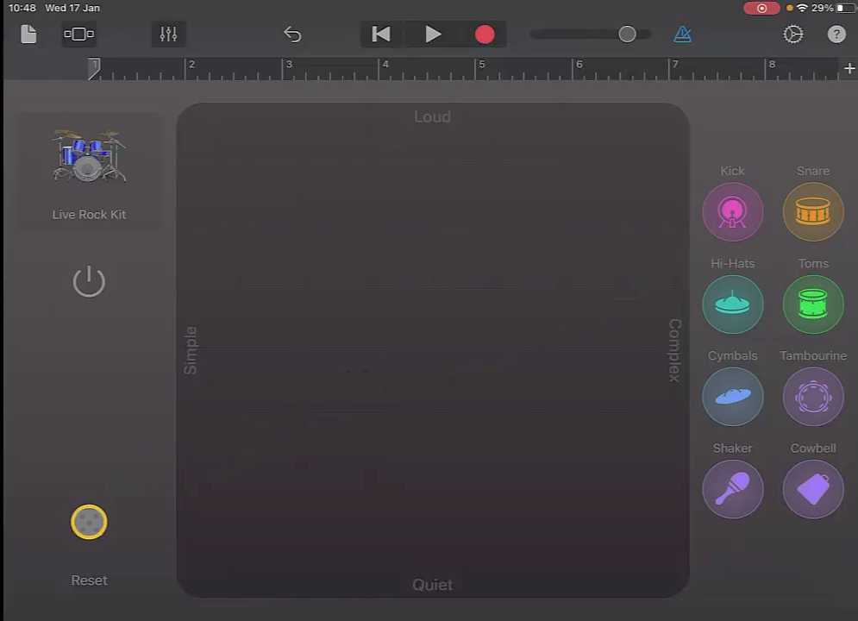
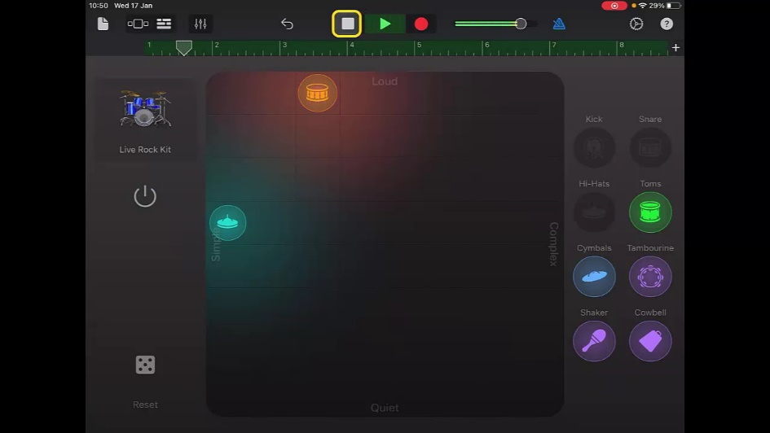
Steps to Create Song
  4. Use dice to find a pattern you like. Try to find one that doesn’t have too much going on.
  5. Once you are happy press ‘Record’. Once the bar fills up and turns green you can stop the drums.

Slide 8
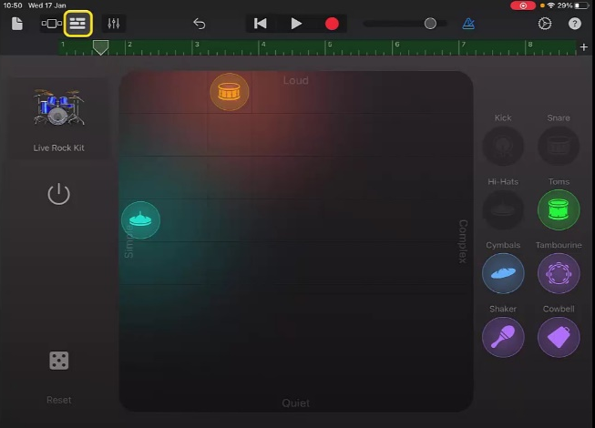
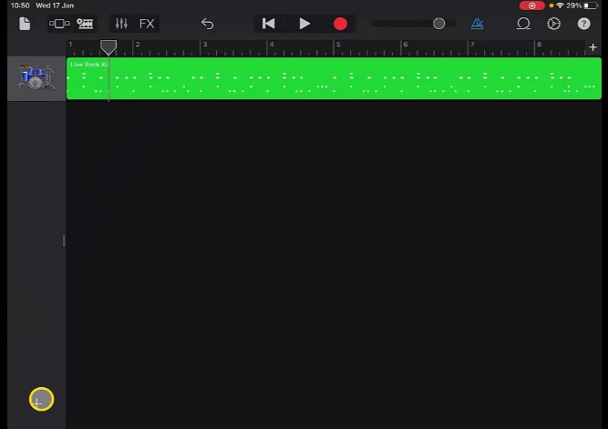
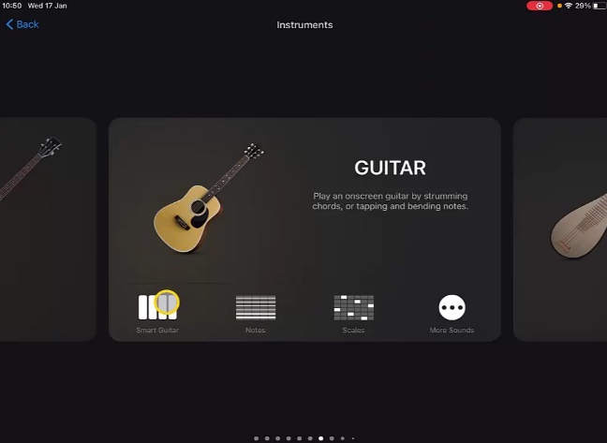
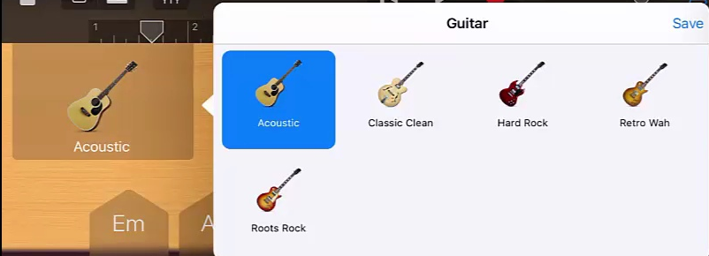
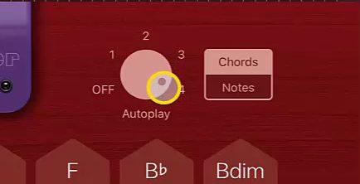
Steps to Create Song
Go to ‘Track View’ and ‘+’ to add a new instrument. Swipe to find ‘Guitar’ and choose ‘Smart Guitar’.
  Tap on the type of guitar and change it to ‘Hard Rock’. Change the ‘Autoplay’ dial to ‘4’.

Slide 9
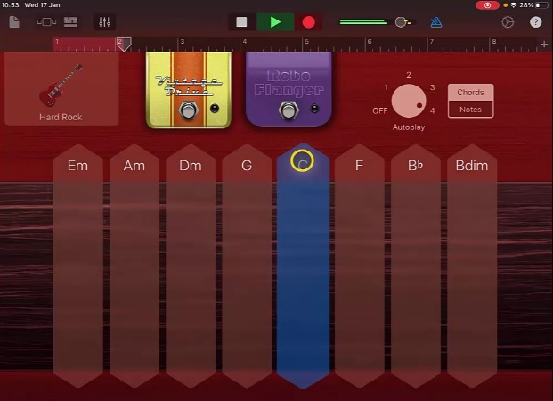
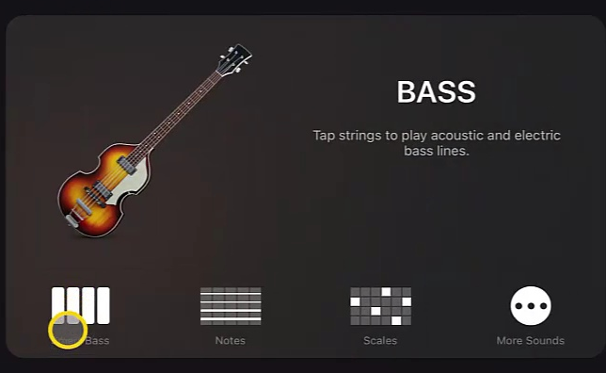
Steps to Create Song
  8. Press ‘Record’ and play the ‘G’ chord, change to ‘C’ when the red line reaches number 2. Change back to ‘C’ at number 3, ‘G’ at 4 and so on.
  9. Return to ‘Track View’ and choose ‘+’ to add a new instrument. Swipe to find ‘Bass’ and choose ‘Smart Bass’.

Slide 10
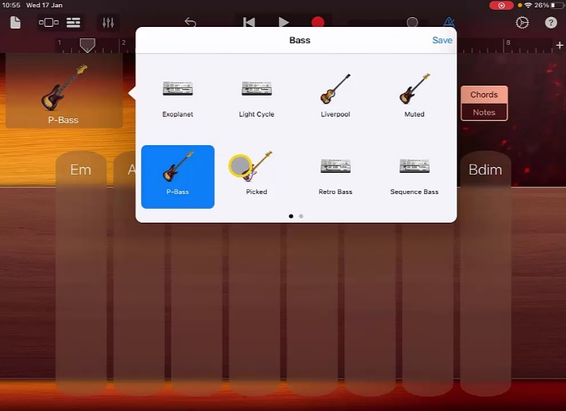
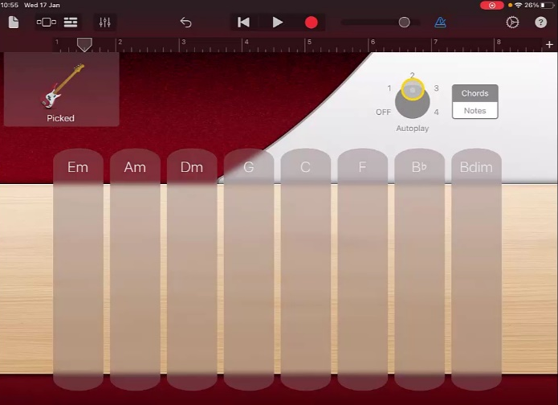
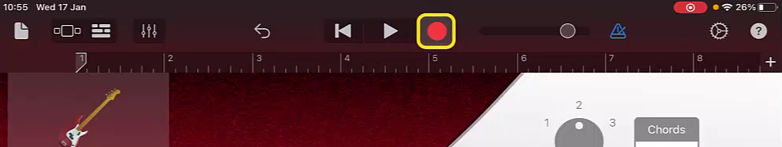
Steps to Create Song
  10. Change the instrument voice to a ‘Picked Bass’ and select ‘Autoplay’ ‘2’.
  11. Press ‘Record’ and follow the chord pattern for Guitar.

Slide 11
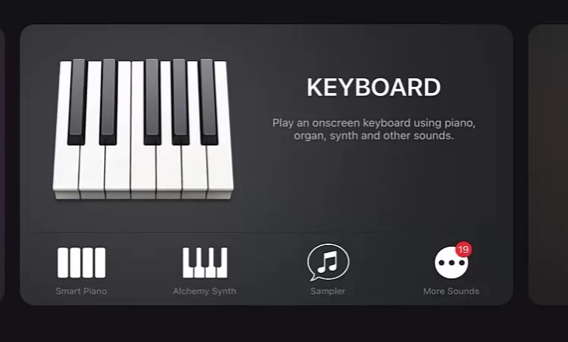
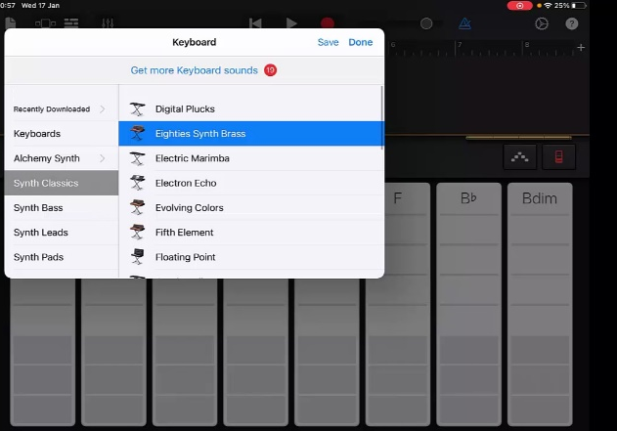
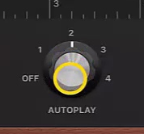
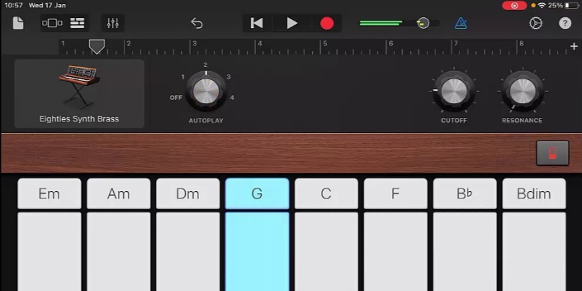
Steps to Create Song
Return to the ‘Track View’, choose ‘+’ and add a Keyboard.
13. Change instrument voice to ‘Eighties Synth Brass’. Choose ‘Autoplay’ ‘2’
14. Record Synth following the chord pattern as before.
15. Listen back to your recording and remember to rename it.

Slide 12
Plenary Discussion Questions
What did you enjoy the most about creating this track?
What did you find challenging about creating this track?
What did you learn about the Genre of Music we created?
What instrument or technique was your favourite to include?
What would you do differently if you created another track like this?

