Slide 1

GarageBand
Lessons
Lesson 3 – Creating a Pop Song

Slide 2
Lesson 3: Creating a Pop Song
We are learning to create a pop song using common chords.
I can explain how chords make up a song.
I can use the smart instruments in GarageBand.
I can follow a common chord progression.
I can build a song with multiple instruments.

Slide 3

Vocabulary/Topics to Explore
Pop Genre
Piano Ballads
Chords
Grand Piano
Acoustic Guitar
Tempo

Slide 4


Listening Questions
What can you hear?
What instruments did you hear?
Is it fast or slow?
What is the style of music?
Where in the world is the music from?
When do you think the music was written?

Slide 5
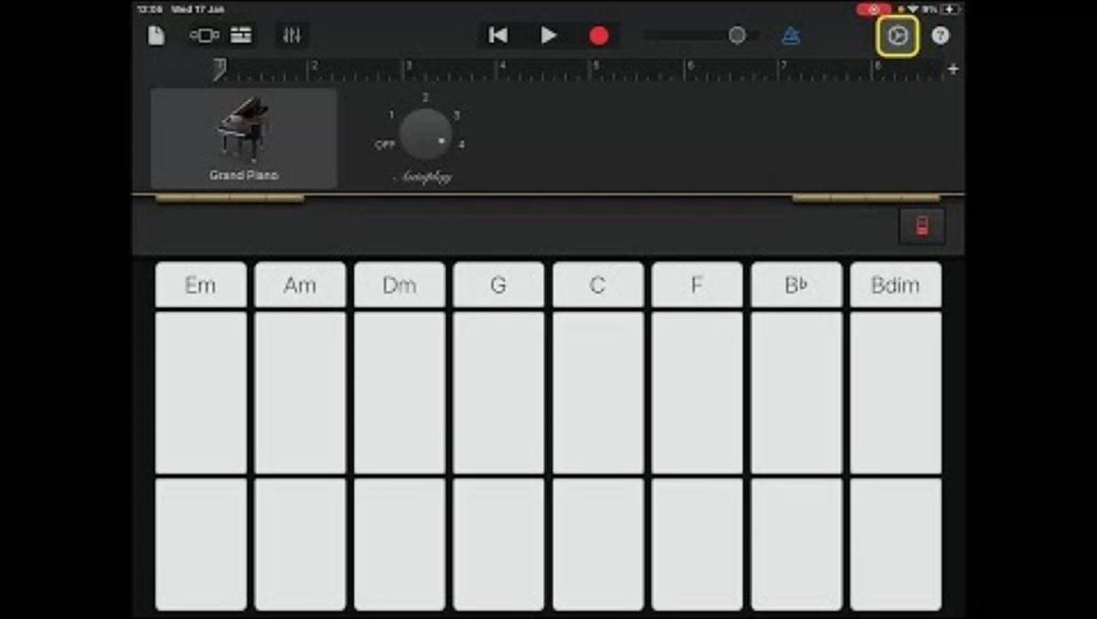
Lesson Video

Slide 6
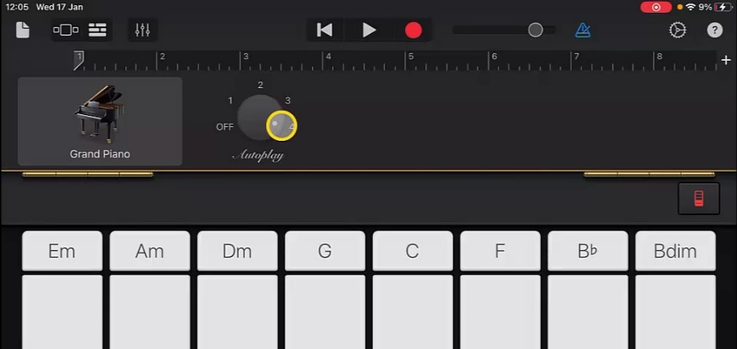
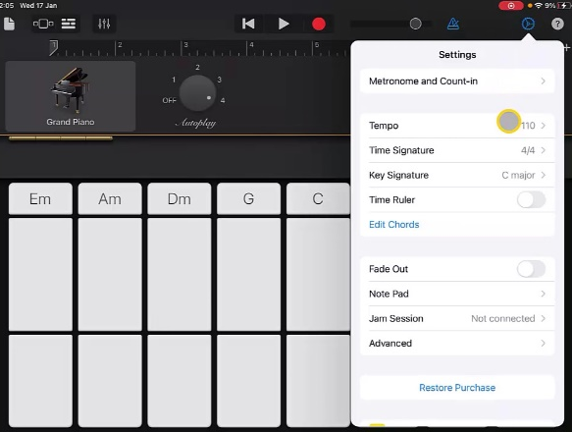
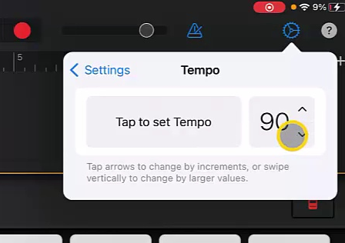
Steps to Create Song
Open a new track and select the Piano. Make sure it is on ‘Grand Piano’ then choose ‘Autoplay’ ‘4’.
2. Go to settings, choose ‘Tempo’ and use the arrows to adjust this to ‘90’.

Slide 7
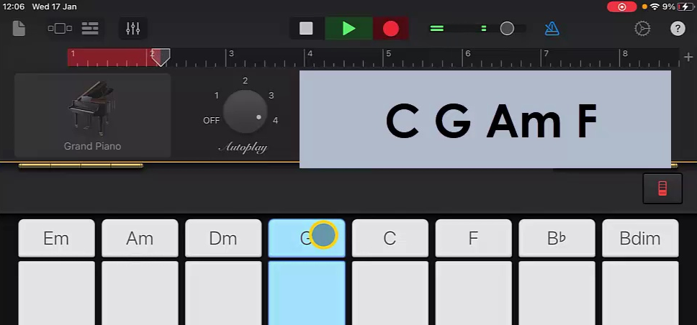
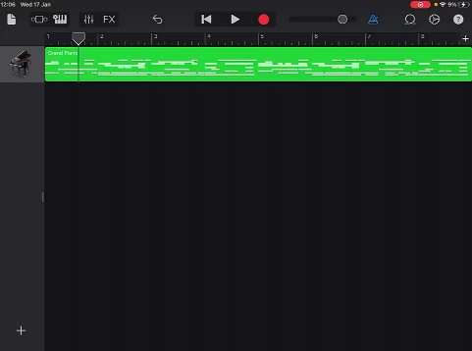
Steps to Create Song
3. Press ‘Record’ and play the chords in order hitting the next one at each number. The pattern should repeat twice.
4. Once happy with recording return to ‘Track View’ and use ‘+’ to add another instrument.

Slide 8
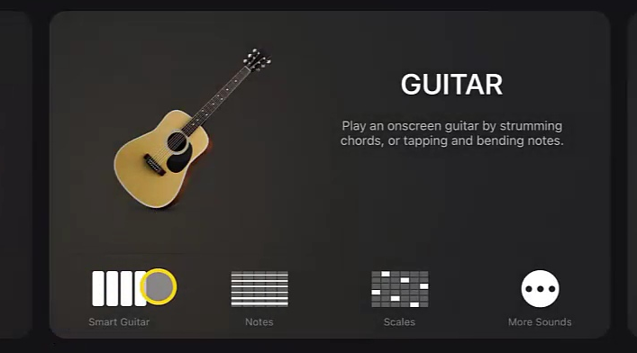
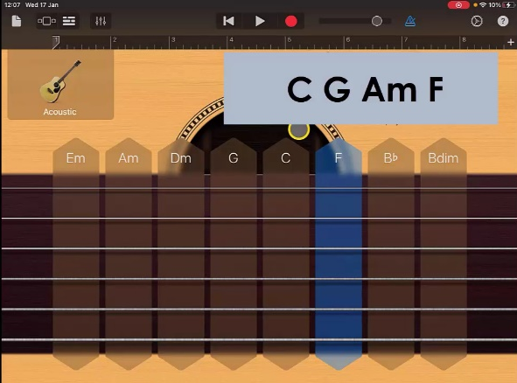
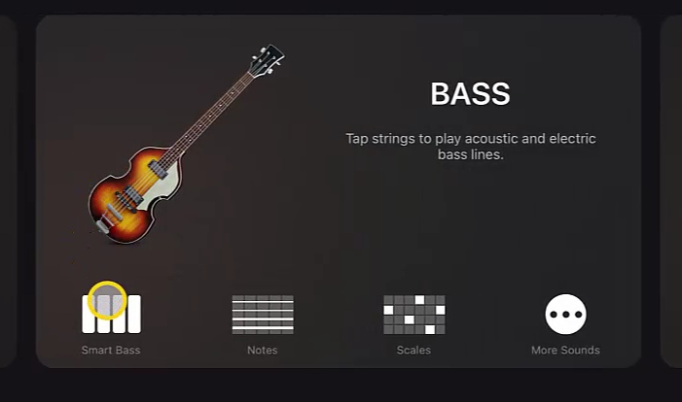
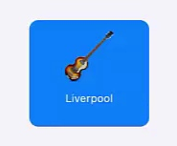
Steps to Create Song
5. Swipe to ‘Guitar’ and choose ‘Smart Guitar’ set the voice to ‘Acoustic Guitar’.
6. Record and play chord pattern along to piano track without Autoplay.
7. Return to the ‘Track View’ and add a new instrument. This time swipe to ‘Bass’ and choose ‘Smart Bass’. Select voice as ‘Liverpool Bass’

Slide 9
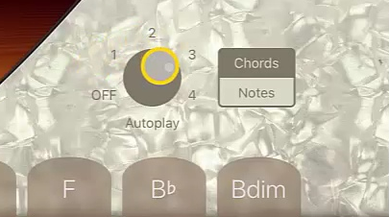
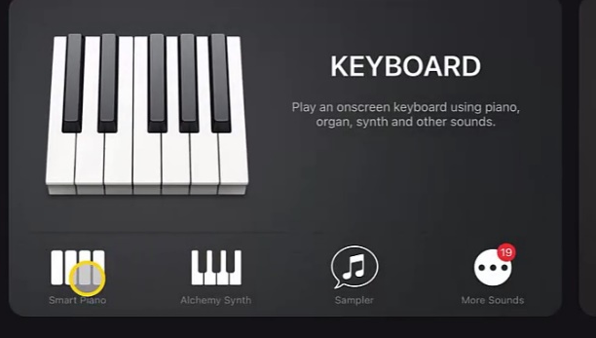
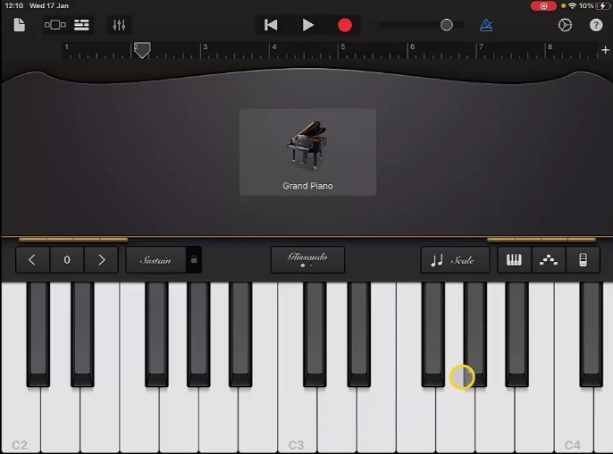
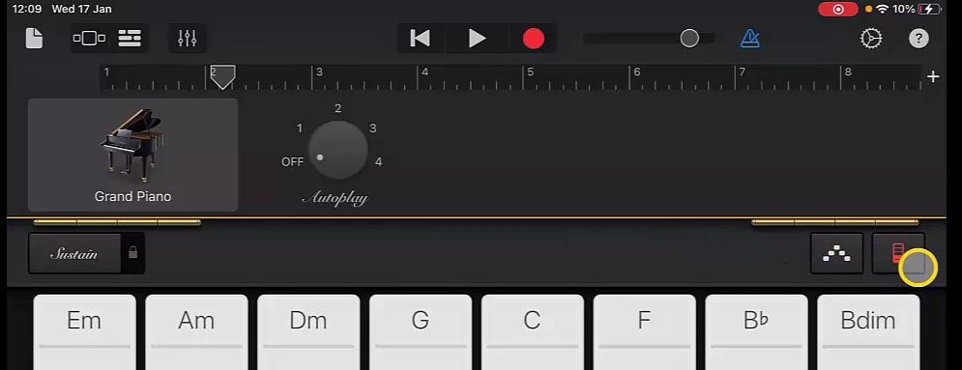
Steps to Create Song
8. Set ‘Autoplay’ to ‘3’ and record following the chord pattern.
9. Once happy with recording return to ‘Track View’ and add a new instrument. This time select ‘Keyboard’. Use the red icon on right to change from chords to keys.

Slide 10
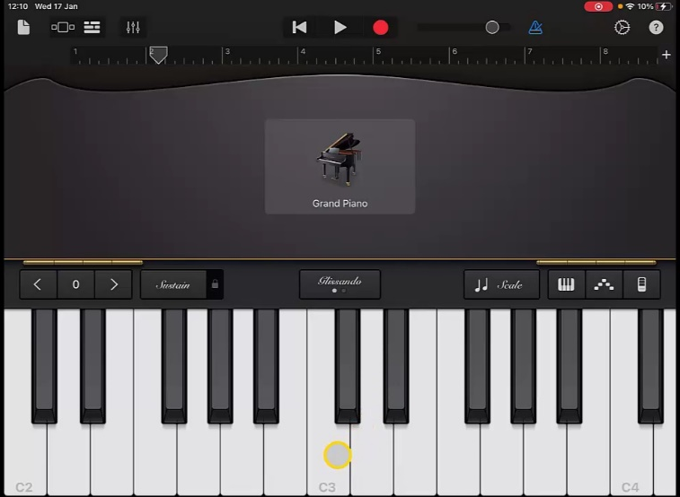
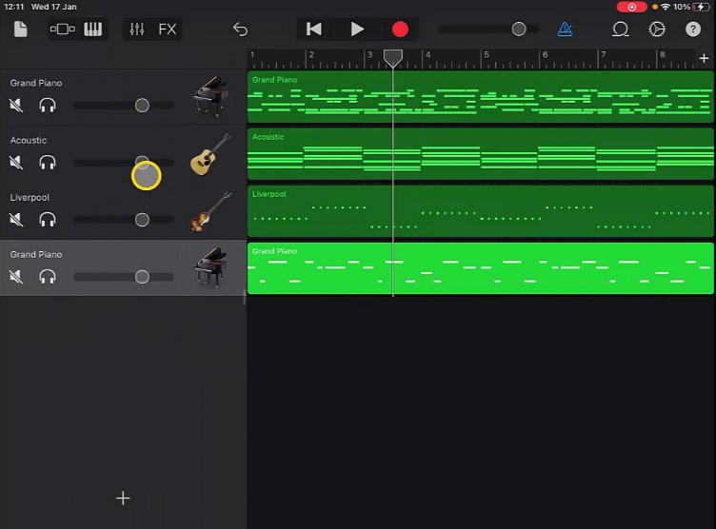
Steps to Create Song
10. Record a melody on the piano using the three notes C, D, E.
11. Return to ‘Track View’ and swipe from left to get track volume controls. Play back track and adjust accordingly.
12. Rename your track before you finish.

Slide 11
Plenary Discussion Questions
What did you enjoy the most about creating this track?
What did you find challenging about creating this track?
What did you learn about the Genre of Music we created?
What instrument or technique was your favourite to include?
What would you do differently if you created another track like this?

