Slide 1

GarageBand
Lessons
Lesson 5 – Creating 12 Bar Blues

Slide 2
Lesson 5: Creating 12 Bar Blues
We are learning to create 12 Bar Blues.
I can explain what blues music sounds like and some of the instruments used.
I can create using the pentatonic scale.
I can create a blues song following a 12 Bar chord pattern.

Slide 3

Vocabulary/Topics to Explore
Blues Genre
12 Bar Blues
Pentatonic Scale
Clavichord
Improvisation

Slide 4


Listening Questions
What can you hear?
What instruments did you hear?
Is it fast or slow?
What is the style of music?
Where in the world is the music from?
When do you think the music was written?

Slide 5
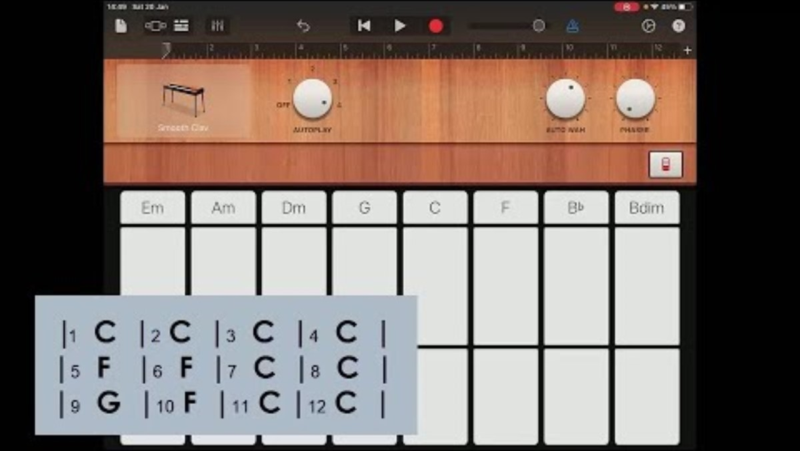
Lesson Video

Slide 6
12 Bar Blues Chord Pattern
|1 C |2 C |3 C |4 C |
|5 F |6 F |7 C |8 C |
|9 G |10 F |11 C |12 C |

Slide 7
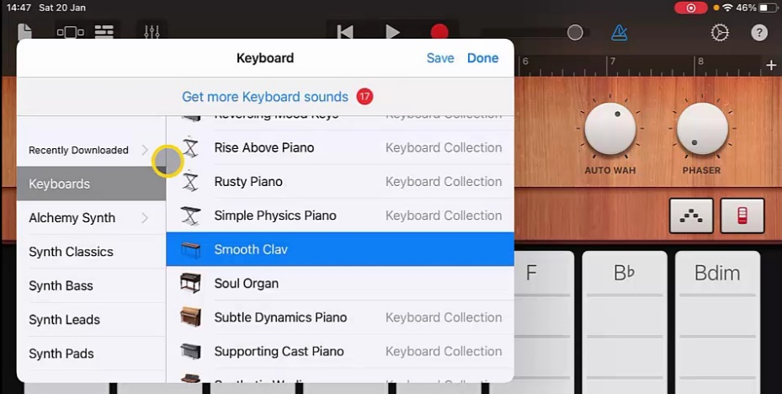
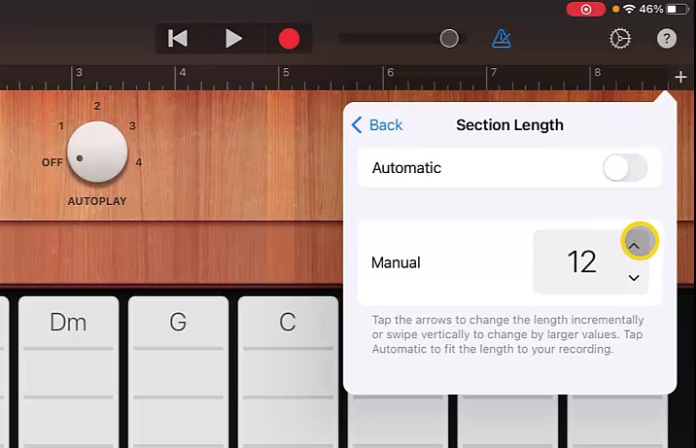
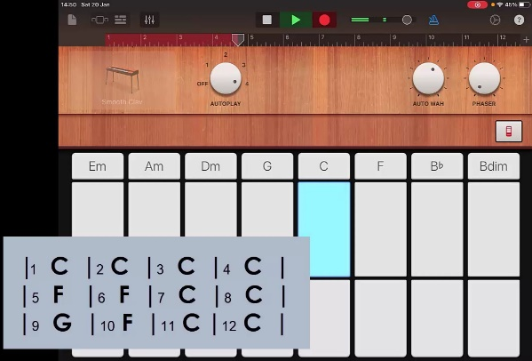
Steps to Create Song
Create a new song and swipe to choose ‘Keyboard’. Change the keyboard voice to ‘Smooth Clav’.
2. Go to the ‘+’ icon at the end of the bars and increase the number of bars in Section A to 12.
3. Go to settings and change the tempo to 100.
4. Set ‘Autoplay’ to 4 and record the track following the chord pattern. Use the largest section of the keys.

Slide 8
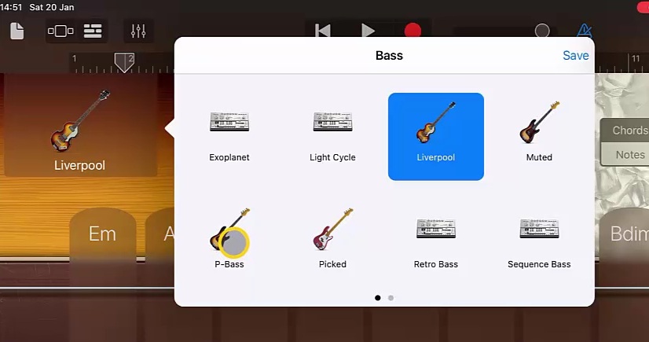
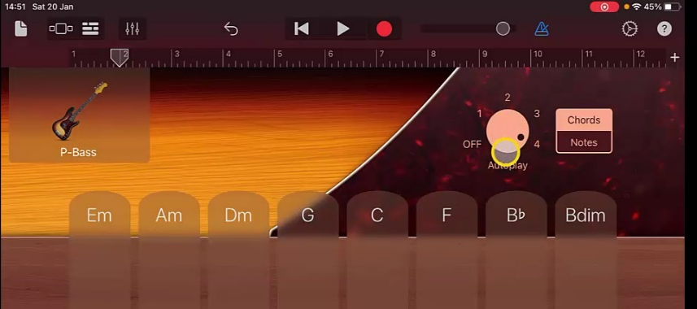
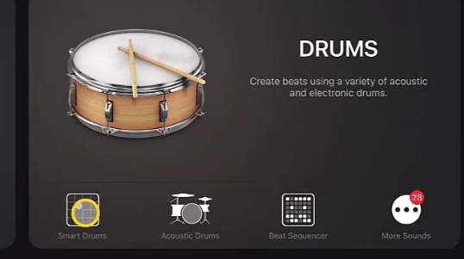
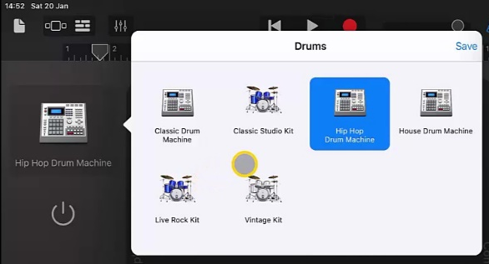
Steps to Create Song
5. Once happy return to ‘Track View’ and add a new instrument. This time a ‘Bass’, select ‘Smart Bass’. Choose the P-Bass sound.
6. Select ‘Autoplay’ ‘4’ and record the chord pattern again.
7. Once happy return to ‘Track View’ and add ‘Drums’ selecting ‘Smart Drums’. Change the voice to ‘Vintage Kit’

Slide 9
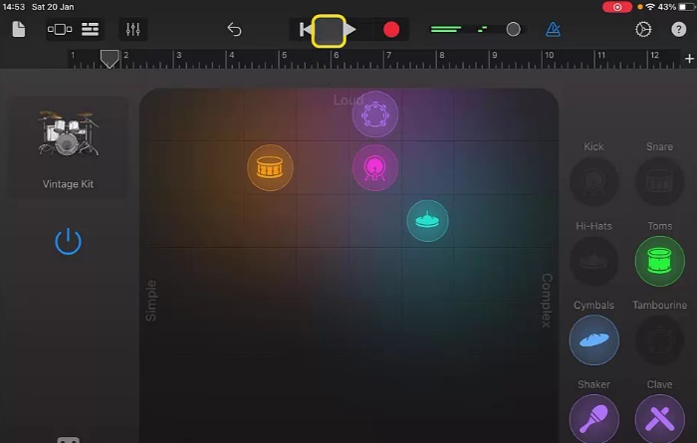
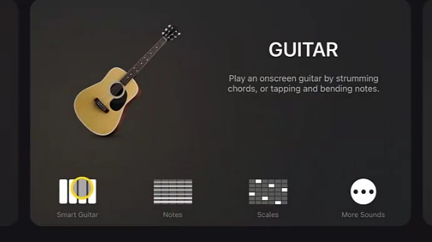
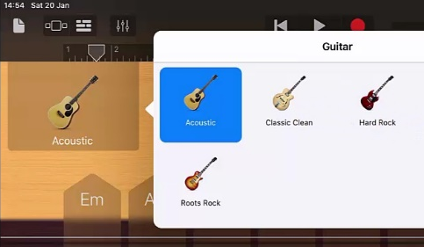
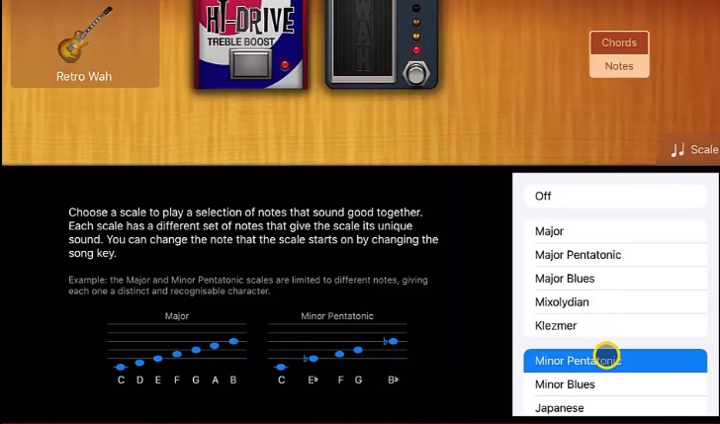
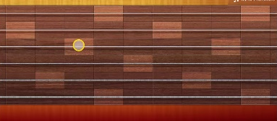
Steps to Create Song
8. Drag the parts of the drum beat into position as shown and record this beat.
9. Return to ‘Track View’ and add a ‘Smart Guitar’ track, change the voice to ‘Retro Wah’.
10. Go to ‘Notes’ and set scale to ‘Minor Pentatonic’.
11. Record a melody by playing single notes and making use of bending. Try and start and end on shaded notes.
12. Return to track view and make changes to volume until you are happy.

Slide 10
Plenary Discussion Questions
What did you enjoy the most about creating this track?
What did you find challenging about creating this track?
What did you learn about the Genre of Music we created?
What instrument or technique was your favourite to include?
What would you do differently if you created another track like this?

