Slide 1

GarageBand
Lessons
Lesson 6 – Creating Classical Music

Slide 2
Lesson 6: Creating Classical Music
We are learning to create a piece of classical music.
I can explain what classical music sounds like and some of the instruments used.
I can explain what a musical key is.
I can create a simple track with different classical instruments and techniques.

Slide 3

Vocabulary/Topics to Explore
Classical Music
Instruments of an Orchestra (Strings, Woodwind, Brass and Percussion)
Clarinet
Flute
French Horn
Key Signatures
Major and Minor

Slide 4


Listening Questions
What can you hear?
What instruments did you hear?
Is it fast or slow?
What is the style of music?
Where in the world is the music from?
When do you think the music was written?

Slide 5
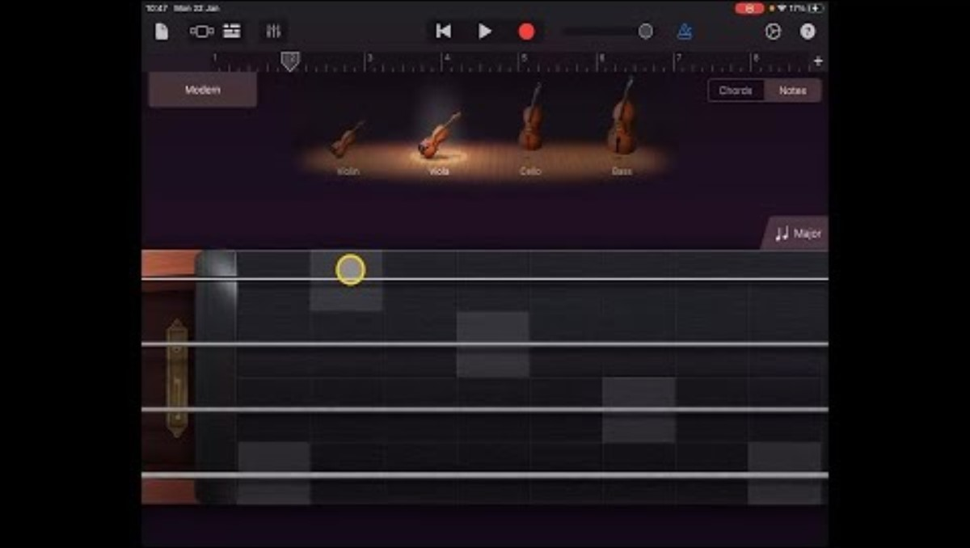
Lesson Video

Slide 6
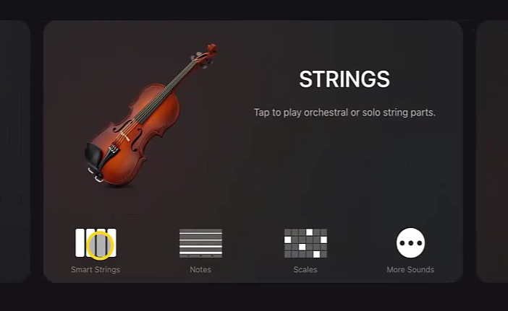
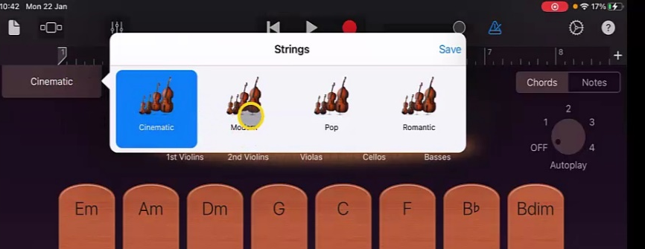
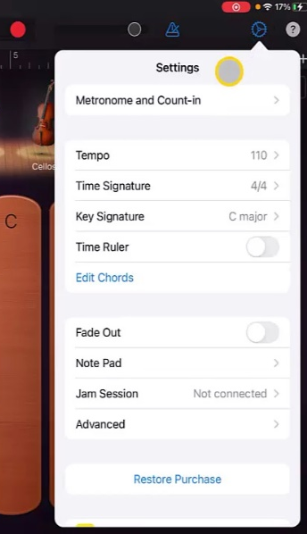
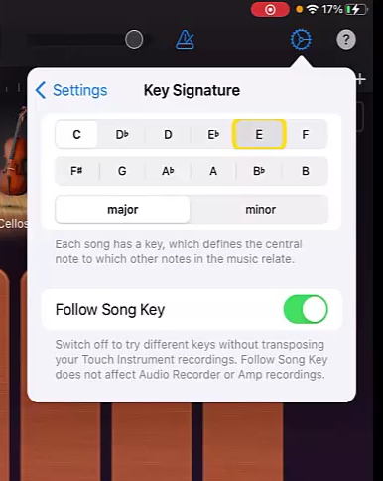
Steps to Create Song
1. Create a new track and select ‘Strings’ and ‘Smart Strings’
2. Set the strings voice to ‘Modern’.
3. Go to settings and change the ‘Key Signature’ to ‘E’ Major’.
Set ‘Autoplay’ to 3 and Record the strings backing track playing the ‘E’ and ‘A’ chords changing at each bar.
5. Return to ‘Track View’ and add a new instrument. This time another ‘Strings’ selecting ‘Notes’.
6. At the top un-select the Violin, Cello and Bass leaving just the Viola.
7. Go to ‘Scale’ and select ‘Major’
8. Record a track by playing some notes on the Viola string.
9. Return to ‘Track View’ and select a new ‘Keyboard’ track. Change the voice to ‘Clarinet’ this can be found in the ‘Other’ tab.
10. Using the red icon at the right hand side to change from Chords to Notes if not already set. Then set the ‘Scale’ to ‘Major’.
11. Record an improvised melody using the notes.
12. Then add another ‘Keyboard’ track, selecting the ‘Flute’ voice this time. As before go to ‘Notes’ and change ‘Scale’ to ‘Major’.
13. Create and record a different melody to the one created on the Clarinet.
14. Finally add one more track. Choose ‘Keyboard’ again and this time choose ‘French Horn’. Go to ‘Notes’ and change ‘Scale’ to ‘Major’.
15. Record a track following the chord pattern of ‘E’ and ‘A’ in the bass part of the chords (shaded part).
16. Once happy make changes to volumes of tracks as appropriate.

Slide 7
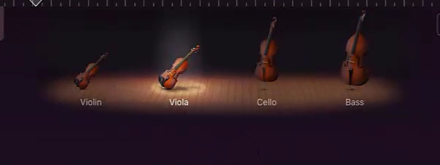
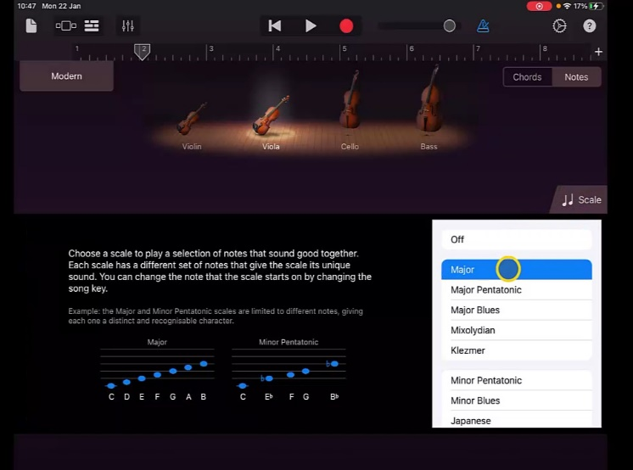
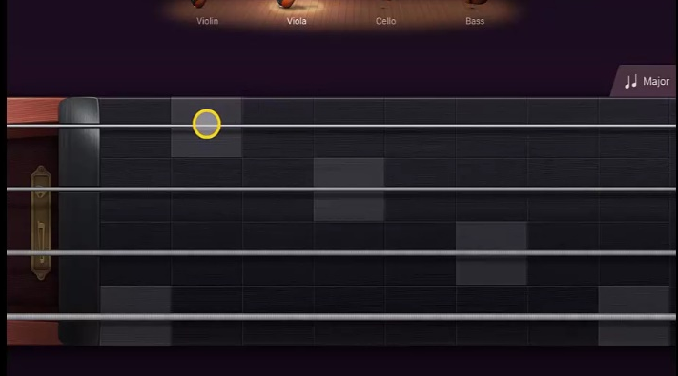
Steps to Create Song
5. Return to ‘Track View’ and add a new instrument. This time another ‘Strings’ selecting ‘Notes’.
6. At the top un-select the Violin, Cello and Bass leaving just the Viola.
7. Go to ‘Scale’ and select ‘Major’
Record a track by playing some notes on the Viola string.

Slide 8
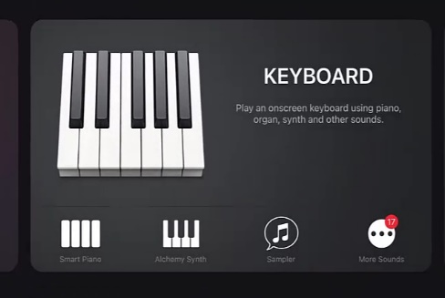
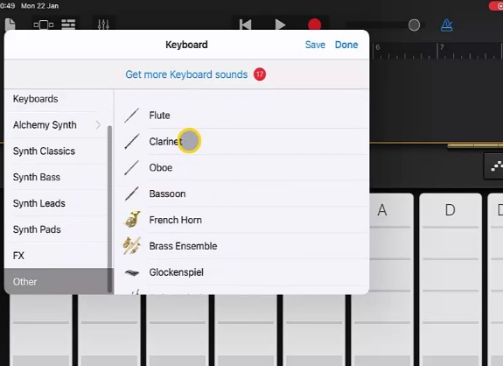
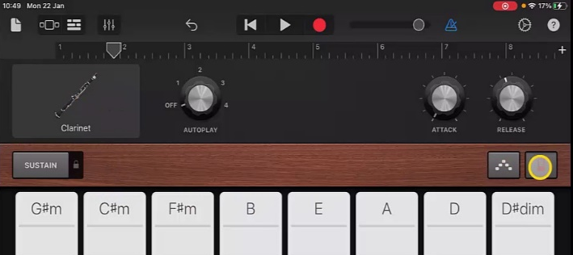
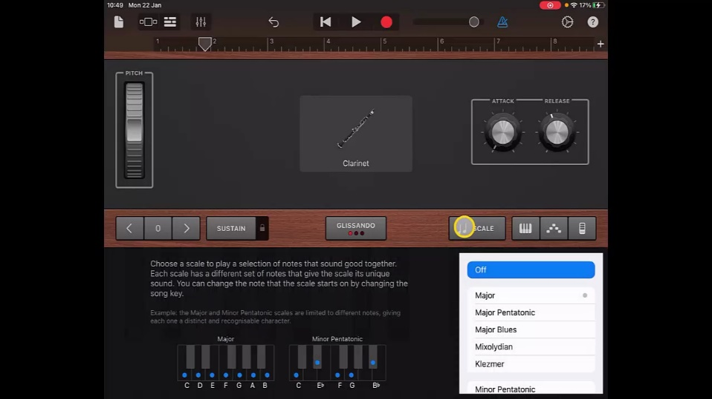
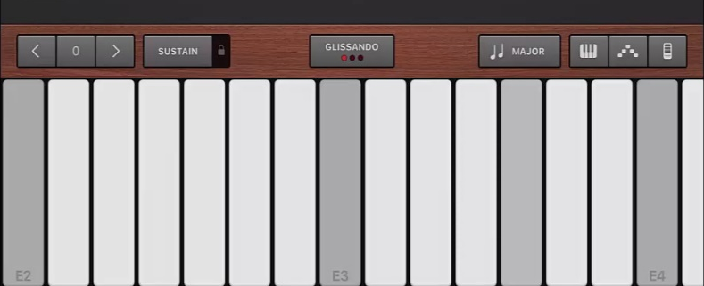
Steps to Create Song
9. Return to ‘Track View’ and select a new ‘Keyboard’ track. Change the voice to ‘Clarinet’ this can be found in the ‘Other’ tab.
10. Using the red icon at the right hand side to change from Chords to Notes if not already set. Then set the ‘Scale’ to ‘Major’.
Record an improvised melody using the notes.

Slide 9
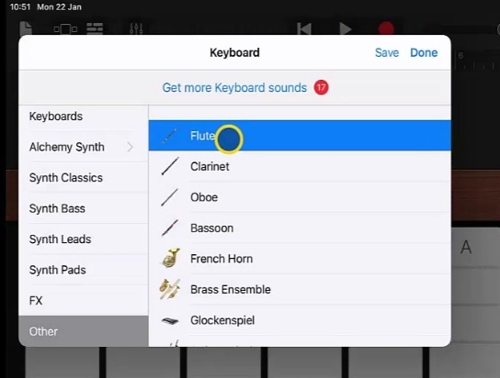
Steps to Create Song
12. Then add another ‘Keyboard’ track, selecting the ‘Flute’ voice this time. As before go to ‘Notes’ and change ‘Scale’ to ‘Major’.
13. Create and record a different melody to the one created on the Clarinet.

Slide 10
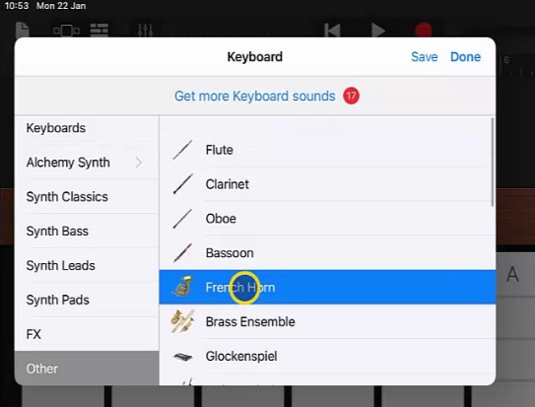
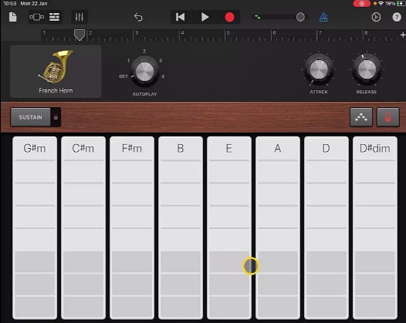
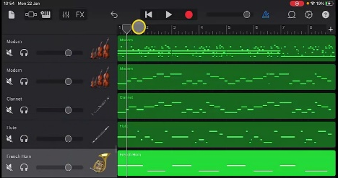
Steps to Create Song
14. Finally add one more track. Choose ‘Keyboard’ again and this time choose ‘French Horn’. Change ‘Scale’ to ‘Major’.
15. Record a track following the chord pattern of ‘E’ and ‘A’ in the bass part of the chords (shaded part).
16. Once happy make changes to volumes of tracks as appropriate.

Slide 11
Plenary Discussion Questions
What did you enjoy the most about creating this track?
What did you find challenging about creating this track?
What did you learn about the Genre of Music we created?
What instrument or technique was your favourite to include?
What would you do differently if you created another track like this?

