Slide 1

GarageBand
Lessons
Lesson 7 – Creating World Music

Slide 2
Lesson 7: Creating World Music
We are learning to create world music.
I can recognise the features of music from a different culture.
I can make use of Chinese instruments.
I can experiment with the instruments and create a simple song.

Slide 3

Vocabulary/Topics to Explore
World Music Genre
Chinese Traditional Music
Guzheng
Erhu
Pipa
Chinese Percussion Instruments

Slide 4


Listening Questions
What can you hear?
What instruments did you hear?
Is it fast or slow?
What is the style of music?
Where in the world is the music from?
When do you think the music was written?

Slide 5
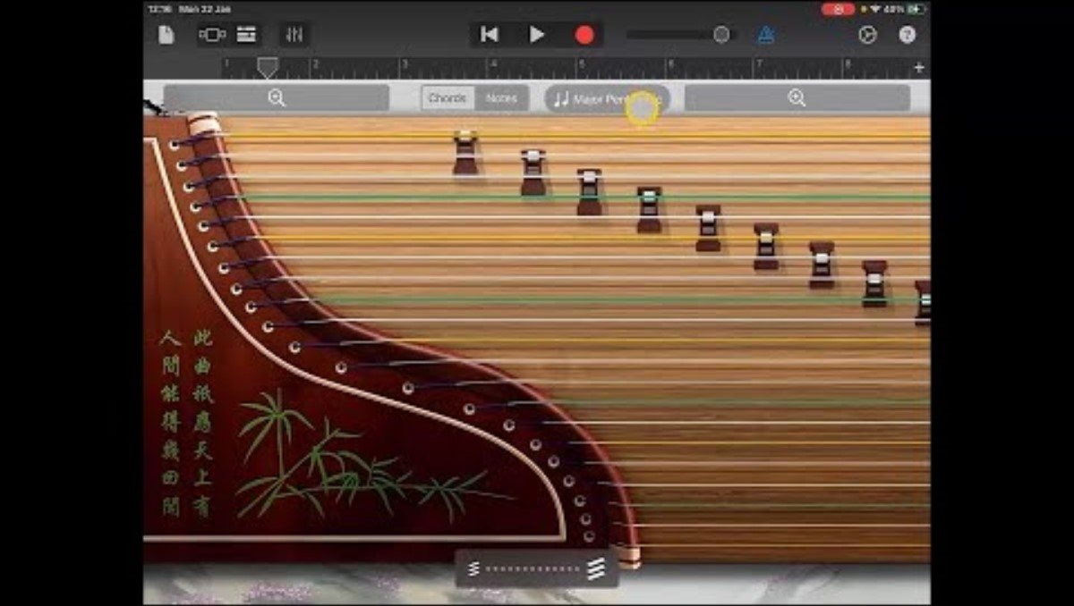
Lesson Video

Slide 6
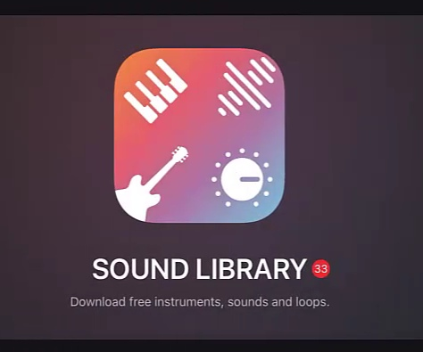
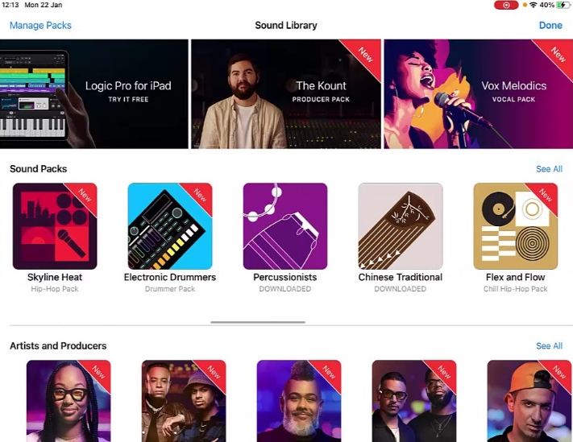
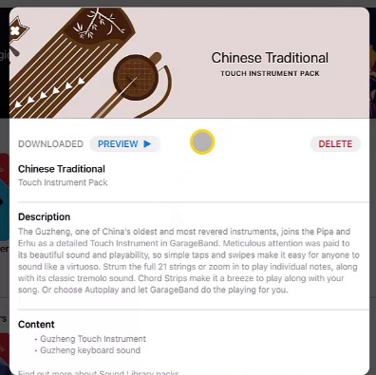
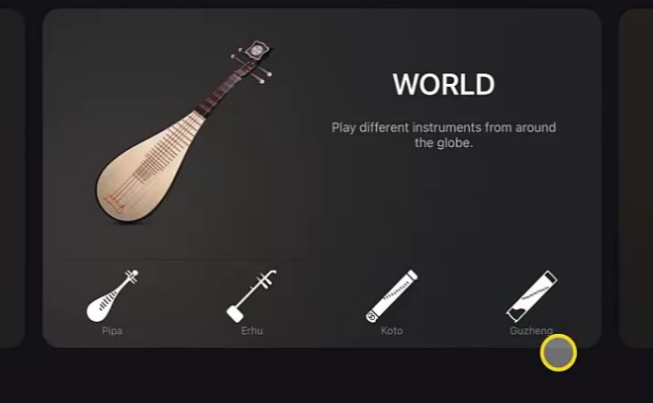
Steps to Create Song
Create a new song and go to ‘Sound Library’. Swipe through the ‘Sound Packs’ to find the ‘Chinese Traditional’ pack and download it.
2. Return to the instrument selector by tapping done and swipe to the ‘World’ section. Choose ‘Guzheng’ which should now be one of the options.

Slide 7
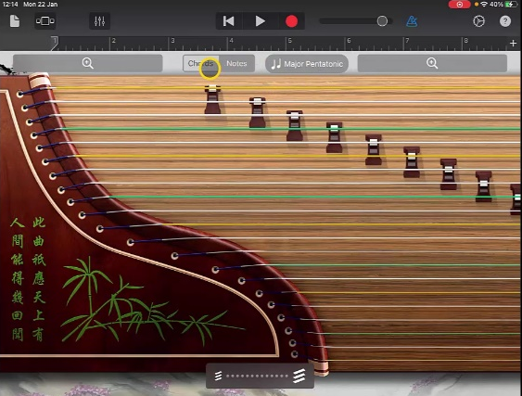
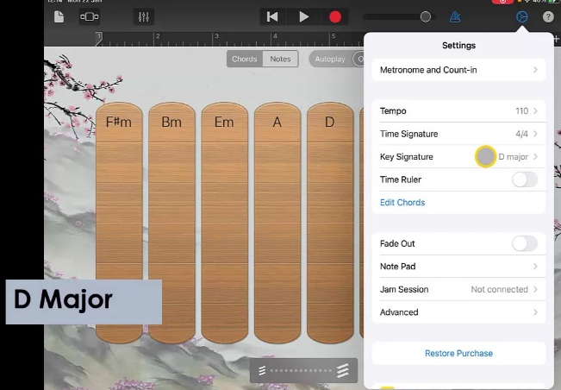
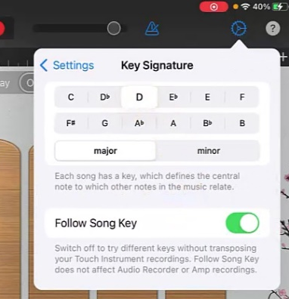

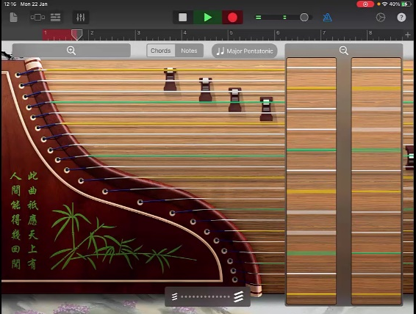
Steps to Create Song
3. Change to the ‘Chords’ view and go to settings and ‘Key Signature’. Change the key signature to ‘D Major’.
4. Choose ‘Autoplay’ ‘3’ and record the ‘D’ chord for the whole track length.
5. Return to ‘Track View’ and add a second ‘Guzheng’. Choose ‘Notes’ this time and make sure it is in ‘Major Pentatonic’
6. Use the zoom function and record a simple melody using the individual strings.

Slide 8
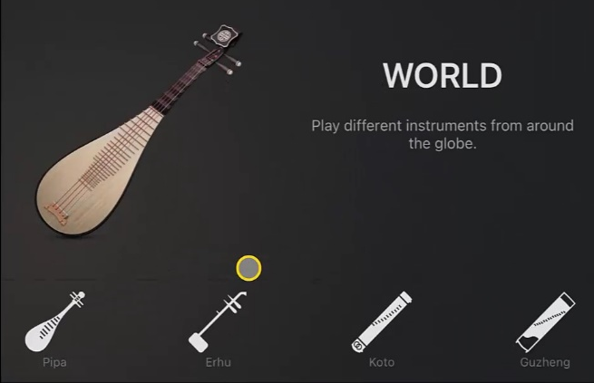
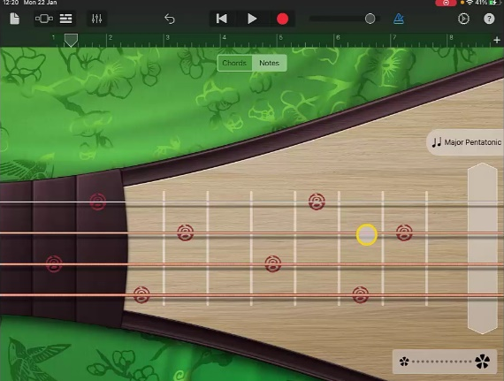
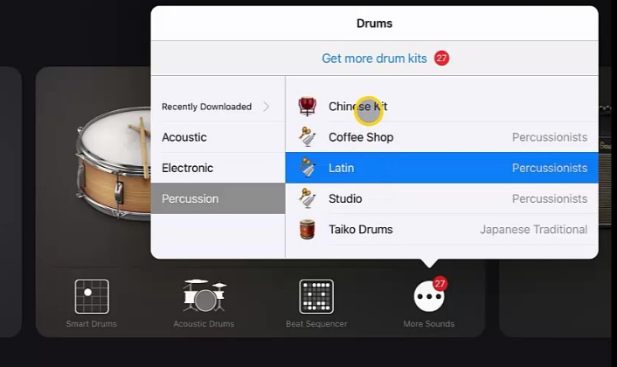
Steps to Create Song
7. Next add a new track and select ‘Erdu’. Make sure you are on ‘Notes’ and ‘Major Pentatonic’.
8. Record a track by sliding up and down the top string on the Erdu.
9. Add a further instrument this time the ‘Pipa’ and record a track by playing the single notes on the top string.
10. For the next track go to ‘Drums’ and select ‘More Sounds’. Go to percussion and choose ‘Chinese Kit’.

Slide 9
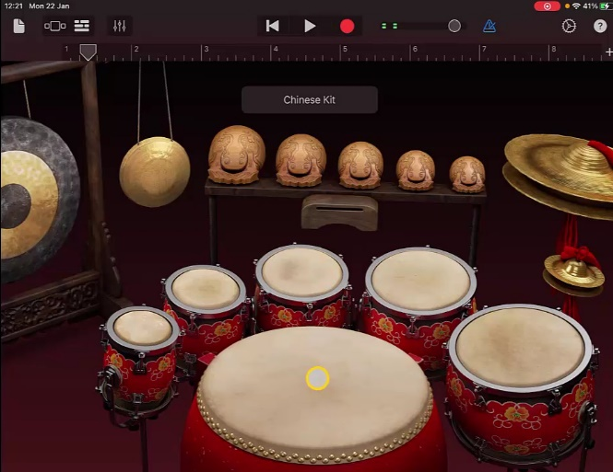
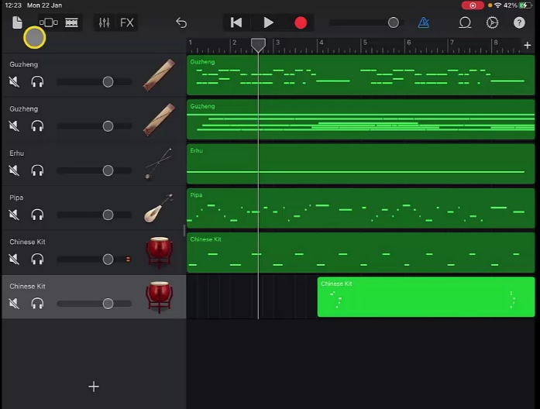
Steps to Create Song
11. Create and record a simple drum beat using the largest drum and one other.
12. Finally add another ‘Chinese Kit’ and add any percussion sounds you would like.
13. Adjust the volumes to finish your track.

Slide 10
Plenary Discussion Questions
What did you enjoy the most about creating this track?
What did you find challenging about creating this track?
What did you learn about the Genre of Music we created?
What instrument or technique was your favourite to include?
What would you do differently if you created another track like this?

