Slide 1

GarageBand
Lessons
Lesson 8 – Creating Jazz Music

Slide 2
Lesson 8: Creating Jazz Music
We are learning to create Jazz Music
I can explain what jazz music sounds like and some of the instruments used.
I can create using the major blues scale.
I can create a jazz song using multiple instruments and techniques.

Slide 3

Vocabulary/Topics to Explore
Jazz Music
Saxophone
Upright Bass
Brass in Jazz
Jazz Piano
Walking Bass
Major Blues Scale

Slide 4


Listening Questions
What can you hear?
What instruments did you hear?
Is it fast or slow?
What is the style of music?
Where in the world is the music from?
When do you think the music was written?

Slide 5
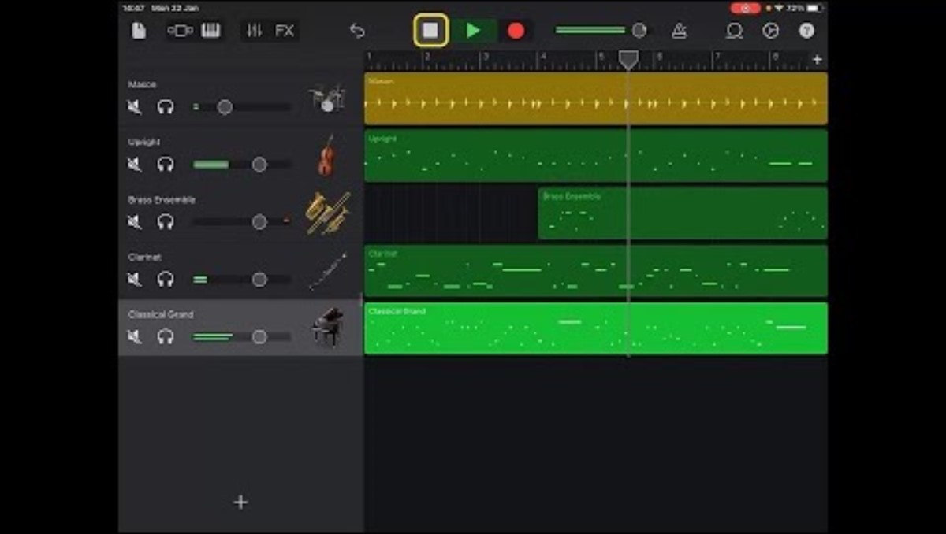
Lesson Video

Slide 6
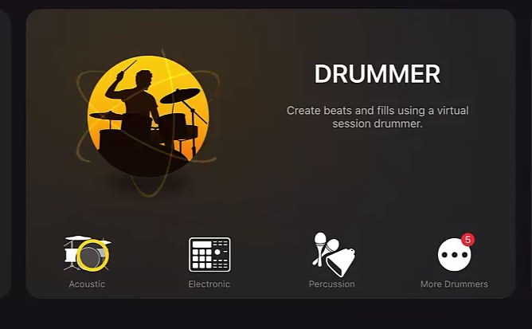
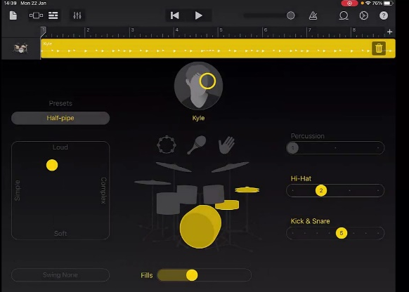
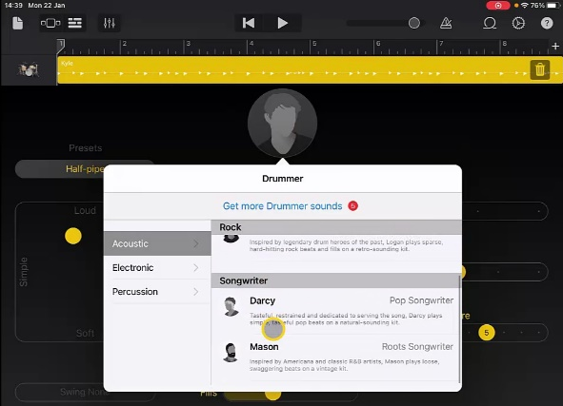
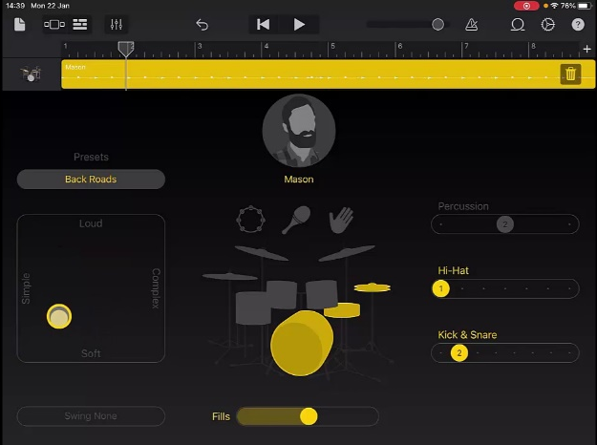
Steps to Create Song
1. Create a new song and swipe to find ‘Drummer’ (Not ‘Drums’) and choose ‘Acoustic’.
2. Tap on the face and change the drummer to ‘Mason’. Move the yellow circle to ‘Simple’ and ‘Soft’. Take away the symbol. Reduce the fills. Then Kick and Snare to 1. Go to Swing and choose ‘1/8 Swing Heavy’
3. No need to record as track is automatic. Return to the ‘Track View’ and add a new ‘Keyboard Instrument’.

Slide 7
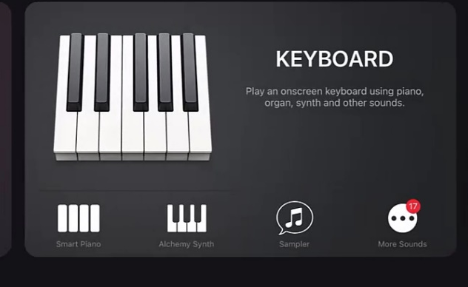
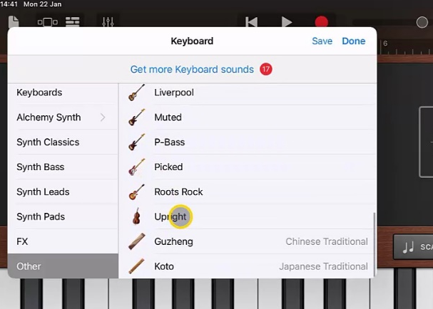
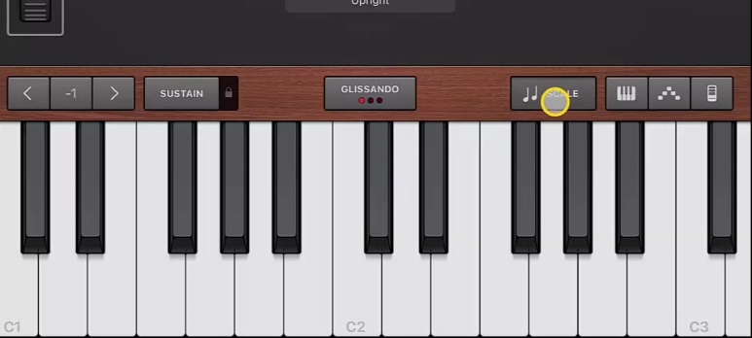
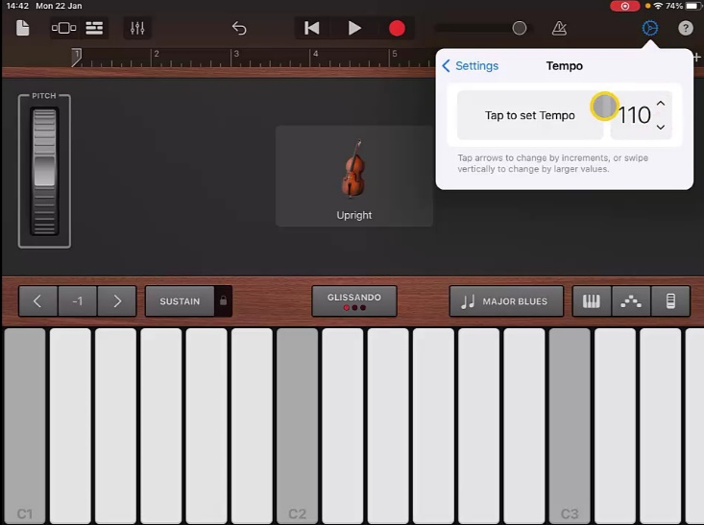
Steps to Create Song
4. Change the voice of this instrument to ‘Upright’ this is found in the ‘Other’ tab. Change the scale to ‘Major Blues’.
5. Go to settings and change the tempo to 110.
6. Create and record a walking bass by going up and down keyboard moving to the beat. (You may want to turn down the drums to hear this).

Slide 8
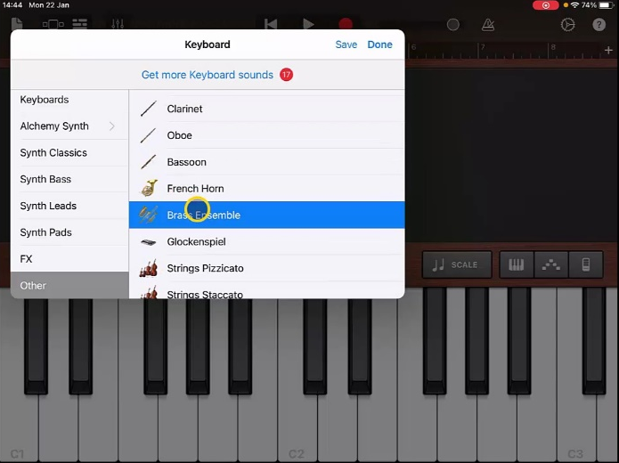
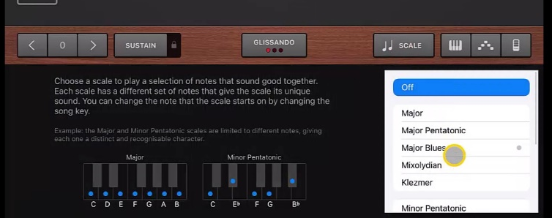
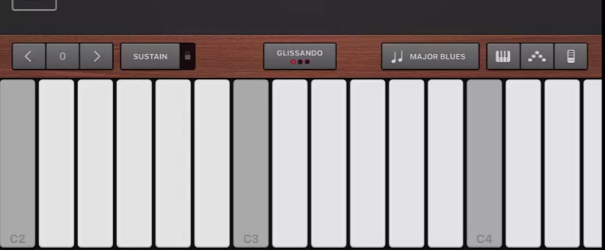
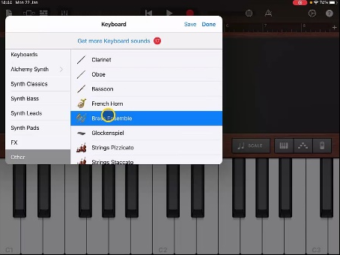
Steps to Create Song
7. Once you are happy add another ‘Keyboard’ instrument and this time choose ‘Brass Ensemble’ in the voices.
8. Change the scale again to ‘Major Blues’.
9. Record a short riff at Bar 4 and Bar 8.
10. Once you have your track. Add a further ‘Keyboard’ instrument and change the voice to ‘Clarinet’ and ‘Scale’ to ‘Major Blues’.

Slide 9
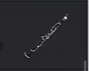

Steps to Create Song
11. Record an improvised melody using the Clarinet.
12. You could repeat steps 10 and 11 and change to ‘Classical Grand’ then choose your favourite to keep.
13. Once you are happy adjust the volumes and rename the track.

Slide 10
Plenary Discussion Questions
What did you enjoy the most about creating this track?
What did you find challenging about creating this track?
What did you learn about the Genre of Music we created?
What instrument or technique was your favourite to include?
What would you do differently if you created another track like this?

