Slide 1

GarageBand
Lessons
Lesson 9 – Creating Reggae Music

Slide 2
Lesson 9: Creating Reggae Music
We are learning to create Reggae Music
I can explain what reggae music sounds like and some of the instruments used.
I can create a reggae beat.
I can create a reggae song using multiple instruments and techniques.

Slide 3

Vocabulary/Topics to Explore
Reggae Music
Reggae Beats
Jamaican Culture

Slide 4


Listening Questions
What can you hear?
What instruments did you hear?
Is it fast or slow?
What is the style of music?
Where in the world is the music from?
When do you think the music was written?

Slide 5
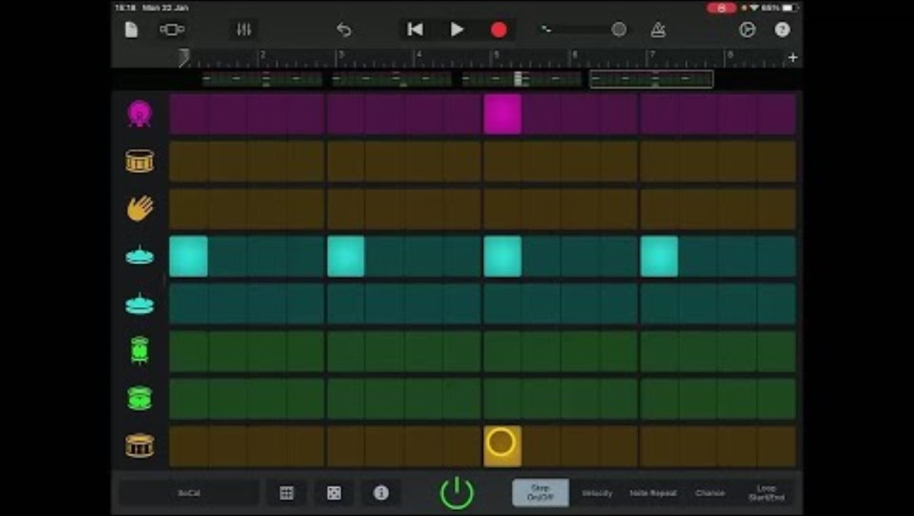
Lesson Video

Slide 6
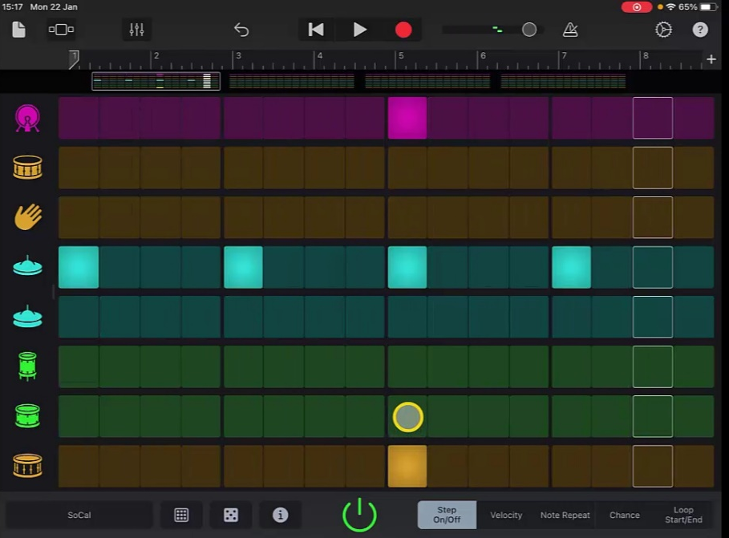
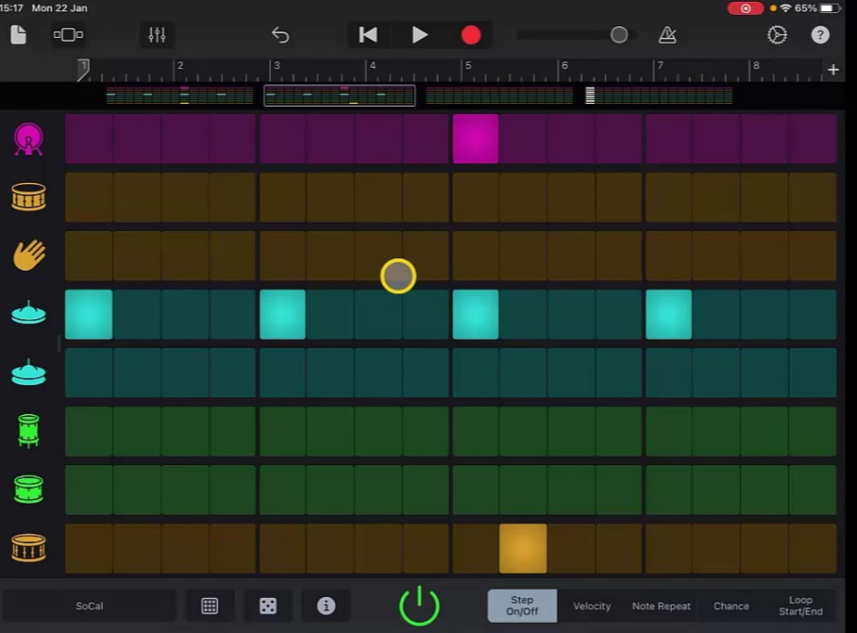
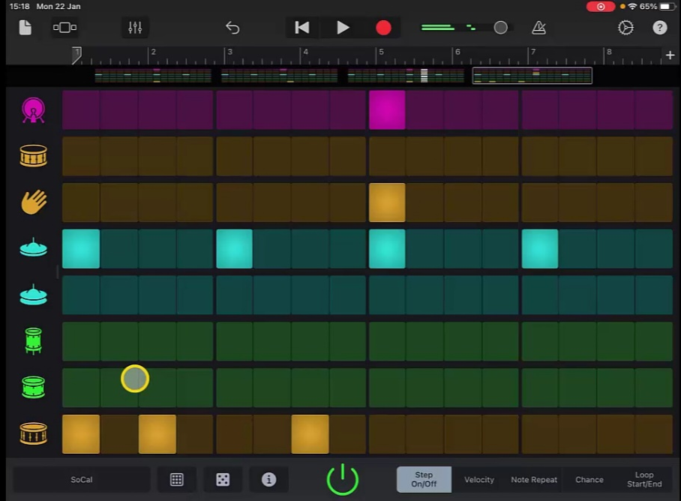
Drum Pattern
1
2
3
4

Slide 7
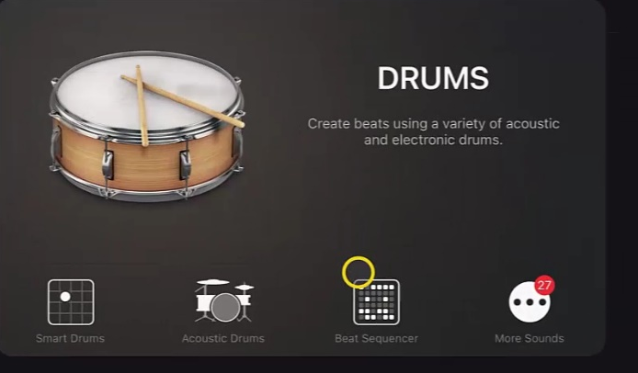
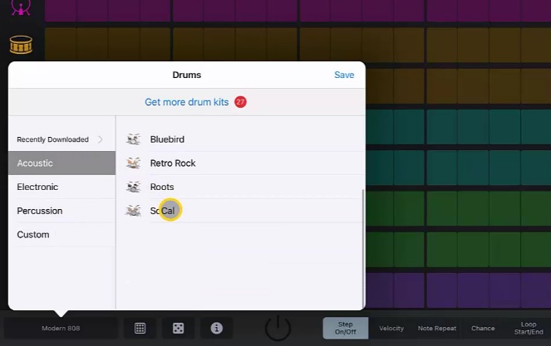
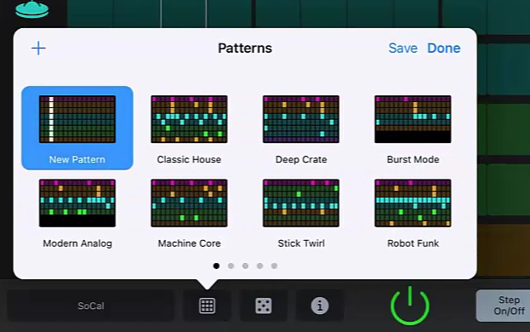
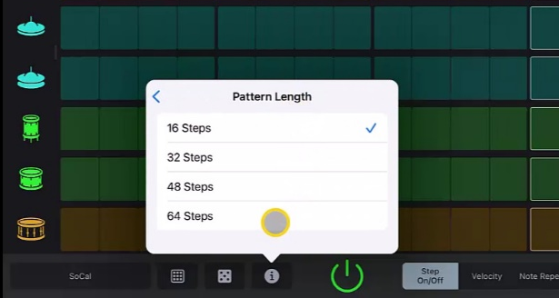
Steps to Create Song
Create a new song and go to ‘Drums’ selecting ‘Beat Sequencer’.
2. Change the voice to the ‘SoCal’
acoustic kit and create a new pattern.
3. Using the ‘i’ icon change the length of the track to 64 steps.

Slide 8
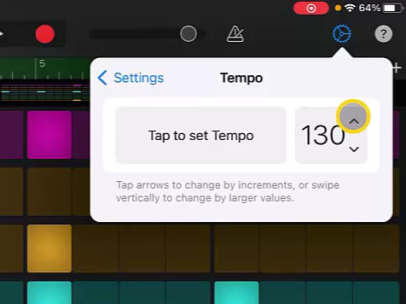
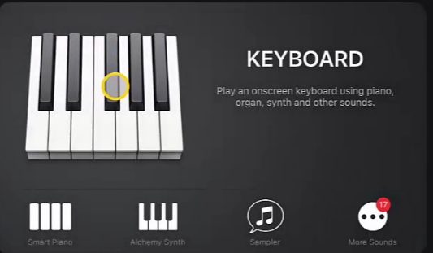
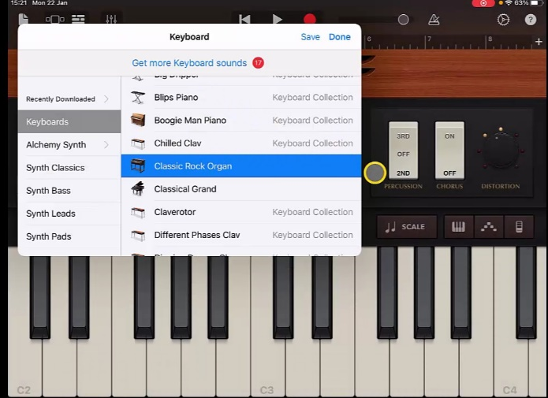
Steps to Create Song
4. Create the pattern as shown (on previous slide) with the changes in each of the parts. When you are happy, record the pattern.
5. Go to settings and change the tempo to 130.
6. Create a new ‘Keyboard’ track and change the voice to ‘Classic Rock Organ’

Slide 9
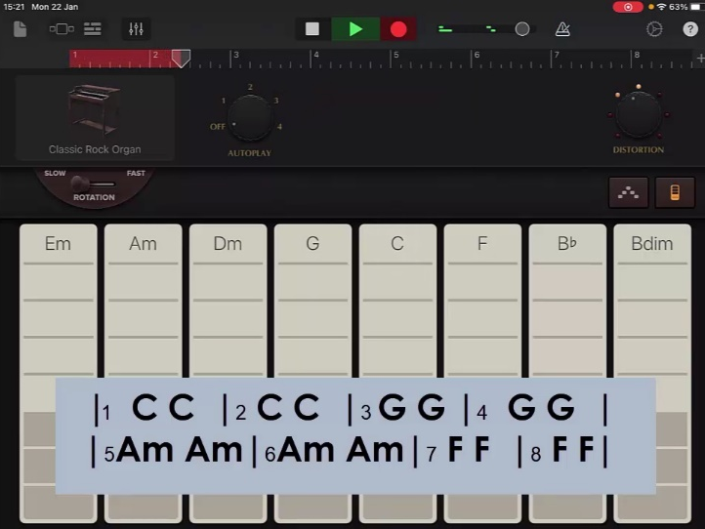
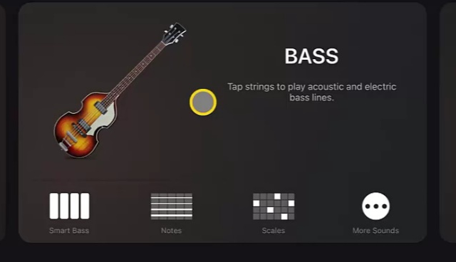
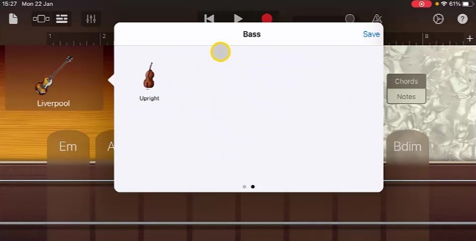
Steps to Create Song
7. Record the chord pattern by hitting the chords on the 2nd and 4th beat each time. This may take some practice.
8. Create a new track and choose ‘Bass’ and ‘Smart Bass’. Change the voice to ‘Upright’.

Slide 10
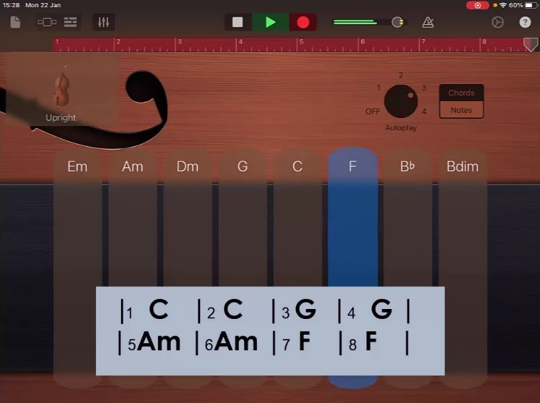
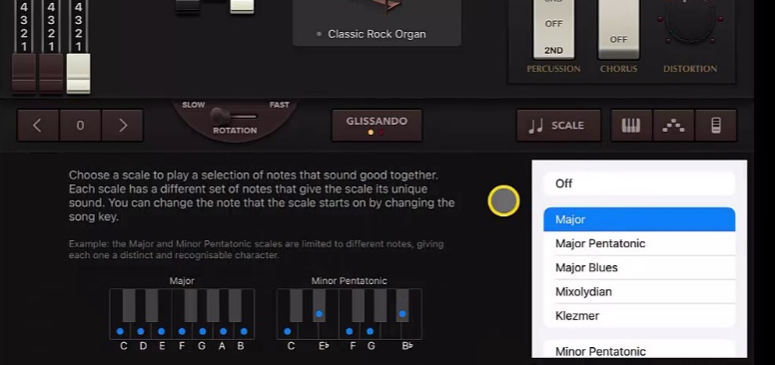
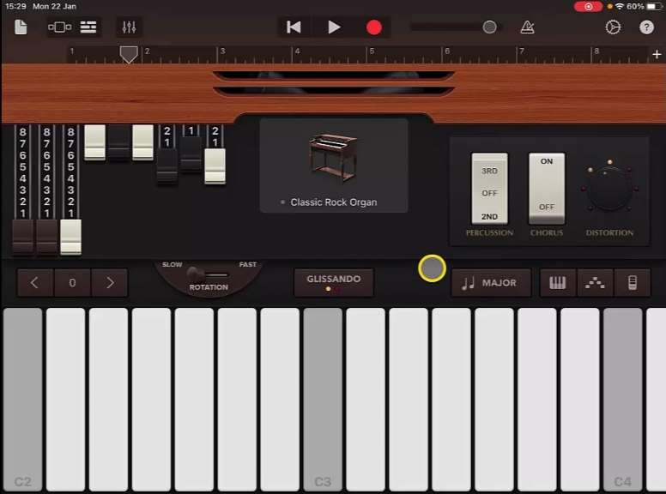
Steps to Create Song
9. Set ‘Autoplay’ to ‘3’ and follow the chord pattern when recording.
10. Next add a new instrument track selecting ‘Keyboard’ and ‘Classic Rock Organ’ again.
11. Change the ‘Scale’ to ‘Major’.
12. Create and record a melody that moves equally between C E and G.
13. Adjust the volumes and rename the track when you are finished.

Slide 11
Plenary Discussion Questions
What did you enjoy the most about creating this track?
What did you find challenging about creating this track?
What did you learn about the Genre of Music we created?
What instrument or technique was your favourite to include?
What would you do differently if you created another track like this?

