Slide 1

GarageBand
Lessons
Lesson 10 – Creating Your Own Tracks

Slide 2
Lesson 10: Creating Your Own Tracks
We are learning to create music of our choice using GarageBand.
I can select instrument sounds for my track.
I can choose styles and techniques to use.
I can use the skills I have learned to experiment and improve my track.

Slide 3

Vocabulary/Topics to Explore
Do you remember what these are?
Beat
Tempo
Melody
Key
Accompaniment
Bars

Slide 4


Listening Questions
What can you hear?
What instruments did you hear?
Is it fast or slow?
What is the style of music?
Where in the world is the music from?
When do you think the music was written?

Slide 5
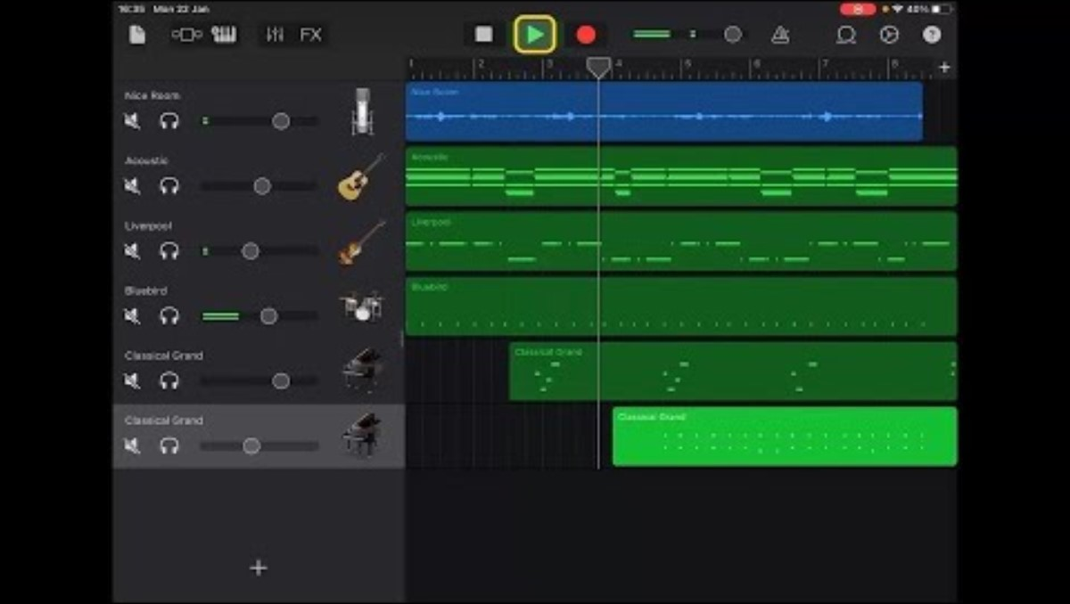
Lesson Video

Slide 6
Your Own Song
Your song should include:
At least 4 tracks/instruments
Be at least 8 Bars long
Include at least one Melody track.
Include at least one accompaniment track.
The rest is up to you!
Remember to make use of Tempo, Length of Bars and Key Signature when you set up your track.

Slide 7
Plenary Discussion Questions
What did you enjoy the most about creating this track?
What did you find challenging about creating this track?
What would you do differently if you created another track like this?

