Slide 1

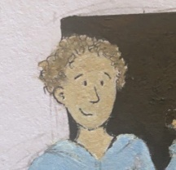





GarageBand
Lessons
Themed Lesson – Christmas Song

Slide 2
Themed Lesson – Christmas Song
We are learning to create a Christmas song.
I can explain what a chord is.
I can use the smart instruments in GarageBand.
I can follow a simple chord progression.
I can build a song with multiple instruments.

Slide 3



Listening Questions
What can you hear?
What instruments did you hear?
Is it fast or slow?
What is the style of music?
Where in the world is the music from?
When do you think the music was written?

Slide 4
Vocabulary/Topics to Explore
Christmas Songs.
Glockenspiel
Bells in Christmas Music
Brass Instruments
Sustain
Major Pentatonic Scale

Slide 5
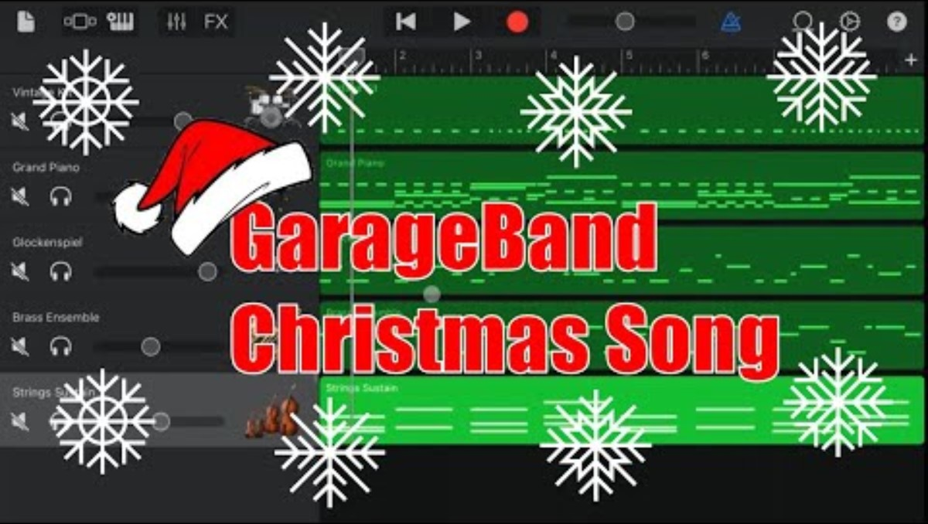
Lesson Video

Slide 6
Plenary Discussion Questions
What did you enjoy the most about creating this track?
What did you find challenging about creating this track?
What did you learn about the Genre of Music we created?
What instrument or technique was your favourite to include?
What would you do differently if you created another track like this?

