Slide 1







Christmas
Micro:bit
Lessons
LED Christmas Trees

Slide 2

LED Christmas Trees
We are learning to create a Christmas display using LEDs and the micro:bit.
I can recognise some simple electronic components.
I can explain some simple electronics concepts.
I can connect LEDs to the micro:bit pins in a circuit.
I can code my circuit to light up in sequence.

Slide 3


Electrical Safety
Always turn off the power before you make changes to a circuit.
Never connect your electronic circuits to live electricity (e.g. Wall Plugs).
Don’t connect GND direct to any other pin (Short Circuit).
Our 3V batteries are safe but higher voltages are not!

Slide 4
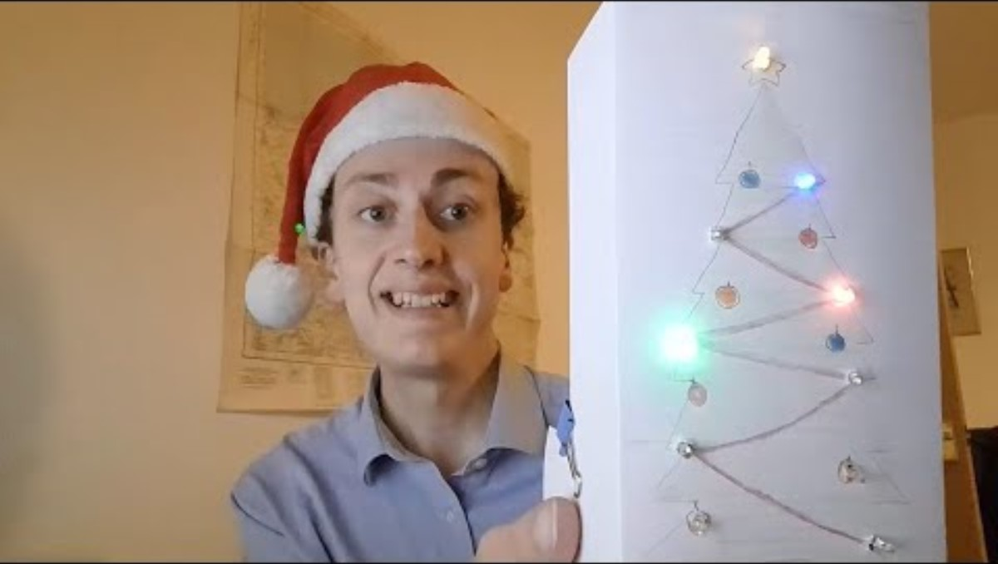
Introduction Video

Slide 5
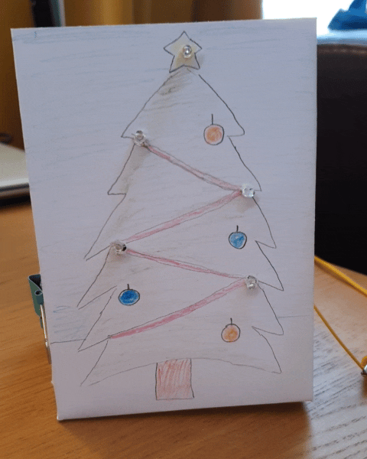
What are we trying to create?

Slide 6
What is electricity?

Slide 7
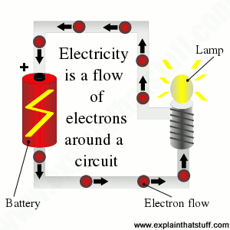
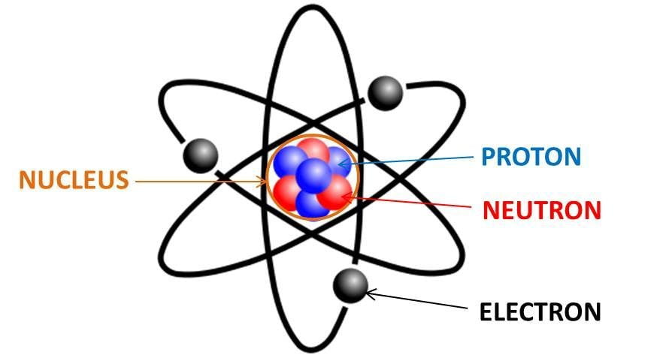
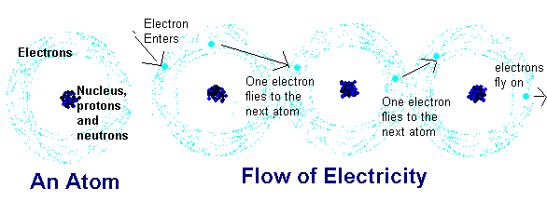
What is electricity?
Notes:
https://www.qrg.northwestern.edu/projects/vss/docs/power/2-whats-electron-flow.html#:~:text=Electron%20flow%20is%20what%20we,travel%20in%20only%20one%20direction.

Slide 8
What is an LED?

Slide 9
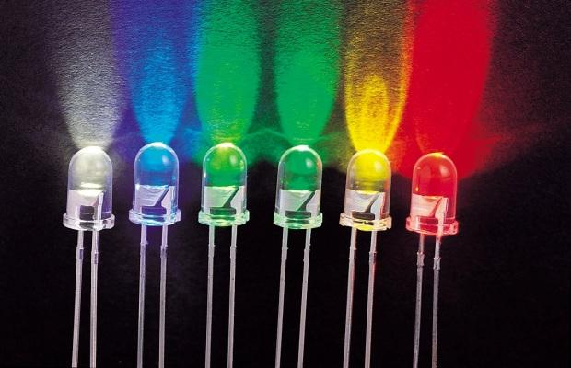
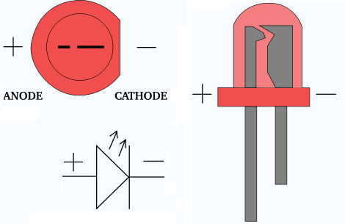
What is an LED?
An LED (Light Emitting Diode) is a one directional electronic component that emits (gives off) light.
They have a positive leg called the ‘Anode’ and a negative leg called the ‘Cathode’.

Slide 10
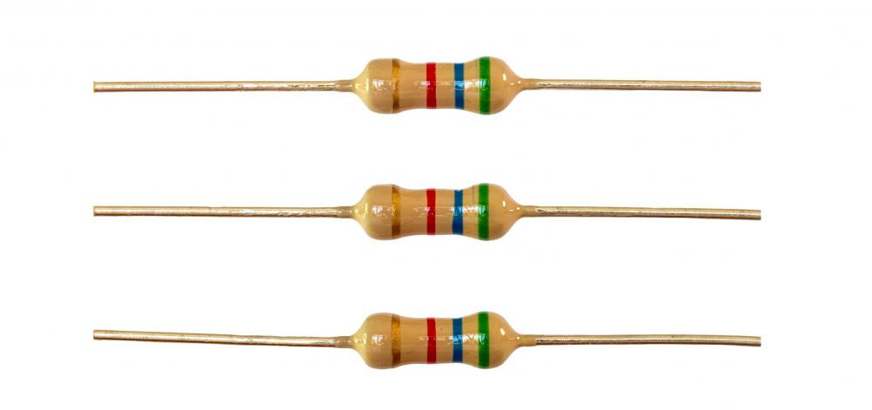
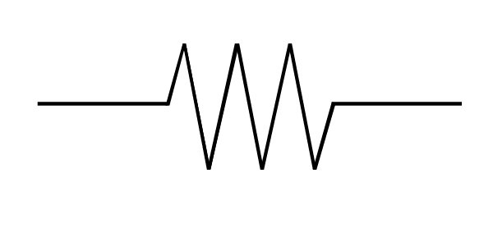
What is a Resistor?
A resistor limits the electrical current that flows through a circuit. In a resistor the energy of the electrons that pass through the resistor are changed to heat and/or light.

Slide 11
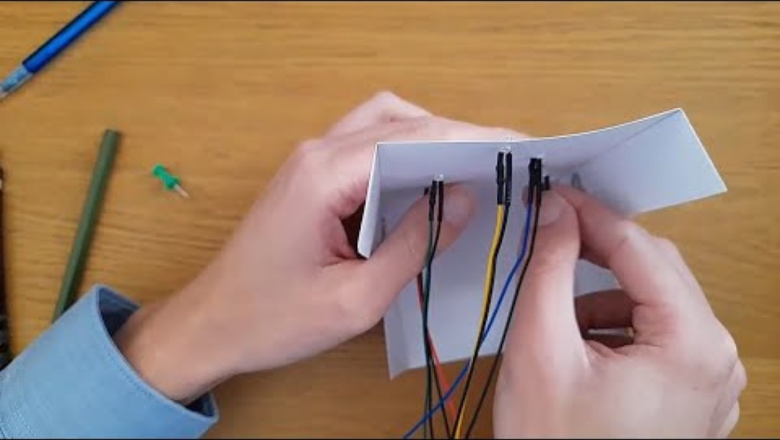
Video 2

Slide 12
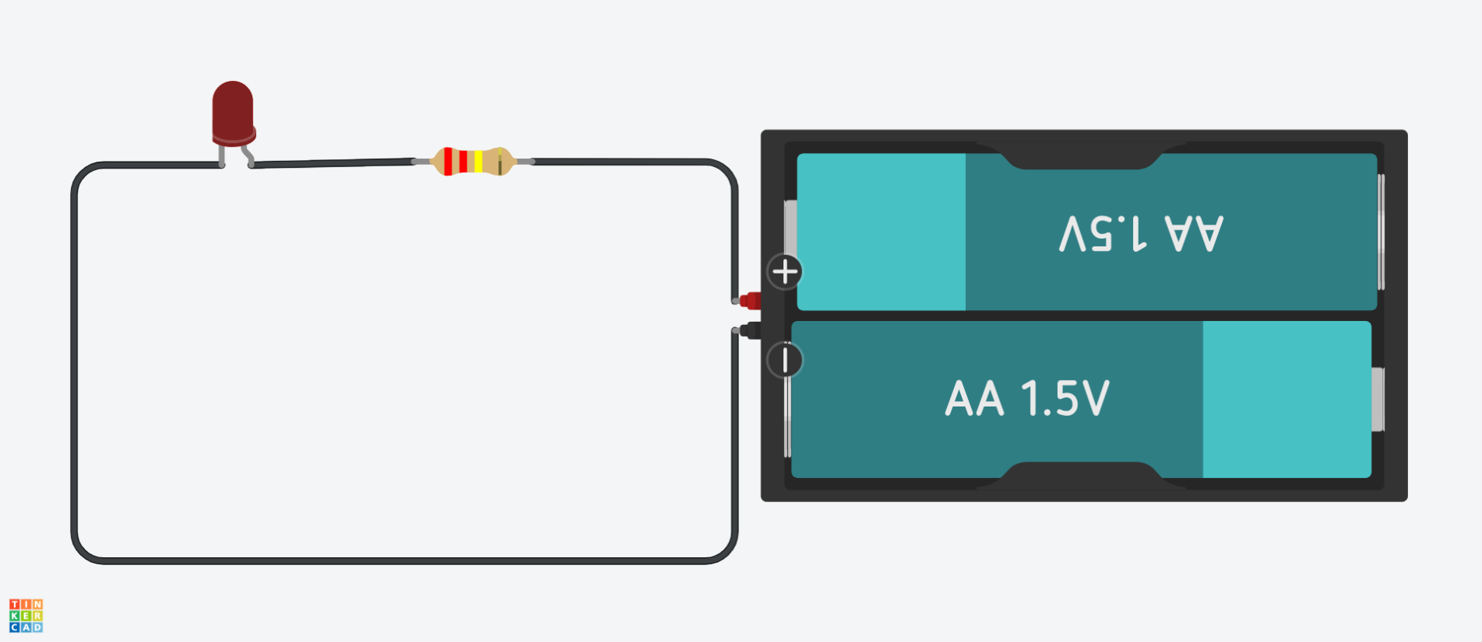
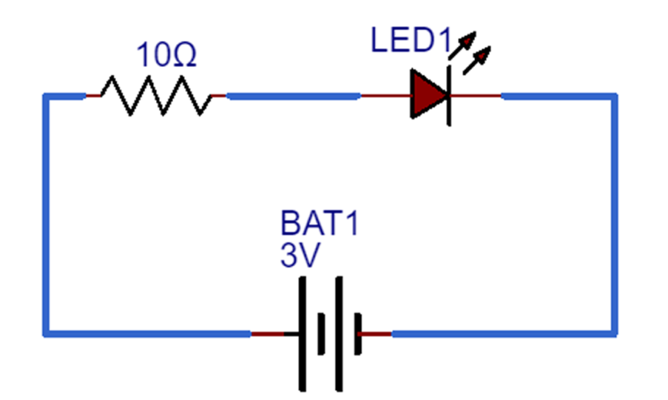
Creating a Circuit

Slide 13
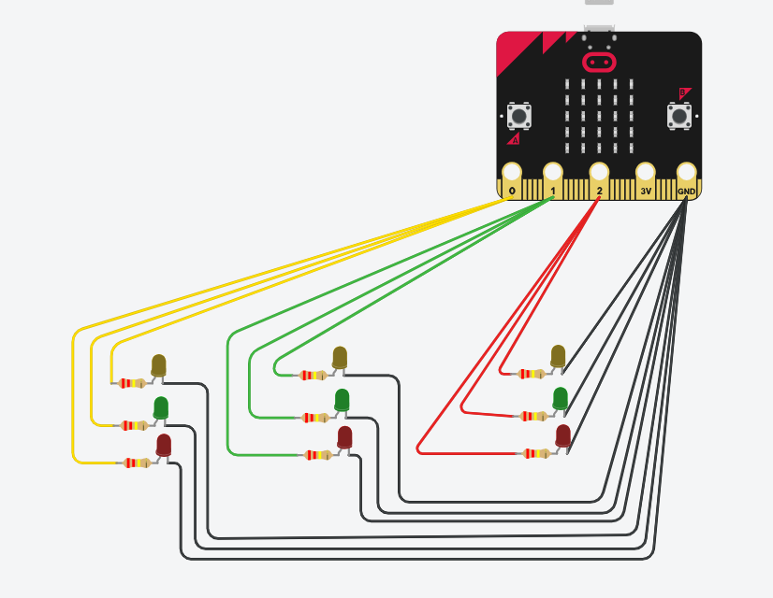
Our Circuit

Slide 14
Instructions
Put the LEDs into the holes in your card with the wires on the side without the picture.
Connect all the black wires to the ground pin using crocodile clips.
Connect 1/3 of the coloured wires to Pin 0.
Connect the next 1/3 to Pin 1.
Connect the final 1/3 to Pin 2.

Slide 15
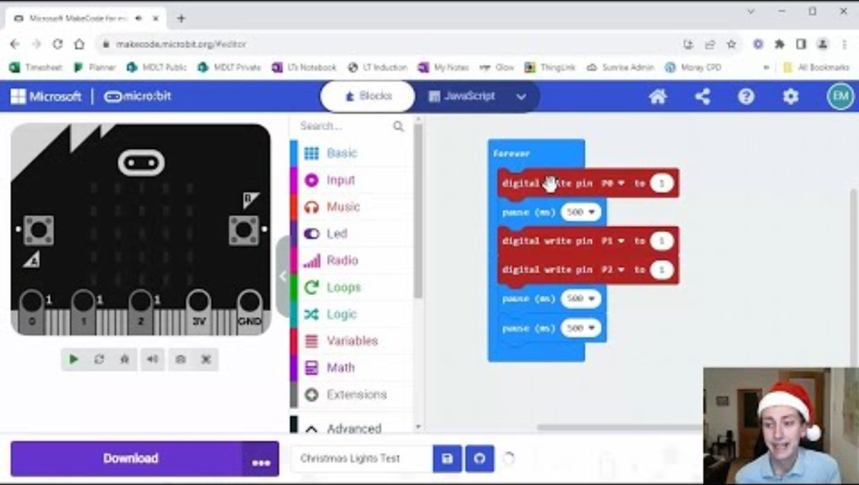
Video 3

Slide 16
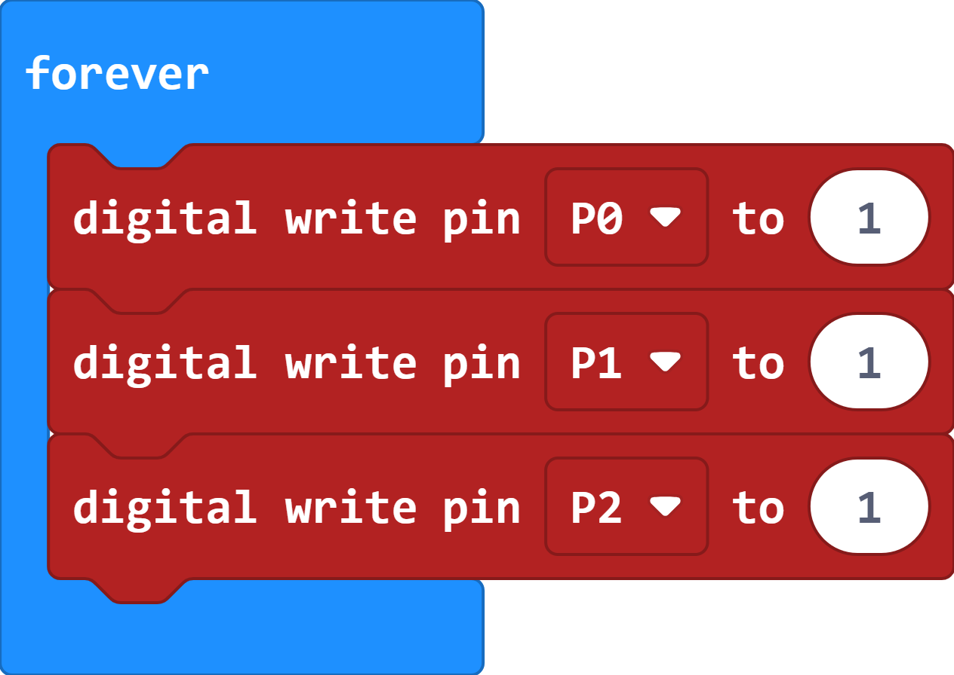
The Simple Code

Slide 17
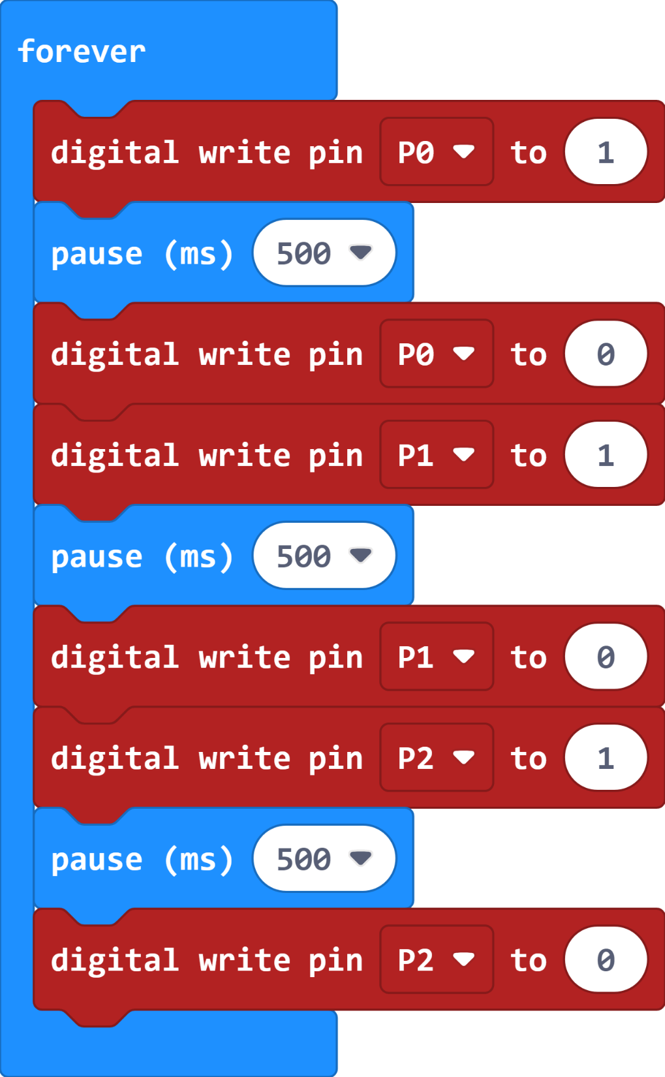
The Improved Code

Slide 18
(Extension)
Adjust the program to create a different sequence with the lights.
You could change the length of time they ‘flash’.
You could change the order they light up.
Create some Christmas music to accompany the sequence.

Slide 19
Plenary Discussion Questions
What is an LED?
What is a resistor?
Which Pin had the most connections?
What was the main block used in our program?
What is the difference between 0 and 1 when using the Pins?
Can you think of other ways to use these programs?

Slide 20
Christmas
Micro:bit
Lessons
Have a great Christmas!!!

