Slide 1
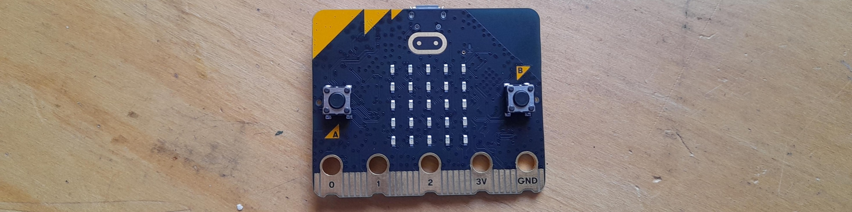

Micro:bit Starter
Lessons
Lesson 0 – Introducing the micro:bit.

Slide 2
Lesson 0: Introducing the micro:bit
We are learning to create code for a micro:bit.
I can explain what some of the micro:bit's parts do.
I can create code using MakeCode.
I can design and code images for the micro:bit’s LEDs.

Slide 3
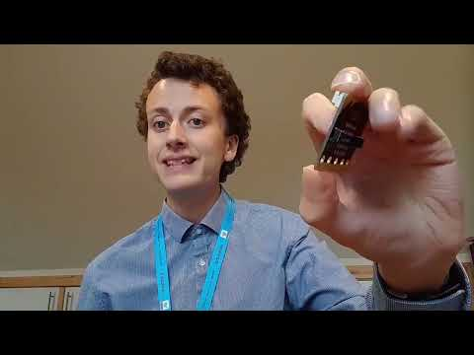
Video

Slide 4
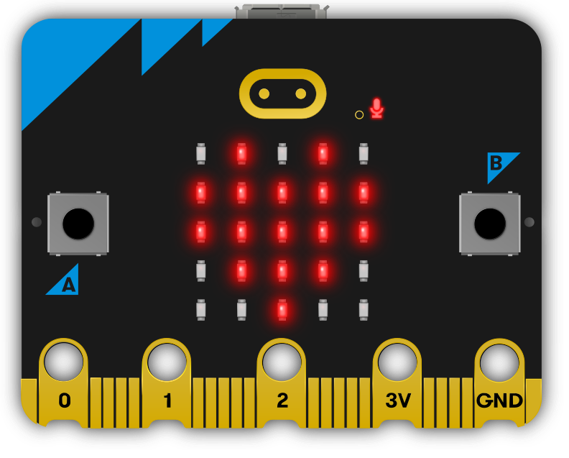
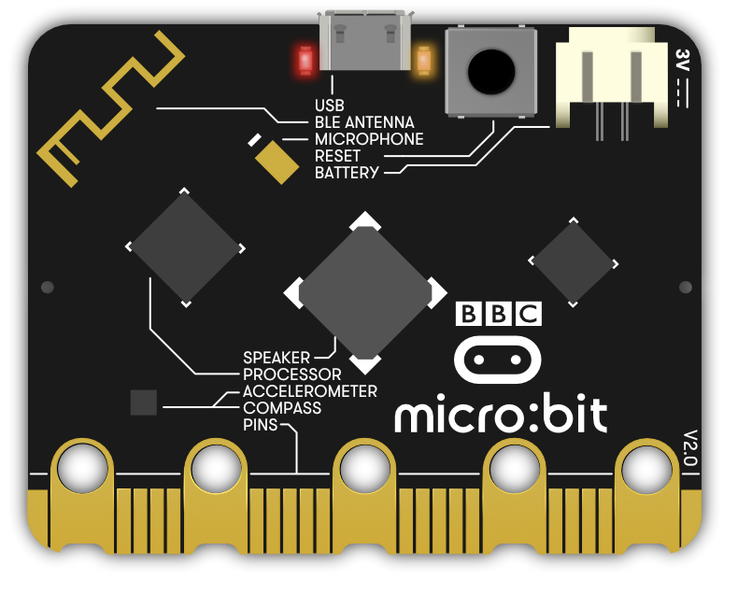
Label the micro:bit
LED Screen
Button A
USB Port
Button B
Reset Button
Battery Connector

Slide 5
Drawing challenge
You have 10 seconds to draw….. on your Post it note.
When the time is up hold up your Post it Note.

Slide 6
Drawing challenge
A House

Slide 7
Drawing challenge
You have 10 seconds to draw….. on your Post it note.
When the time is up hold up your Post it Note.

Slide 8
Post it note challenge
A Pizza

Slide 9
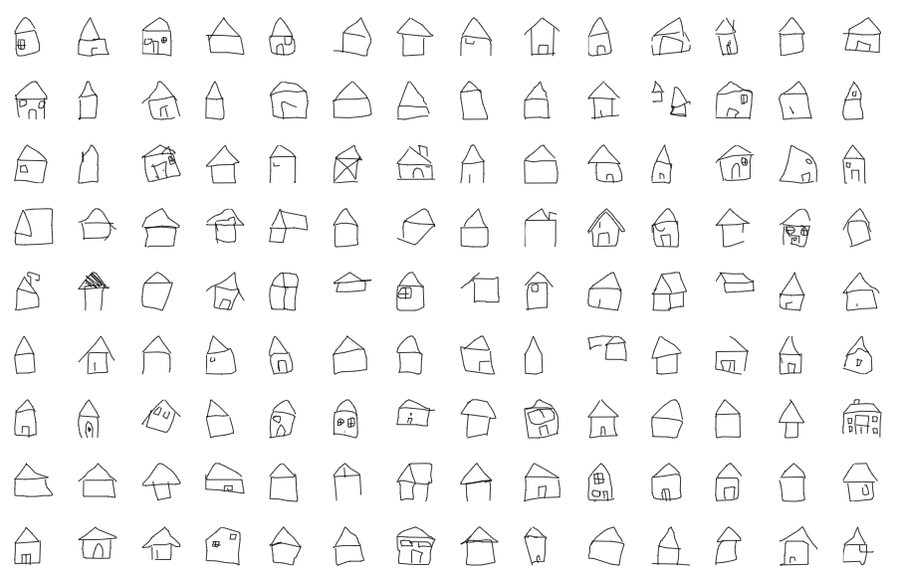
Post it note challenge
https://quickdraw.withgoogle.com/data/house

Slide 10
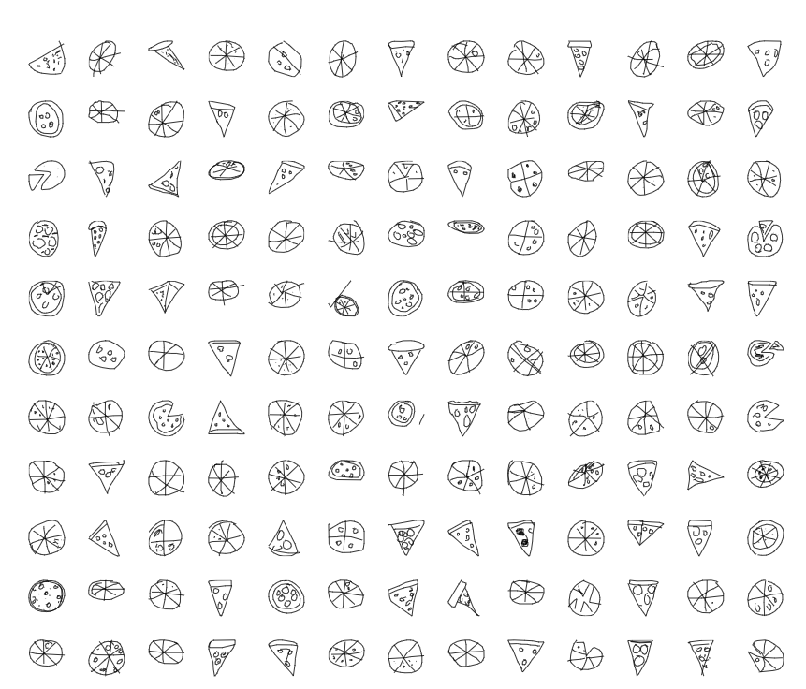
Post it note challenge
https://quickdraw.withgoogle.com/data/house

Slide 11


Abstraction
Abstraction is about making things simpler by choosing what’s important without worrying about detail.
https://www.youtube.com/watch?v=u2u7UJSRuko

Slide 12
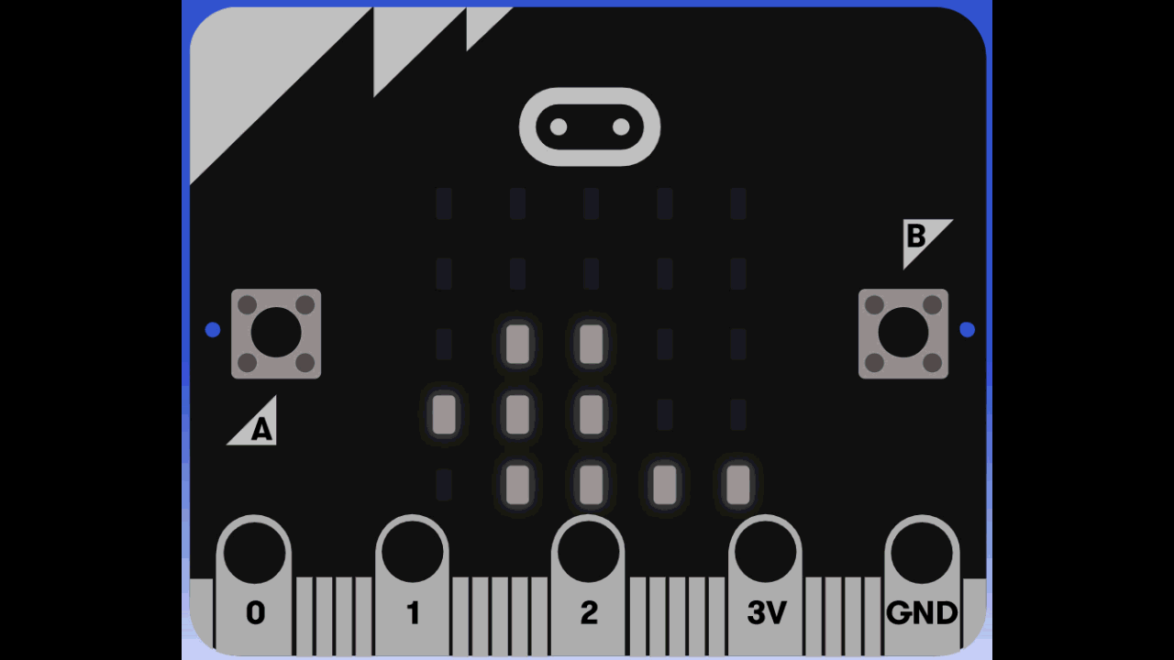
What we are coding…

Slide 13
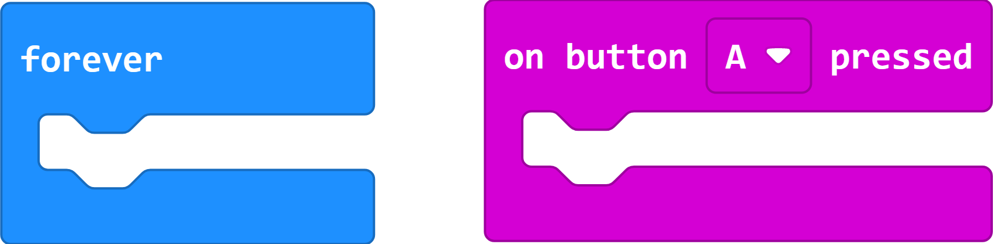
What’s the difference?

Slide 14
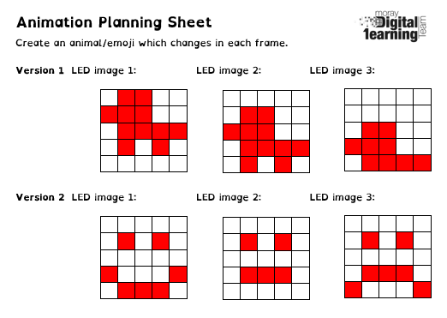
Planning – The most important part!

Slide 15
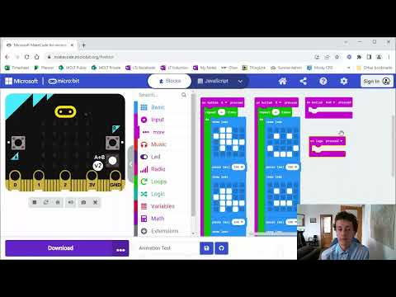
Video Part 2

Slide 16
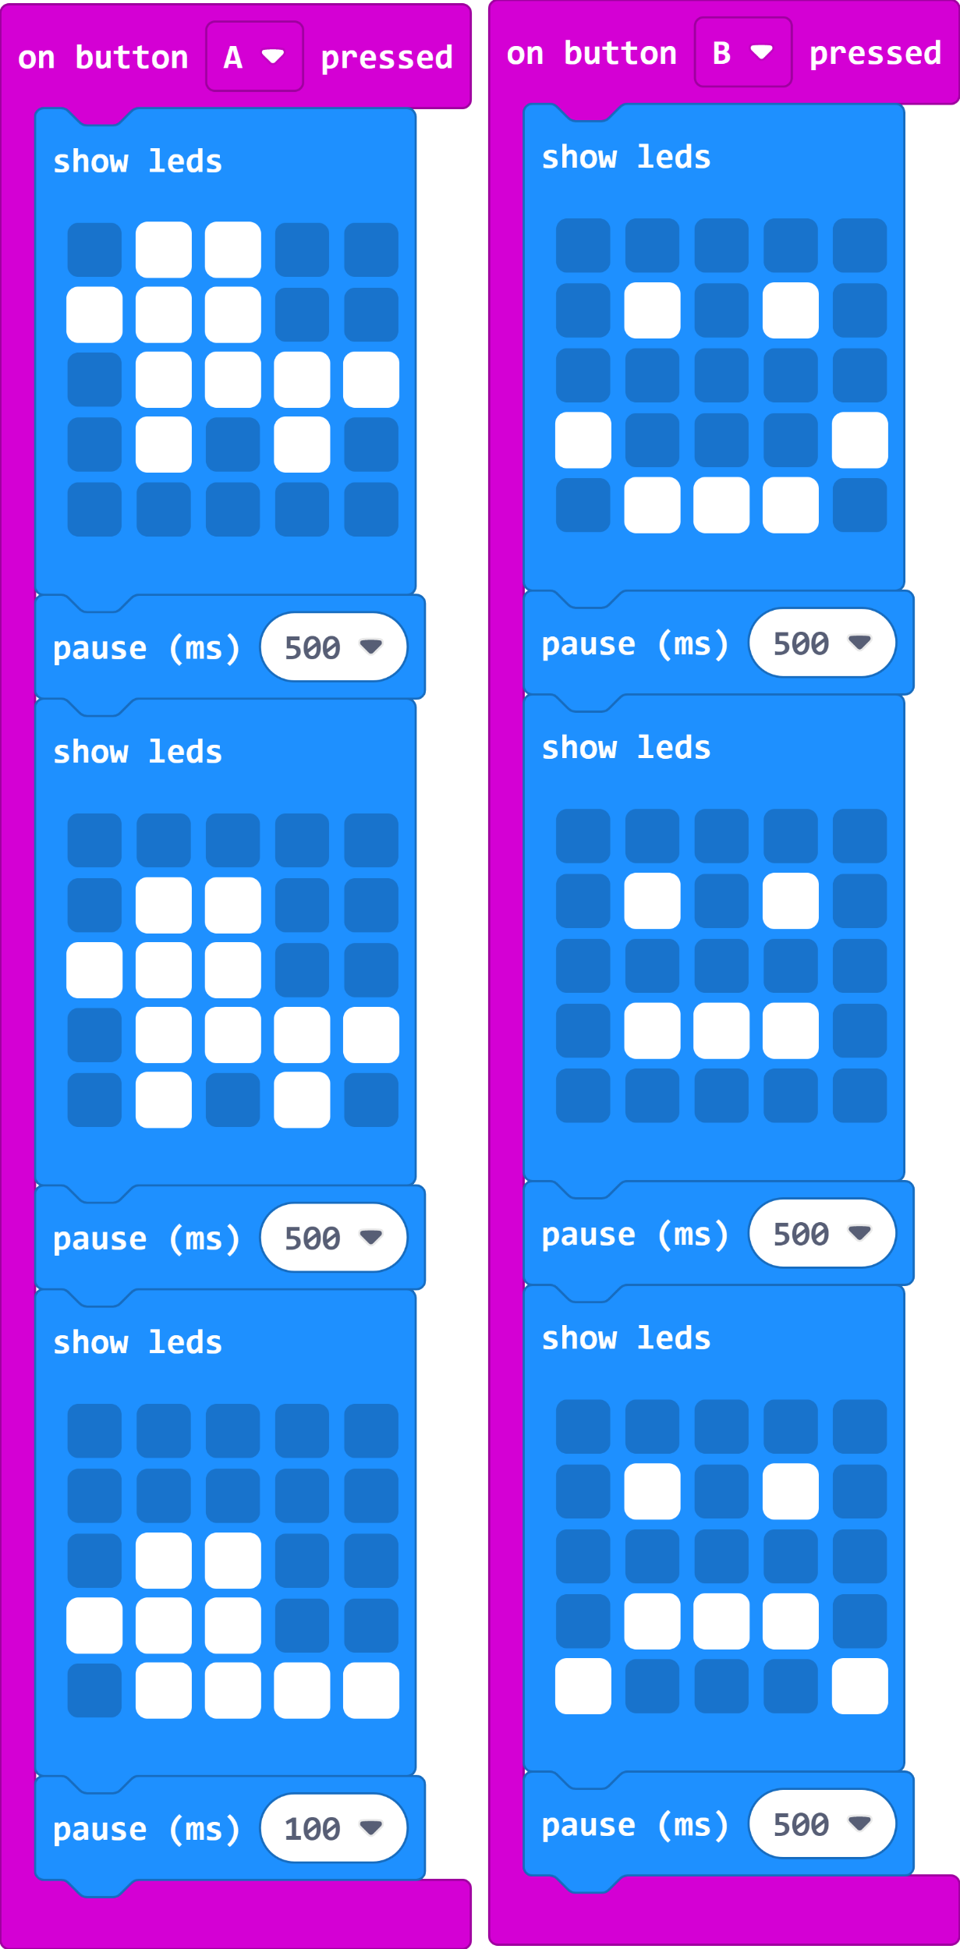
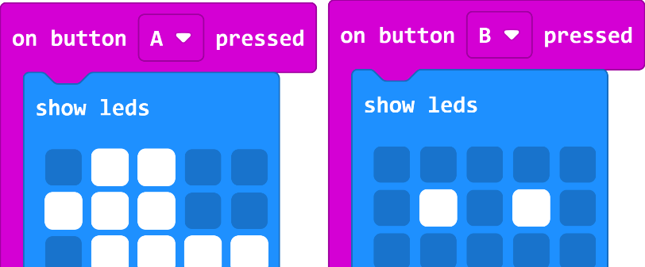
makecode.microbit.org

Slide 17
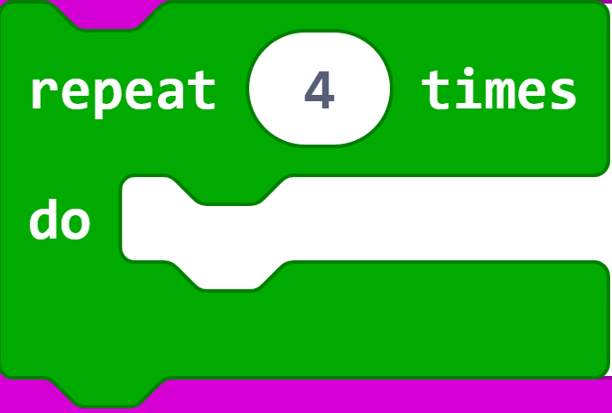
Loops?

Slide 18
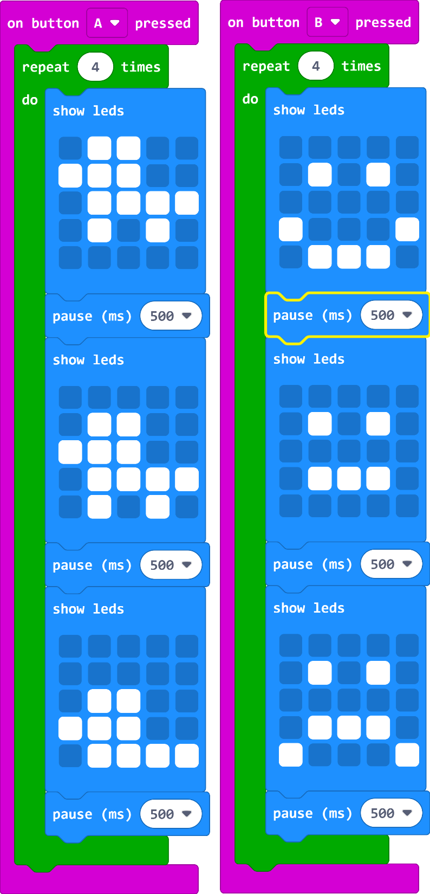
Loops?

Slide 19
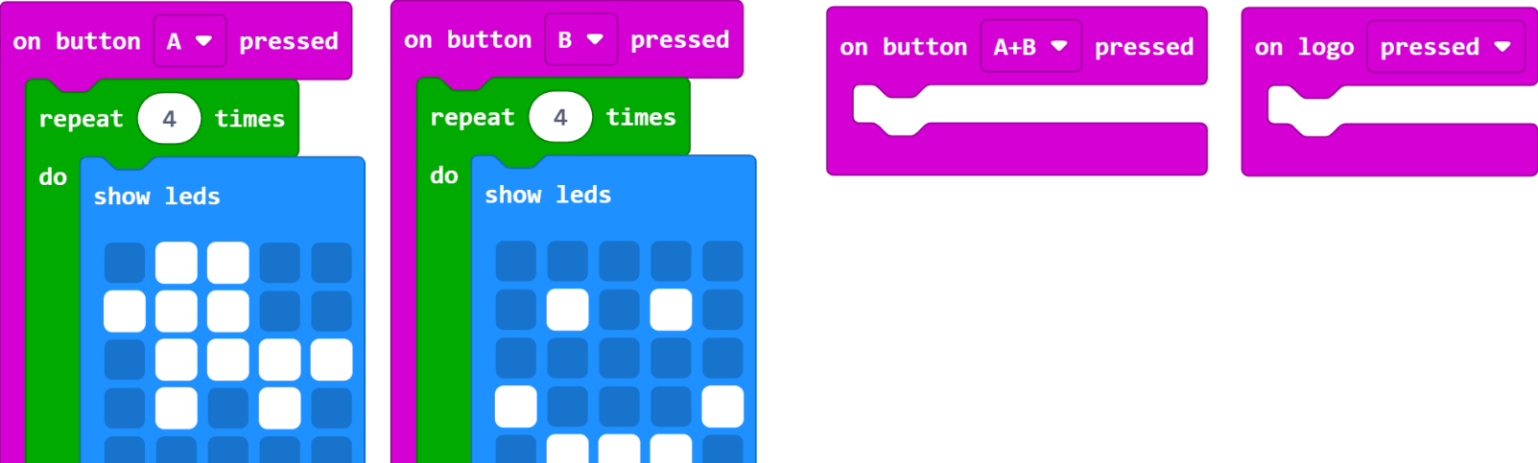
More Inputs?
Add your second animations or new ones to A+B and on logo pressed.

Slide 20
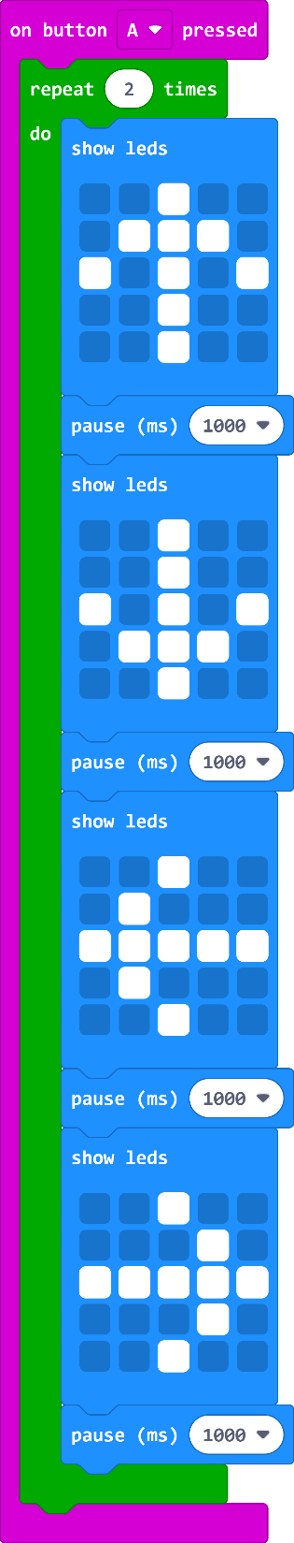
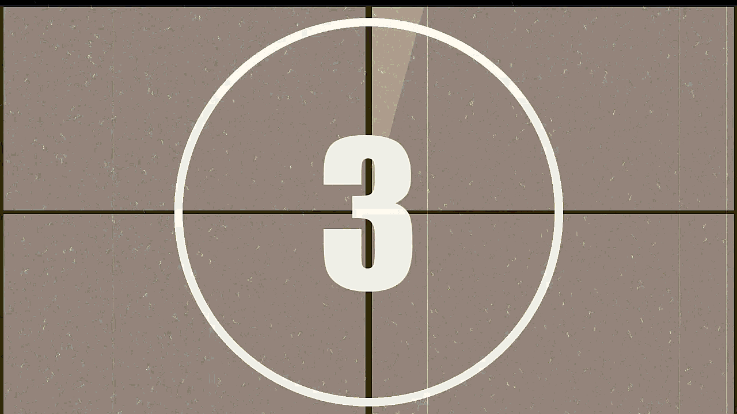
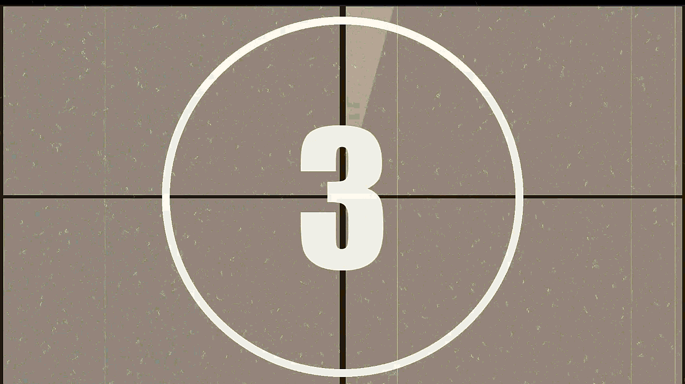
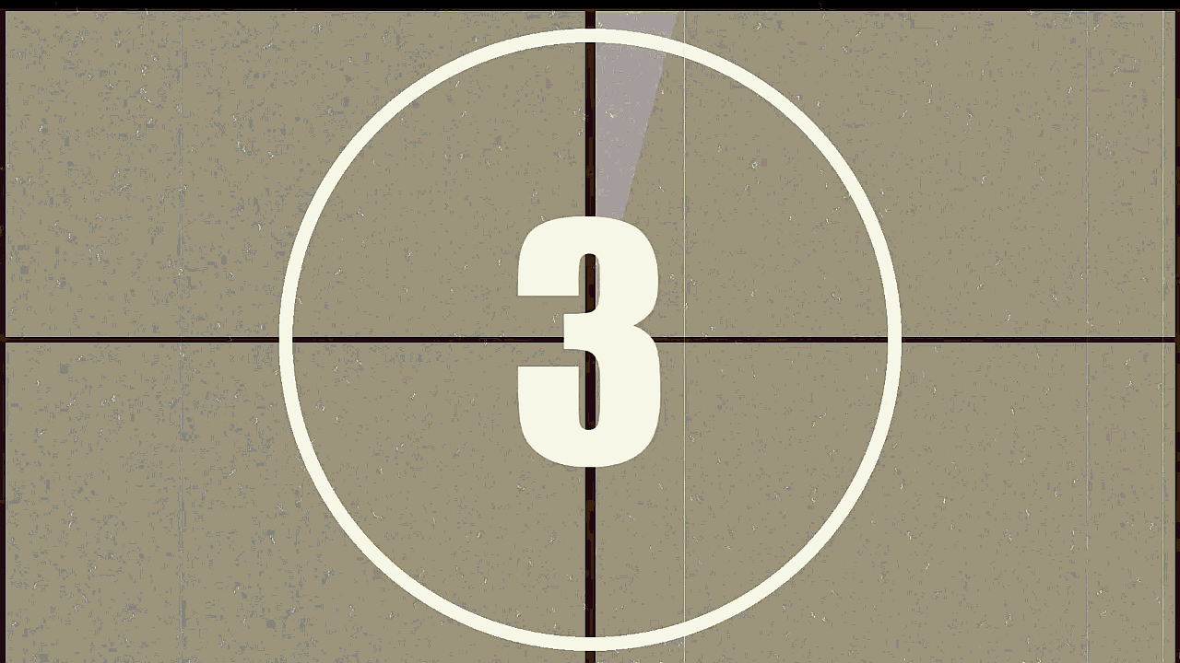
Which one matches the code?
A:
B:
C:

Slide 21
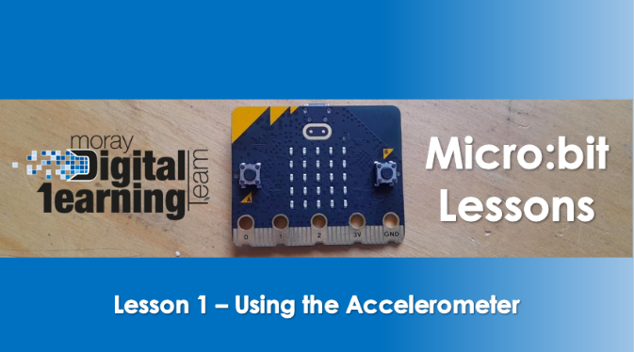
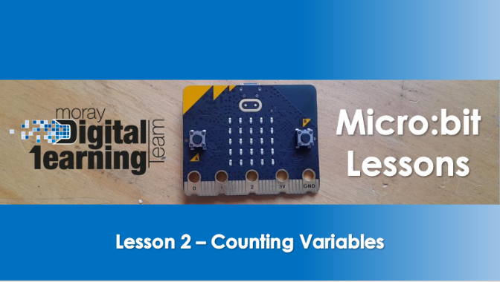
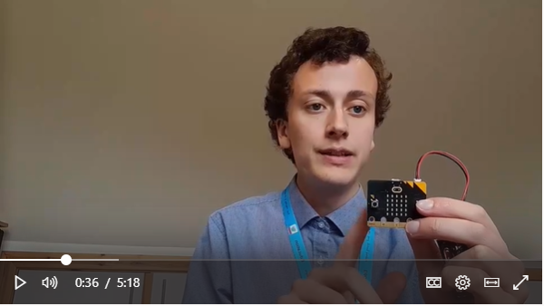

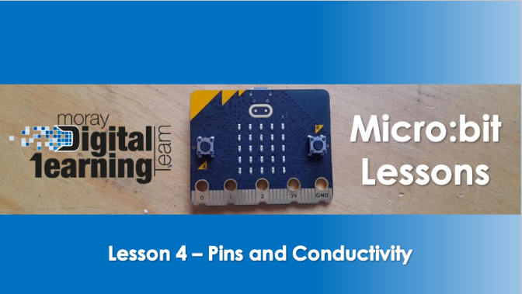
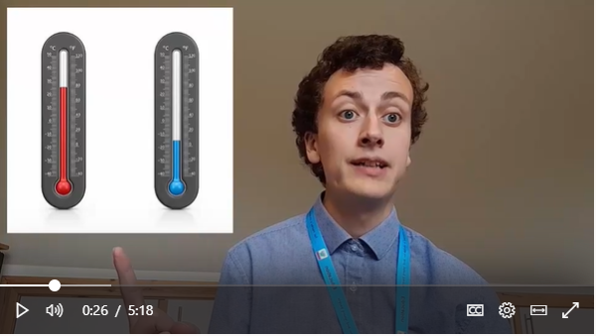
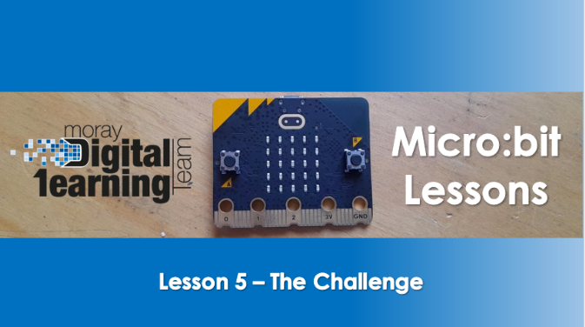
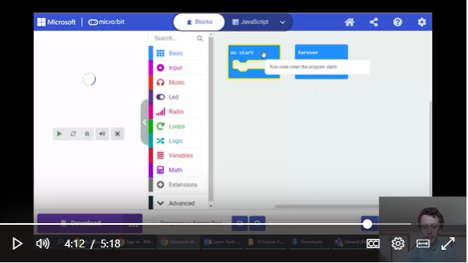
Next Lessons…

Slide 22
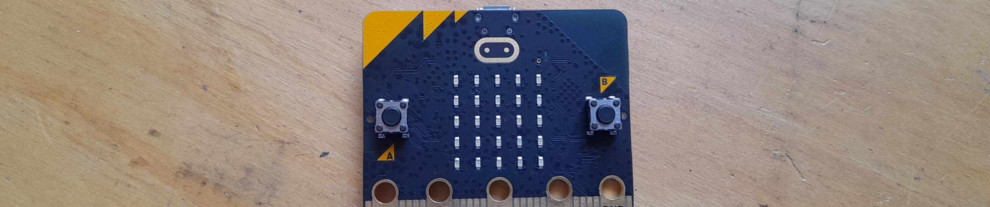
Micro:bit
Challenge
Adapt a micro:bit project and make it your own
At the end of these lessons...

Slide 23
Micro:bit
Lessons
Thank you for listening and taking part!

