Slide 1


Micro:bit Starter
Lessons
Lesson 1 – Using the Accelerometer

Slide 2
Lesson 1: Using the Accelerometer
We are learning to use the inputs and outputs on a micro:bit.
I can describe what an input and output is.
I can describe what an accelerometer is.
I can create code which uses the accelerometer.

Slide 3
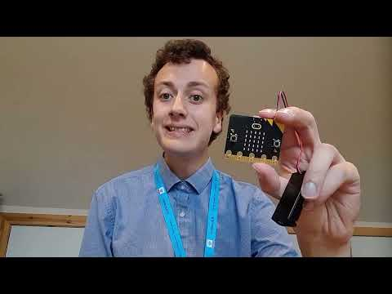
Video

Slide 4
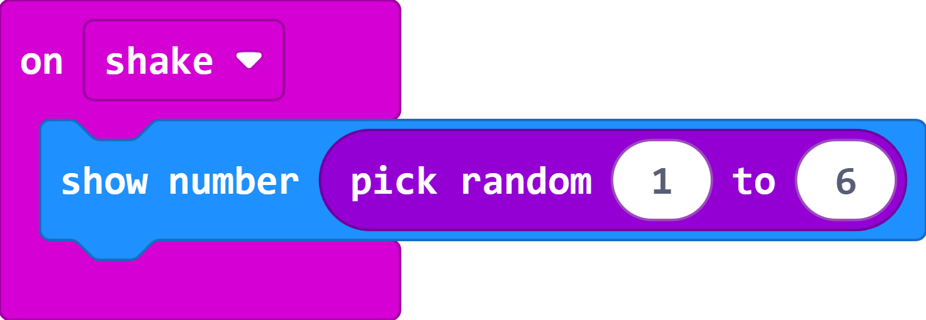
Coding a Dice
This just needs two lines of code – Remember to show number between 1 and 6 (No zero on a dice
While you wait for the next task, create a game with your partner using the dice.

Slide 5
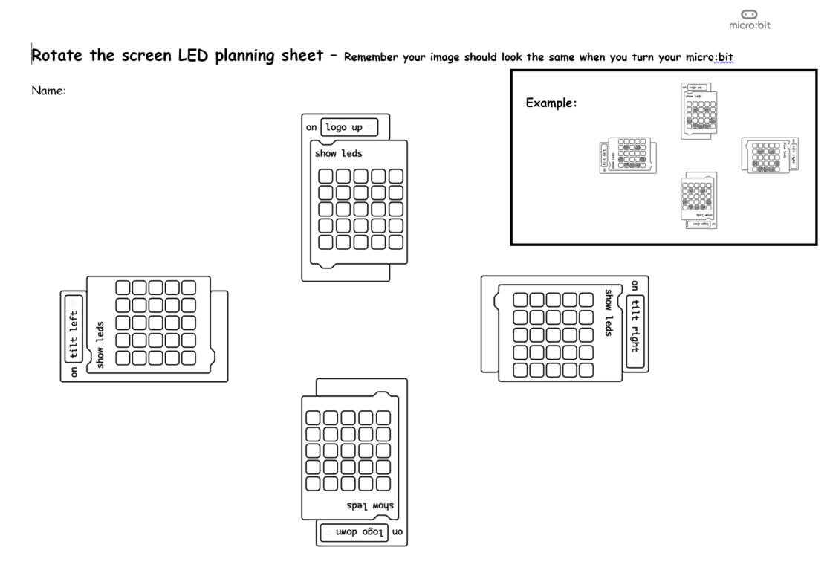
Plan your rotating code
Remember the image must be the same but a different way up in each part of the code.

Slide 6
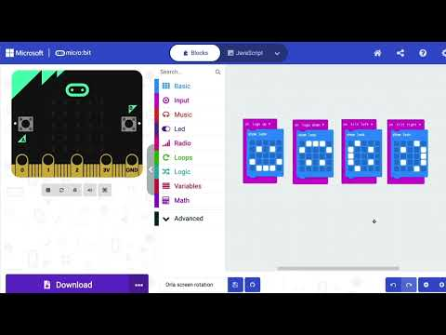
Video
https://www.youtube.com/watch?app=desktop&v=Z30iJ9BbnL8

Slide 7
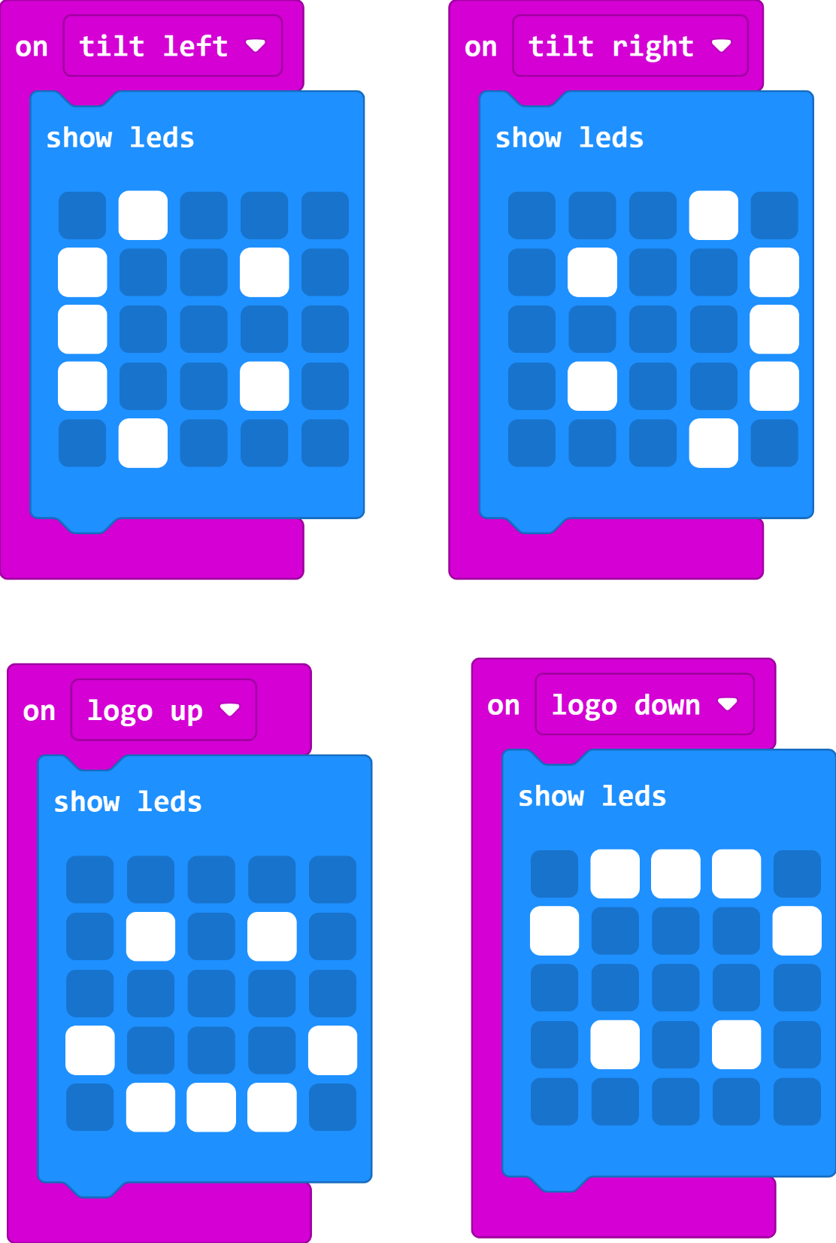
Coding your rotating code
Does it work?
Does the image seem to stay the same way up?
At what point does it turn?

Slide 8
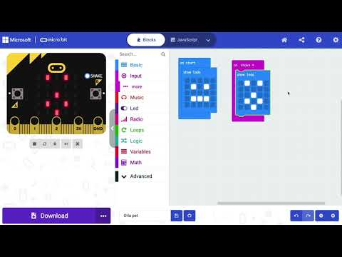
Extension Video
https://www.youtube.com/watch?v=XMIUv4t0puY

Slide 9
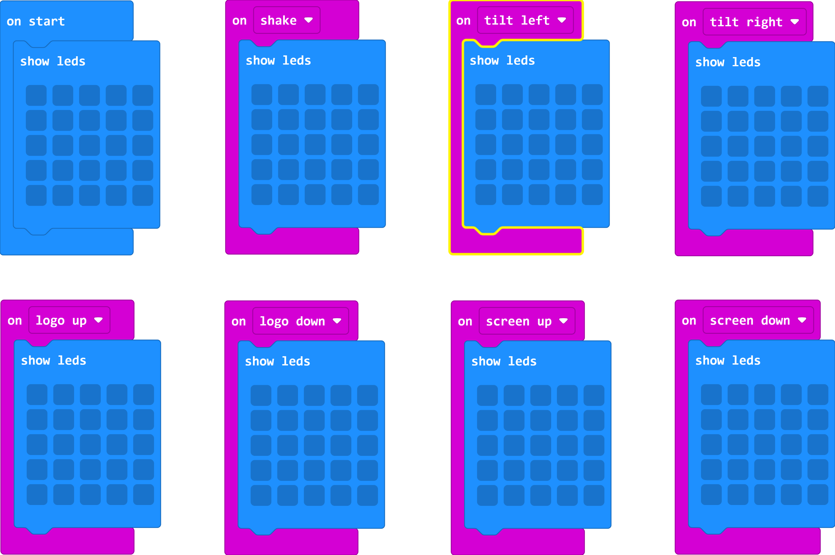
Extension Code

Slide 10
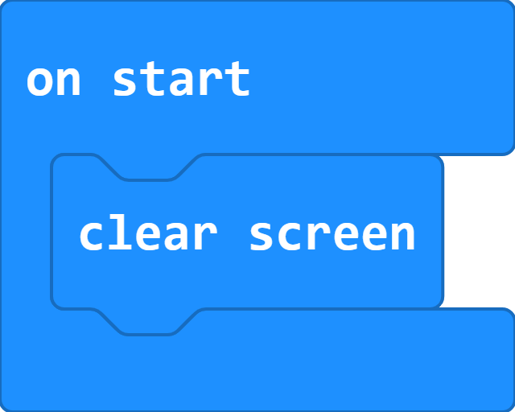
Clear all
To make sure your micro:bit is ready for the next class/time.

Slide 11
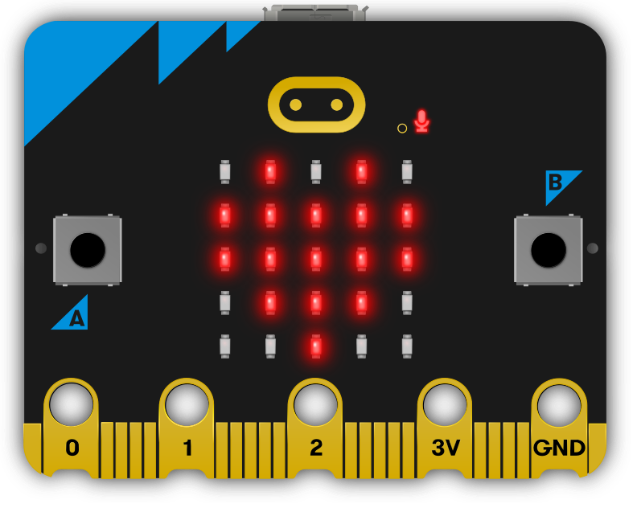
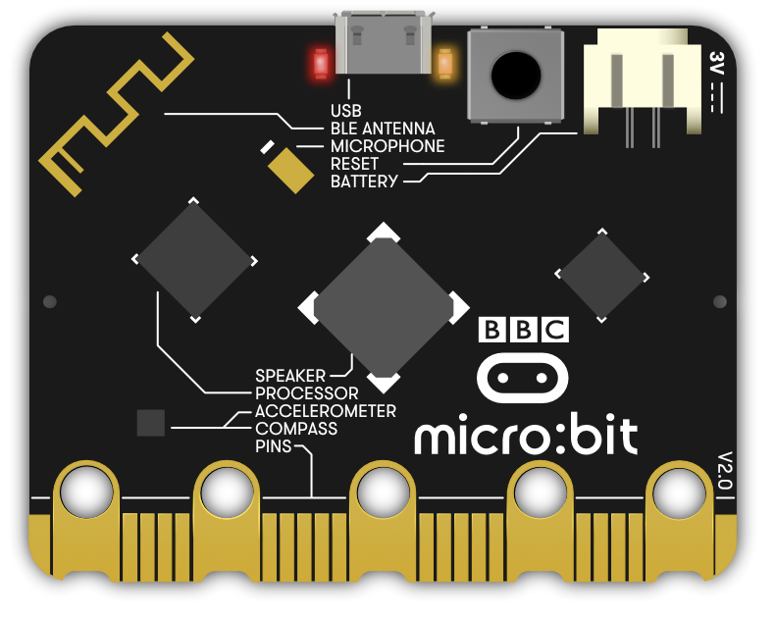
Matching Inputs and outputs
Inputs | Outputs
Accelerometer
Buttons
Compass
Speaker
Touch Logo
25 LED Lights
Pins
Microphone
Radio Antenna

Slide 12
Plenary Discussion Questions
What is the difference between an input and output?
Can you name the inputs and outputs on the micro:bit?
What are some real life uses for the accelerometer?

