Slide 1


Micro:bit Starter
Lessons
Lesson 2 – Counting Variables

Slide 2
Lesson 2: Counting Variables
We are learning to use the micro:bit to count.
I can explain what a variable is and how it is used.
I can describe times that computers could be used to count things.
I can use the touch sensor input on a micro:bit.
I can create code which counts a number of inputs.

Slide 3
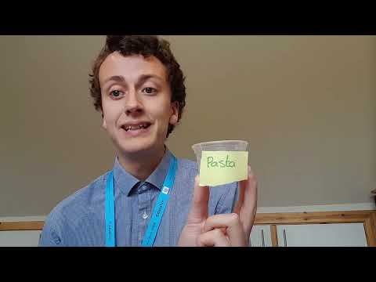
Video

Slide 4
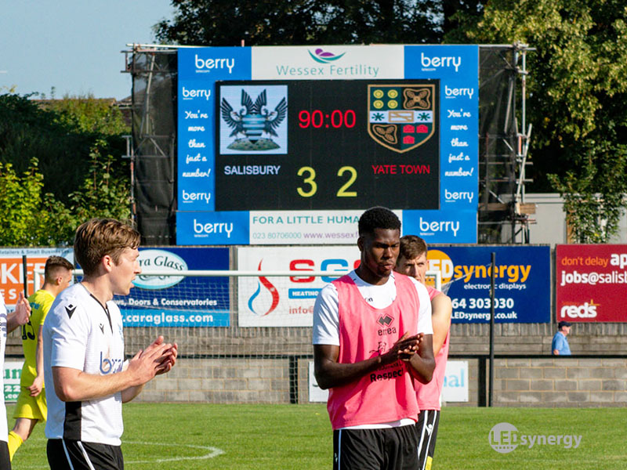
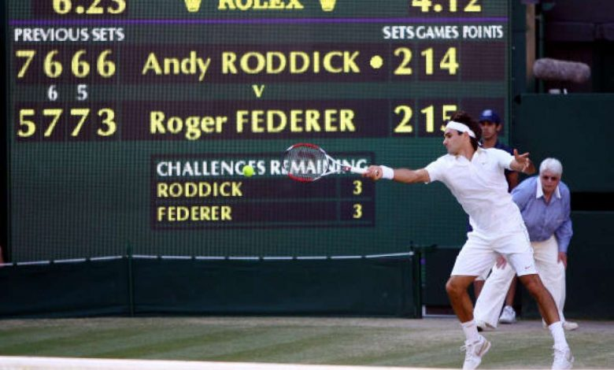


Real Life Uses of a Electronic Counter

Slide 5
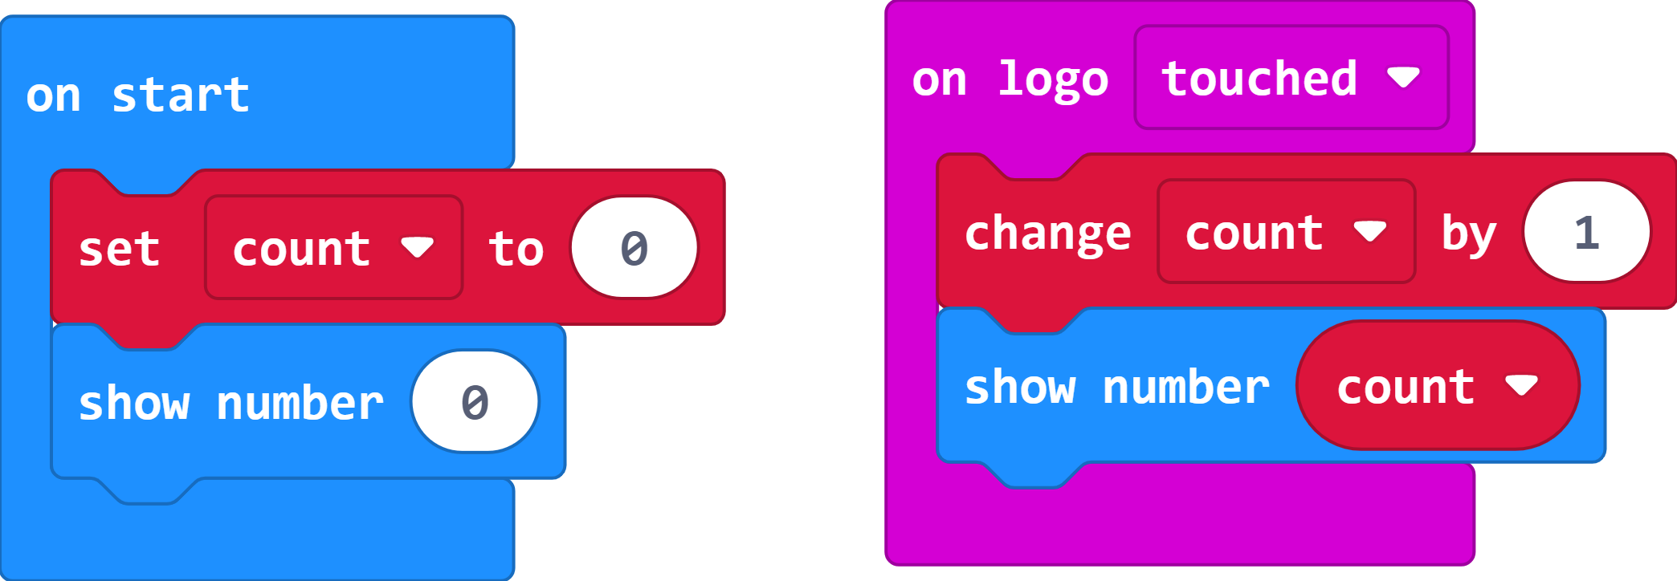
Simple Counter Code
Find something to count to test your counter.
What is the highest number it can count to?
How can you reset the counter to 0?

Slide 6
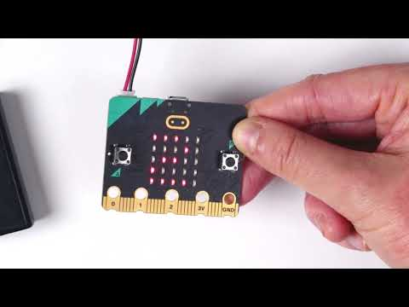
Video – Step Counter
https://www.youtube.com/watch?v=cH1ETCVf6xk

Slide 7
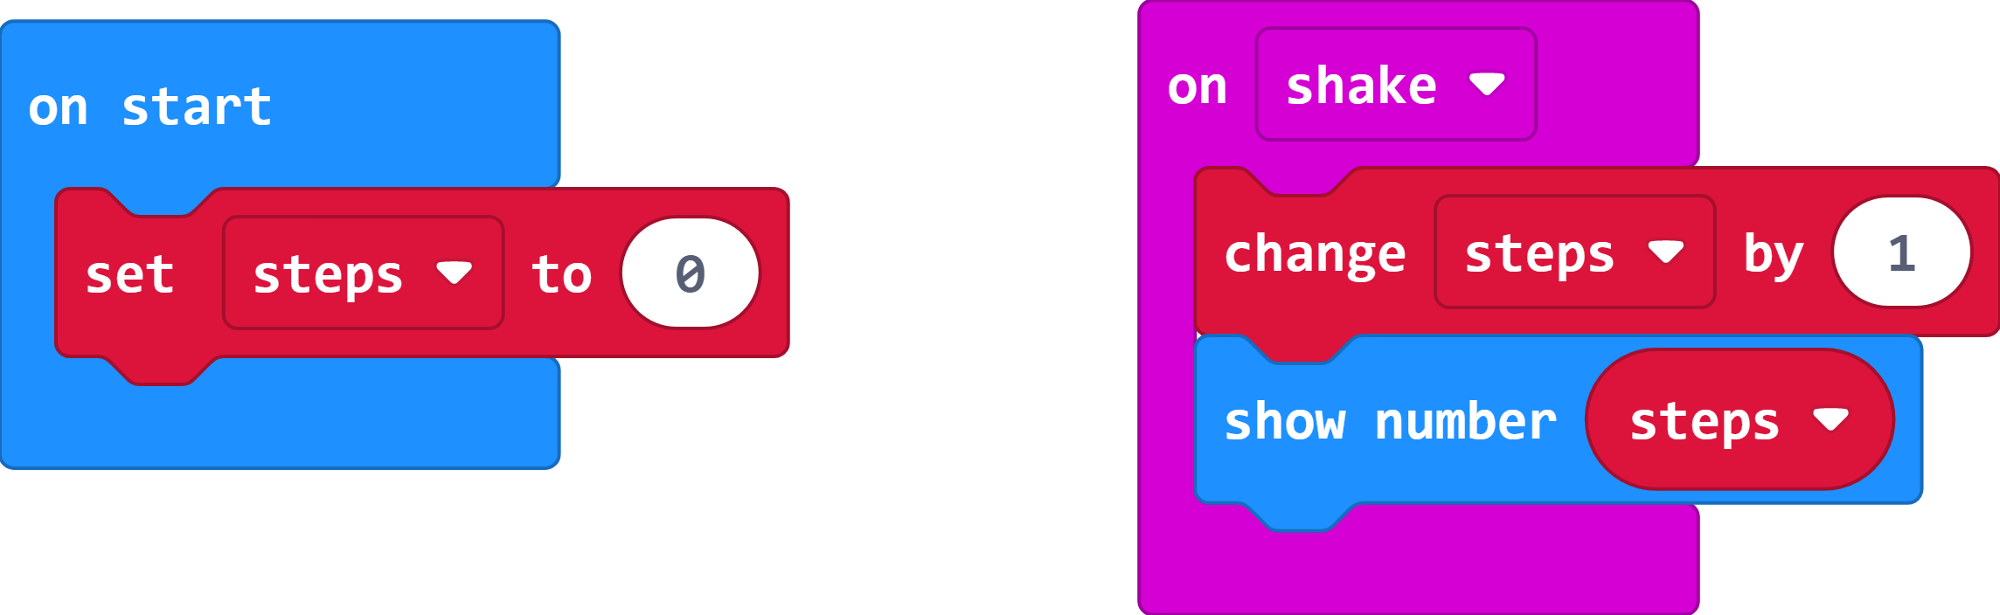
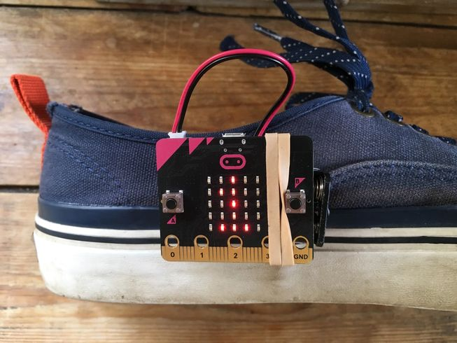
Step Counter Code
Test your code by shaking the micro:bit!

Slide 8
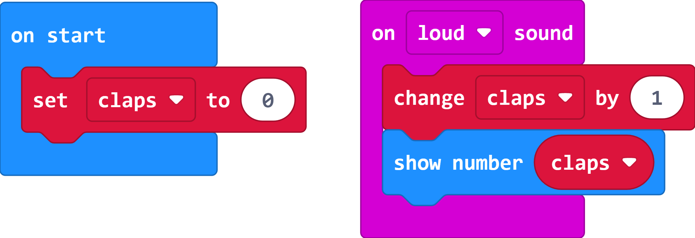

Clap Counter Code
Replace the ‘on shake’ with ‘on loud’.
Rename the variable ‘claps’ by right clicking.
How many claps can you count?

Slide 9
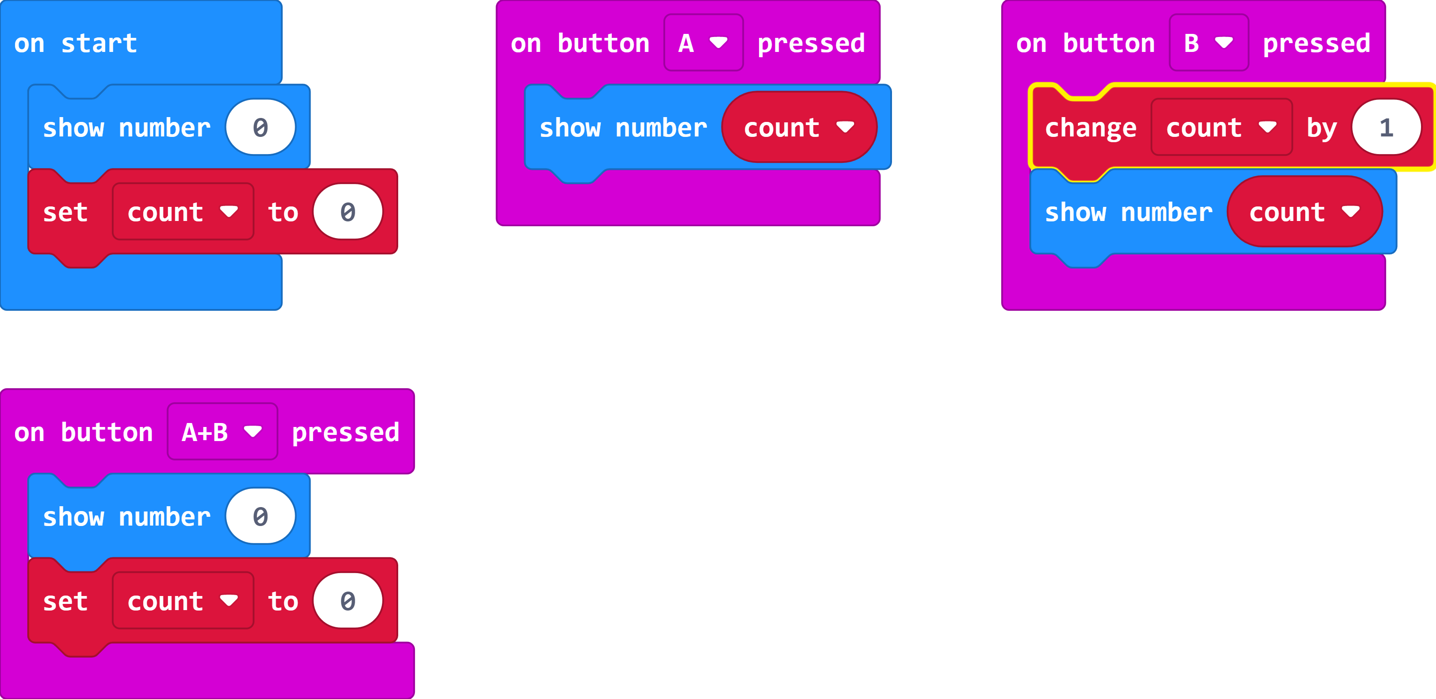
Extension – Counter that resets
Copy the code and find out what it does.
What happens when you press button A, B and both together?

Slide 10
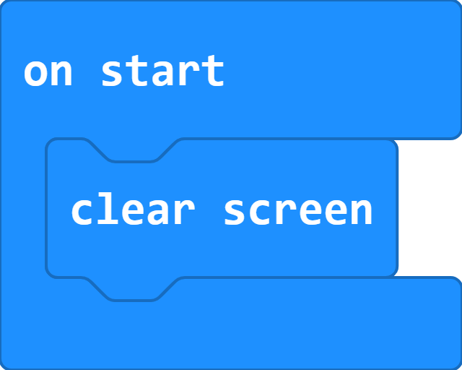
Clear all
To make sure your micro:bit is ready for the next class/time.

Slide 11
Plenary Discussion Questions
What is a variable?
What are some real life uses for having a electronic counter?
Which inputs on the micro:bit did we use today?

