Slide 1


Micro:bit Starter
Lessons
Lesson 3 – Light and Temperature Sensors

Slide 2
Lesson 3: Light and Temperature Sensors
We are learning to use the light and temperature sensors on the micro:bit.
I can recognise why recording light and temperature may be important.
I can create code which uses the light sensor
I can create code which uses the temperature sensor.

Slide 3
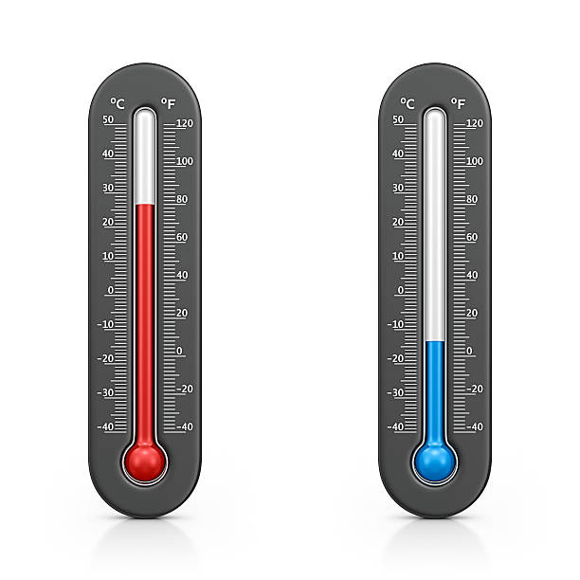

Light and Temperature Sensors

Slide 4
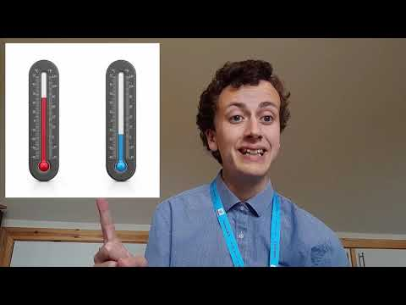
Video

Slide 5
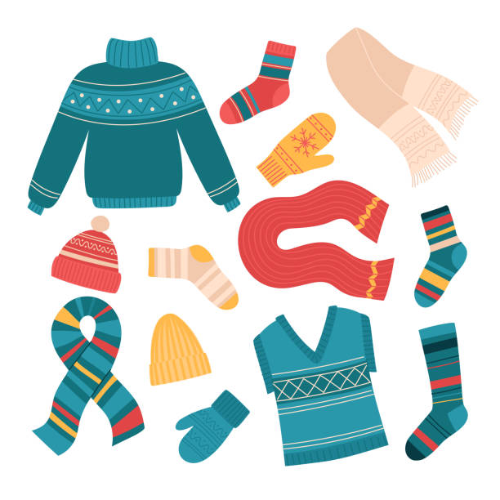
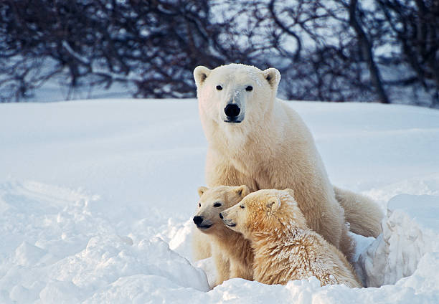
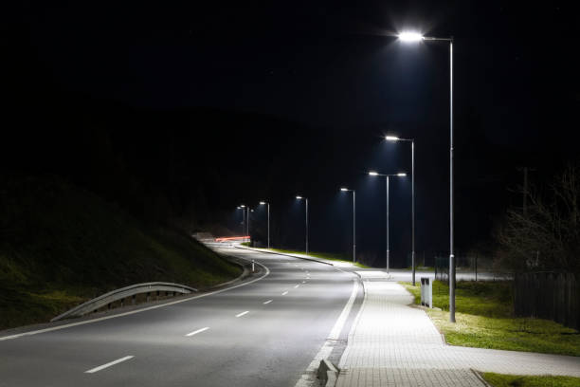

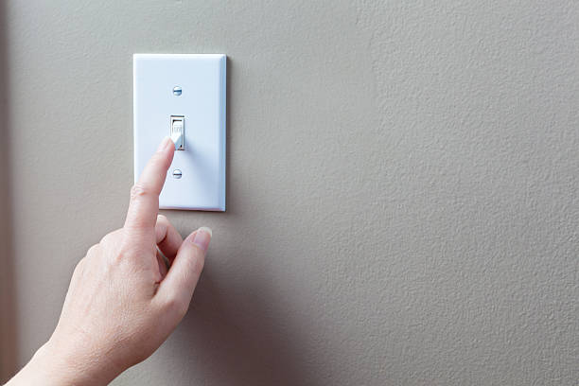
Real Life Uses of Light and Temperature
Sensors

Slide 6
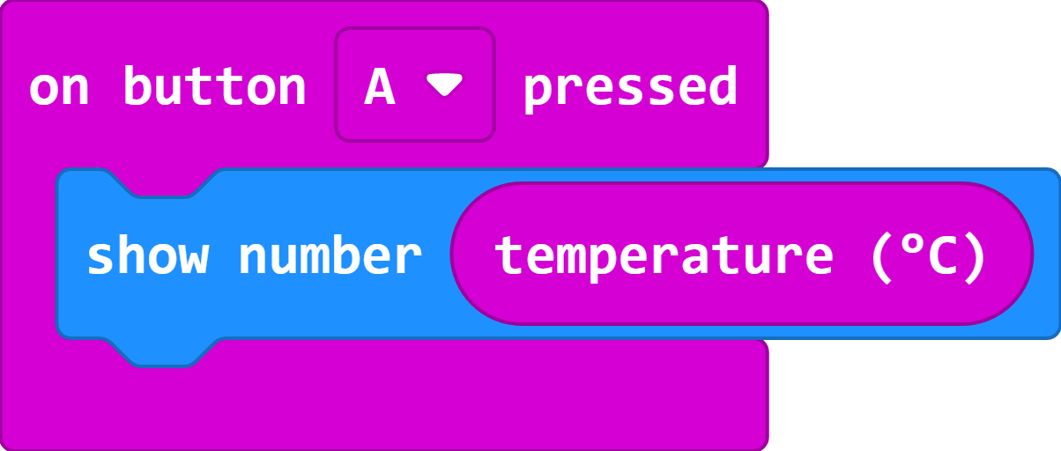
Temperature Sensor Code
Compare the temperature you get with the rest of the class.
Can you find the coldest and hottest part of the classroom?

Slide 7
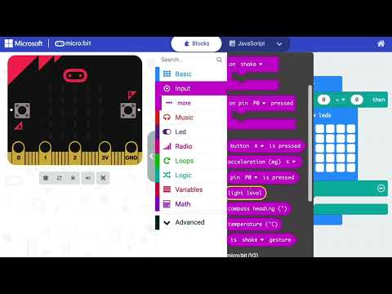
Video – Night Light
https://www.youtube.com/watch?v=eazGGlPdj3s

Slide 8
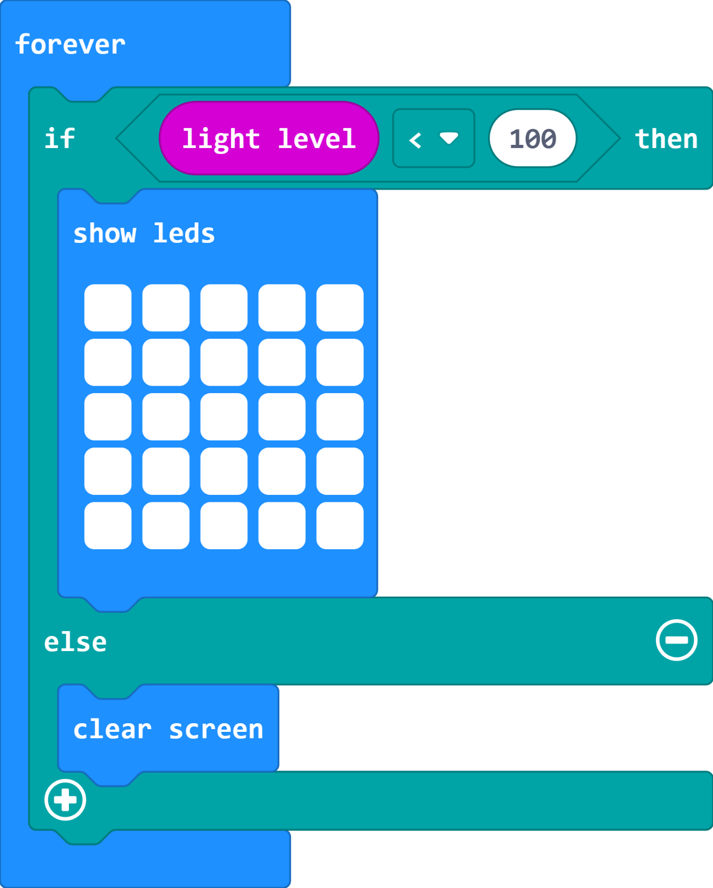
Night Light Code
Test your code by putting it somewhere dark or covering it.
You may have to change the number in the top of the code. This will change how much light will make it go dark!

Slide 9
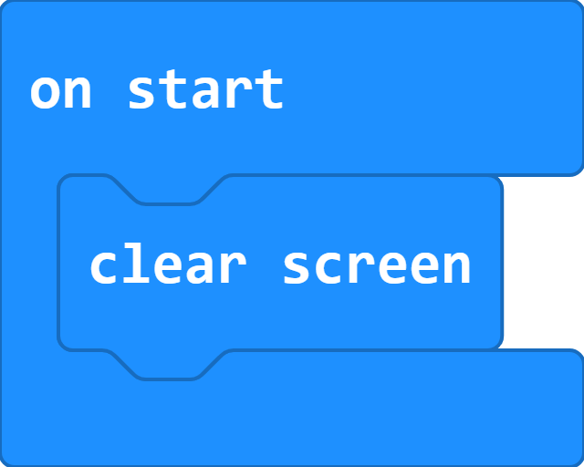
Clear all
To make sure your micro:bit is ready for the next class/time.

Slide 10
Plenary Discussion Questions
Why may you need to find out light and temperature of a location?
What was the highest temperature in the room?

