Slide 1


Micro:bit Starter
Lessons
Lesson 4 – Pins and Conductivity

Slide 2
Lesson 4: Pins and Conductivity
We are learning to make use of the pins on the micro:bit.
I can locate the pins on the micro:bit and explain what they do.
I can create code which uses the pins on the micro:bit.
I can investigate conductivity using the micro:bit.

Slide 3
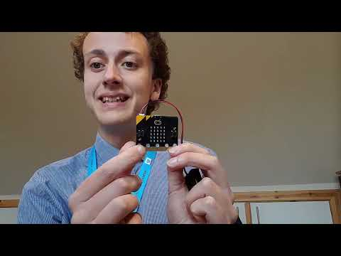
Video

Slide 4
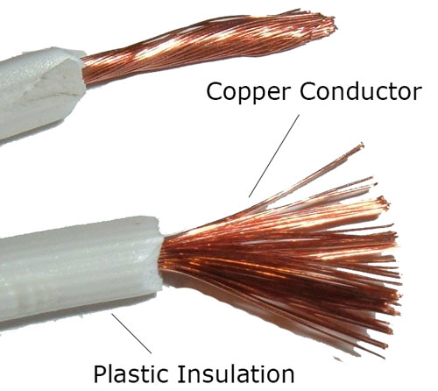
Conductivity
Electricity can only move through some materials, mainly metals.
If something allows electricity to flow it is a conductor.
If it doesn’t allow electricity to flow it is an insulator.
Metal in wires are conductors.
Plastic outside are insulators so you don’t get hurt!

Slide 5
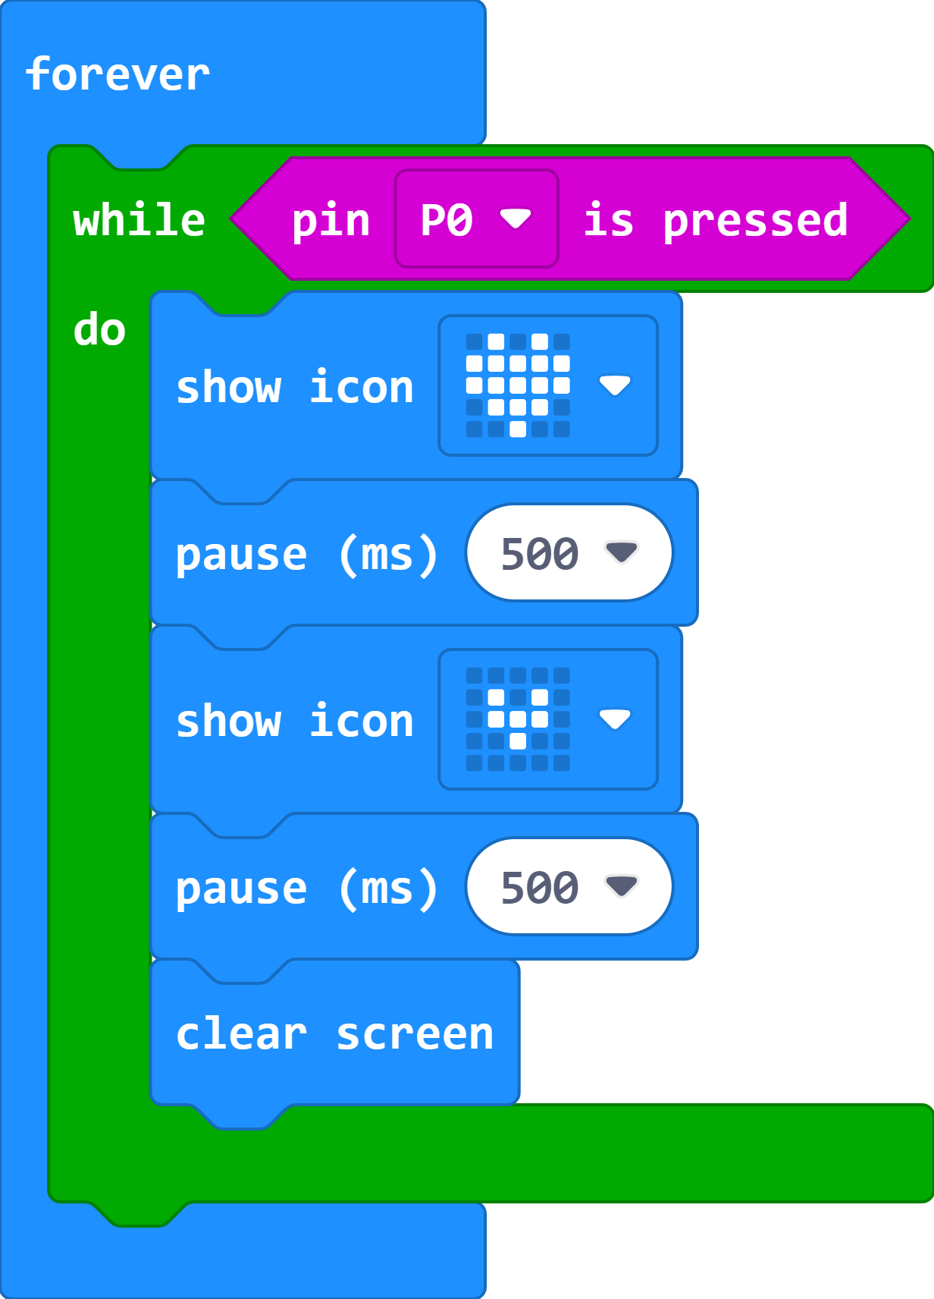
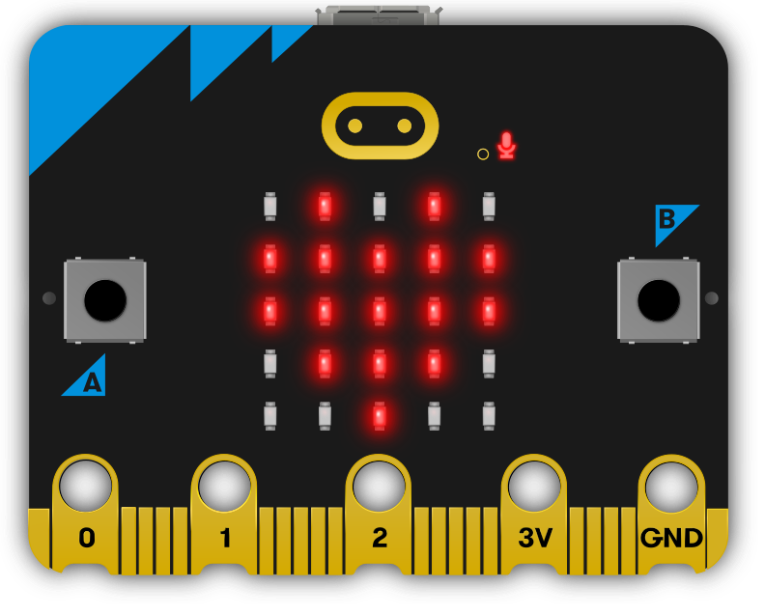
Heartbeat Code
Remember to have one finger on GND and the other on Pin 0 to make this work.

Slide 6
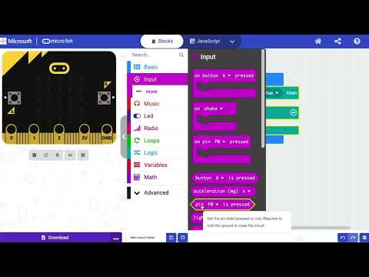
Video – Pin Alarm
https://www.youtube.com/watch?v=gk8wD50En88

Slide 7
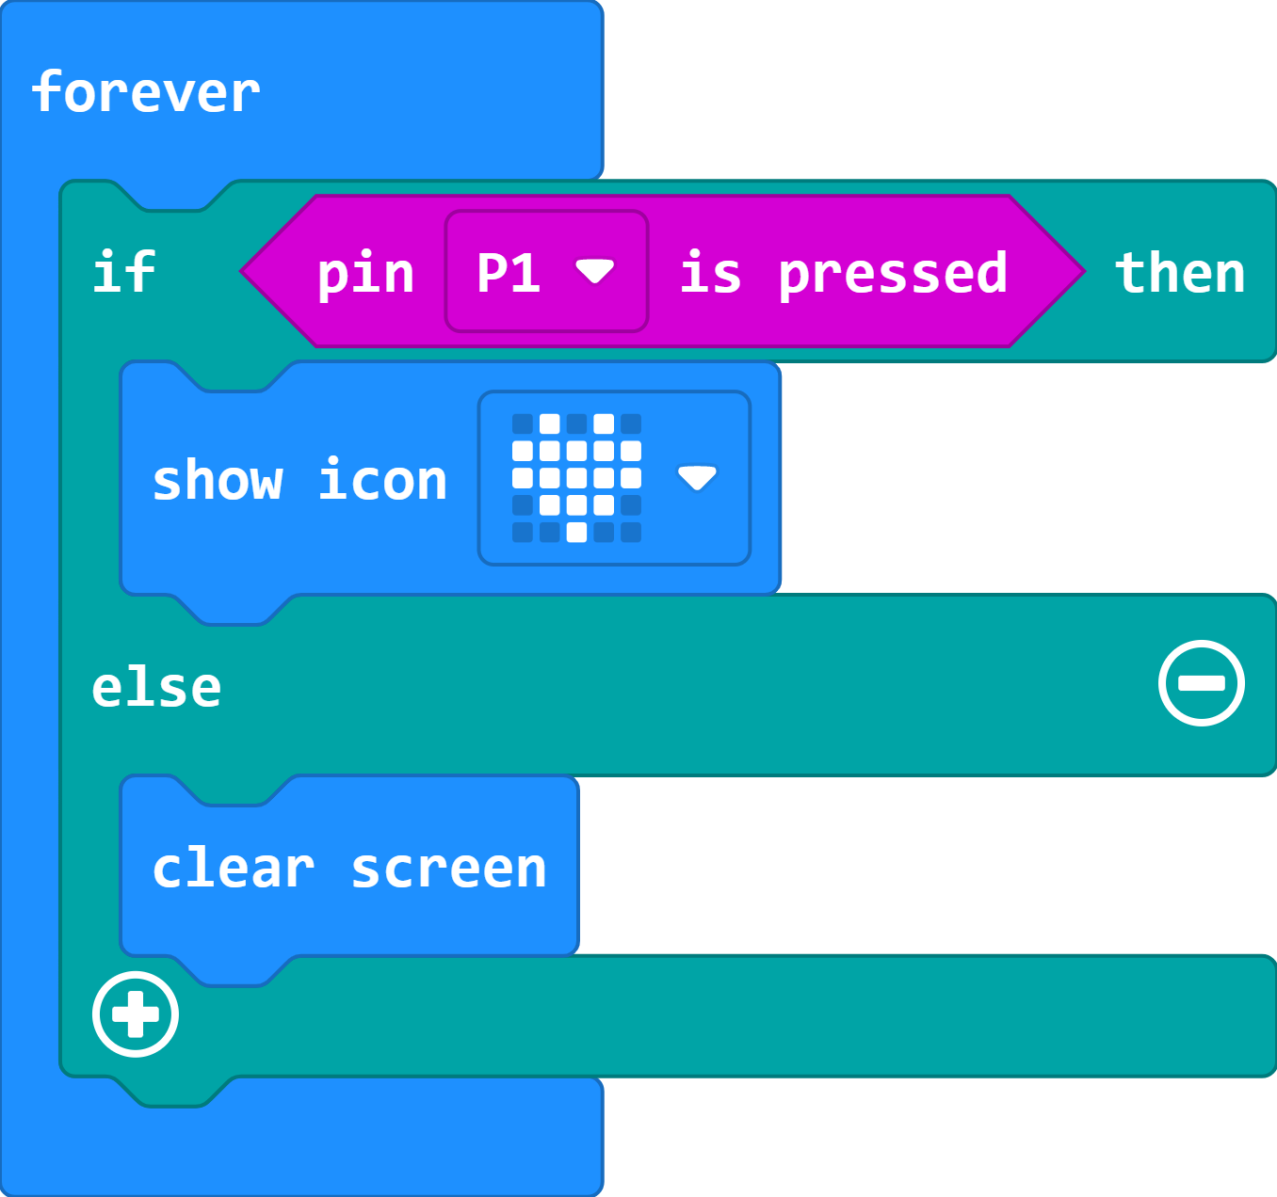
Pin Alarm Code
Now test the conductivity of some items using the worksheet your teacher has given you.
OBJECT TO TEST

Slide 8
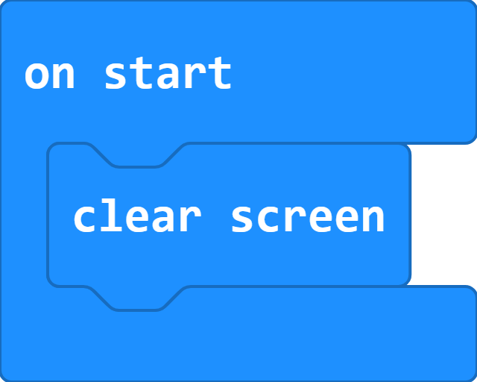
Clear all
To make sure your micro:bit is ready for the next class/time.

Slide 9
Plenary Discussion Questions
What were you most surprised conducted electricity?
What uses could you see for a tin

