Slide 1


Micro:bit Starter
Lessons
Lesson 5 – The Challenge

Slide 2
Lesson 5: The Challenge
We are learning to adapt a micro:bit project to make it our own.
I can describe what an algorithm (code) does.
I can test and adapt a micro:bit project to make it my own.
I can build the micro:bit into something that can be used.

Slide 3
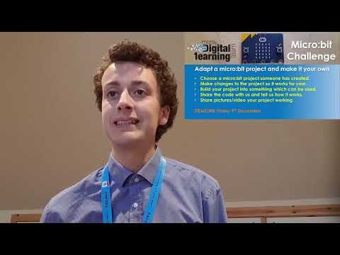
Video

Slide 4
Micro:bit
Challenge
Adapt a micro:bit project and make it your own
Choose a micro:bit project someone has created.
Make changes to the project so it works for your use.
Build your project into something which can be used.
Share the code with us and tell us how it works.
Share pictures/video your project working.
DEADLINE...

Slide 5
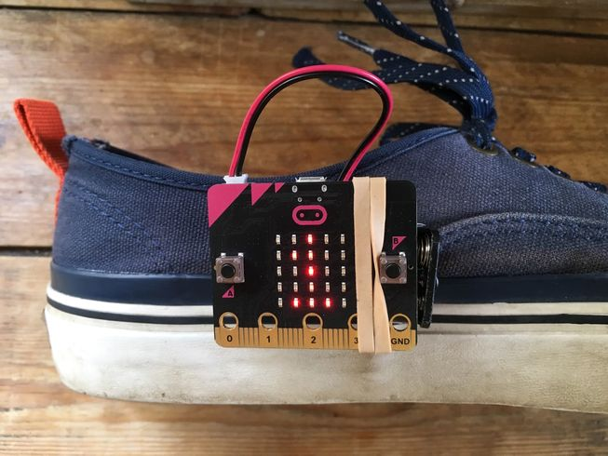

Discussion
What problems have we seen solved by the micro:bit in our lessons so far?

Slide 6
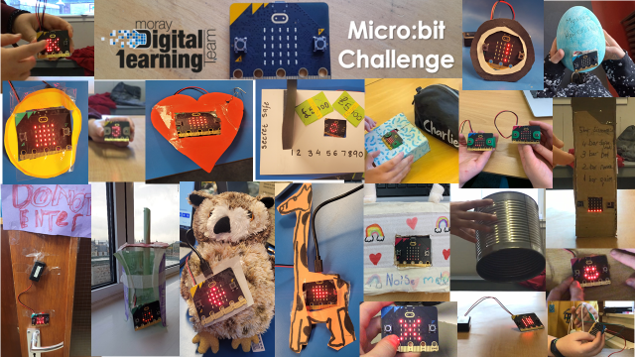
Example Submissions

Slide 7
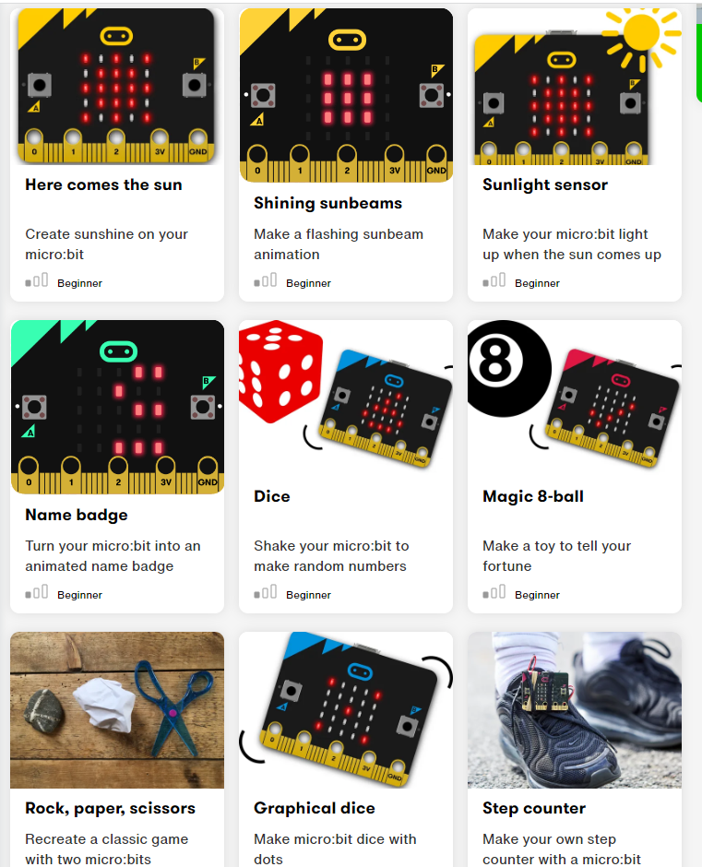
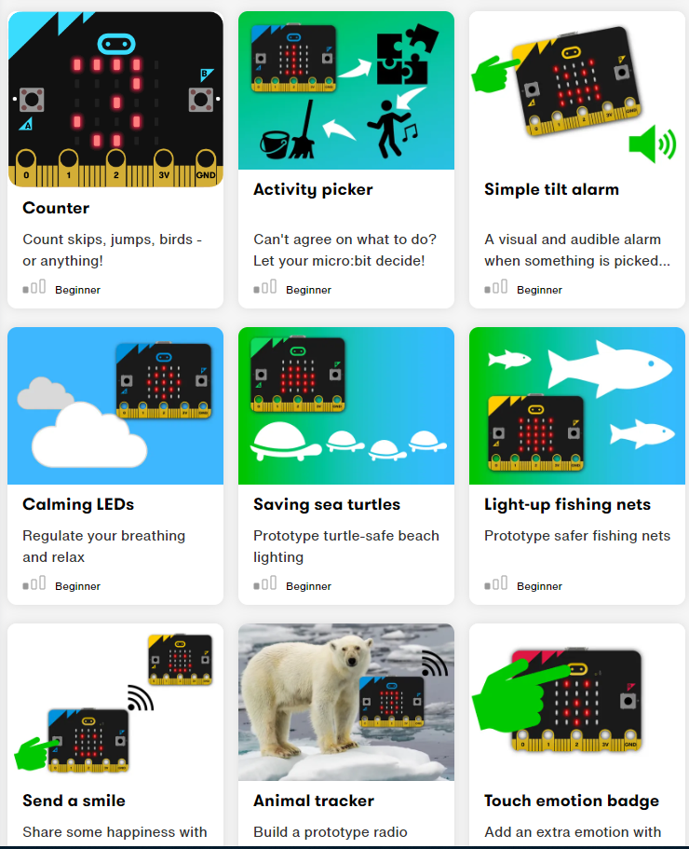
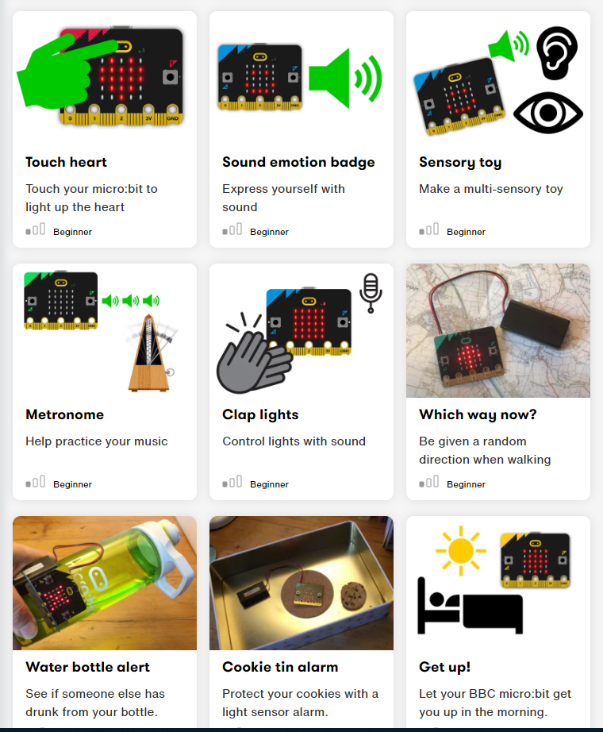
Finding code to make your own
There are lots of really interesting code that you can adapt for your micro:bit challenge.

Slide 8
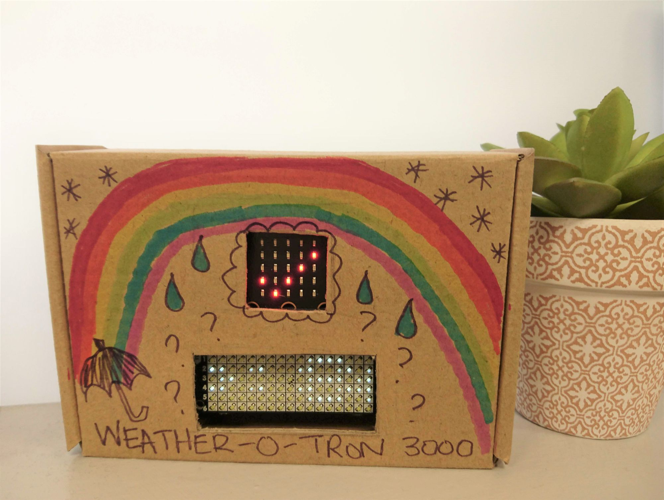
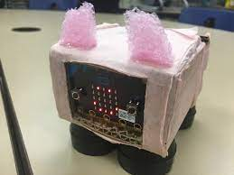
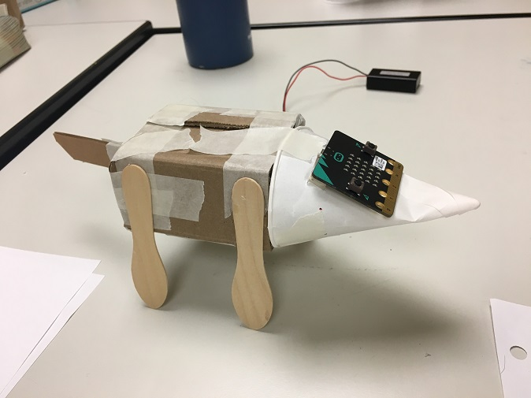
Make Changes
Test your code by downloading it to the micro:bit.
Is there something that you could change to make it better?
Can you make anything to put the micro:bit in or decorate the micro:bit?

Slide 9
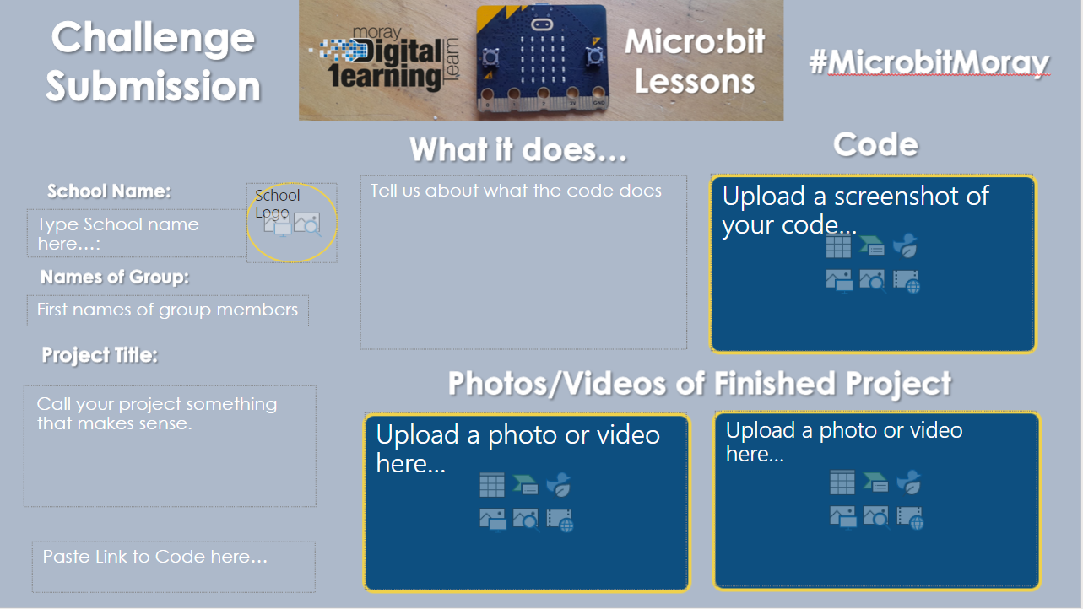
Writing up
To share your project fill out the template slide:

Slide 10
Sharing
Now share your challenge submissions with your teacher.
Well done for taking part!

