Slide 1

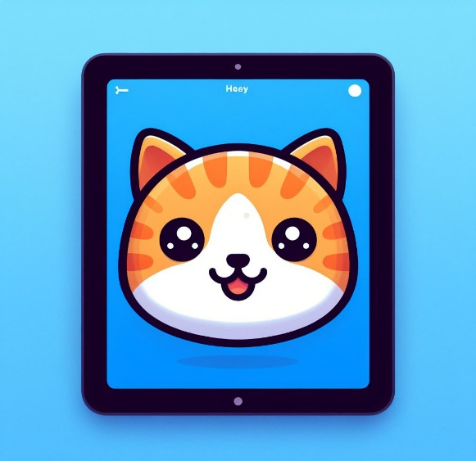
ScratchJr
Lessons
Lesson 1 – Getting Started
Notes:
Notes for teachers:
Learners will need to use the same iPad to access the same piece of music if you split this lesson up.
I would recommend headphones if all learners are working on this at the same time.
The videos are designed to be paused at any points you find suitable. For this reason I have only summarised the steps on a slide as screenshots aren’t as useful as just watching the part of the video again.

Slide 2
Lesson 1: Getting Started
We are learning to code using ScratchJr.
I can create a new project and name it.
I can code my cat to move.
I can add a background to my scene.

Slide 3

Un-Plugged
What languages do you know?

Slide 4

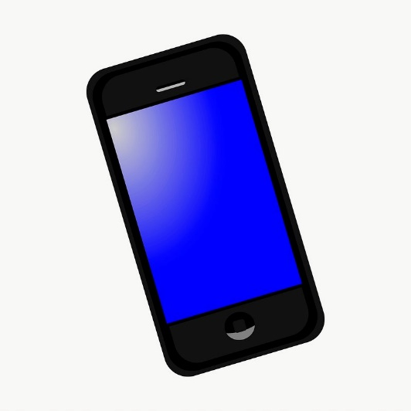
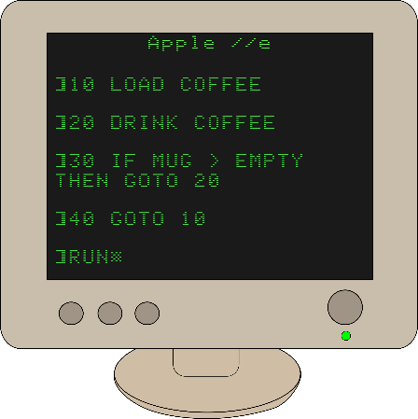
Discussion
What languages do computers use?

Slide 5
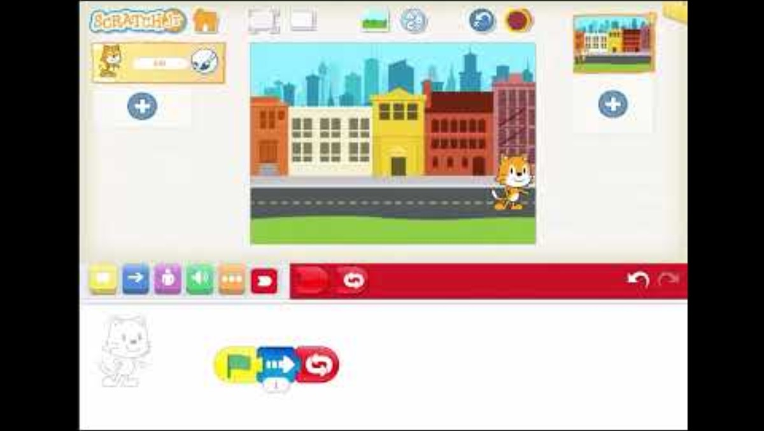
Lesson Video

Slide 6
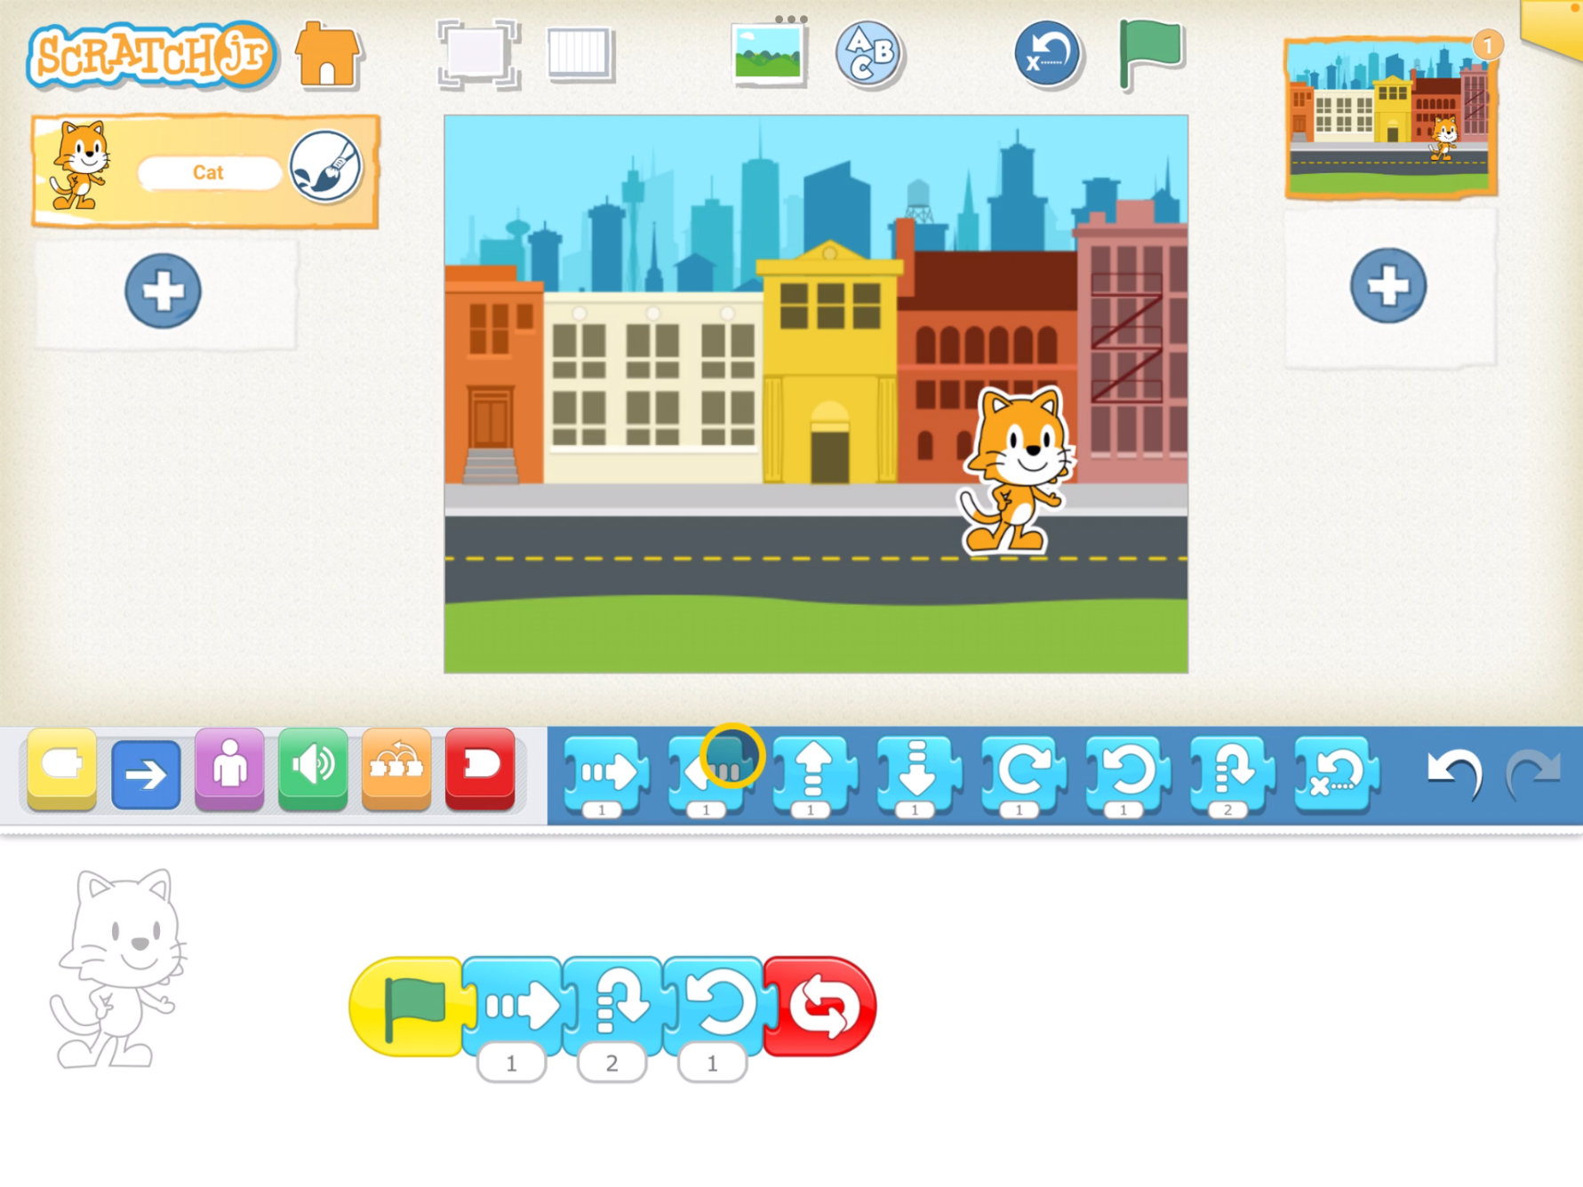
Completed Code

Slide 7
Plenary
What did you learn?

