Slide 1


ScratchJr
Lessons
Lesson 2 – Following Instructions
Notes:
Notes for teachers:
Learners will need to use the same iPad to access the same piece of music if you split this lesson up.
I would recommend headphones if all learners are working on this at the same time.
The videos are designed to be paused at any points you find suitable. For this reason I have only summarised the steps on a slide as screenshots aren’t as useful as just watching the part of the video again.

Slide 2
Lesson 2: Following Instructions
We are learning to code by following instructions
I can use start, move and spin blocks.
I can change how far my cat moves.
I can make my cat dance to instructions.

Slide 3
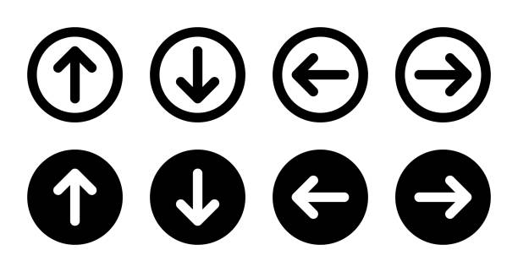
Un-Plugged
Program the teacher!

Slide 4



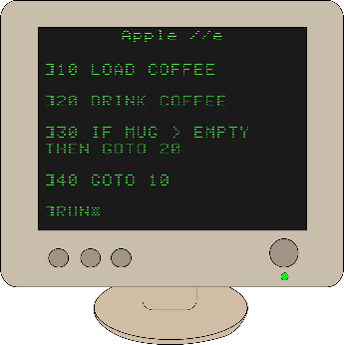
Discussion
Human Language and Computer Language

Slide 5
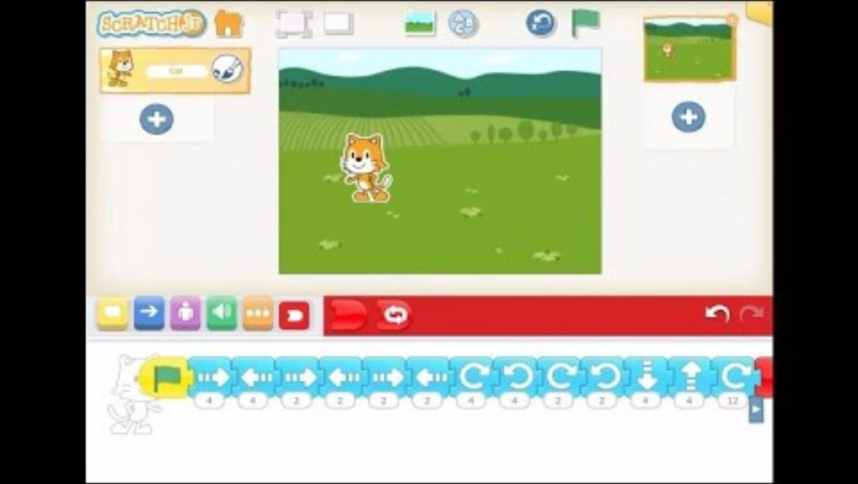
Lesson Video

Slide 6

Hokey Cokey
When you put your cat in.
Your cat out.
In, out, in, out.
Shake it all about.
Do the hokey cokey
and you turn around.
That's what it's all about!

Slide 7
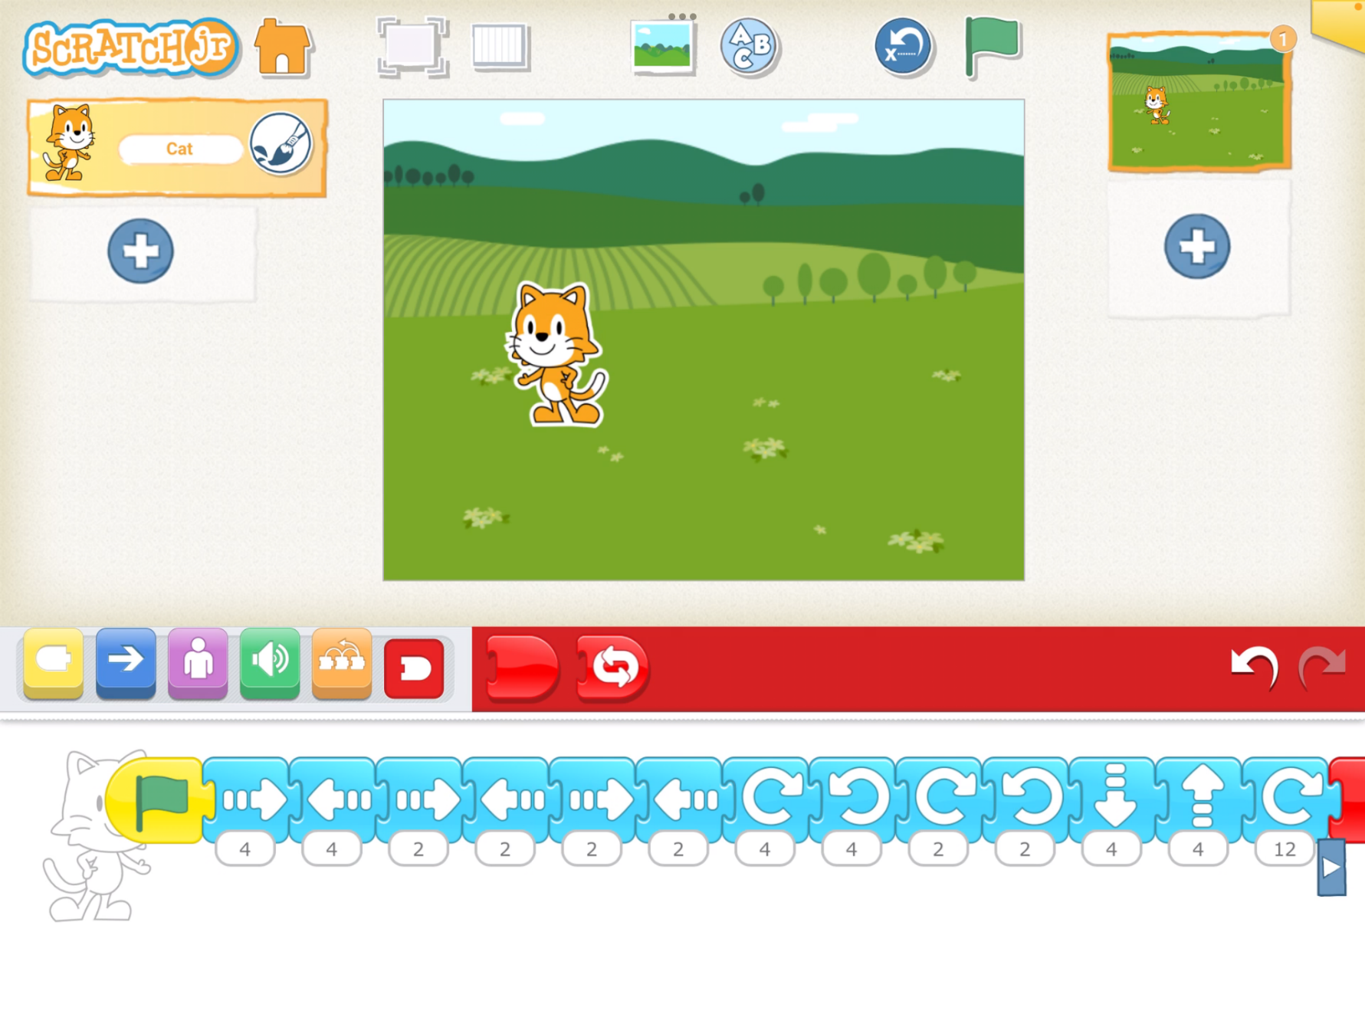
Completed Code

Slide 8
Plenary
What did you learn?

