Slide 1


ScratchJr
Lessons
Lesson 3 – Telling a Story
Notes:
Notes for teachers:
Learners will need to use the same iPad to access the same piece of music if you split this lesson up.
I would recommend headphones if all learners are working on this at the same time.
The videos are designed to be paused at any points you find suitable. For this reason I have only summarised the steps on a slide as screenshots aren’t as useful as just watching the part of the video again.

Slide 2
Lesson 3: Telling a Story
We are learning to code a story.
I can choose two characters and a background.
I can make my characters move.
I can add a title to my story.

Slide 3
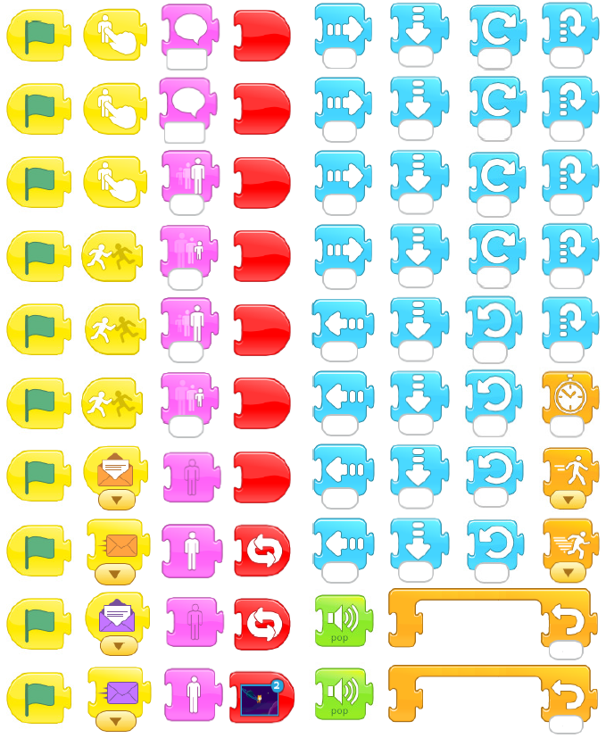
Un-Plugged
Programmer
Says.

Slide 4

Discussion
What makes a good story?

Slide 5
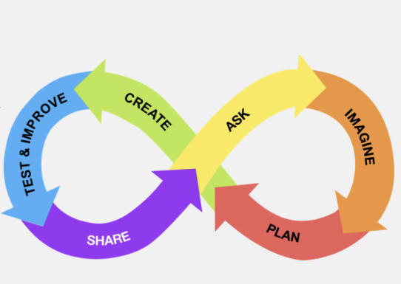
Discussion
Steps to make our code.

Slide 6
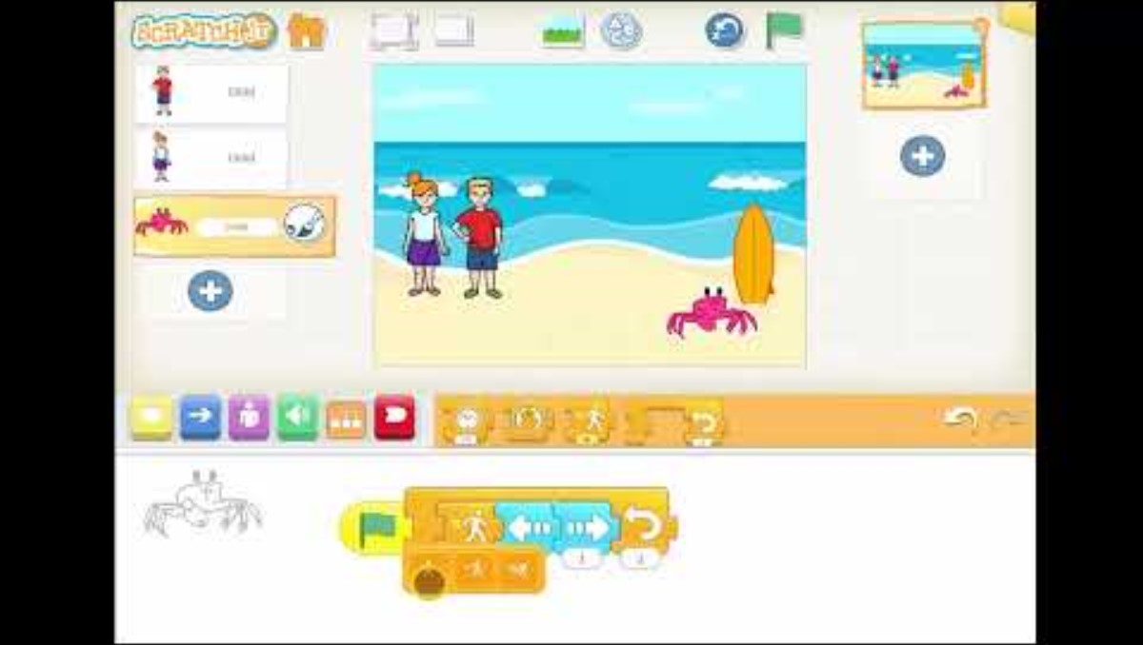
Lesson Video

Slide 7
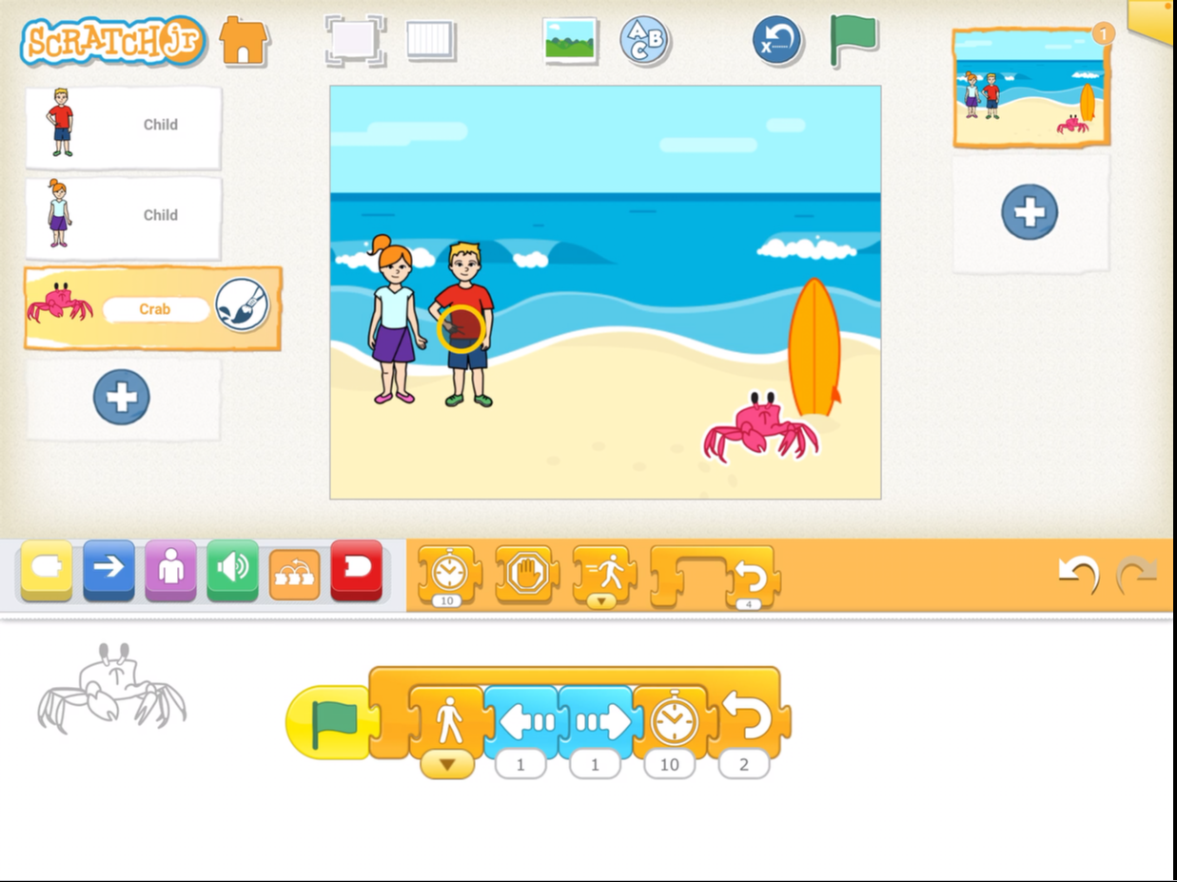
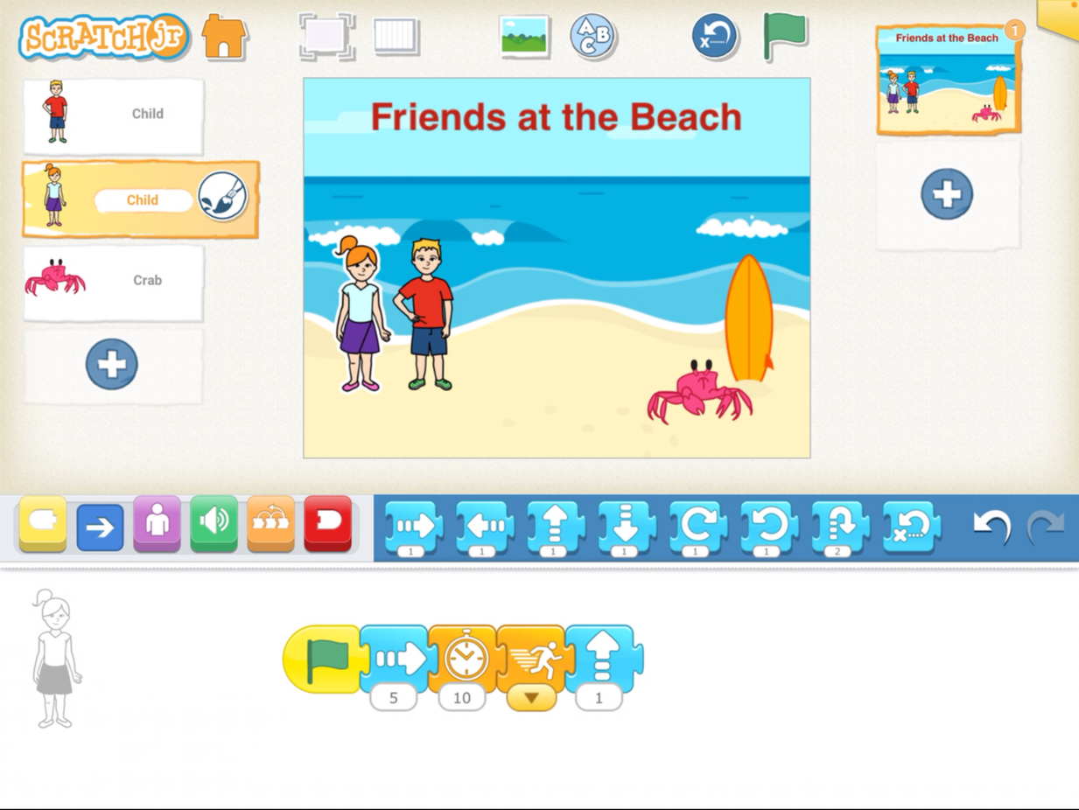
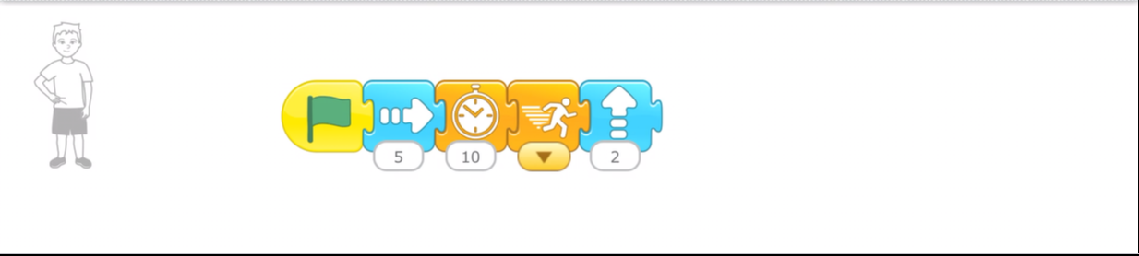
Completed Code

Slide 8
Plenary
What did you learn?

