Slide 1


ScratchJr
Lessons
Lesson 4 – Telling a Longer Story
Notes:
Notes for teachers:
Learners will need to use the same iPad to access the same piece of music if you split this lesson up.
I would recommend headphones if all learners are working on this at the same time.
The videos are designed to be paused at any points you find suitable. For this reason I have only summarised the steps on a slide as screenshots aren’t as useful as just watching the part of the video again.

Slide 2
Lesson 4: Telling a Longer Story
We are learning to code a longer story.
I can choose characters and backgrounds for my story.
I can create more than one scene (or page) in my story.
I can use some purple blocks (Grow, Shrink, Hide and Show)

Slide 3
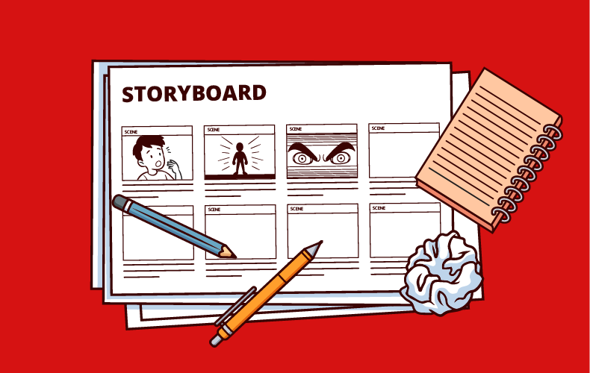
Un-Plugged
One Sentence Story

Slide 4

Discussion
What makes a good story?

Slide 5
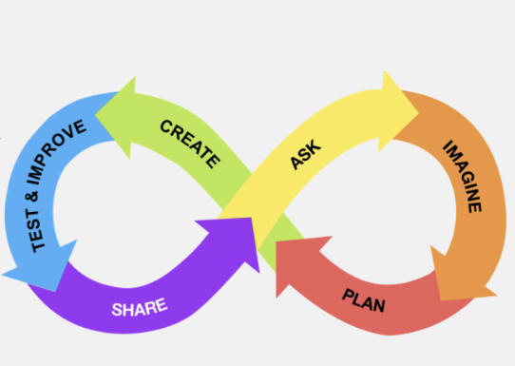
Discussion
Steps to make our code.

Slide 6
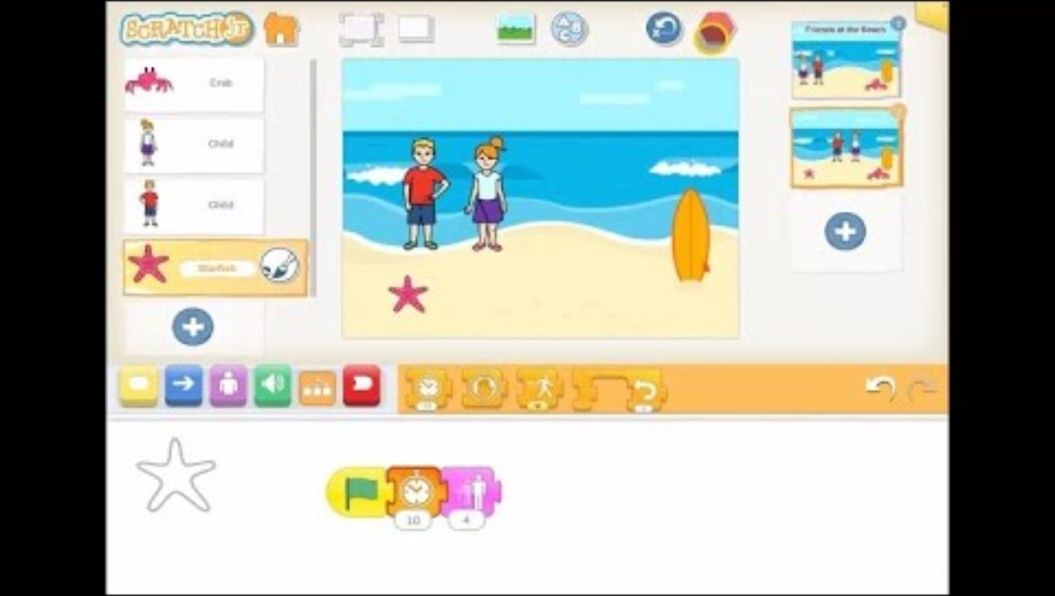
Lesson Video

Slide 7
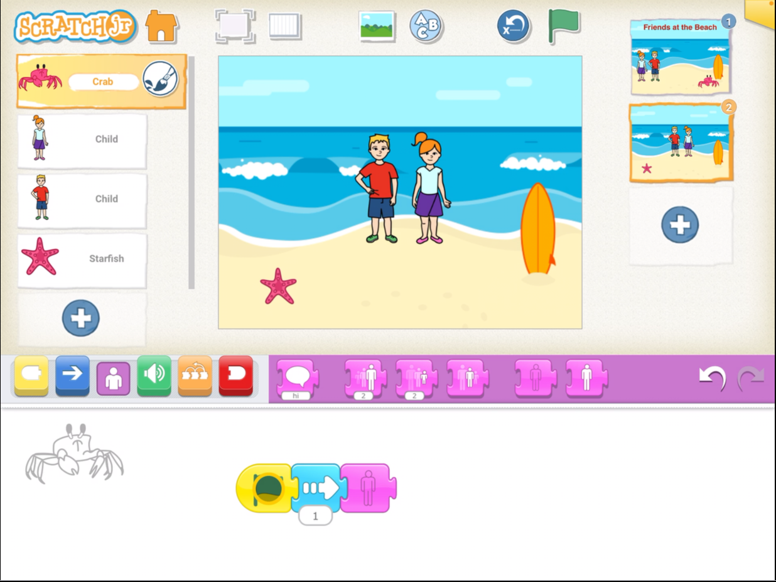
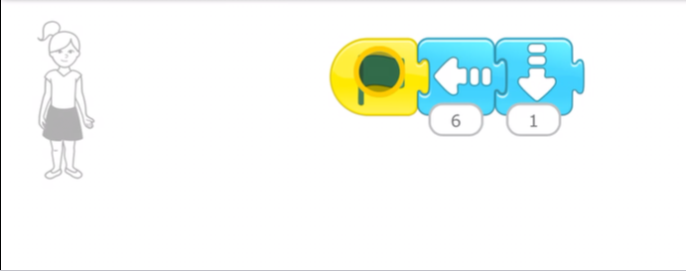
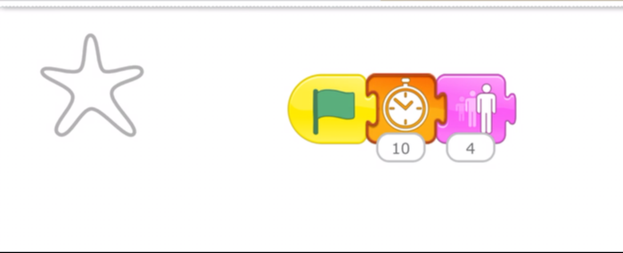
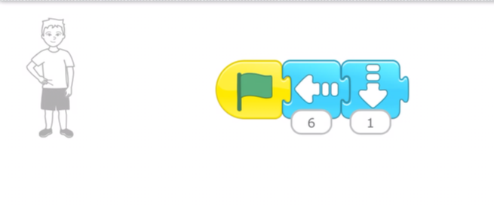
Completed Code

Slide 8
Plenary
What did you learn?

