Slide 1

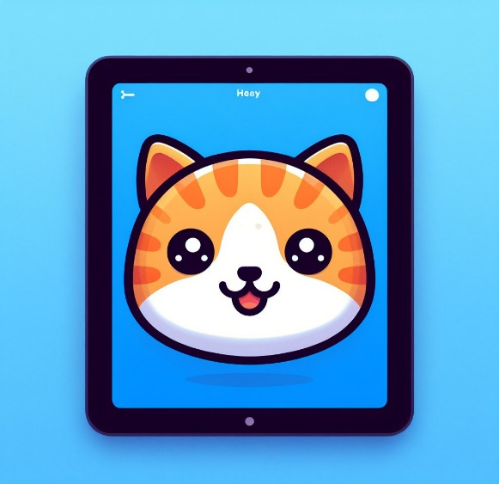
ScratchJr
Lessons
Lesson 5 – Talking Characters
Notes:
Notes for teachers:
Learners will need to use the same iPad to access the same piece of music if you split this lesson up.
I would recommend headphones if all learners are working on this at the same time.
The videos are designed to be paused at any points you find suitable. For this reason I have only summarised the steps on a slide as screenshots aren’t as useful as just watching the part of the video again.

Slide 2
Lesson 5: Talking Characters
We are learning to make our characters talk.
I can add my voice to my story.
I can add speech bubbles to my story.
I can add extra scenes to my story.

Slide 3

Un-Plugged
Debug the teacher

Slide 4
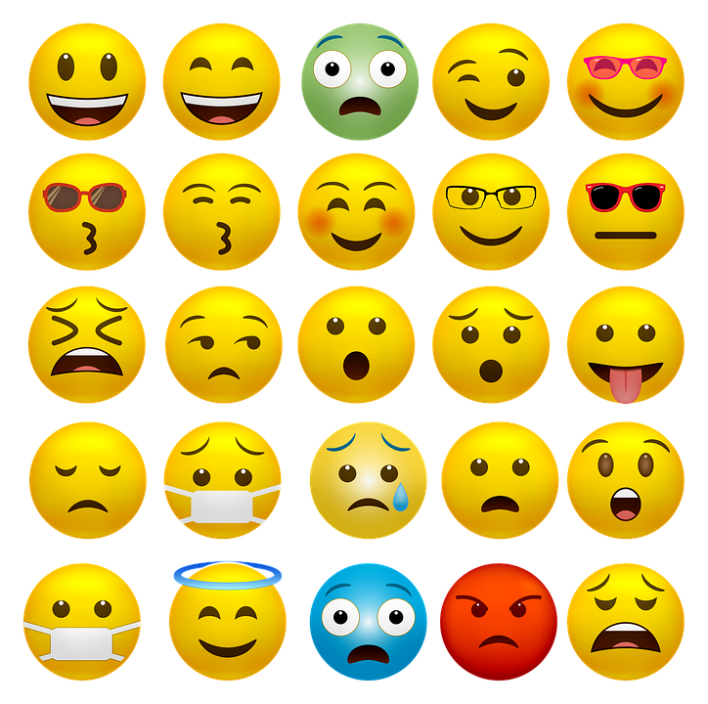
Discussion
What do these faces show?

Slide 5

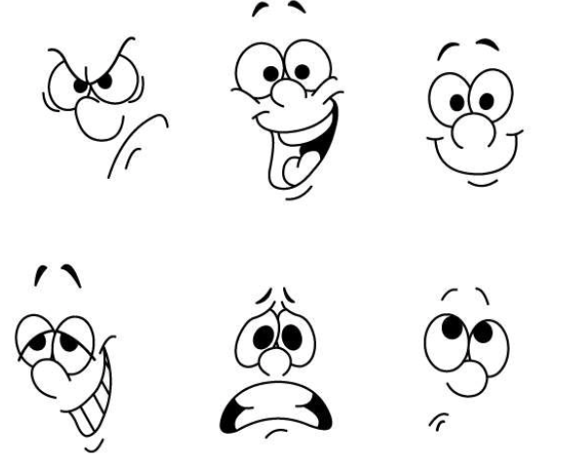
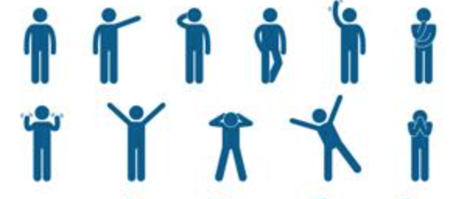
Discussion
How do you speak to people?
VOICES
WORDS
Hello!
Hi!
I’m sad!
I’m happy!
FACES
BODIES

Slide 6
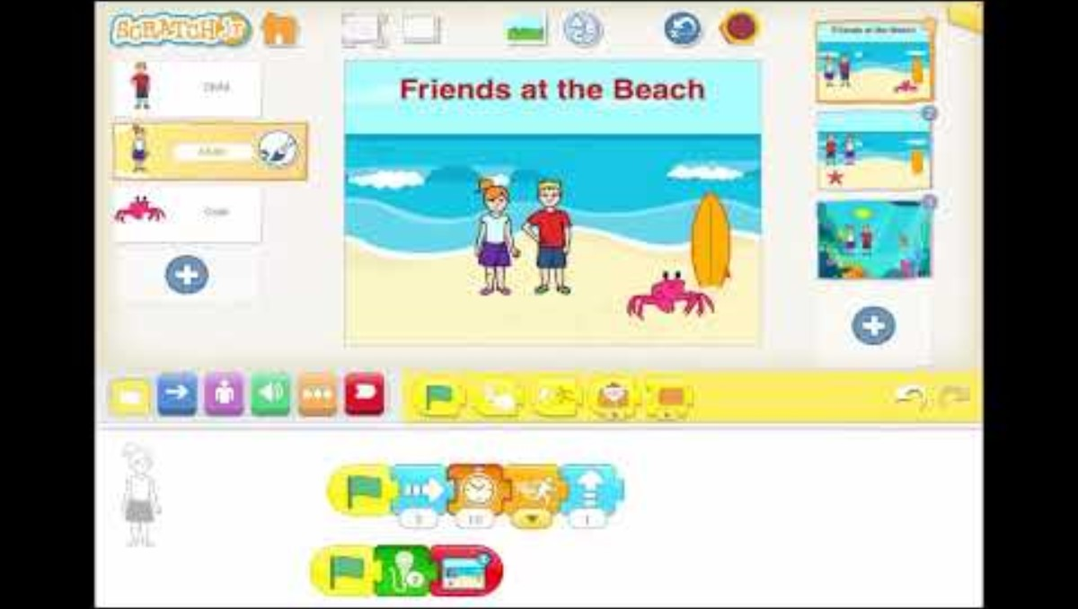
Lesson Video

Slide 7
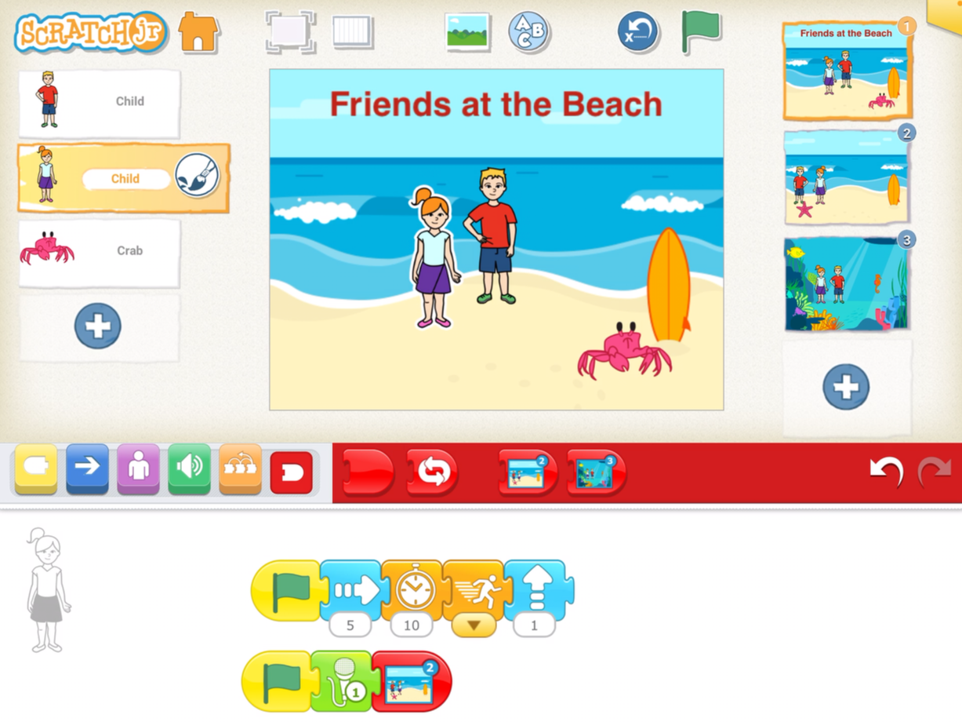
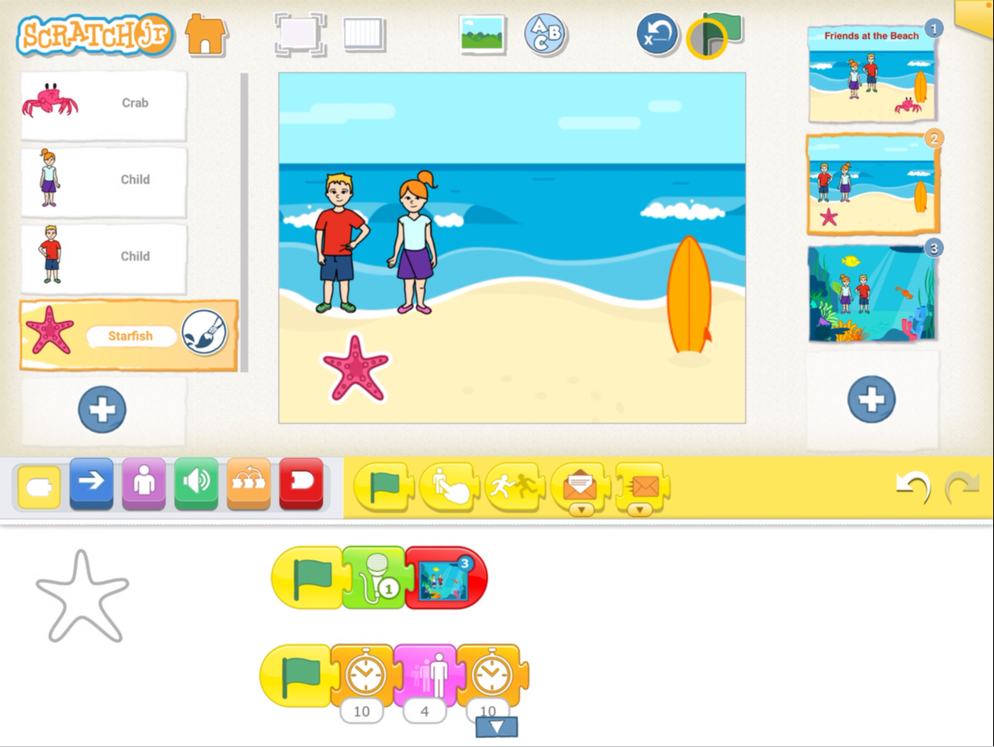
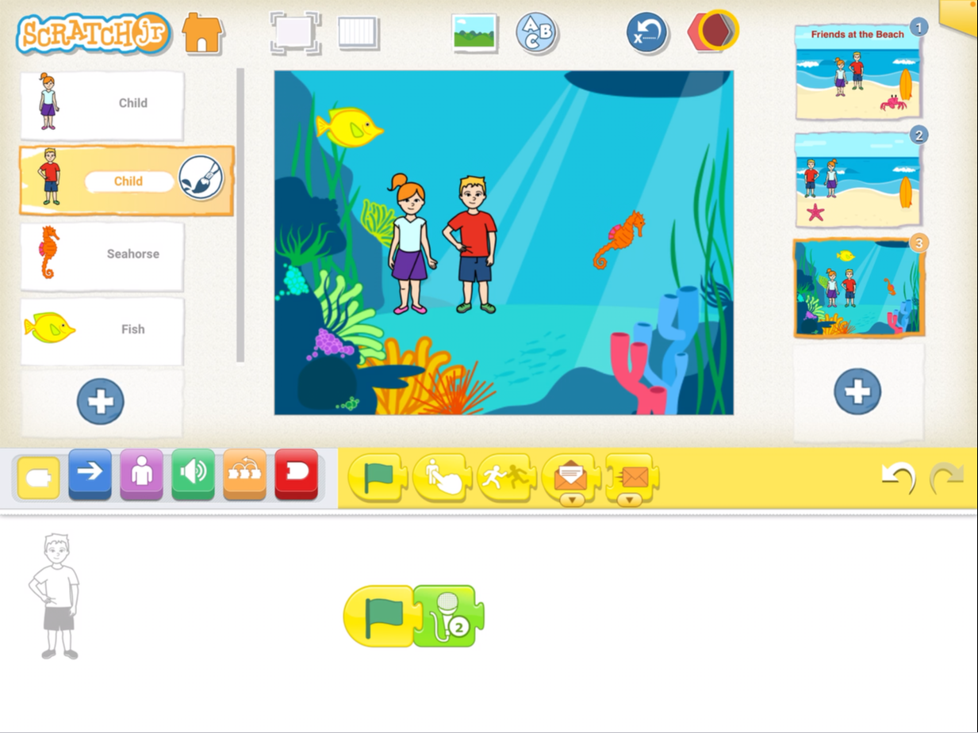
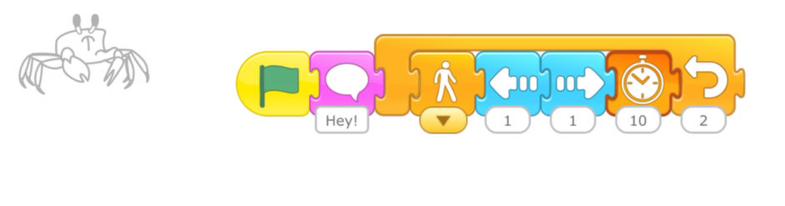
Completed Code

Slide 8
Plenary
What did you learn?

