Slide 1

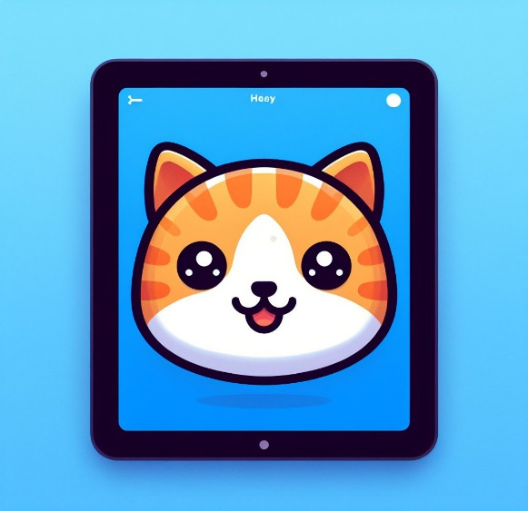
ScratchJr
Lessons
Lesson 6 – My Own Characters
Notes:
Notes for teachers:
Learners will need to use the same iPad to access the same piece of music if you split this lesson up.
I would recommend headphones if all learners are working on this at the same time.
The videos are designed to be paused at any points you find suitable. For this reason I have only summarised the steps on a slide as screenshots aren’t as useful as just watching the part of the video again.

Slide 2
Lesson 6: My Own Characters
We are learning to create our own characters and backgrounds.
I can draw new characters.
I can draw a new background.
I can make my new characters move.

Slide 3
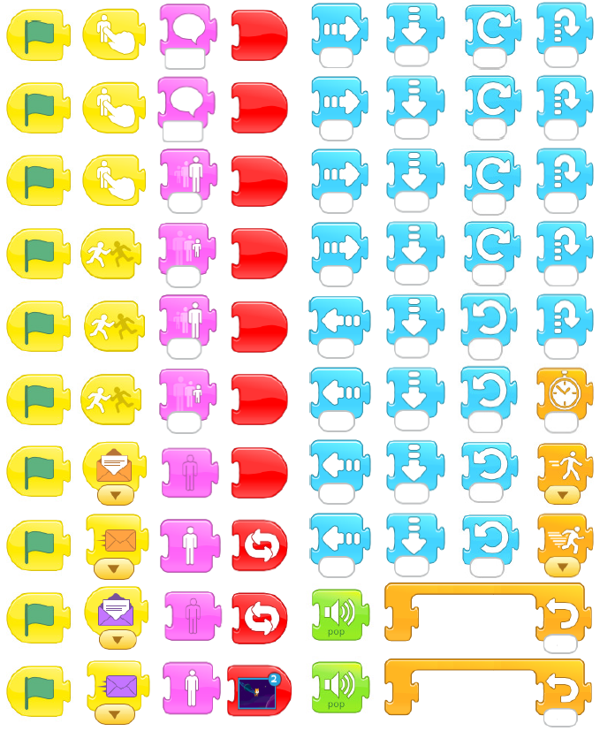
Un-Plugged
Programmer
Says.

Slide 4
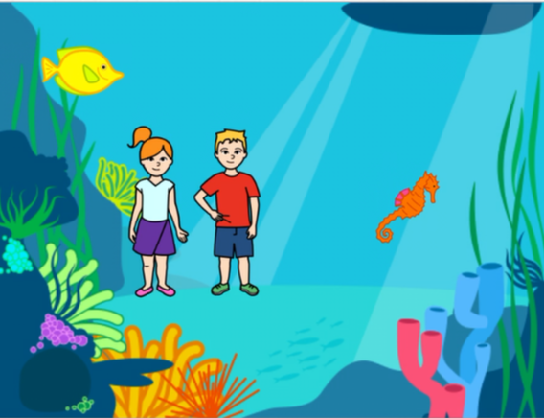
Discussion
What makes a good background and character?

Slide 5
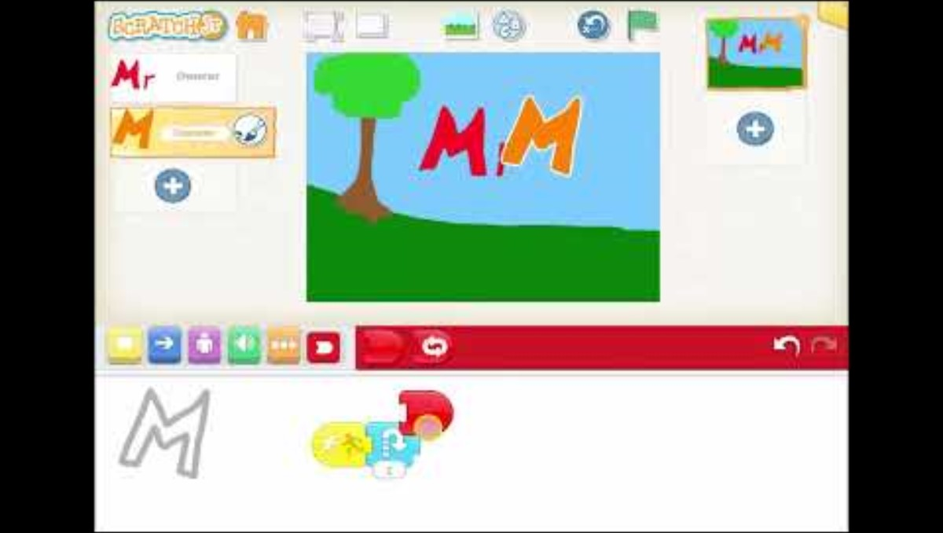
Lesson Video

Slide 6
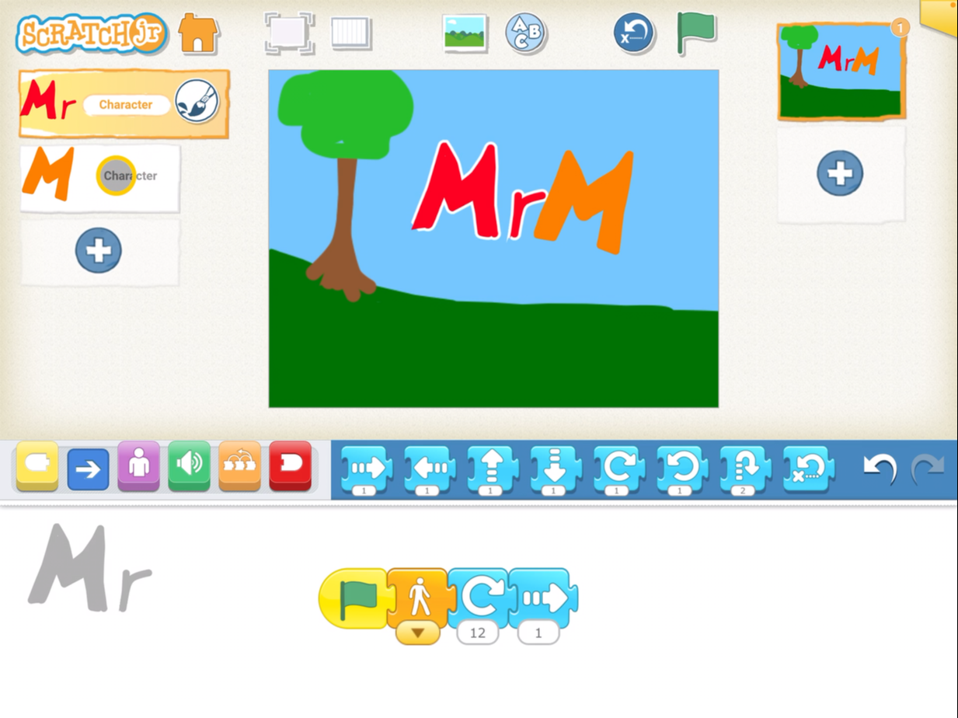
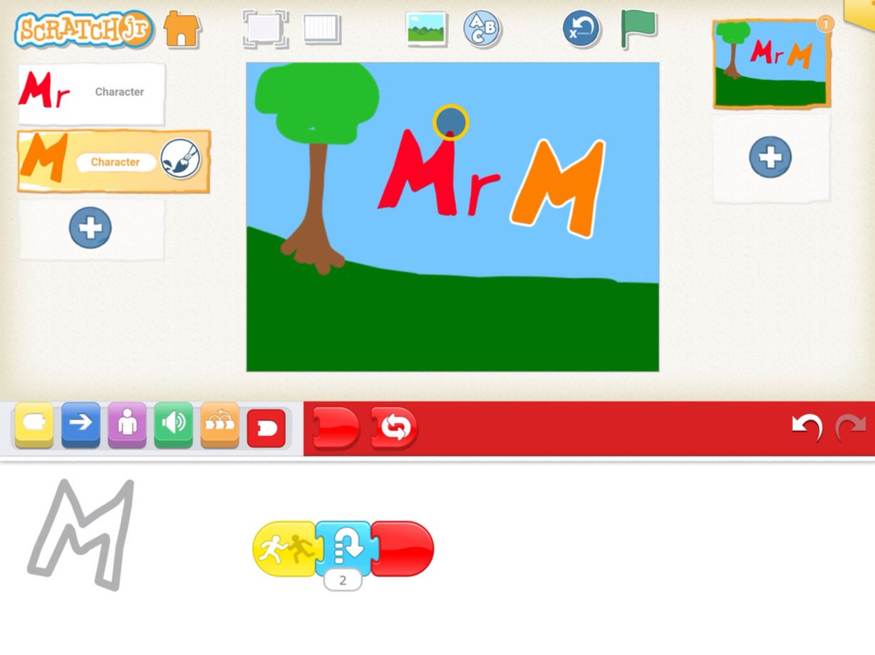
Completed Code

Slide 7
Plenary
What did you learn?

