Slide 1


Micro:bit
Data and Sustainability
Smart Sustainable Home Challenge

Slide 2
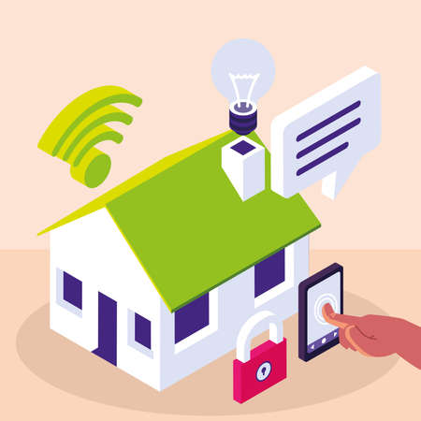
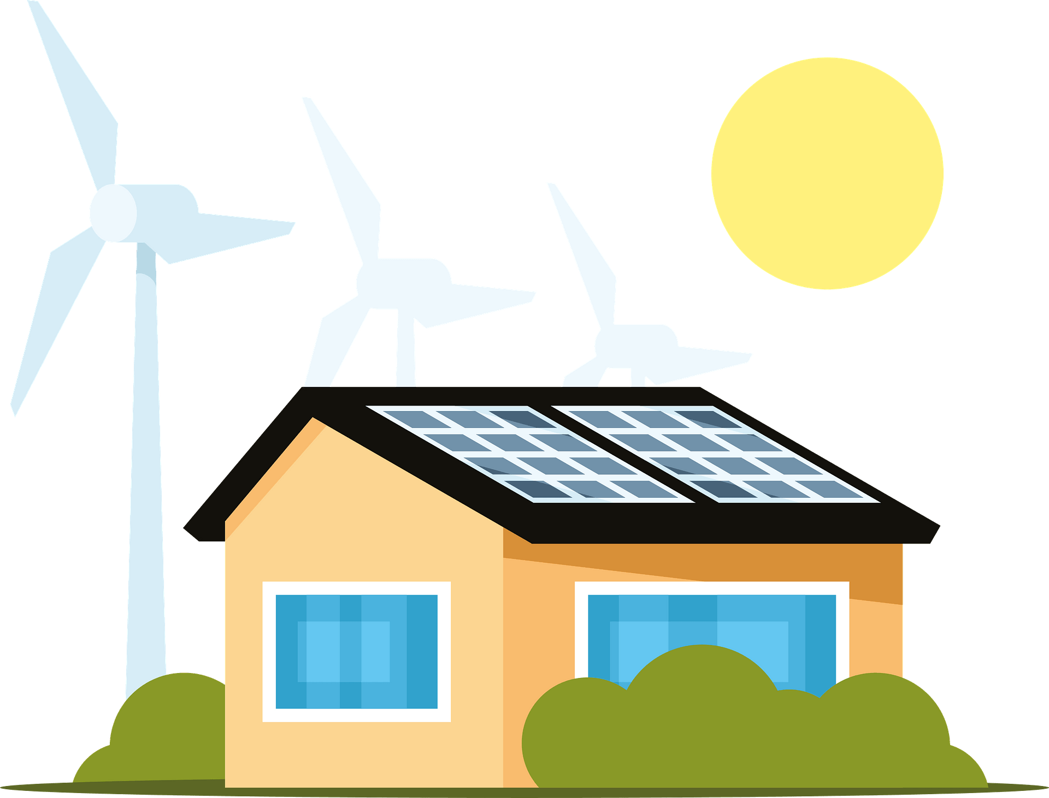
Data and Sustainability
Challenge
Design and build a smart sustainable home.
DEADLINE TBC

Slide 3
Smart Sustainable Home Challenge
We are learning to design and build a smart sustainable house.
I understand the features of a smart sustainable home.
I can design my house including some of these features.
I can adapt or create a micro:bit program for my house.
I can build my design using a variety of materials.

Slide 4
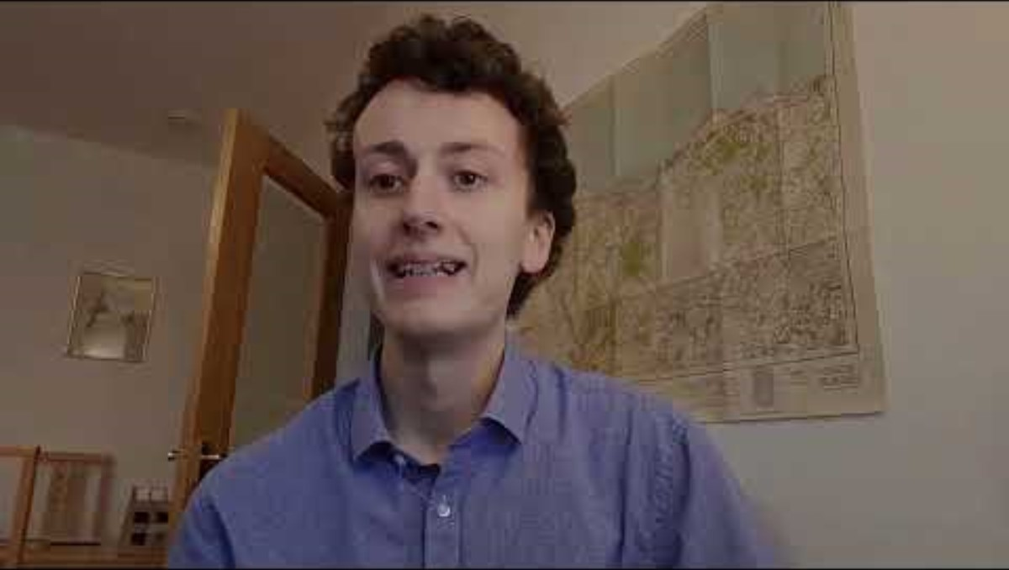
Introduction Video

Slide 5

The Bigger Picture

Slide 6


Part of a bigger Picture… SG11
It is important to think about the impact of our homes on the environment and our communities.
By designing sustainable houses, we can reduce our carbon footprint, conserve resources, and create healthy living environments for ourselves and future generations.

Slide 7
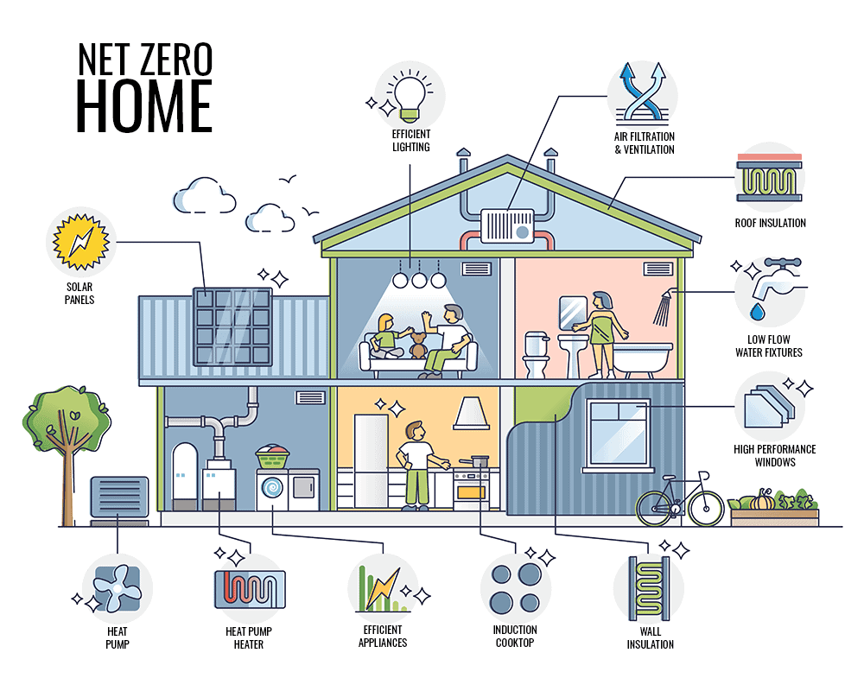
Features of a Smart Sustainable Home
Source: rdcfinehomes

Slide 8
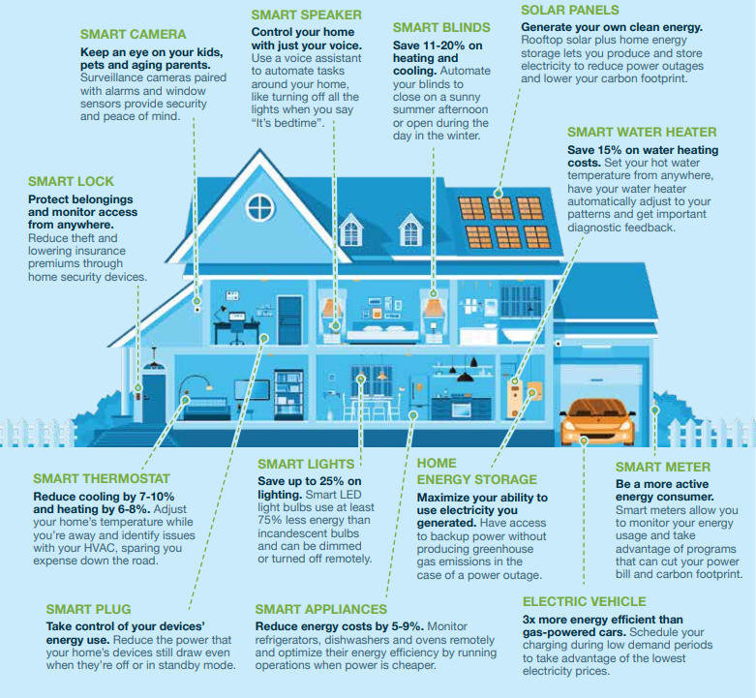
Features of a Smart Sustainable Home
Source: whatissmartenergy

Slide 9
Use the worksheet to choose at least 3 sustainable or smart features for your house design.

Slide 10
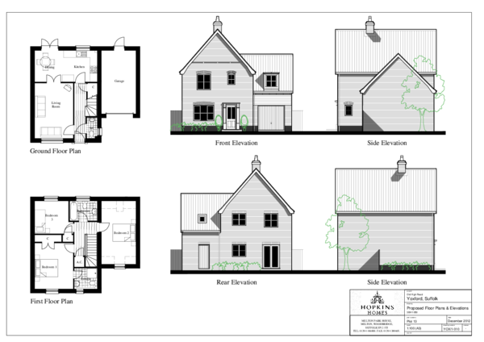
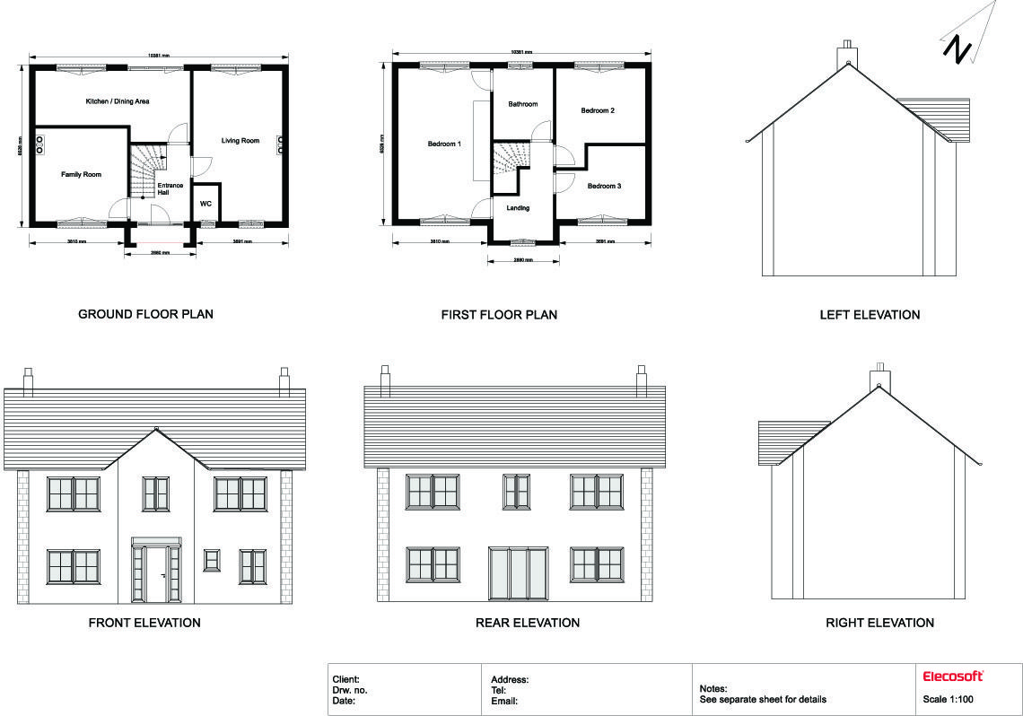
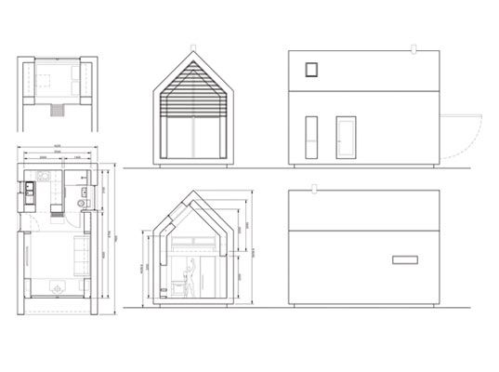
Creating a Plan.

Slide 11
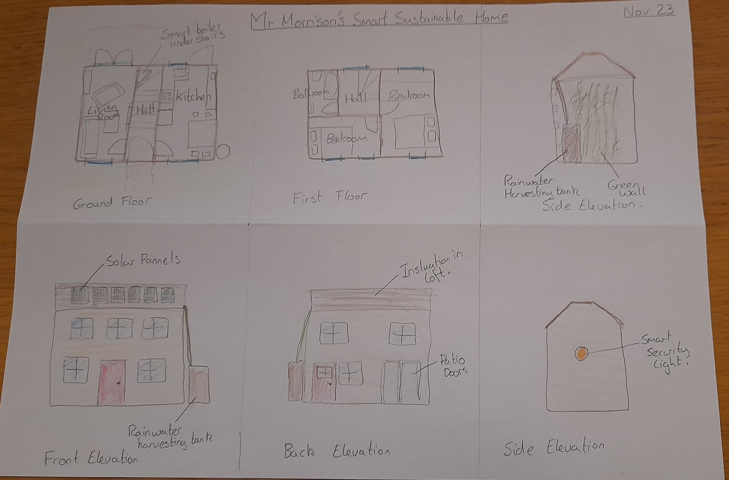
My Plan

Slide 12
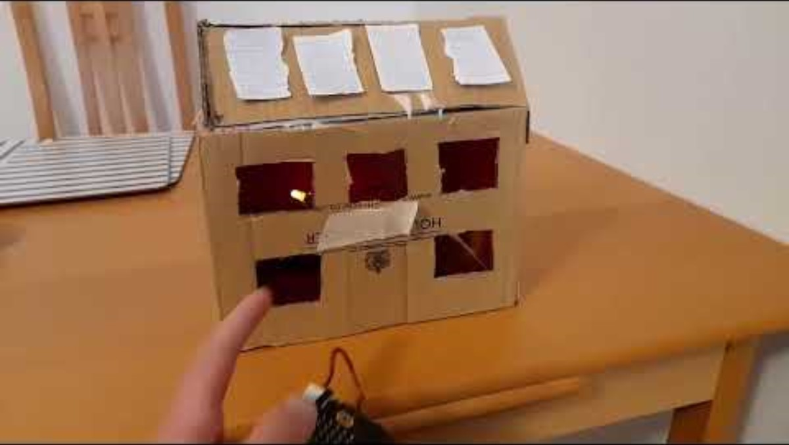
Video 2

Slide 13
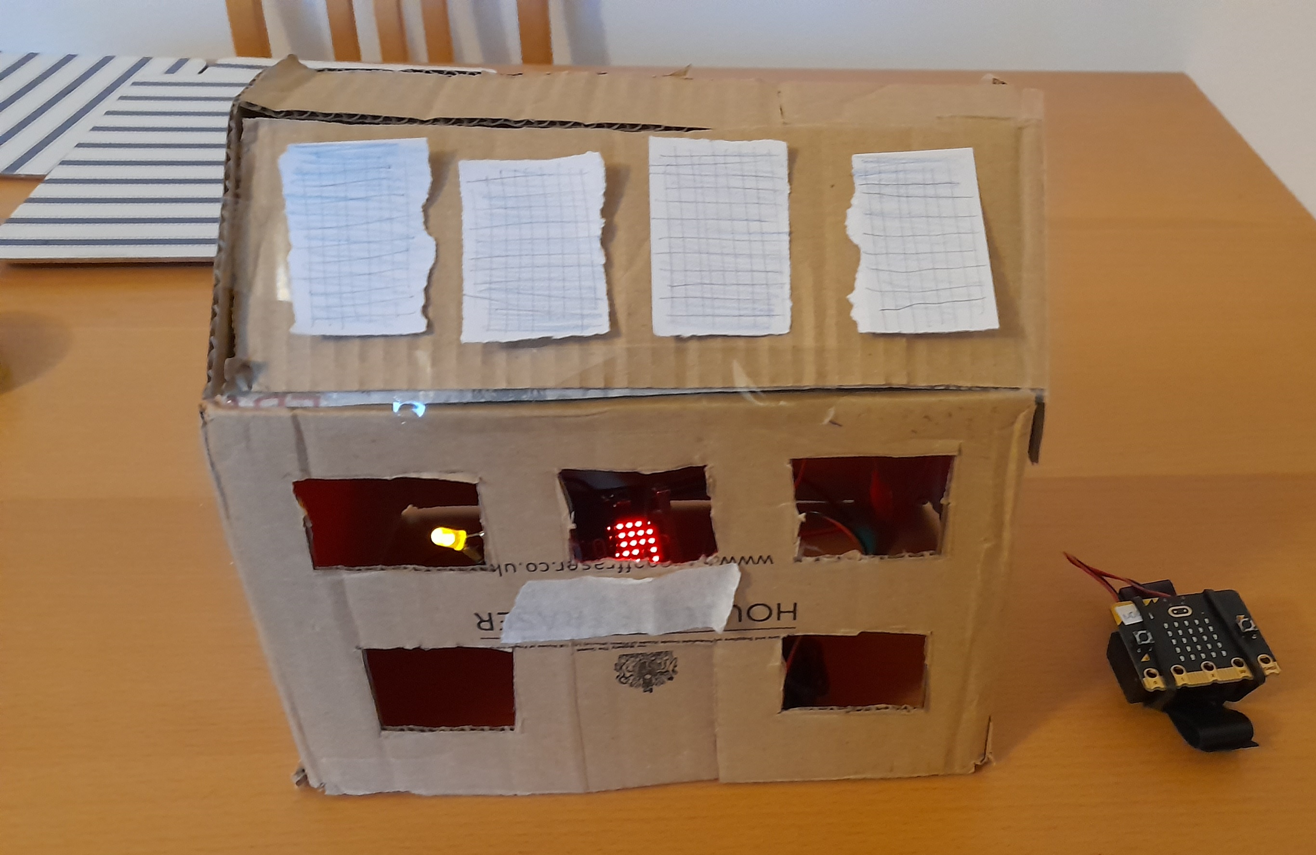
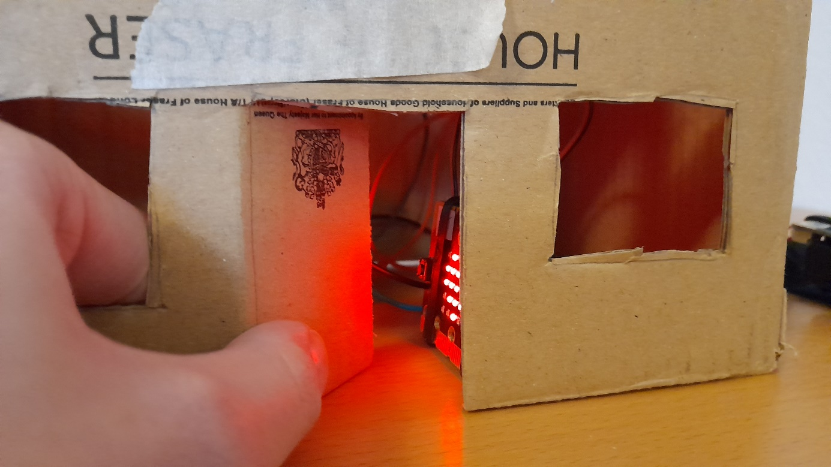
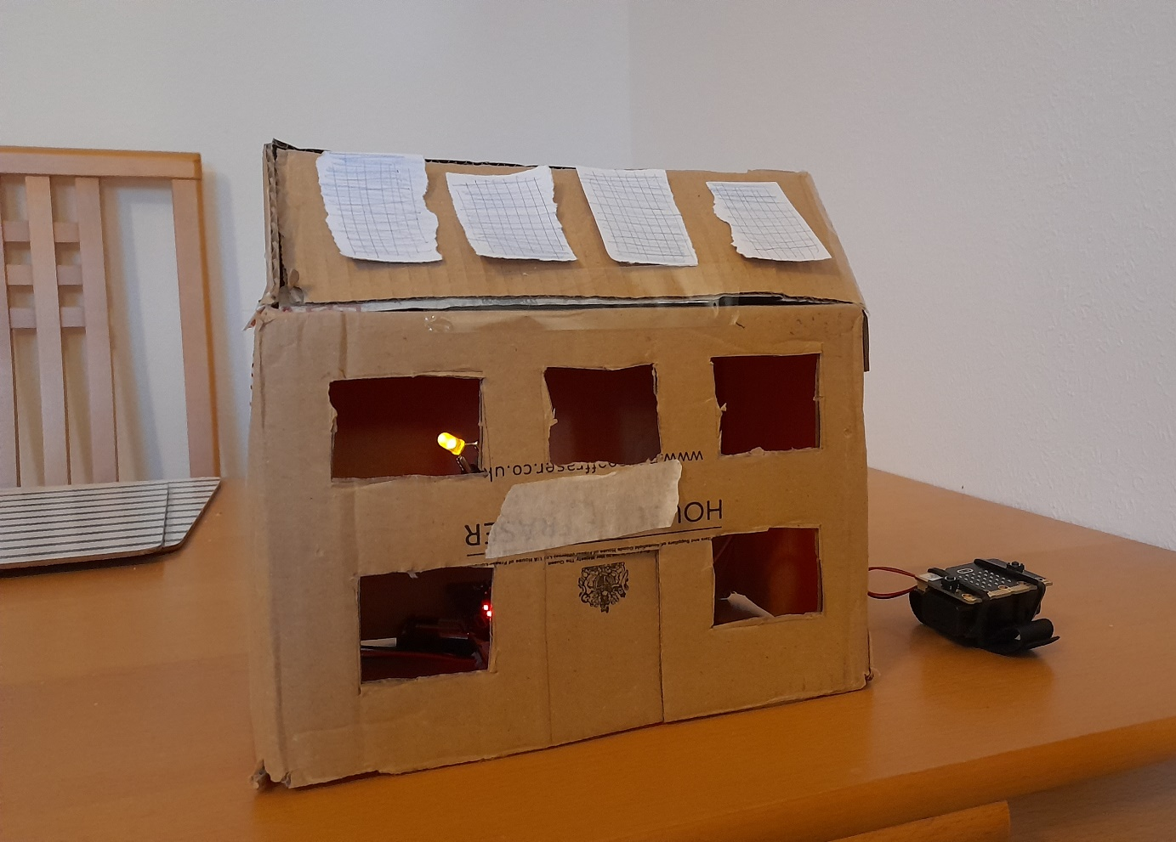
My House

Slide 14
Micro:bit Programs (to use/adapt)
Lighting
Night Light
Disco Lights
Clap Lights
Remote Lights Transmitter/Receiver
Data
Max-Min Thermometer
Indoor Outdoor Thermometer
Sound Logger
Environment Logger
Automation
Alarm Clock
Security Beacon
Door Alarm
Magnet Door Hello
Activity Picker
Proximity Beacon
Tilt Alarm
Radio Door Alarm

Slide 15
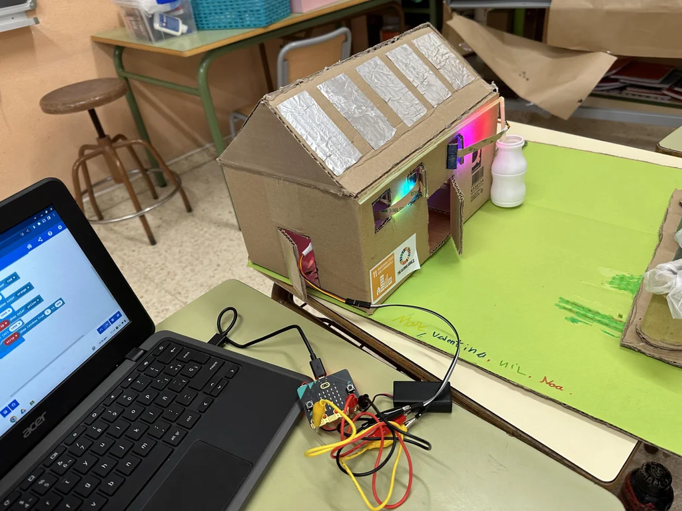
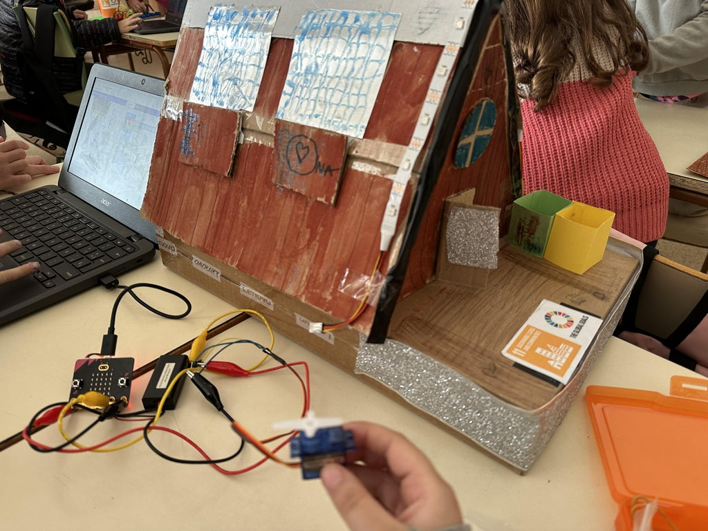
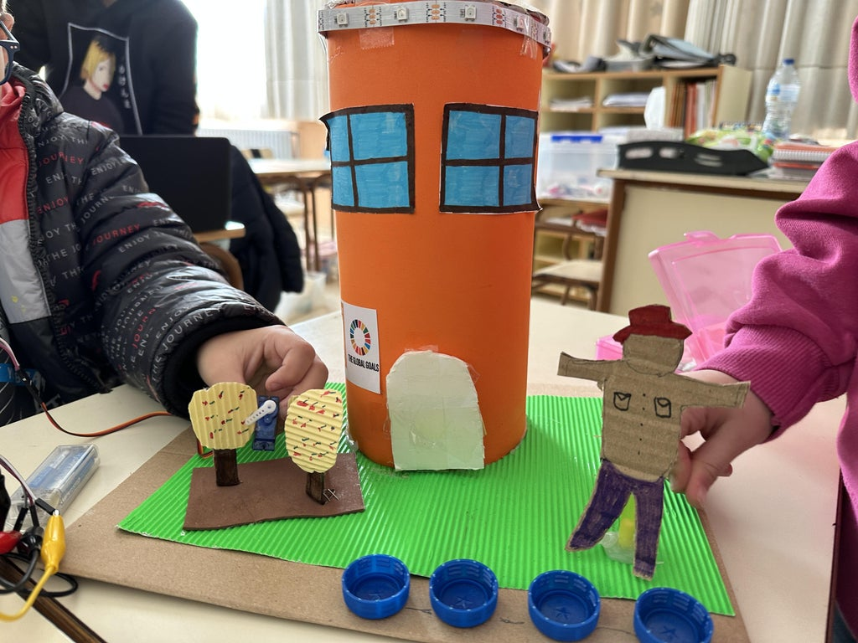
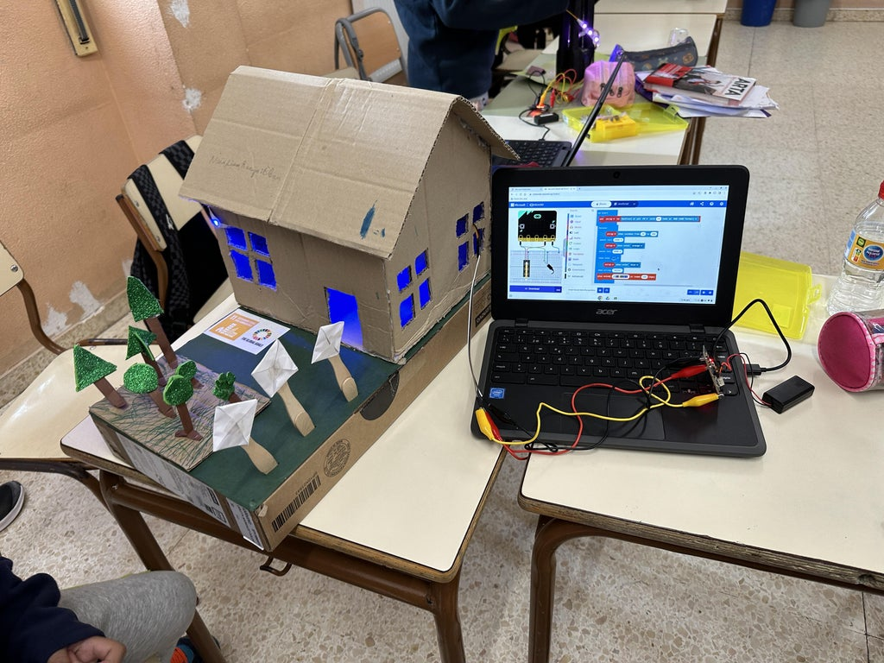
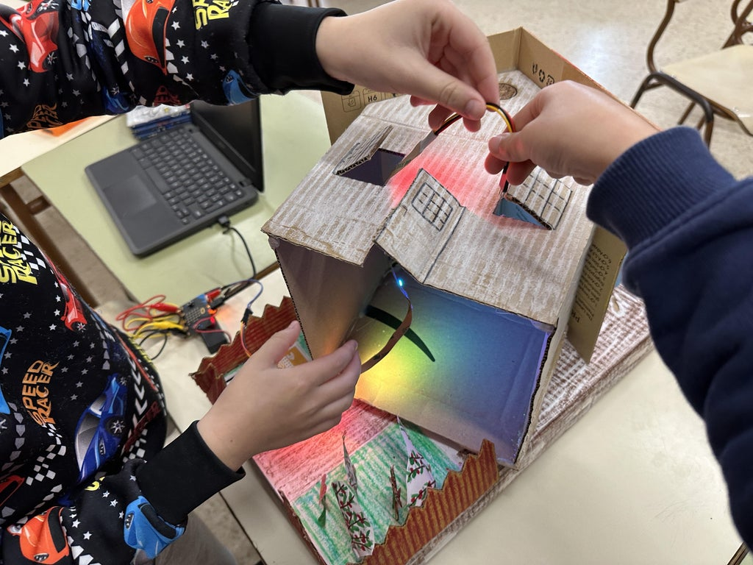
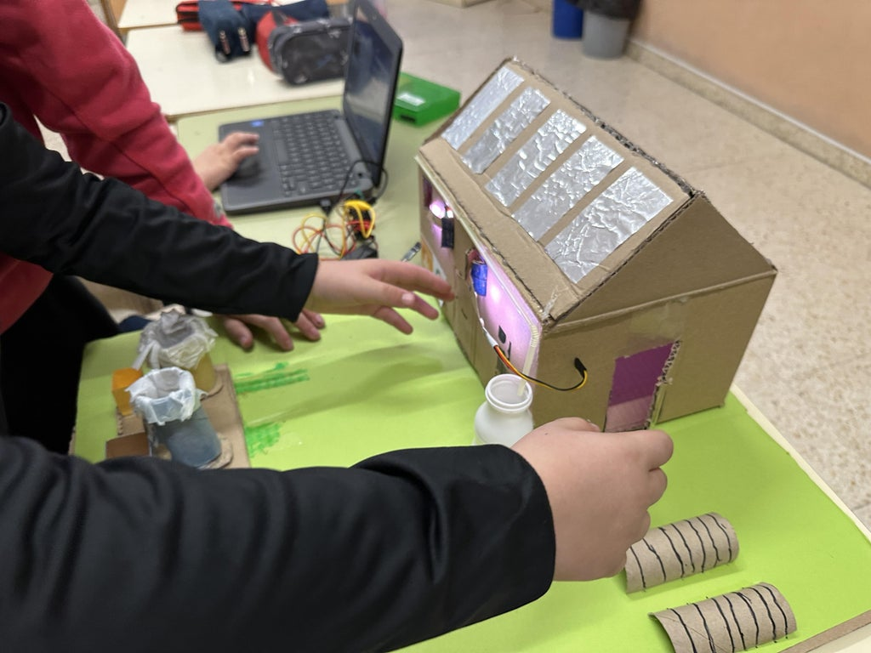
Example Homes

Slide 16
Get building!

Slide 17
Challenge Instructions
Choose Sustainable Features for your house
Create a plan of your house including the sustainable features.
Create a program(s) for the micro:bit to incorporate into your prototype house.
Build your prototype out of upcycled materials
5. Film/Photograph your finished house and add this to the submission template.

Slide 18
Questions?
How big a group can it be?
Any size you like groups of 2-4 work well.
2. Can I create my plan on the computer?
Yes it would be possible to do this with PowerPoint or TinkerCad if you are able.
3. How long should my videos be?
Less than 5mins.
4. How big should my house be?
That’s up to you and your teacher! Anything that fits the micro:bit will be fine.

Slide 19
I look forward to seeing your challenges!
Micro:bit
Data and Sustainability
The main ideas for this challenge come from Elena Vercher – Micro:bit Champion in Spain. Her instructions can be found HERE.

