Slide 1


micro:bit
Tin Foil
Electronics
Lesson 1 – Reaction Game

Slide 2
Lesson 1: Reaction Game
We are learning to use pins on the micro:bit.
I can code an alarm to sound when Pin 0 is pressed
I can build a simple pressure switch and connect it to the micro:bit.
I can use my pressure switch to create a reaction game.

Slide 3
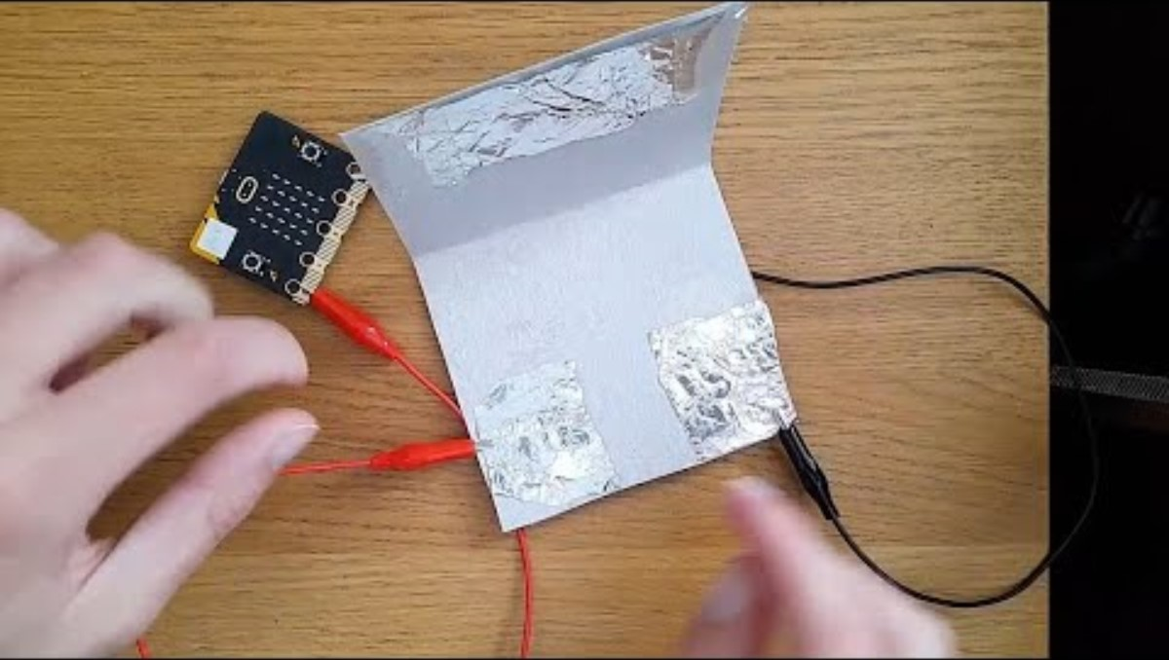
Introduction Video

Slide 4
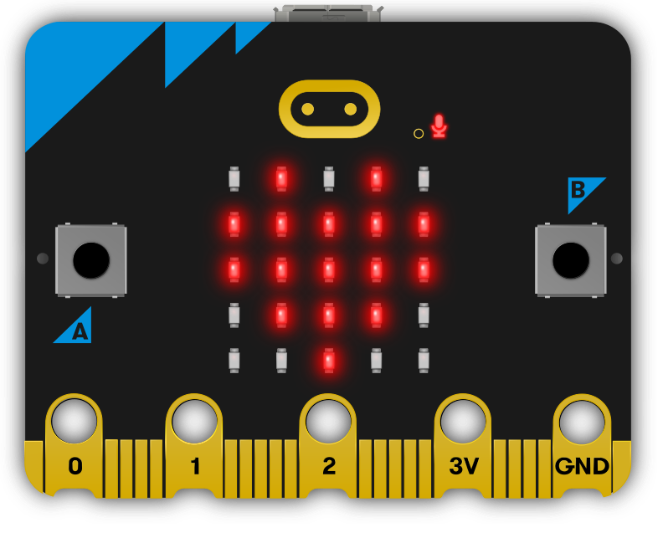
Where are the pins?

Slide 5
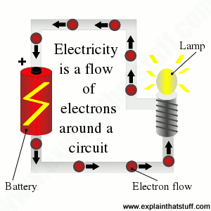
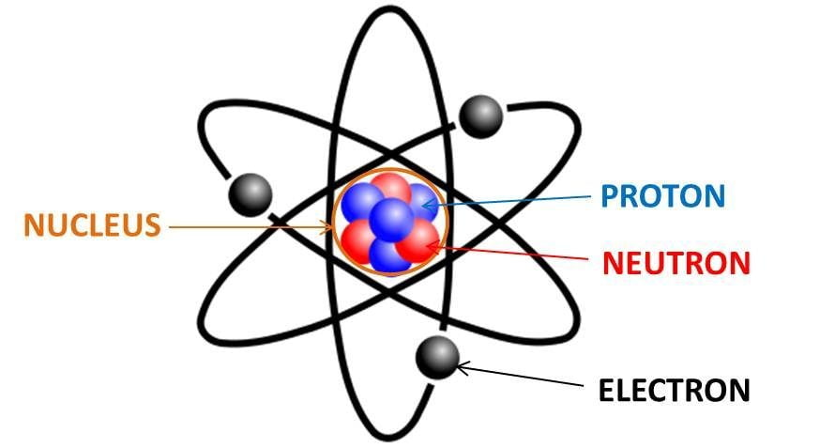
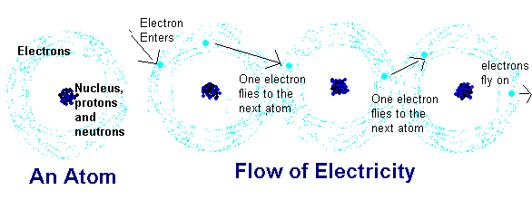
What is electricity?
Notes:
https://www.qrg.northwestern.edu/projects/vss/docs/power/2-whats-electron-flow.html#:~:text=Electron%20flow%20is%20what%20we,travel%20in%20only%20one%20direction.

Slide 6
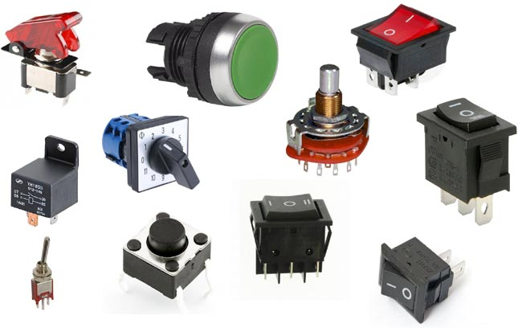
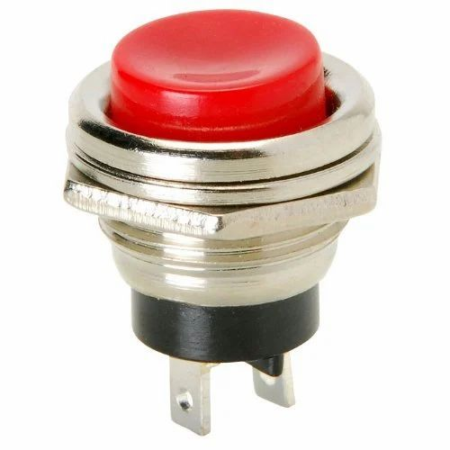
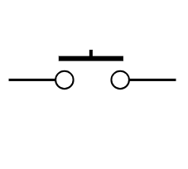
What is a switch?
A switch is any device used to interrupt the flow of electrons (electricity) in a circuit. Usually on or off.

Slide 7
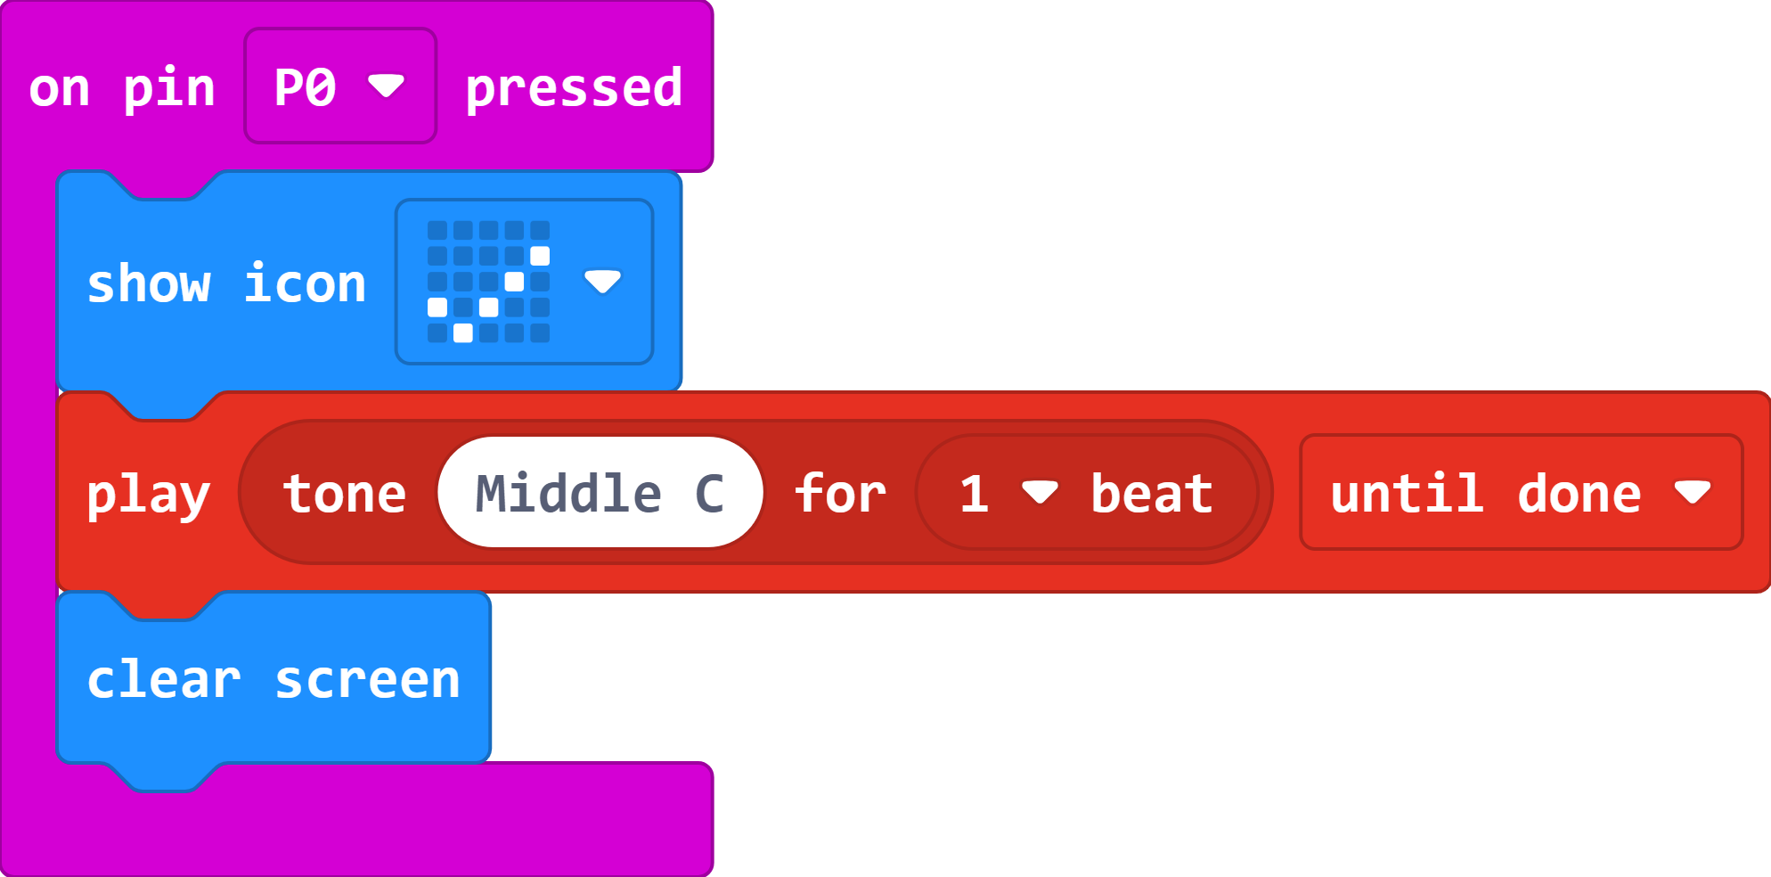
The Code

Slide 8
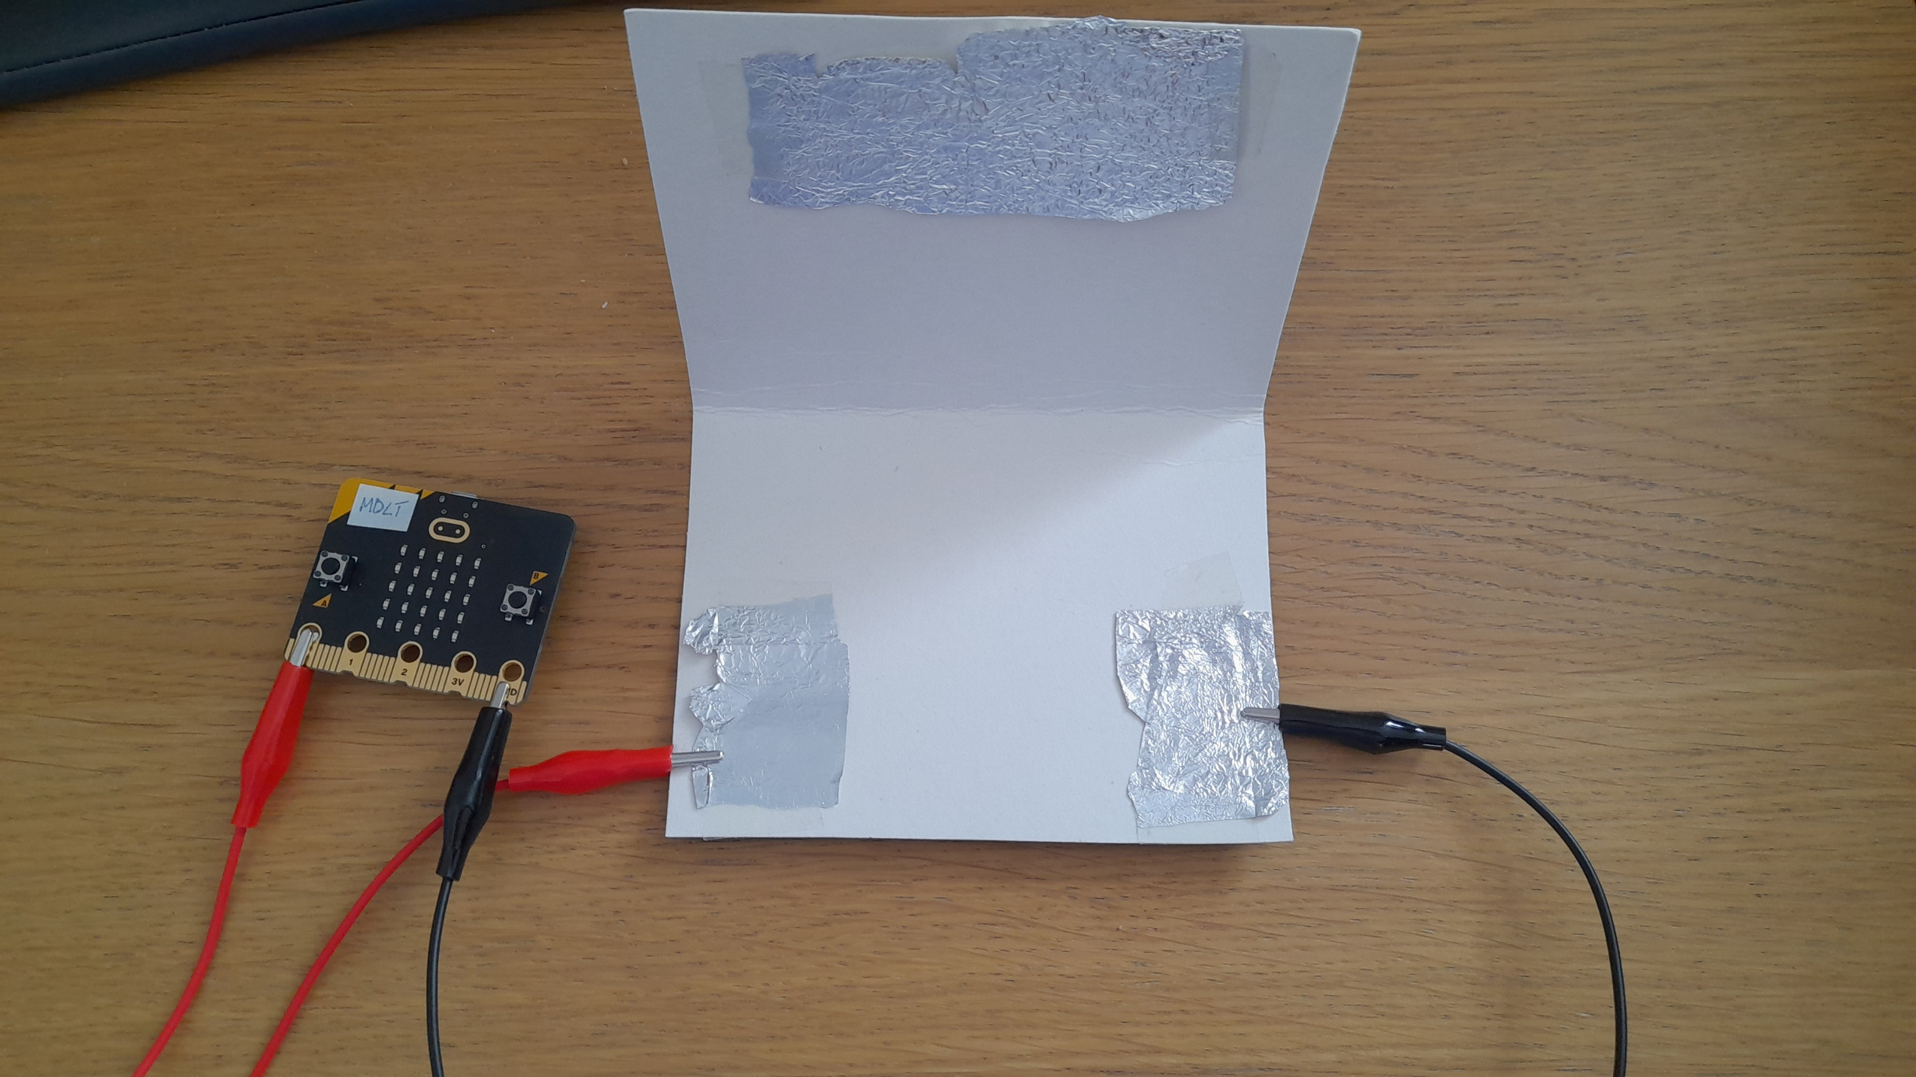
Pressure Switch

Slide 9
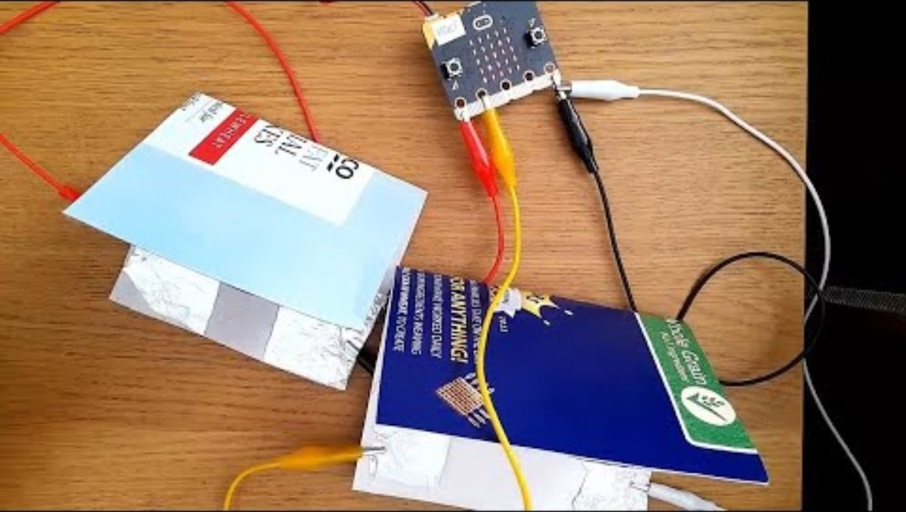
Video 2

Slide 10
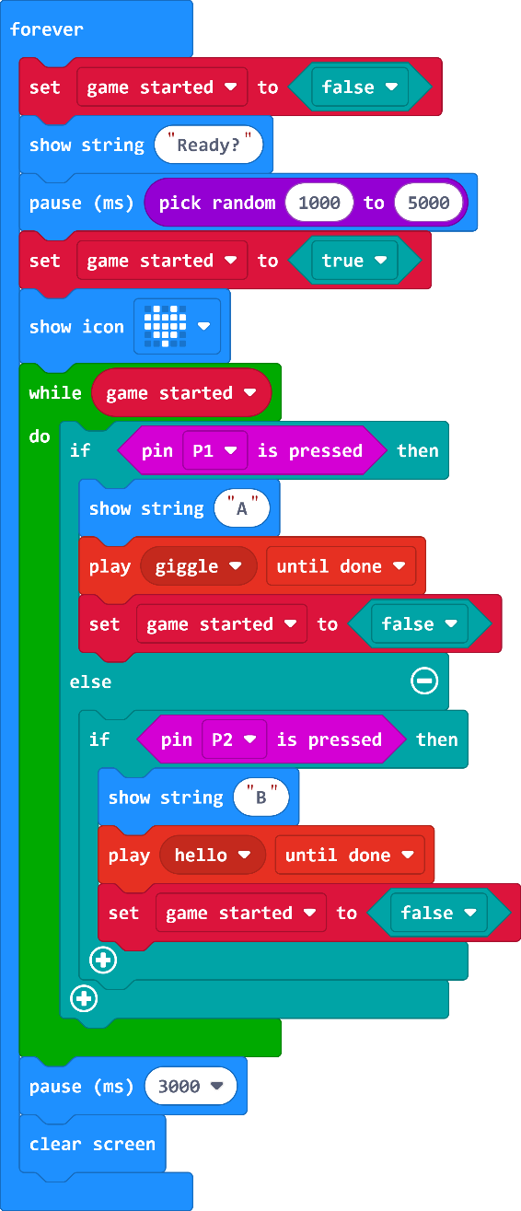
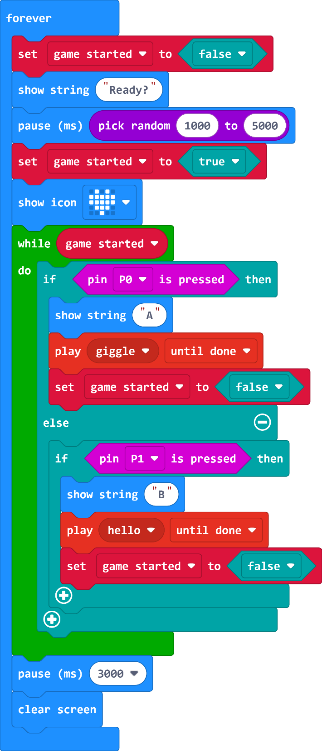
The Code

Slide 11
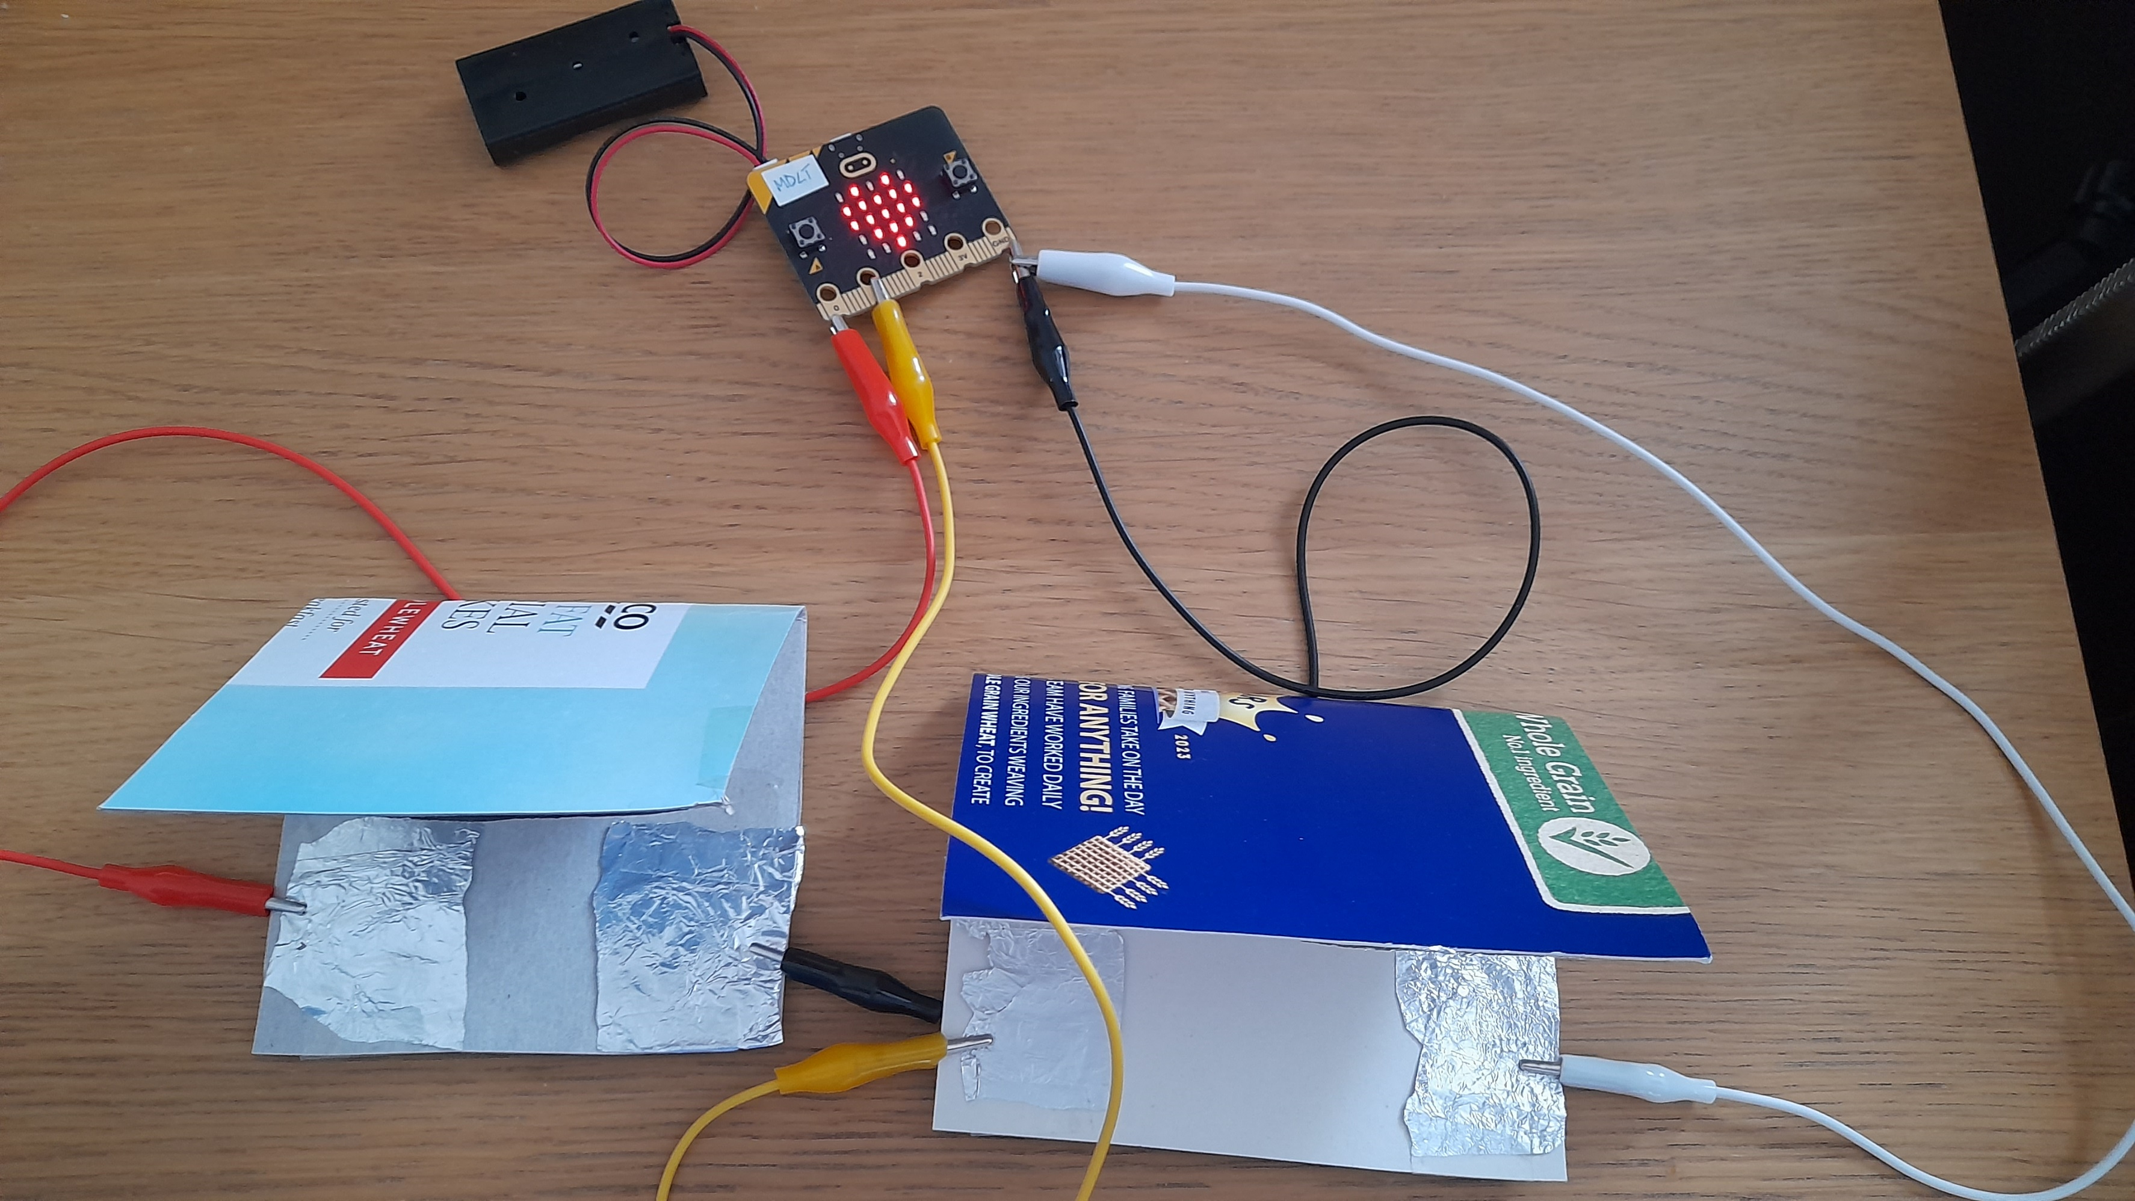
Reaction Game

Slide 12
Plenary Discussion Questions
What is a switch?
Why is tin foil a good material to create circuits with the micro:bit?
What could you do to improve the reaction game?

