Slide 1


micro:bit
Tin Foil
Electronics
Lesson 2 – Musical Instrument

Slide 2
Lesson 2: Musical Instrument
We are learning to create a musical instrument using the micro:bit
I can make different sounds happen for each pin on the micro:bit.
I can build a cardboard and tin foil musical instrument.
I can make my instrument play music when parts are touched.

Slide 3
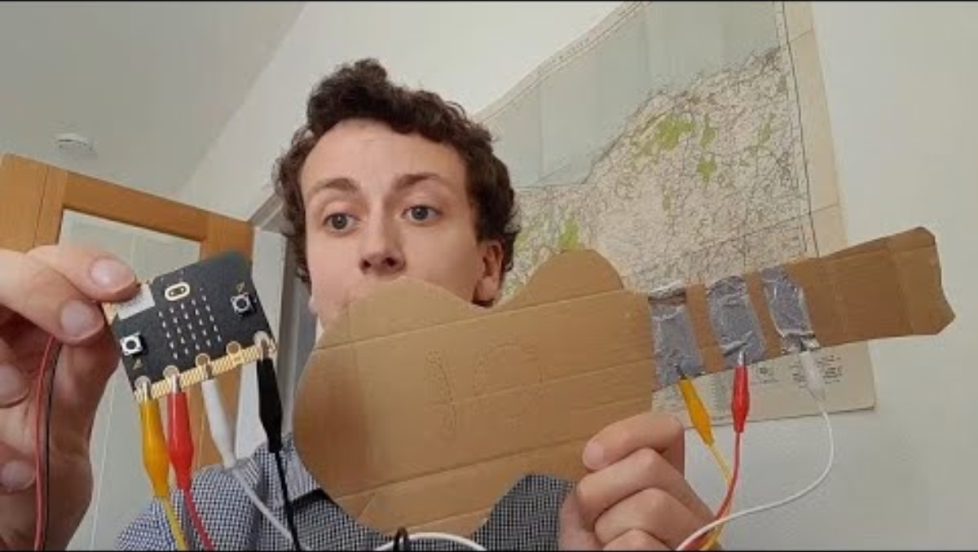
Introduction Video

Slide 4
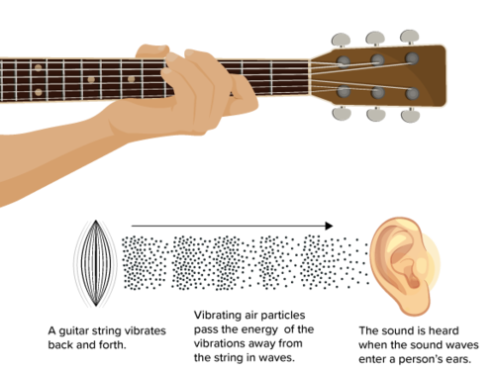
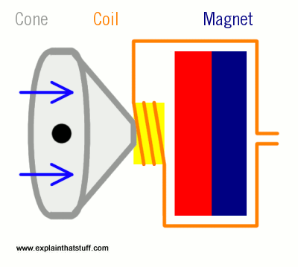
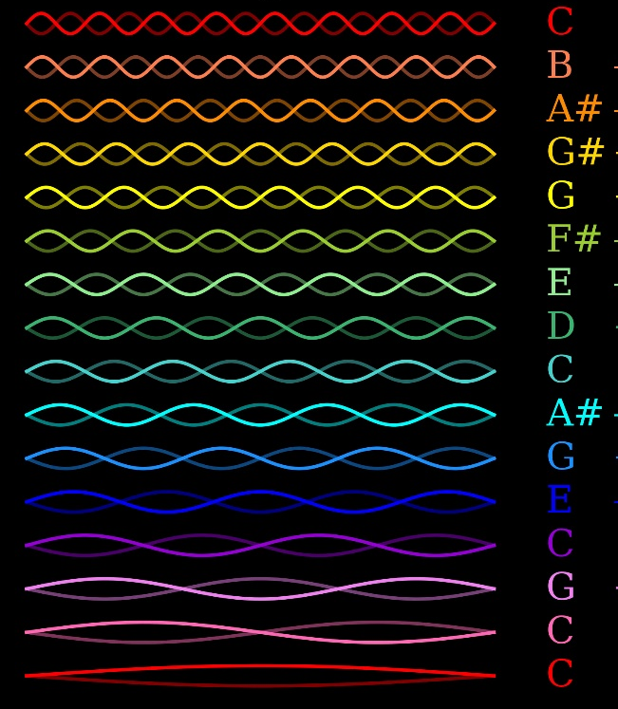
How do musical instruments work?
Notes:
Source https://www.google.com/url?sa=i&url=https%3A%2F%2Fflexbooks.ck12.org%2Fcbook%2Fck-12-physics-flexbook-2.0%2Fsection%2F12.1%2Fprimary%2Flesson%2Fsound-waves%2F&psig=AOvVaw3gV8czEMNRVOejvTfP2PMz&ust=1715851975511000&source=images&cd=vfe&opi=89978449&ved=0CBIQjhxqFwoTCNDG4e2sj4YDFQAAAAAdAAAAABAj

Slide 5
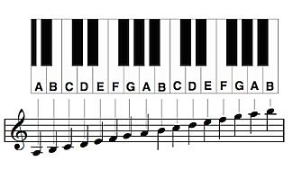
What is music made of?
Low Octave
Middle Octave
High Octave
Notes:
The notes. Letters A-G repeat. All of the same letters sound similar but each is higher than the one before. There are some notes which are ‘sharp’ or ‘flat’ these are the black notes on the piano. They change the key.

Slide 6
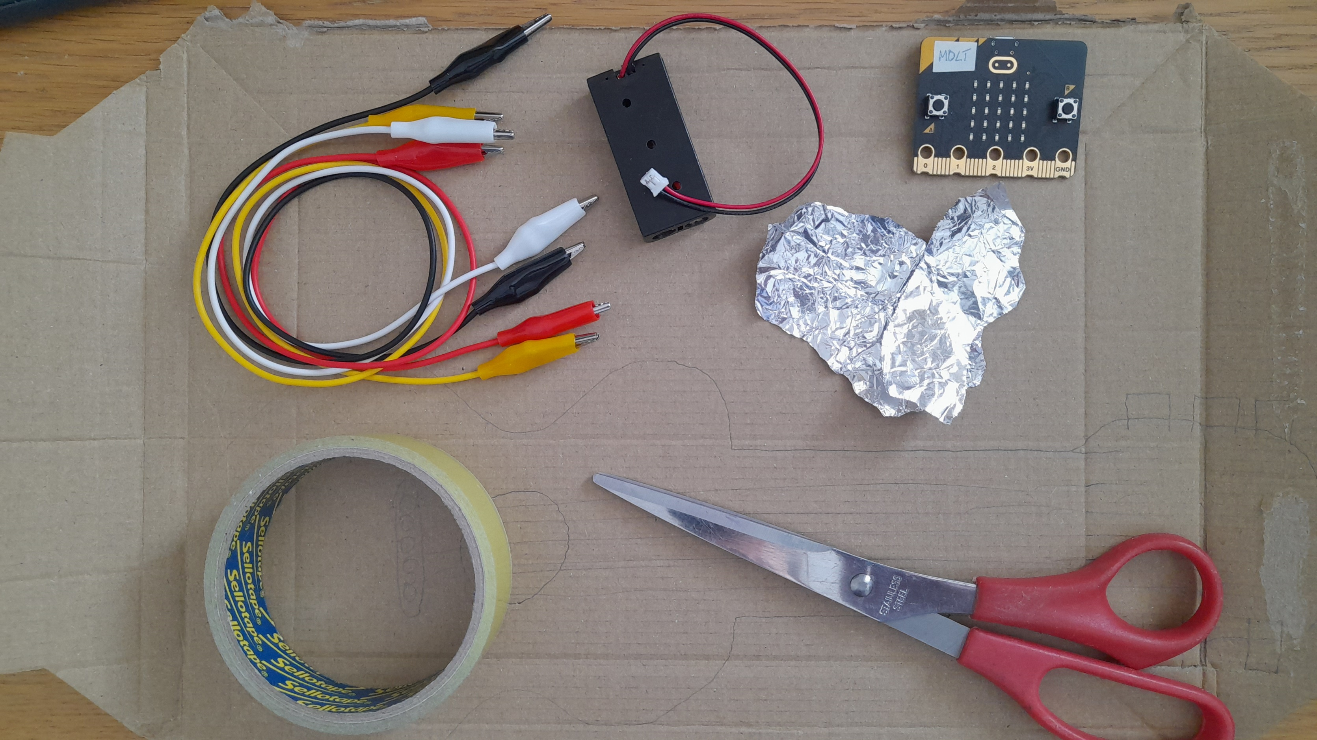
Materials

Slide 7
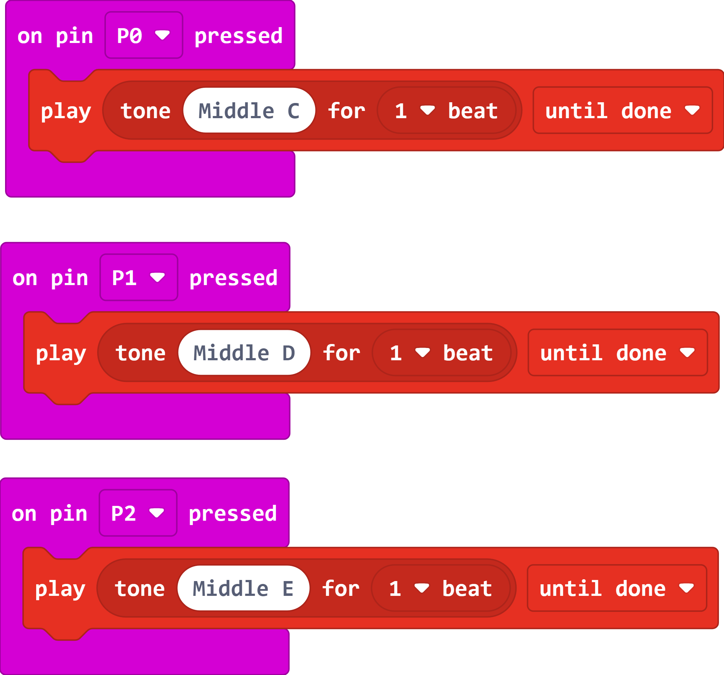
The Code

Slide 8
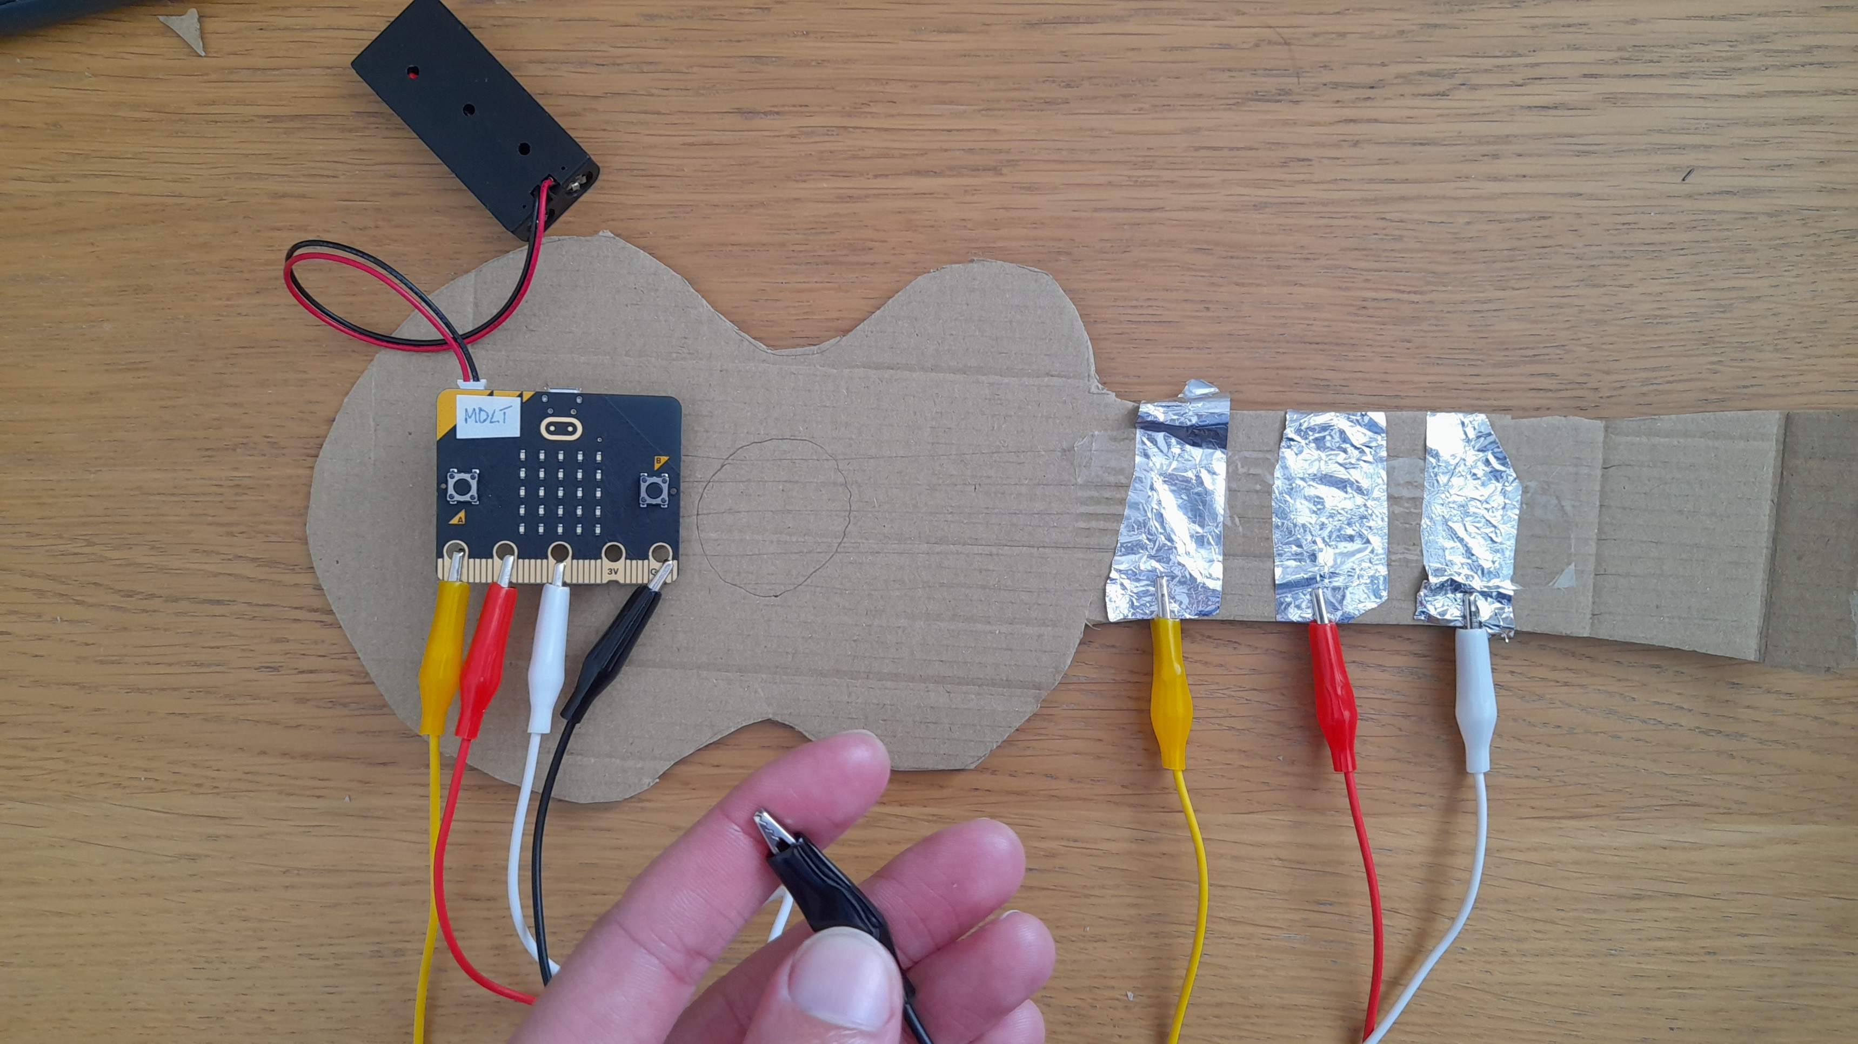
Our Guitar

Slide 9
Example Song
Mary Had A Little Lamb
E D C D E E E
D D D
E E E
E D C D E E E
D D E D C

Slide 10
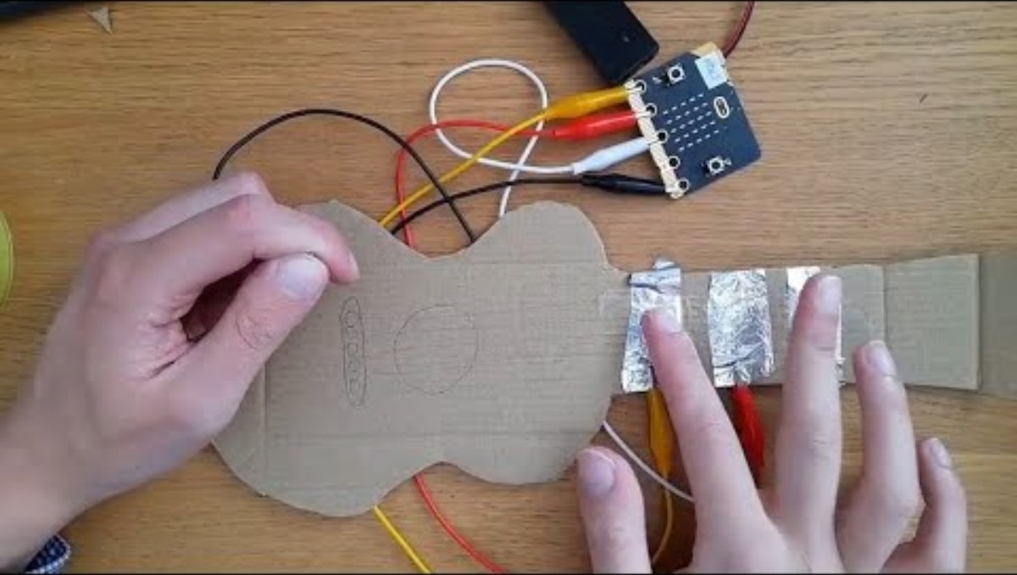
Video 2

Slide 11
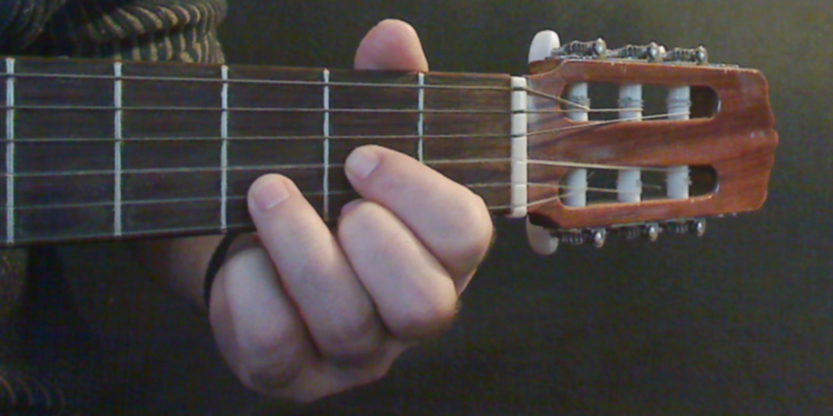
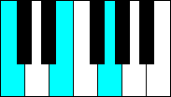
What is a chord?
A group of 3 or more notes played at the same time.
Most music is made up of chords.

Slide 12
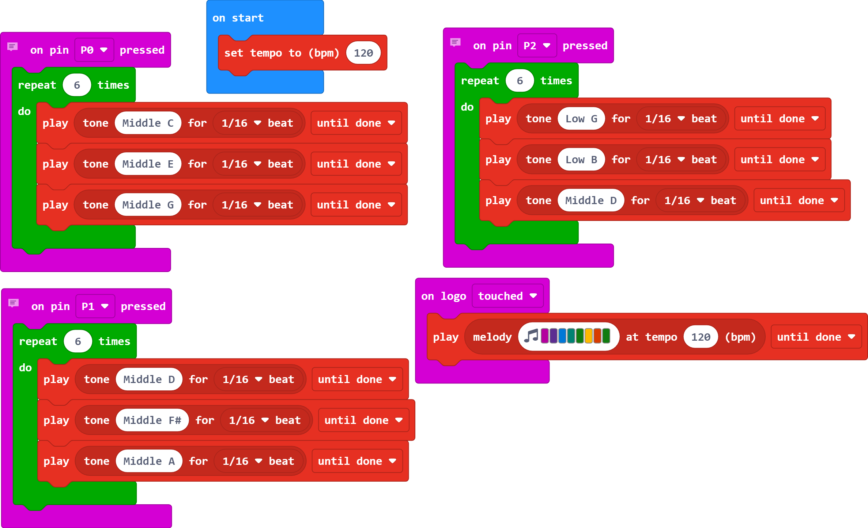
The Code

Slide 13
Plenary Discussion Questions
What is the output on the micro:bit which creates sound called?
What is a chord?
What could you do to improve your instrument?

