Slide 1


micro:bit
Tin Foil
Electronics
Lesson 3 – Operation Game

Slide 2
Lesson 3 – Operation Game
We are learning to create an operation game using the micro:bit.
I can create and design my operation board and pieces.
I can code the alarm for the game.
I can build the circuit for the game.

Slide 3
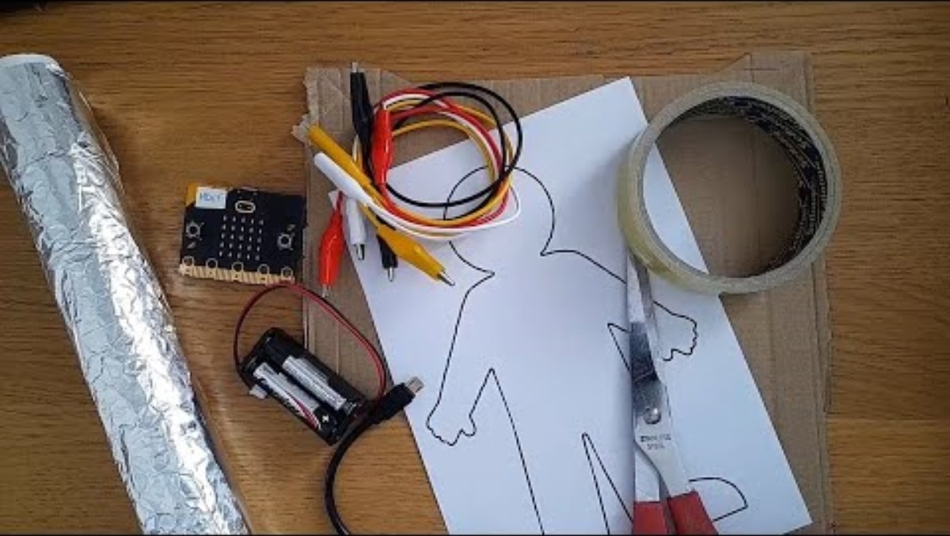
Introduction Video

Slide 4
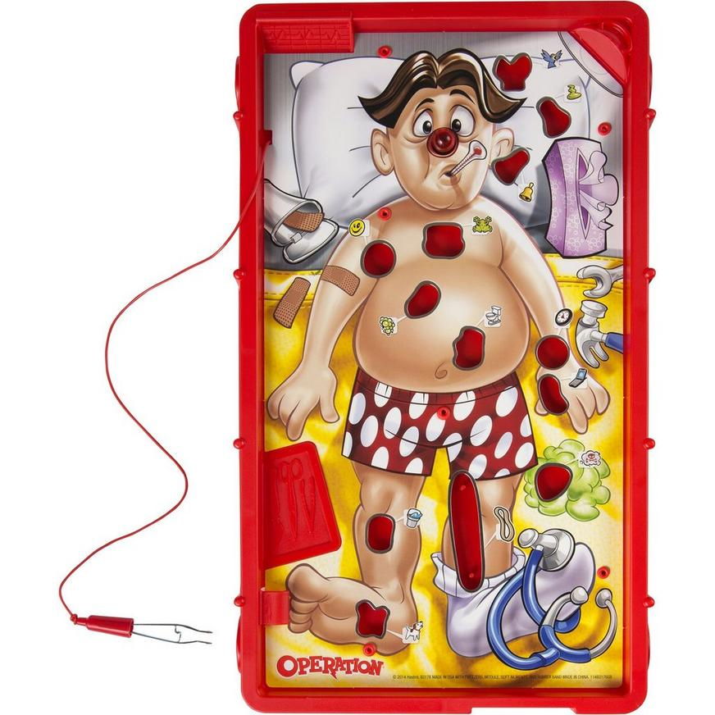
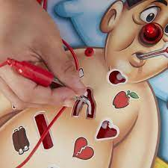
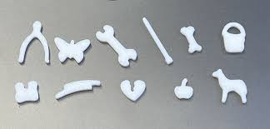
How does the operation game work?

Slide 5
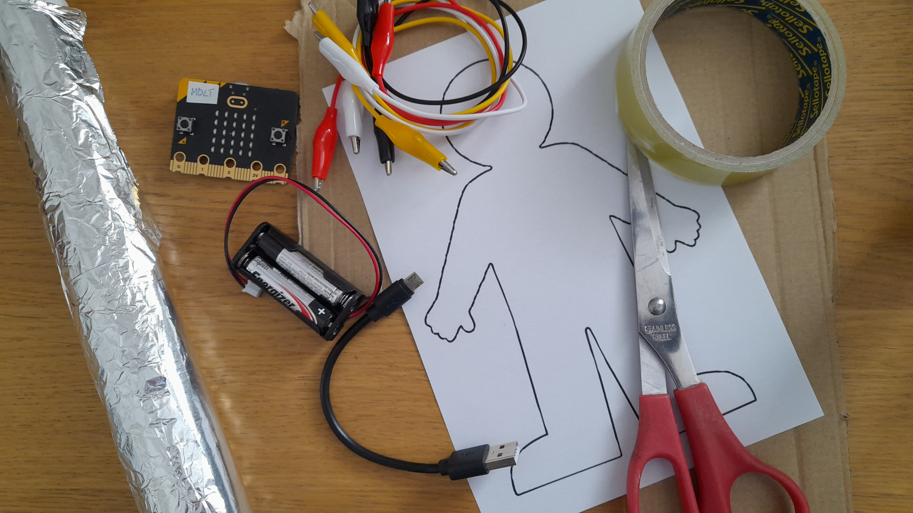
Materials

Slide 6
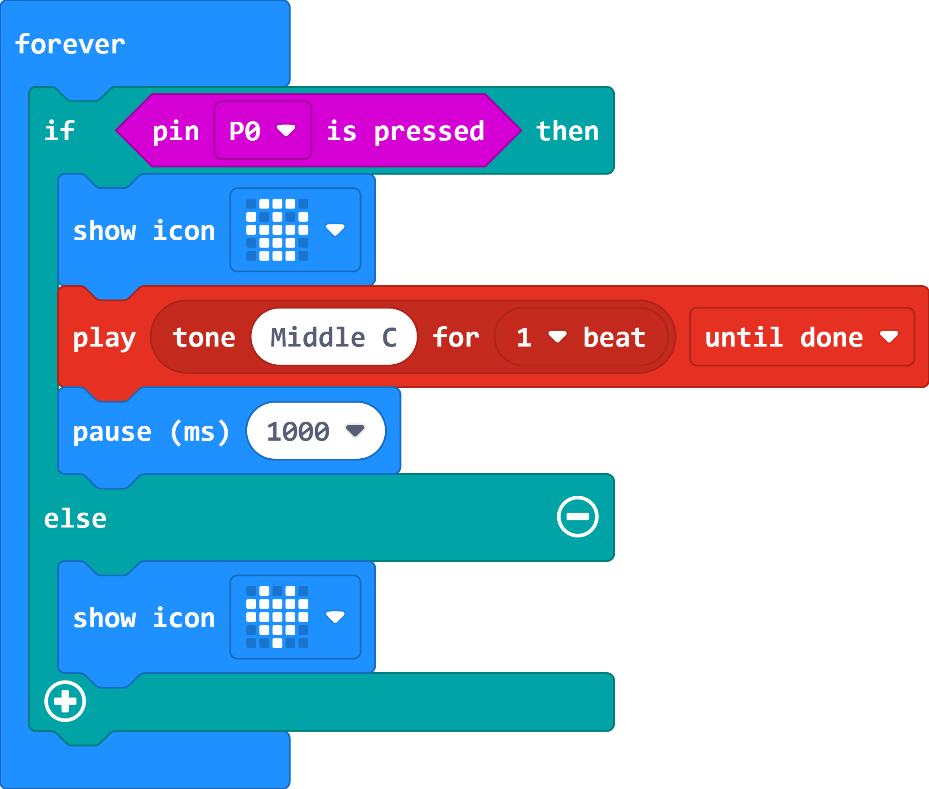
The Code

Slide 7
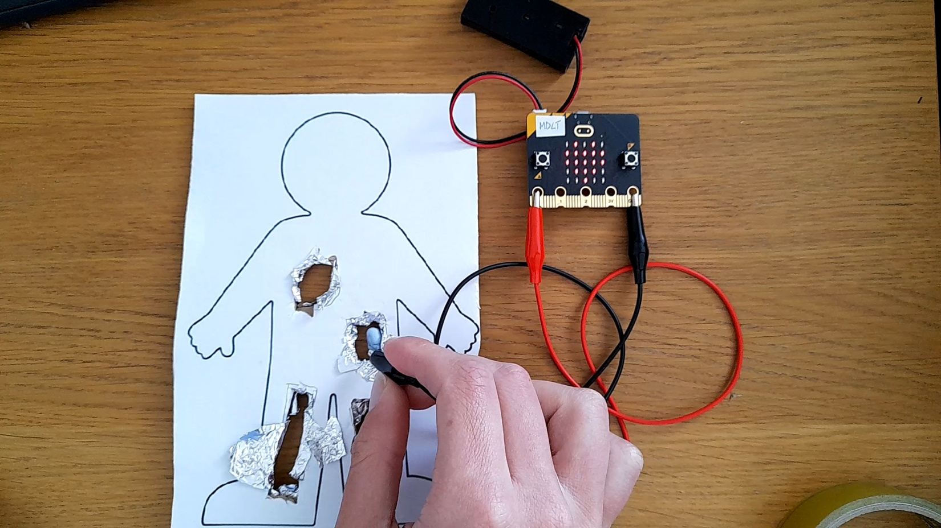
Our Game

Slide 8
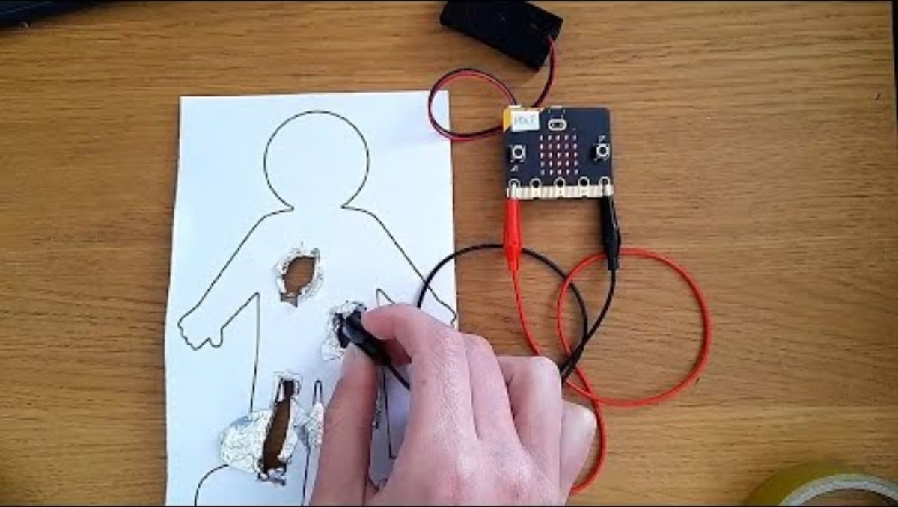
Video 2

Slide 9
How could we improve the game?

Slide 10
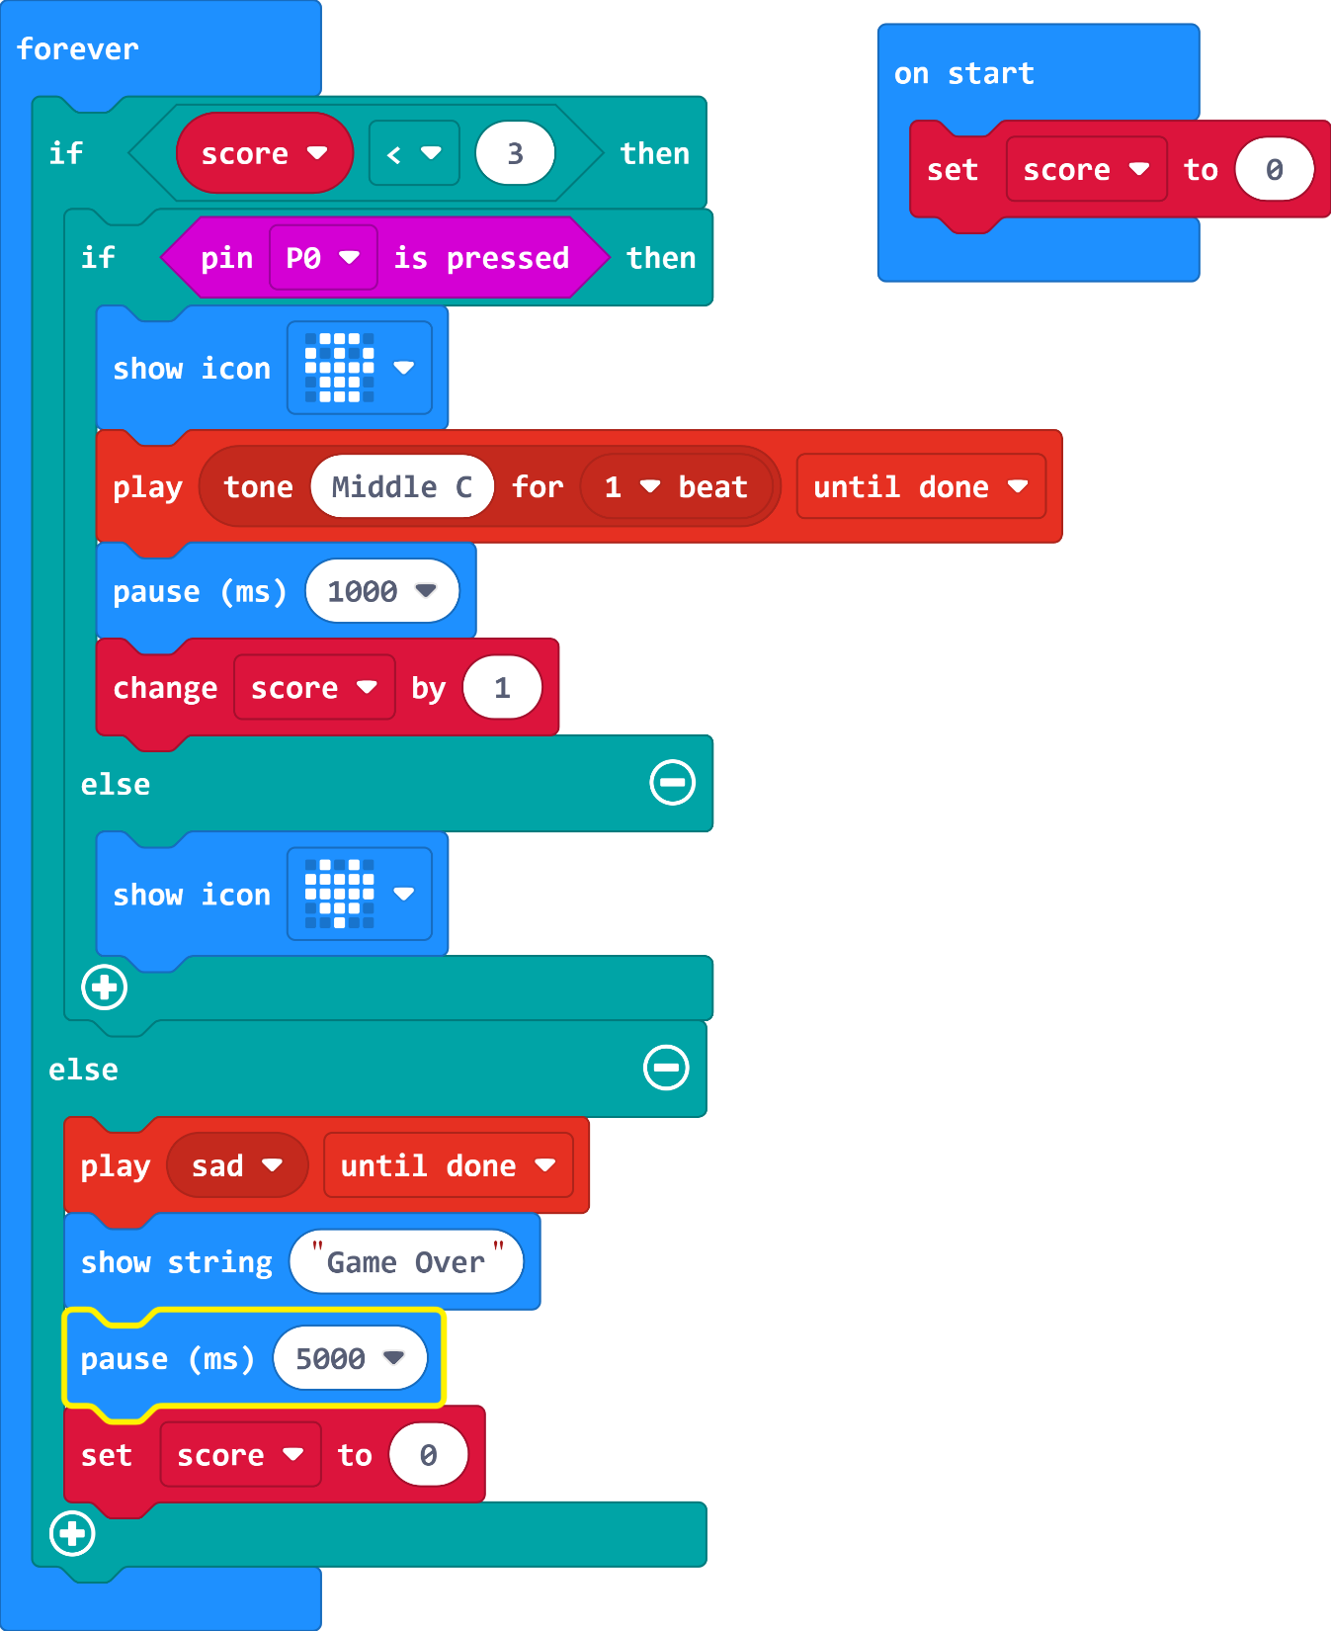
The Code

Slide 11
Plenary Discussion Questions
What does the first code wait for to happen?
What could you do to improve your game?
Can you think of other games which could use the same sort of circuit and code?

