Slide 1


micro:bit
Tin Foil
Electronics
Lesson 4 – Target Game

Slide 2
Lesson 4 – Target Game
We are learning to create a target game using the micro:bit.
I can build my goal/target.
I can create code that keeps score.
I can build the circuit and test my game.

Slide 3
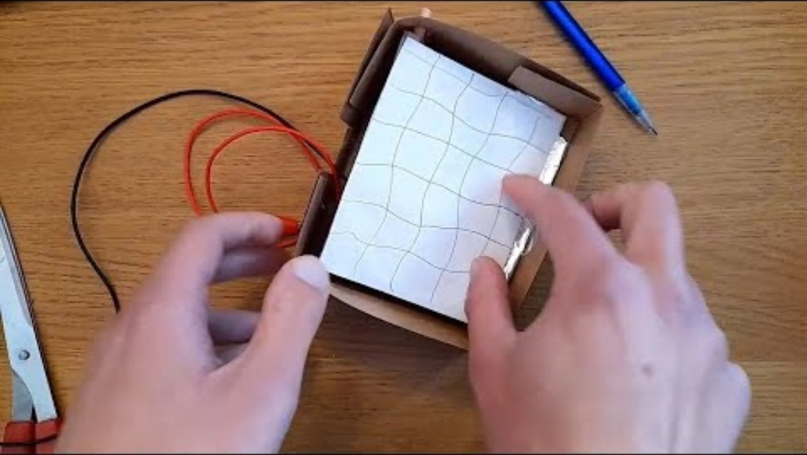
Introduction Video

Slide 4
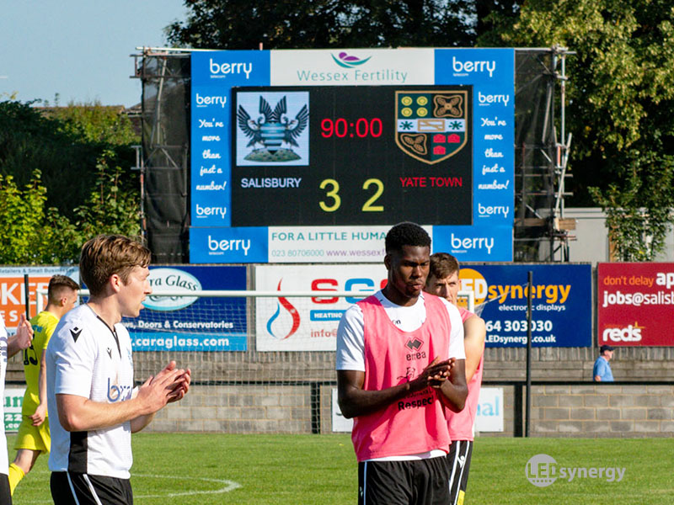
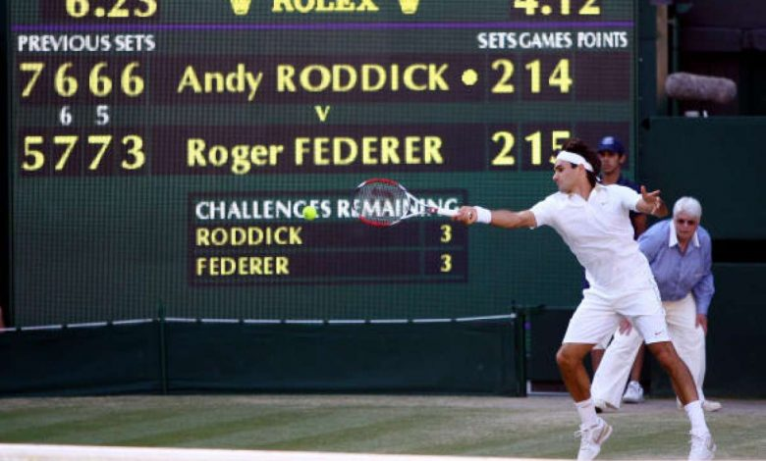
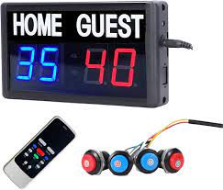
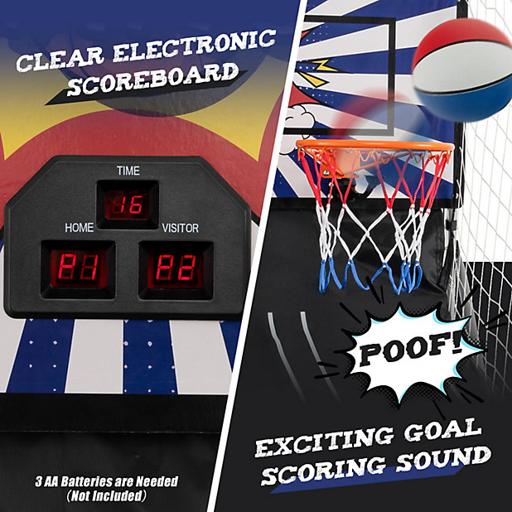
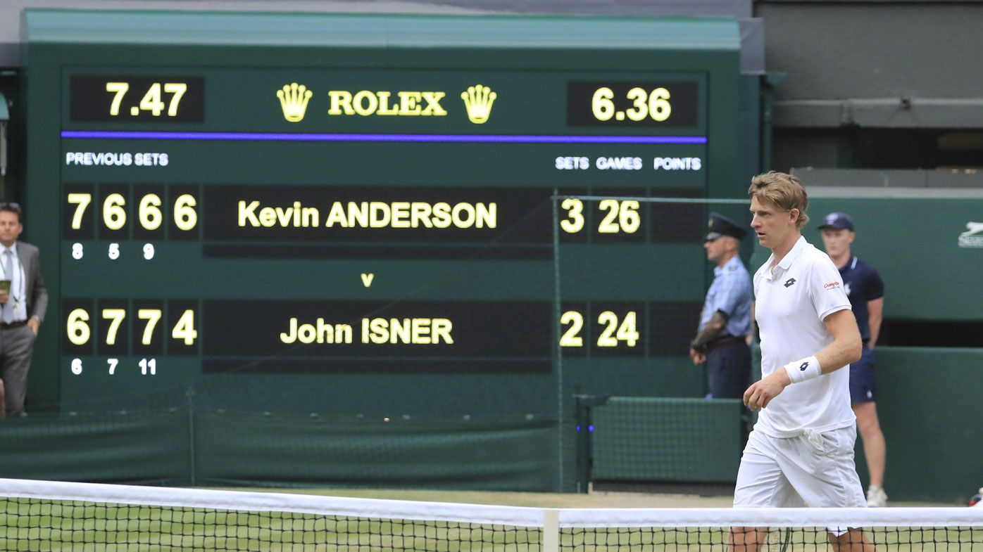
Electronic score keeping…

Slide 5
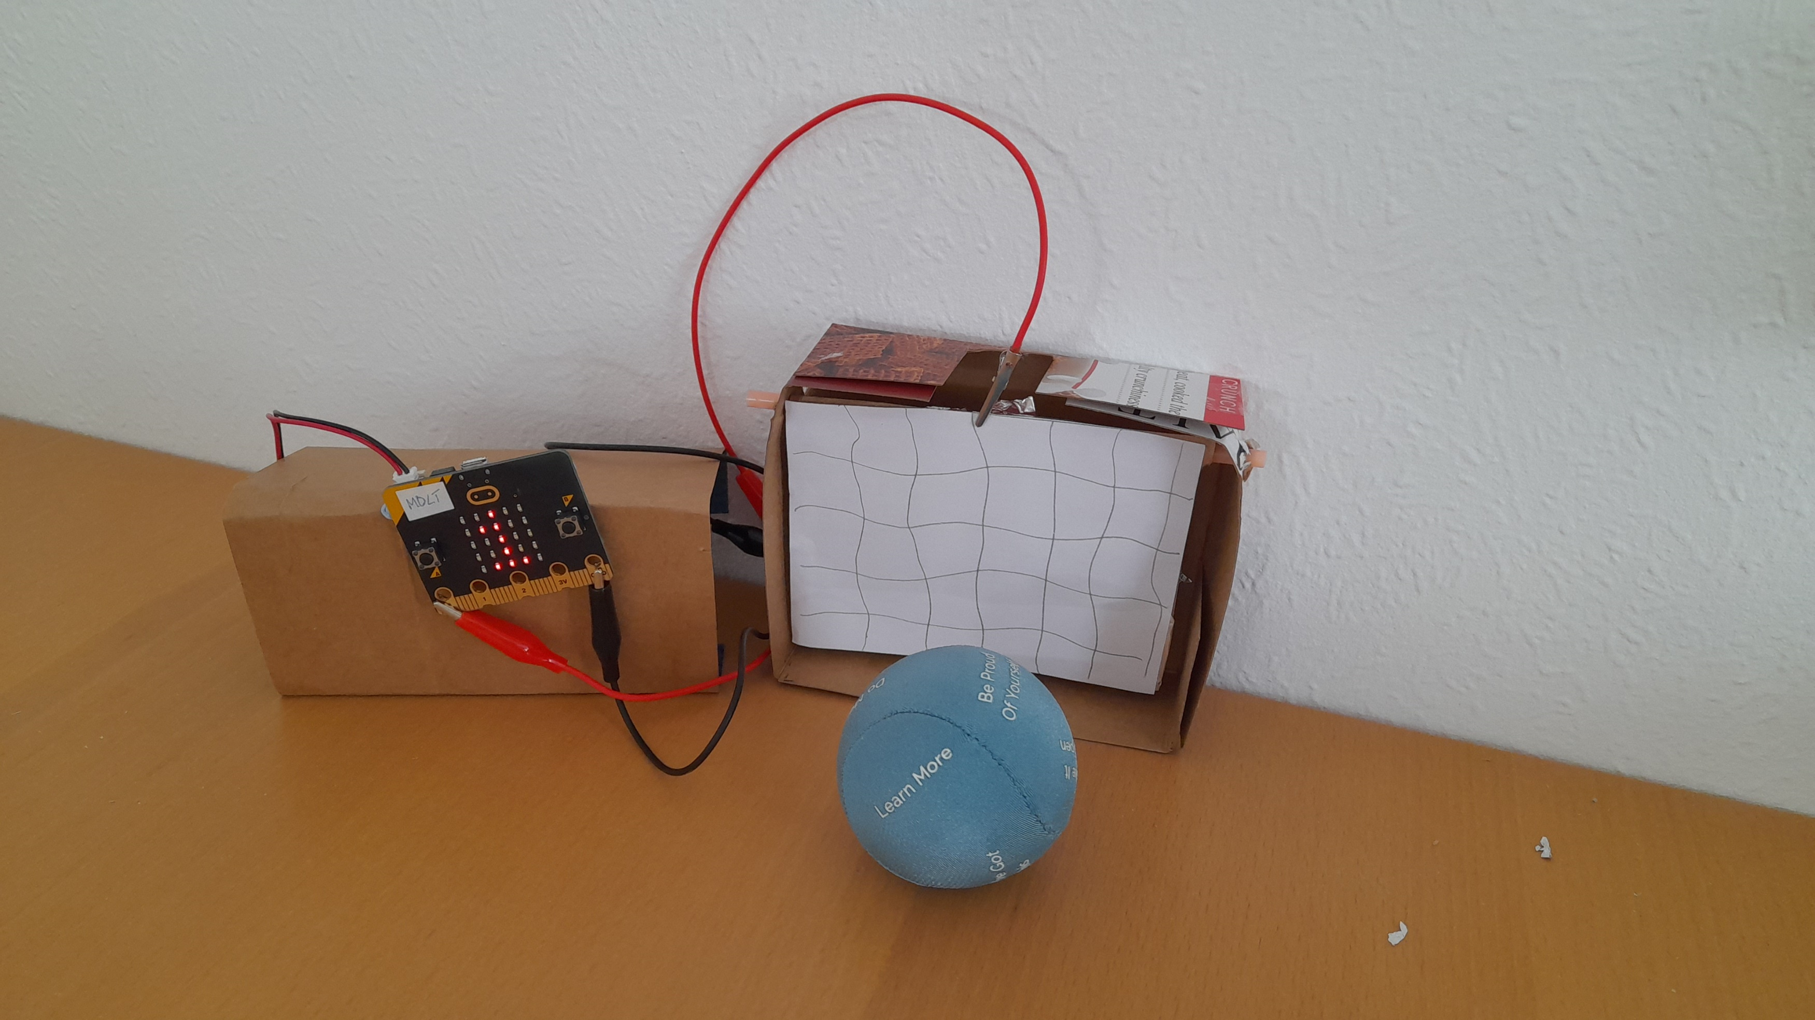
Our Game

Slide 6
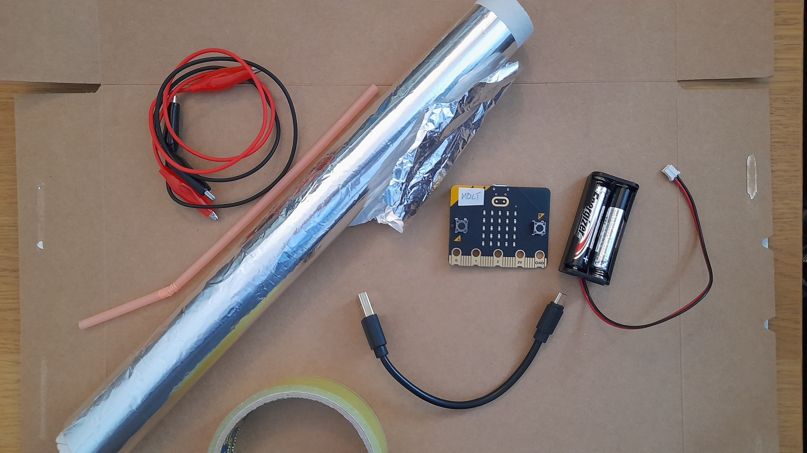
Materials

Slide 7
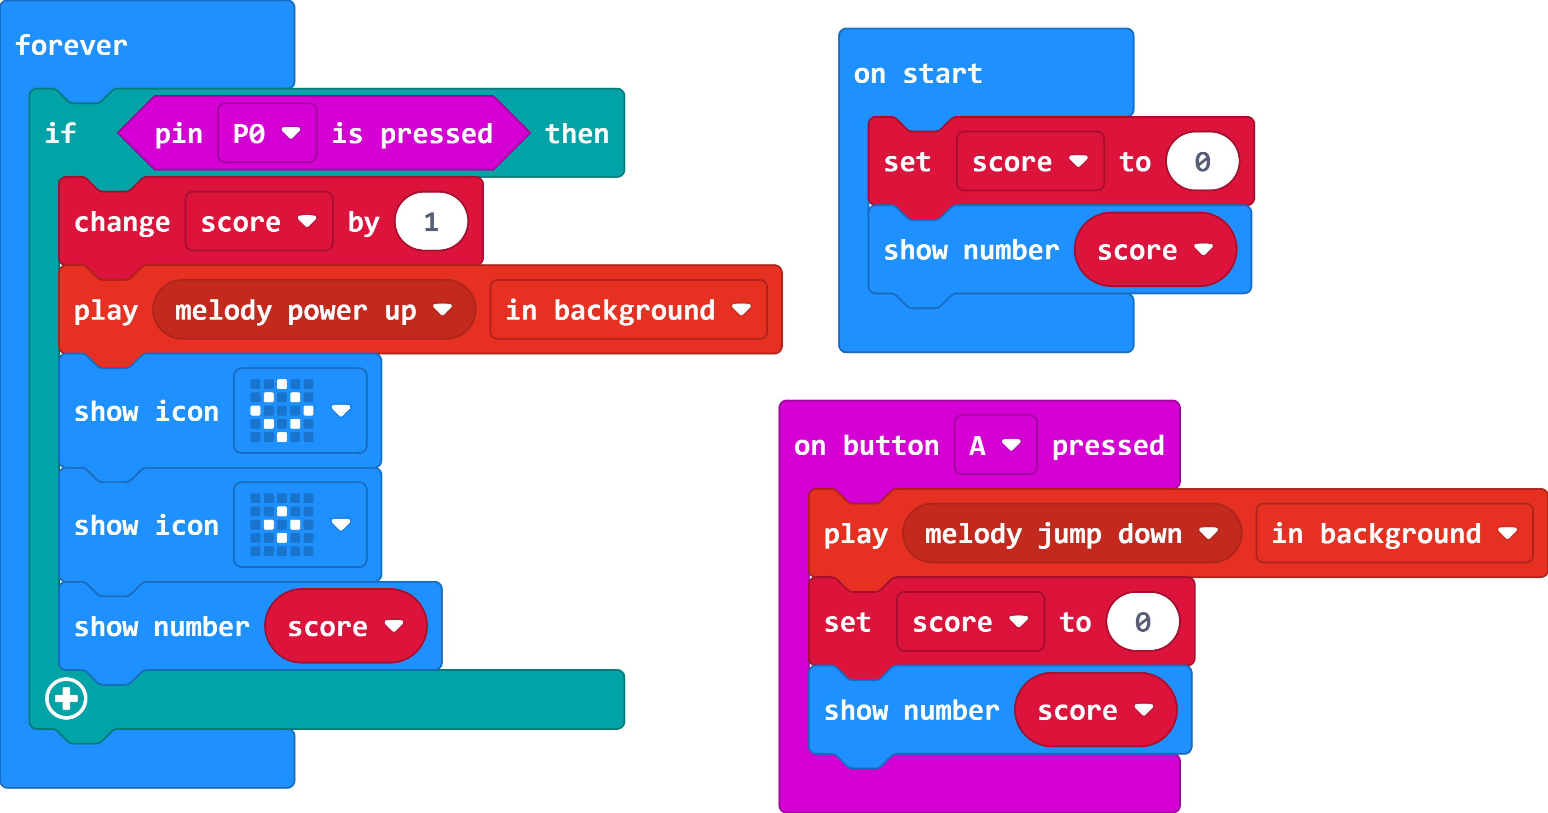
The Code

Slide 8
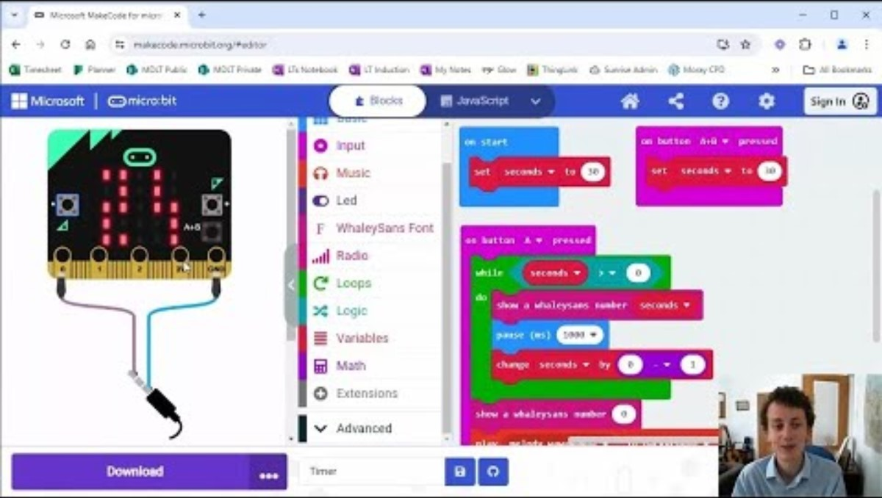
Video 2

Slide 9
How could we improve the game?

Slide 10
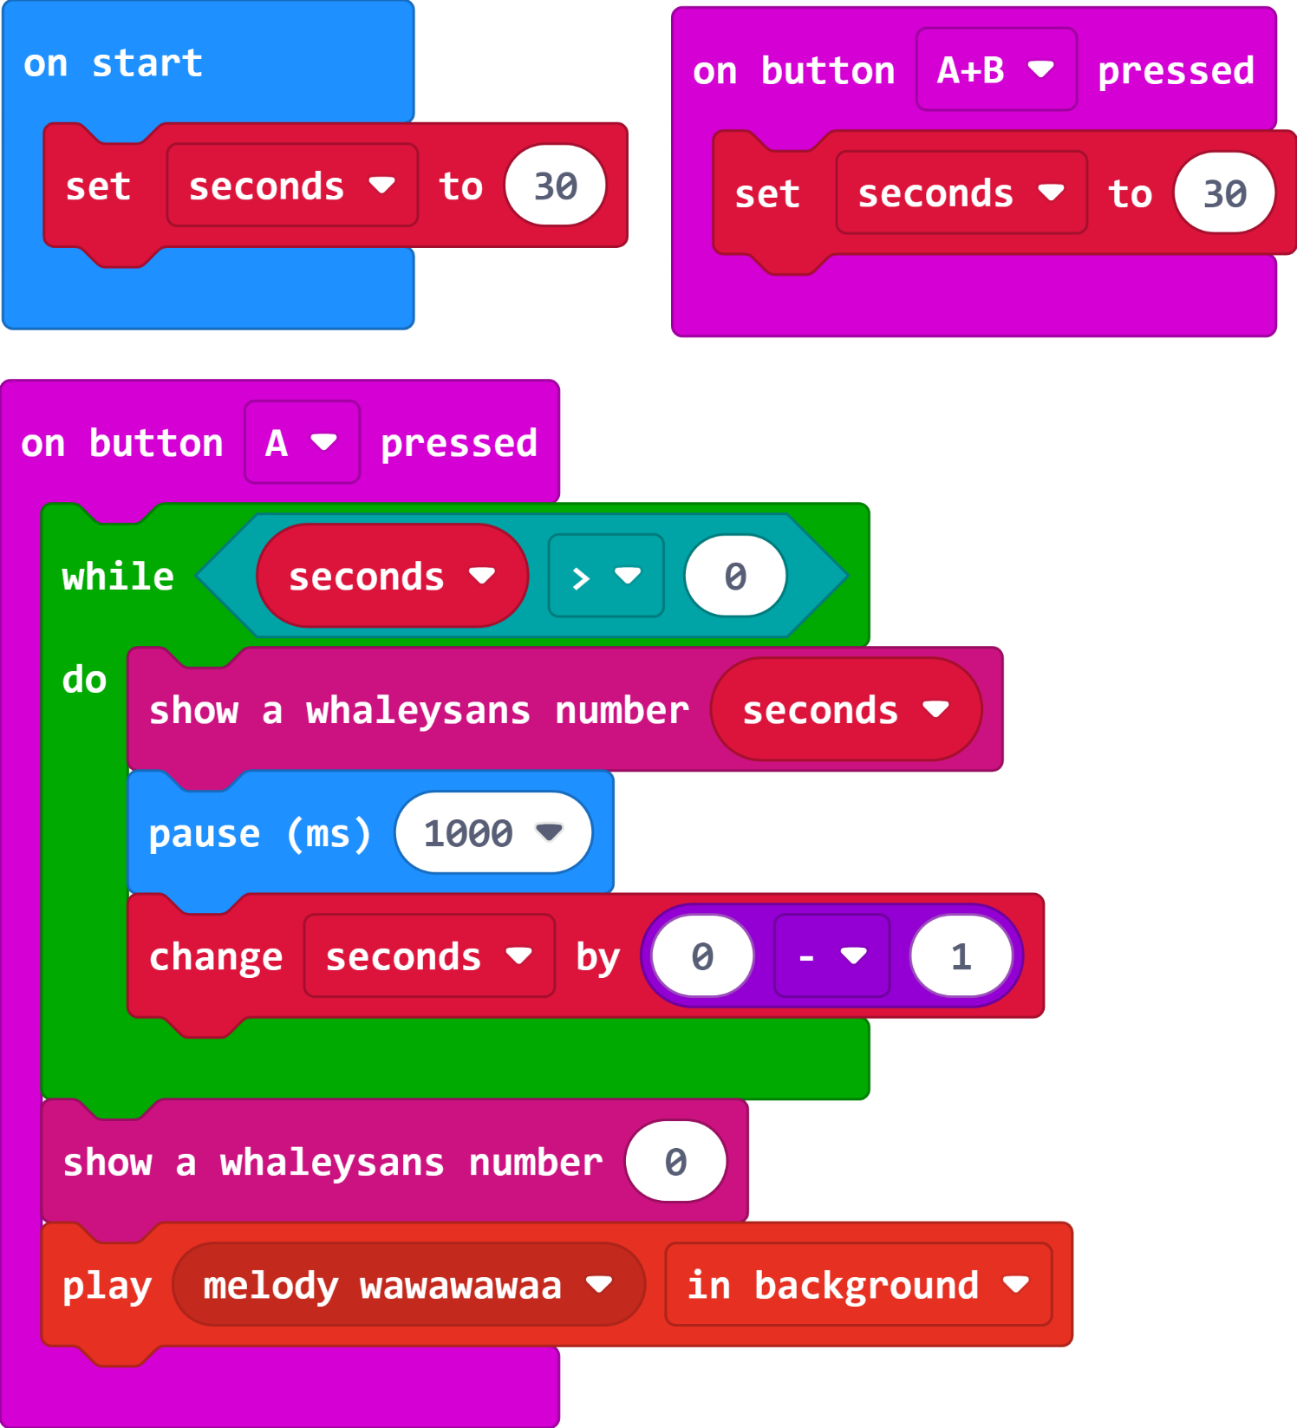

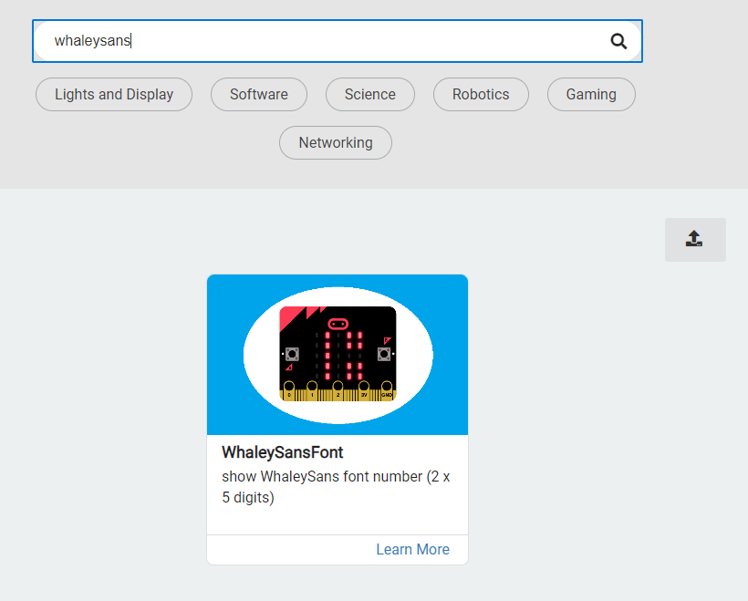
The Code

Slide 11
Plenary Discussion Questions
Where have you seen electronic score keepers like this?
What could you do to improve your game?
Can you think of other games which could use the same sort of circuit and code?

