Slide 1


micro:bit
Tin Foil
Electronics
Lesson 5 – Maze Game

Slide 2
Lesson 5 – Maze Game
We are learning to create a maze game using the micro:bit.
I can design and build my maze.
I can code the score keeper and timer.
I can build the circuit and test my maze.

Slide 3
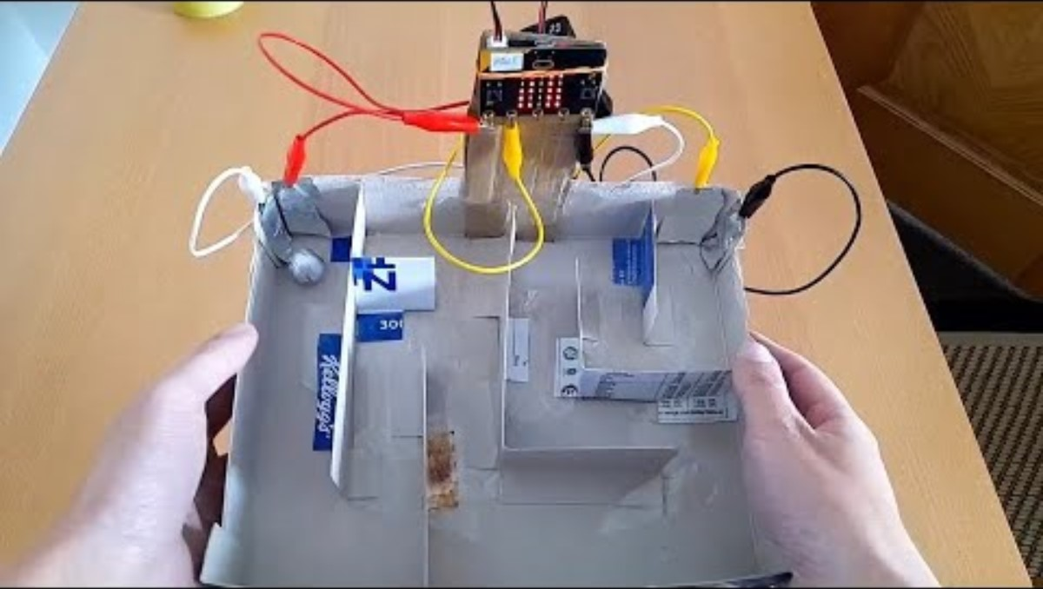
Introduction Video

Slide 4
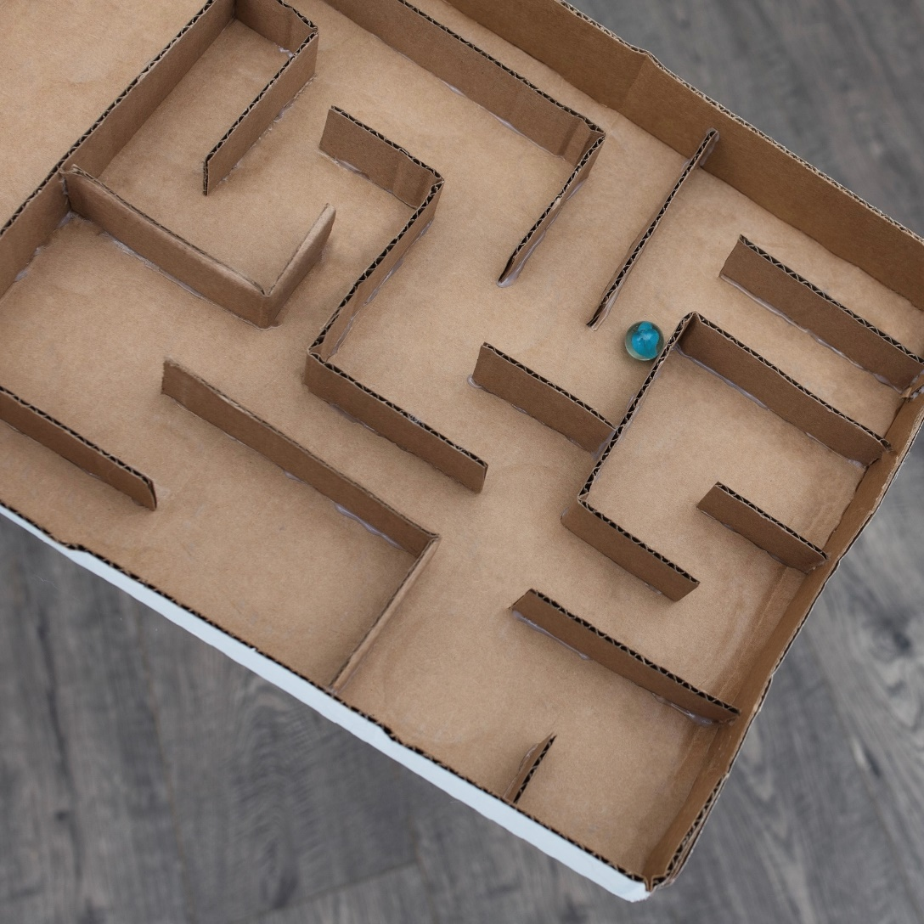
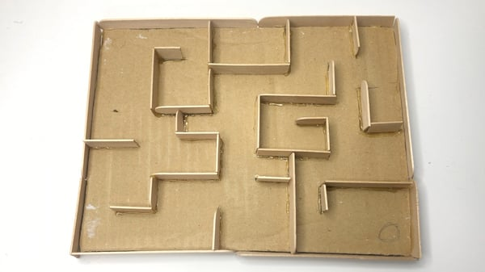
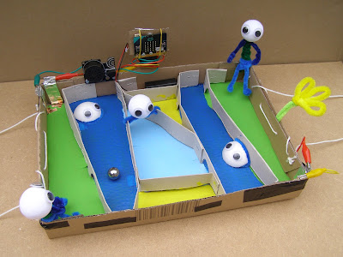
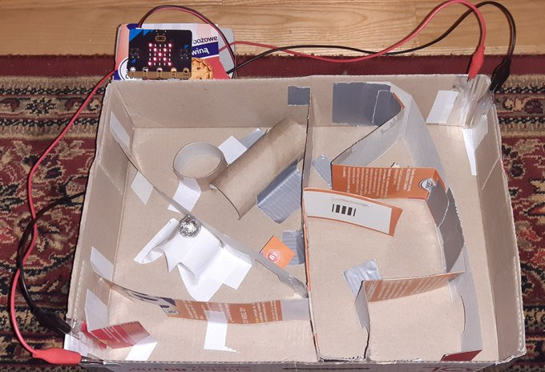
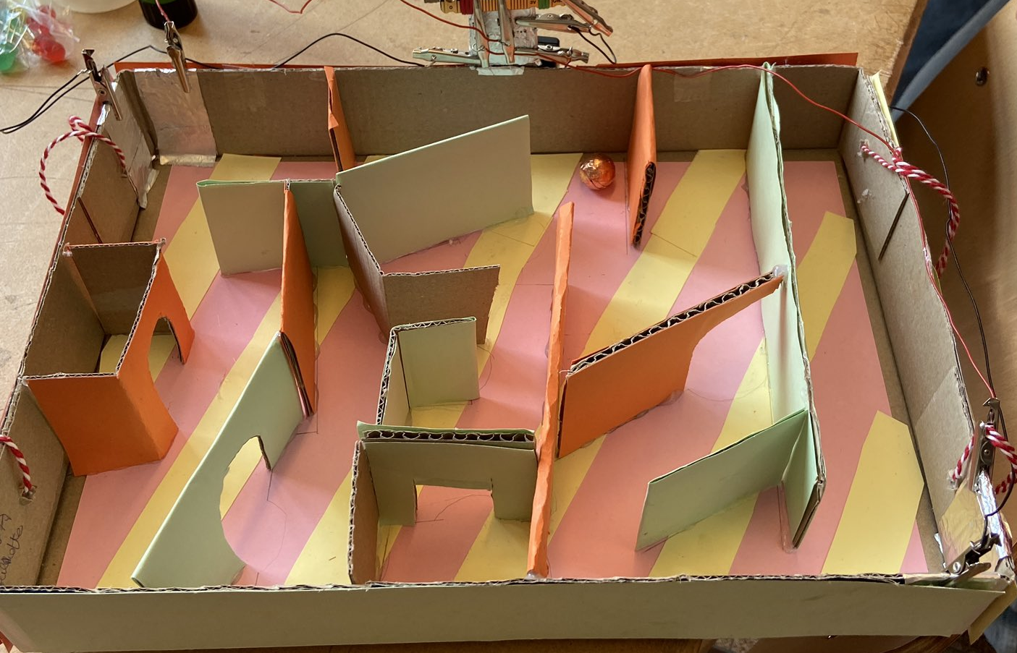
Features of a good Maze?

Slide 5
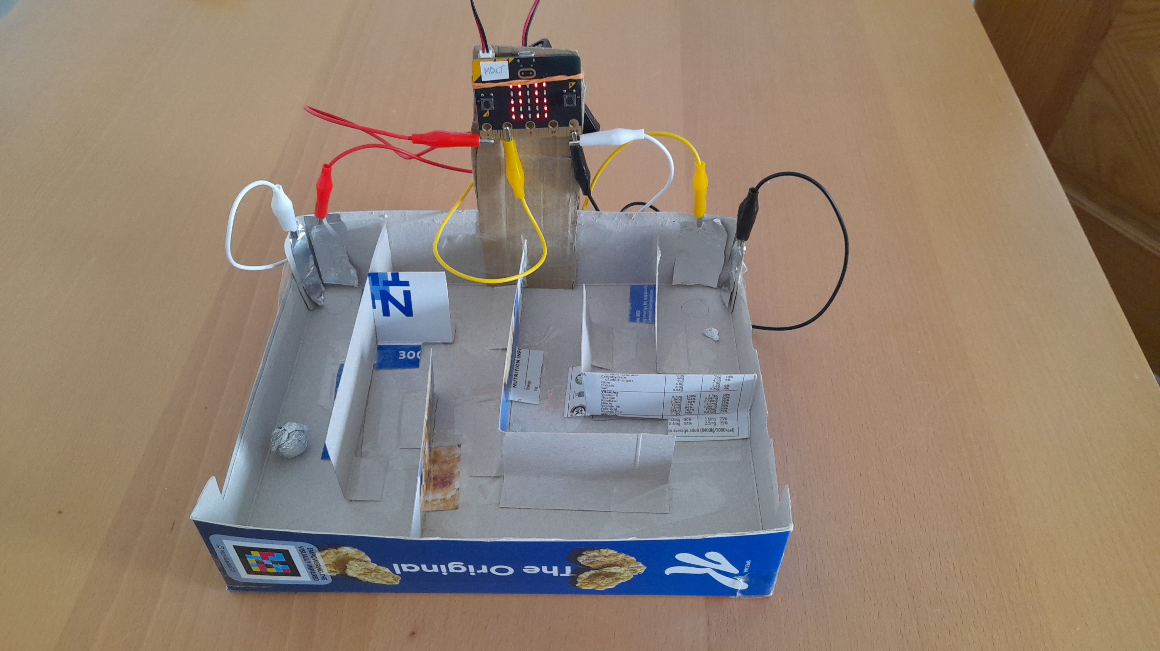
Our Game

Slide 6
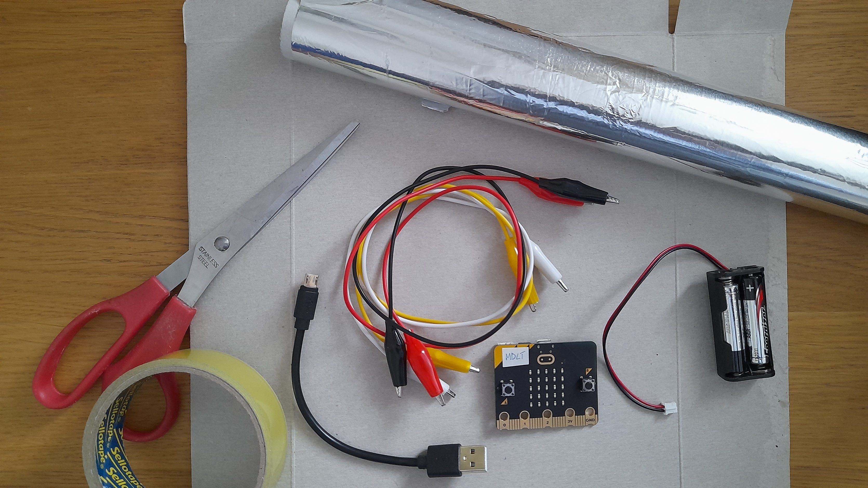
Materials

Slide 7
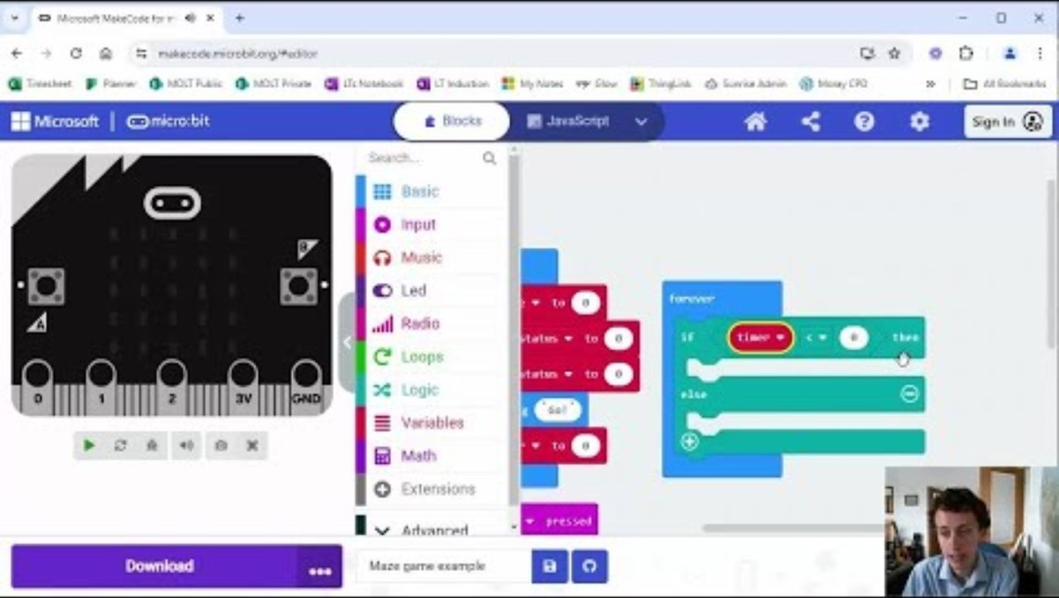
Video 2

Slide 8
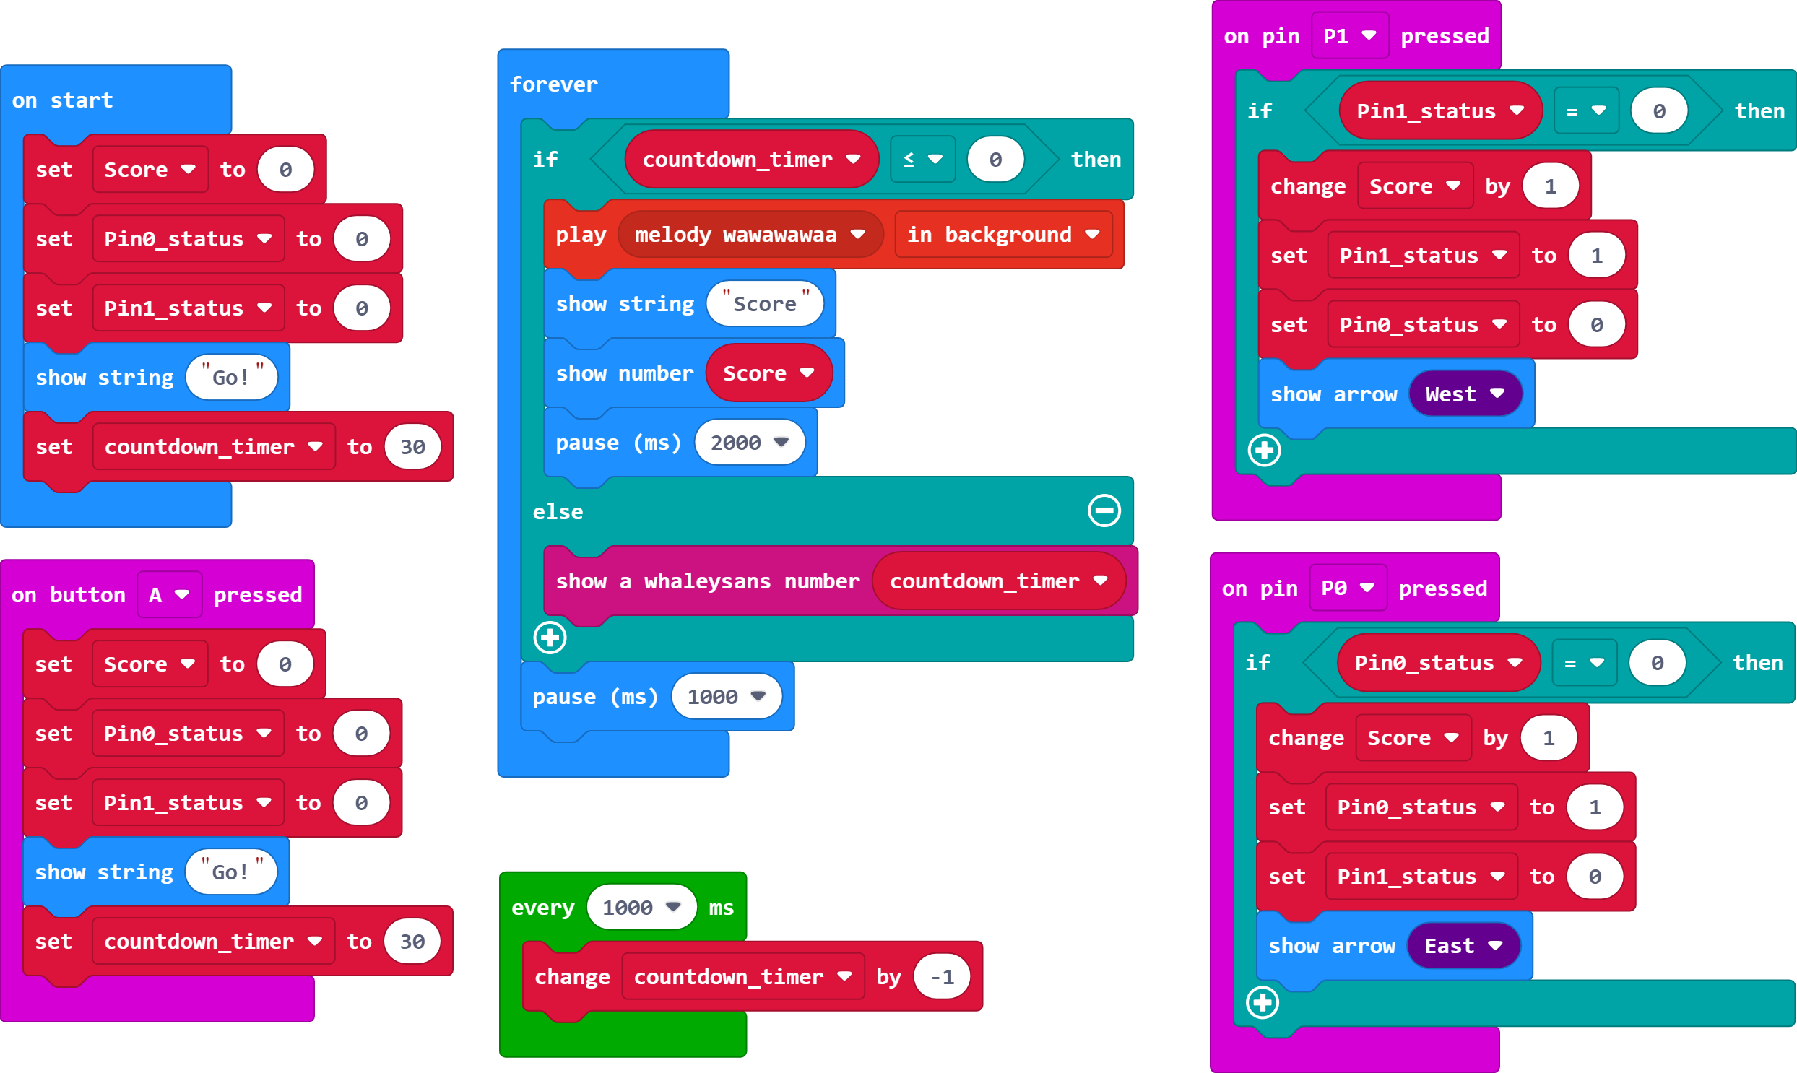

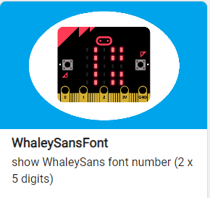
The Code

Slide 9
The Code
You can change the length of the timer here. For example 30seconds, 60seconds, and up to 99 seconds.

Slide 10
How to play the game?
Place the ball in the maze.
Press Button A to start the timer.
Move the ball to one of the tin foil contacts.
When arrow shows move to the other corner and find the tin foil contact.
When timer ends read the score.

Slide 11
Plenary Discussion Questions
Why did this game use two of the input pins on the micro:bit?
What could you do to improve your game?
Can you think of other games which could use the same sort of circuit and code?

