Slide 1


Challenge Template
Micro:bit
Beyond
Basics
Download and complete Slide 3 for your group

Slide 2

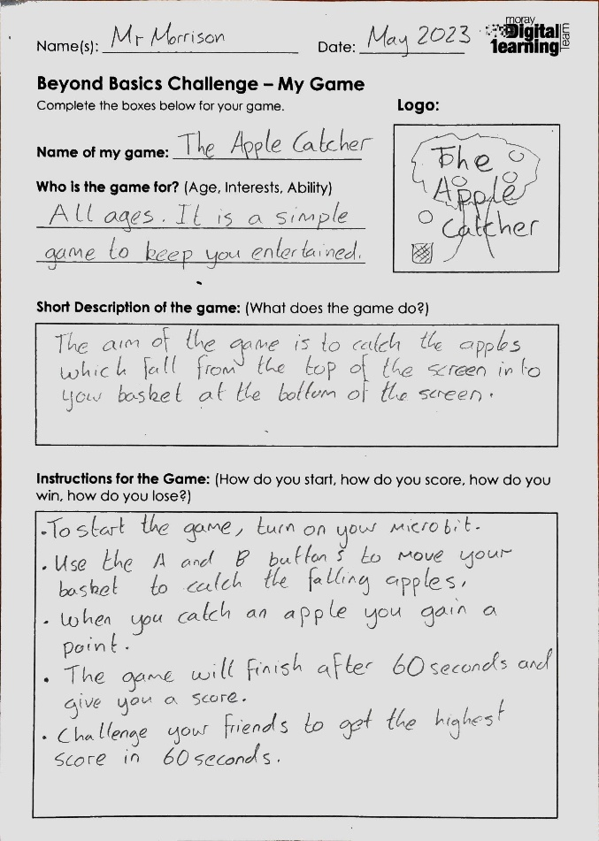
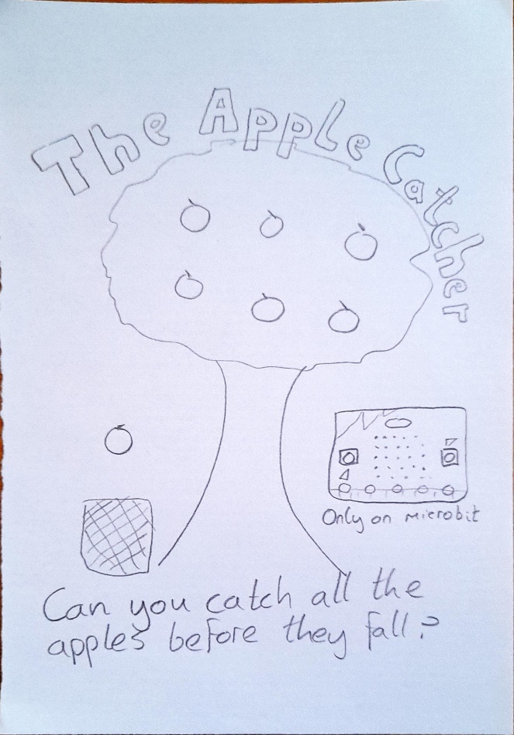
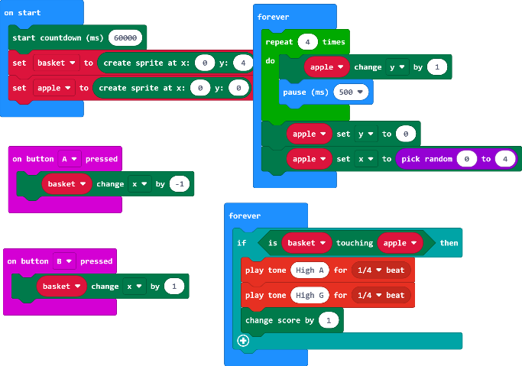
EXAMPLE
Moray Primary
Mr Morrison
The Apple Catcher

