Slide 1


Challenge Template
Micro:bit
Lessons
Download and complete Slide 3 for your group

Slide 2

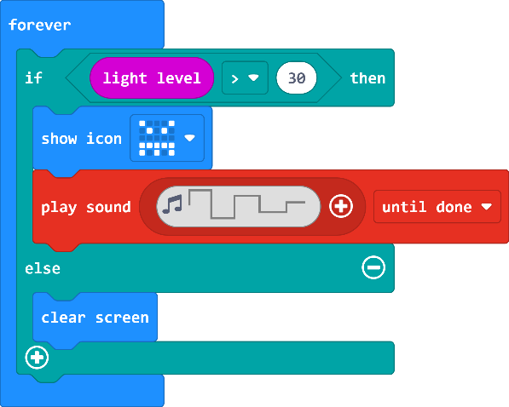
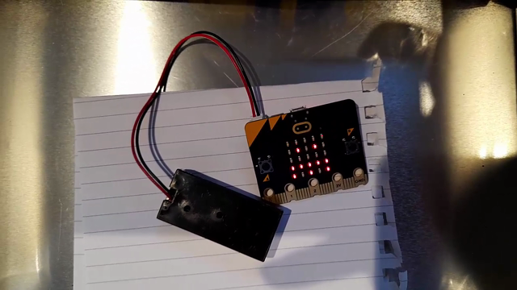
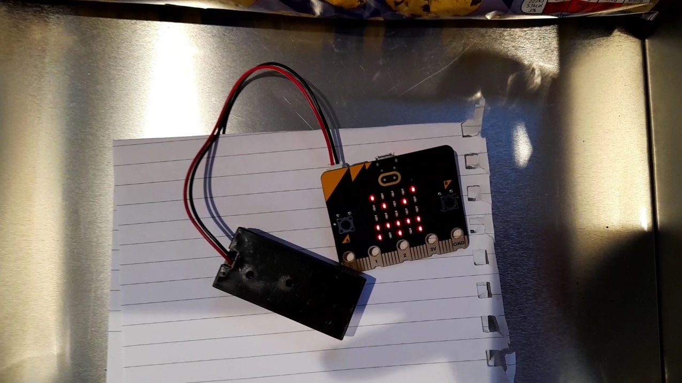
EXAMPLE
The micro:bit is hidden in my biscuit tin. When someone tries to steal a biscuit it detects the light and sets off an alarm. It also shows an angry face on the micro:bit.
The alarm will stop when the lid is put back on the biscuit tin.
Moray Primary
Mr Morrison
My Biscuit Tin Alarm
https://makecode.microbit.org/_09UYMz13o4Xw

